Slide 1
Race, Ethnicity and Nationaly
Rana Salman, 464719
Yoko Kato, 459032

Slide 2
Linking race, ethncitiy and nationality in Jelly Beans

Slide 3

Race
A human construct, mode of categorization based on physical appearance.
Race is ascribed that is, people are assigned to racial categories based on what others see.
In the case of Jellybeans, race is color.

Slide 4
Race
Caucasian
Mongoloid (Asian)
Negroid (Black)
Australoid. (Southeast Asia, South Asia, Australia, Melanesia, Polynesia)
*Classification by Carleston S. Coon in 1962*

Slide 5
Race
The United Nations has opted to drop the term "race" and replace it with "ethnic groups" instead.
"National, religious, geographic, linguistic and cultural groups do not necessarily coincide with racial groups: and the cultural traits of such groups have no demonstrated genetic connection with racial traits. Because serious errors of this kind are habitually committed when the term 'race' is used in popular parlance, it would be better when speaking of human races to drop the term 'race' altogether and speak of 'ethnic groups'.

Slide 6
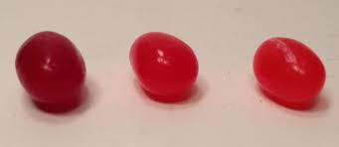
Ethnicity
A dynamic process involving the negotiation of self-identity in relation to significant others within a particular context:
“as much the product of internal arguments of identity and contestation as of external objectification” (Werbner 1 997: 18)
Premised on notions of shared descent, heritage and culture.
In the case of jelly beans, ethnicity is flavour.
Cherry
Cinnamon
Strawberry

Slide 7
Ethnicity
According to a 1998 study published in the Scientific American, there are more than 5,000 ethnic groups in the world:
Arabs
Kurds
Americans
Japanese
Marathi
etc

Slide 8
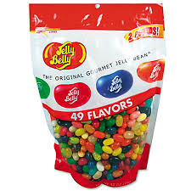
Nationality
Someone’s national origin. The place where a person holds citizenship.
Nationality is flexible.
In case of Jellybeans, it is the jellybean bag.

Slide 9
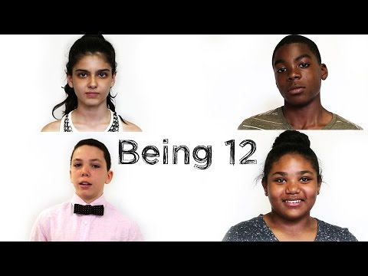

Slide 10
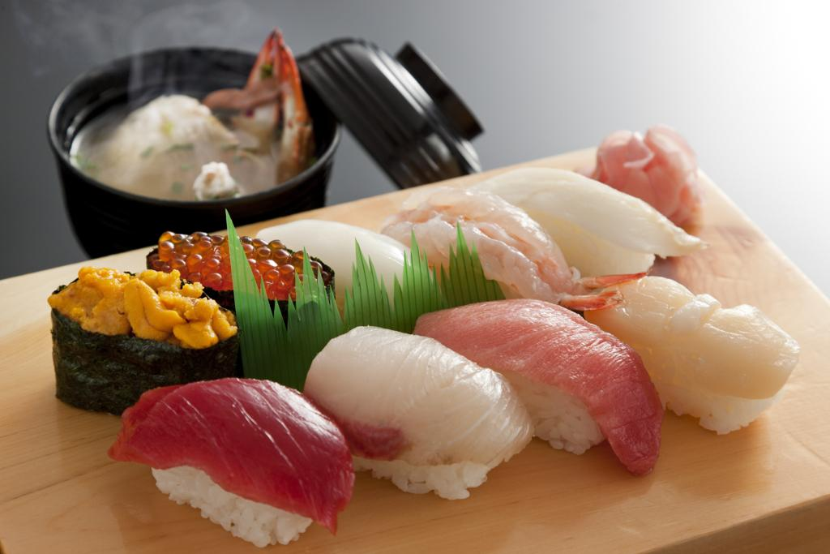
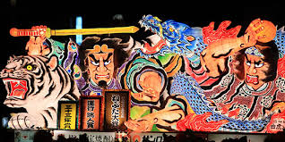
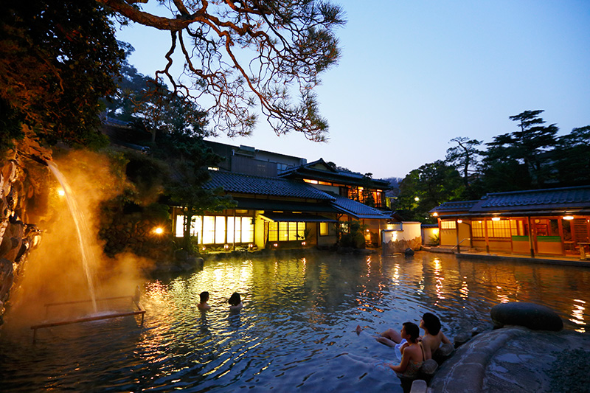

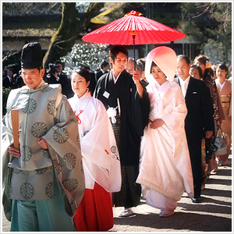

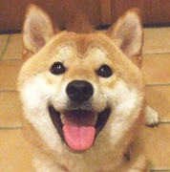
"Long way to go to embrace the diversity"

Slide 11
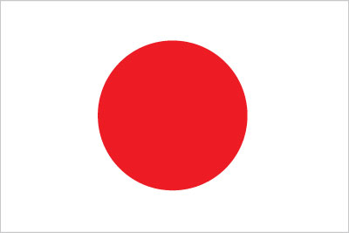
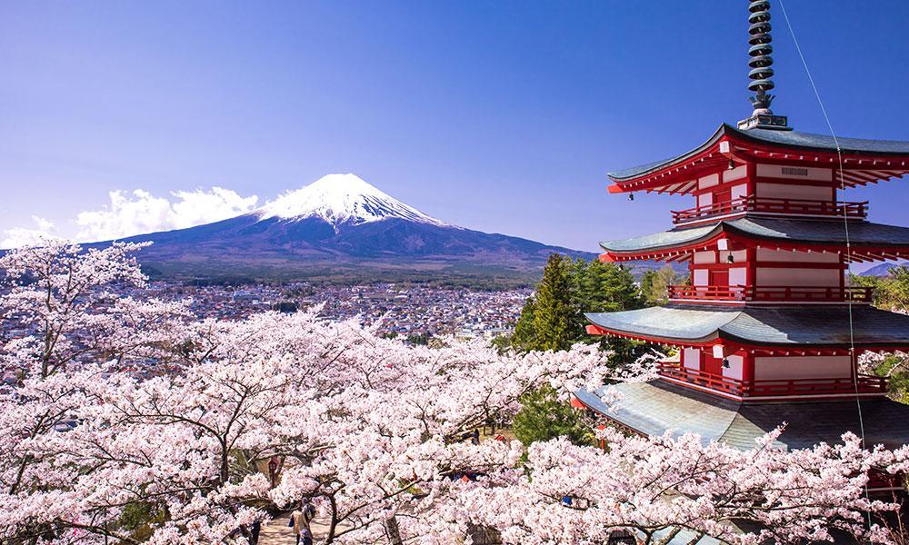
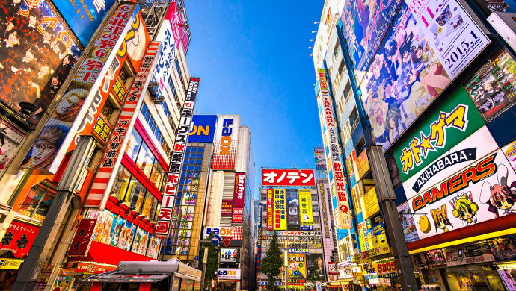
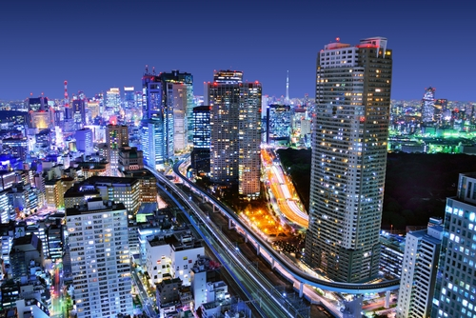
Being "Hafu" in Japan
Hafu (half) ＝ biracial / etnically half Japanese
comes from "Half", indicating the half foreign-ness

Slide 12
"Hafu"
Emerged in the 1970s in japan
☞ now the most commonly used label, preferred term of
self-definition
☞ almost like a nation or an etnic group within Japan
☞ Not only a description, but an entity in itself

Slide 13
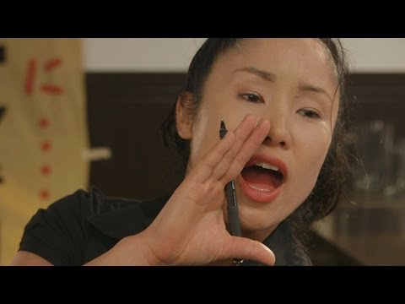

Slide 14
"Hafu"in social context
"Hafu" account for a small portion of Japan's population
☞ approximately 36,000 children with a non-japanese parent are born every year
☞ 3 percent of births
With a rise in international marriage, their numbers are growing

Slide 15
In 2014 39,511 international marriage =
accounted for 5.5％ of all marriages in Japan
Japanese - Chinese 13,019
Japanese - Philippines 8,517
Japanese - Koreans 8,023
Japanese- American 1.679
Japanese - Brazilian 524
Japanese - British 403
Visible hafus are minority of minority

Slide 16
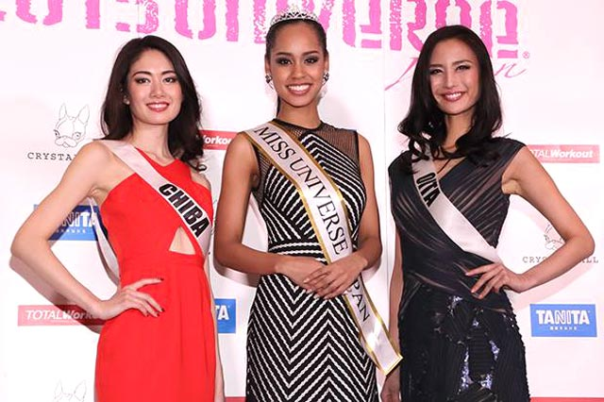
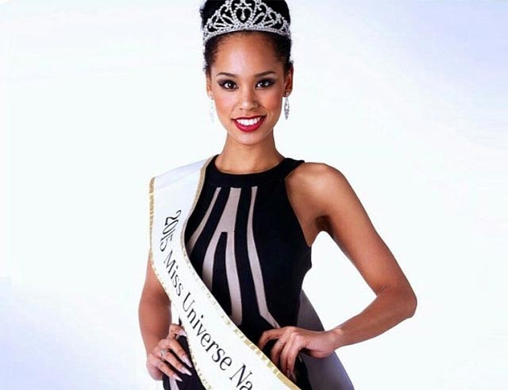
Miss Universe Japan 2015
Ariana Miyamoto (23)
Born to a Japanese mother and
African american fater

Slide 17
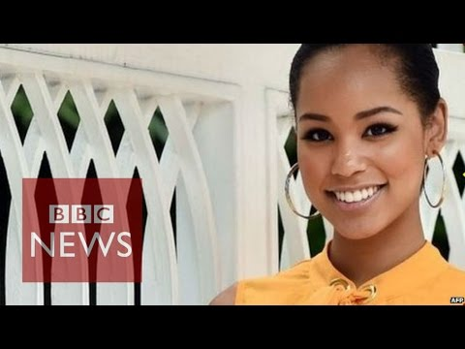

Slide 18
"I don't think the equivalent word for 'Hafu' exists overseas, but in Japan you need it to explain who you are. "
-Ariana Miyamoto
Miss Universe Japan 2015

Slide 19

The Hafu project
Begun in 2009
Aiming to promote
"awareness of racial diversity in japan" and
"the issues facing those of mixed heritage"

Slide 20
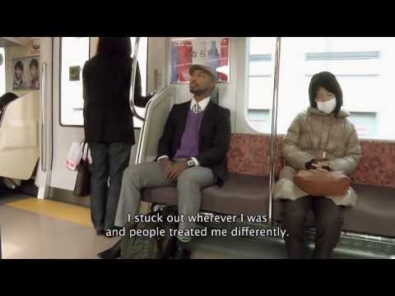

Slide 21
Factors that affect the "hafu" sense of belongingness and identity assertion
・education
・relationship to family and friends
・where and how they were raised
・personal characteristics
・the ways in which they have been projected by the surrounded society

Slide 22
Ethnicity and Mental Health
People from minority ethnic groups experience poorer health due to negative attitudes towards them.
Understanding of the inequalities and disparities in health (equally in mental health), can provide insights into the social processes that underpin these inequalities.
And can therefore, form a useful basis for strategies to address or even overcome inequalities in mental health.

Slide 23
Risk factors for mental illness in ethnic minorities
Exlusion from school.
Social deprivation as a result of unemployment.
Prevelance of crime and drug cultures.
Over-representation in prison populations. (White, 2006)
Social and economic inequalities.
Racial harassment and discrimination.

Slide 24
Negative Perceptions (black men+mental health services
Reluctance to seek help
Services not sure how to engage
Increased risk of worsening distress
Increased likelihood of coercive interventions
Reinforcement of negative perceptions
The Spiral of Opression:
Keating (2007)
Continued reluctance to engage

Slide 25
Alvarado’s racial stereotype theory(1987):
Four key themes in racial representations:
Exotic
Dangerous
Humorous
Pitied

Slide 26
Exotic:
Certain ethnic groups can be represented as being exotic. This is sometimes portrayed through Latino Americans as they are seen as being sex symbols and are represented as being rather explicit.

Slide 27
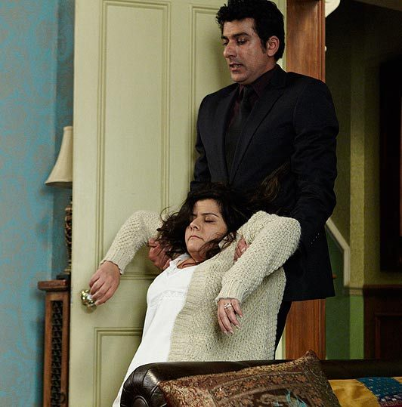
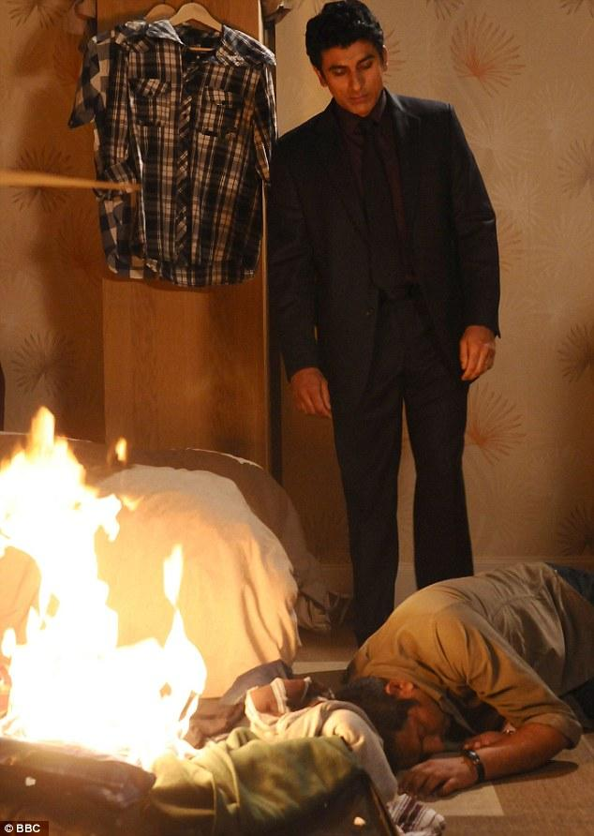
Dangerous:
Some ethnic groups can be portrayed as dangerous through the analysis of certain people's behaviour. For example, characters in soaps such as Eastenders with a different ethnic background to others is related to violent and aggressive behaviour e.g. abuse.

Slide 28

Humorous:
Other ethnic groups are represented as being humorous through the use of animation and cartoon characters such as Simpsons.

Slide 29
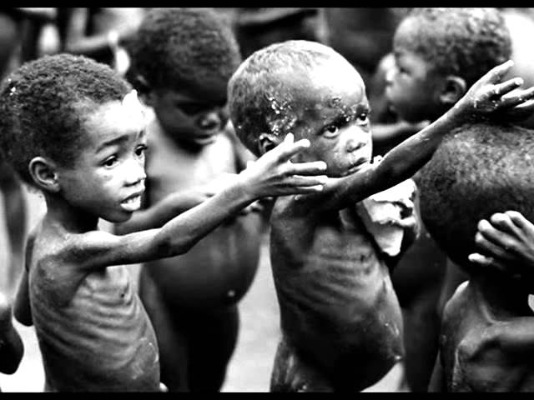
Pitied:
Adverts and documentaries raise awareness for African people and young children who are in need of water and food in order to survive. By doing this not only is it presenting real problems in the world but also creating an atmosphere of pity within the audience which in turn persuades members to pay and portray beneficial methods so they can help these young children in need

Slide 30
Discussion questions
Q. How do the media influence discussions on ‘race’?
Q.Why do you think children from some minority ethnic groups are the highest educational achievers?

Slide 31
References
Ministry of Health, Labour, and Welfare. (2014). Vital statistic report. Retrieved
from http://www.mhlw.go.jp/toukei/saikin/hw/jinkou/tokusyu/
gaikoku14/dl/03.pdf
A. Metraux (1950) "United nations Economic and Security Council Statement by
Experts on Problems of Race", American Anthropologist 53(1): 142-145)
Craig, G. (2012). Understanding 'race' and ethnicity: theory, history, policy,
practice. Bristol: Policy.

Slide 32
Roxana Seberi. (2015). Being "hafu" in Japan: MIxed-race people face ridicule,
rejection. ALJAZEERA AMERICA. Retrieved from http://america.aljazeera.com/articles/2015/9/9/hafu-in-japan-
mixed-race.html
'Hafu' / Half japanese. (2010) Retrieved from http://www.hafujapanese
.org/index.html

