Slide 1
Media Society and Culture

Slide 2
News media in a democratic society
Is supposed to
Report events objectively as they occur, to allow citizens to make informed political choices
Control governmental abuses of power, through investigative journalism
But, it is more like a Propaganda System
However, this control is remains invisible when the media are private and formal censorship is absent, portraying themselves as the voice of public

Slide 3
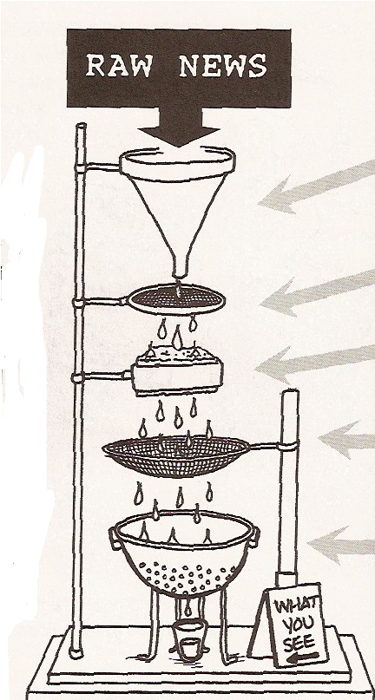
News Filters
Financial ownership
Funding through advertising
Reliance on PR
“Flak”
“Anti-communism”

Slide 4
News Filters
corporate ownership of the media (Own interests)
Financial reliance on advertising (Source of money, Business friendly)
Reliance on PR information provided by government and business (Limited source of news. Over-reliance on power eilites)
“Flak” as a means of disciplining the media (Law suits, petitions, complaints from interest groups/powers/businesses)
“anticommunism” (Anti-terrorism) as a control mechanism (Obedient audience. Controlled by fear)

Slide 5
What’s happening?
What is going on in Fukushima? Guantanamo? North Korea? etc
Information on the Occupy Movement at the beginning of the movement?

Slide 6
Rich Media Poor Democracy
Robert McChesney
Most of the news and entertainment available today comes from just a few massive entertainment corporations so large they function as virtual monopolies or oligopolies
A handful of media giants compete with one another for market share, but they all know their mutual survival is assured.

Slide 7
Media in Politics
  Transmit political information from political actors to the public
  Gatekeeping
    Media makes decisions about what is news, and for how long
  Watchdog function
    Informal check in our political system
      Media allows the public to keep tabs on behavior of elected officials
  Expand scope of an issue
    More media attention leads to higher levels of public knowledge about issue
      This leads to more pressure on politicians

Slide 8
Media Bias. Ideology?
Ideologically Biased Media – Progressive, Liberal, Conservative
Corporate Bias: Corporations’ desire to maintain business interests

Slide 9
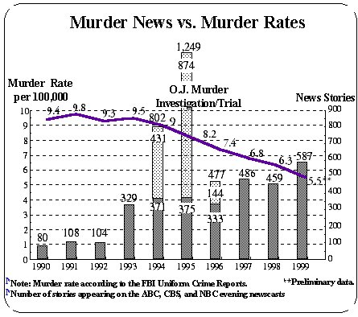
Obsessive Society

Slide 10
http://www.youtube.com/watch?v=Kc9OHBHtho8

