Slide 1
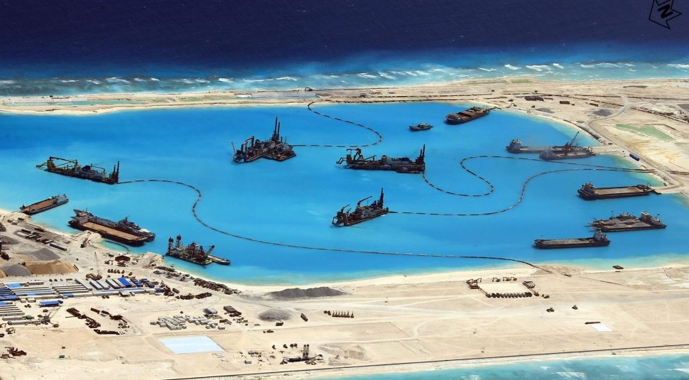

Slide 2
Regional conflicts: US and South China Sea
Luboš Přikryl & Tomáš Daněk

Slide 3
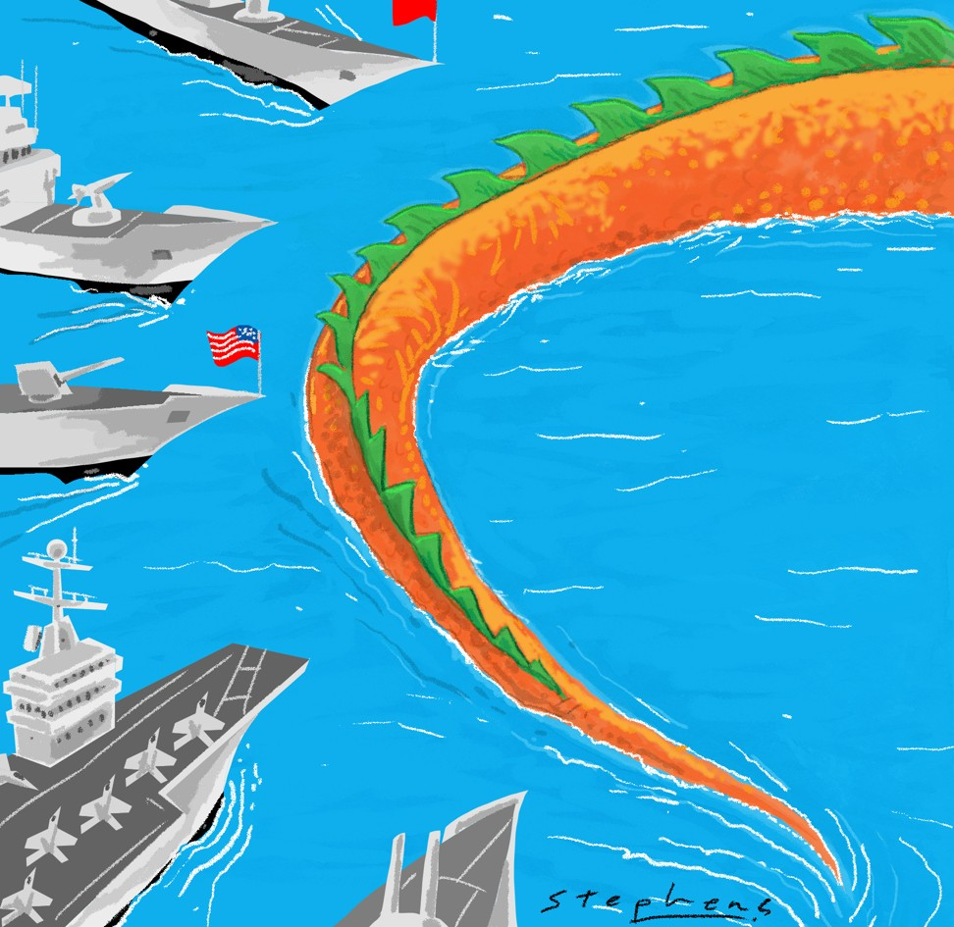
What is it about?
South China sea presents very lucrative area
Oil reserves, gas reserves, fish populations, and viable trade routes
According to UN law, large part of the SCS is international waters
UN Maritime law declares international waters cant be claimed
China doesn‘t respect the 200 miles rule
China enforces historical 9 dash border (and with it resources of SCS)

Slide 4
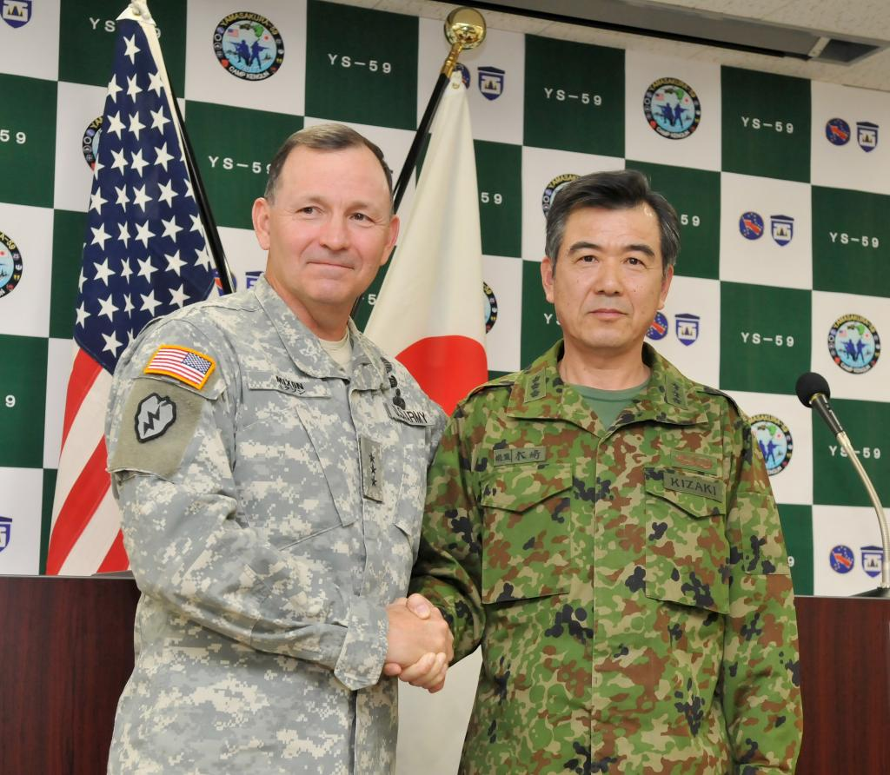
What is it about?
This puts China at odds with other actors in the region
Those actors are US allies or partners
China backs its claims with military buildup
Other regional powers uneasy
Some of these (South Korea, Japan) directly relies on US for defense

Slide 5
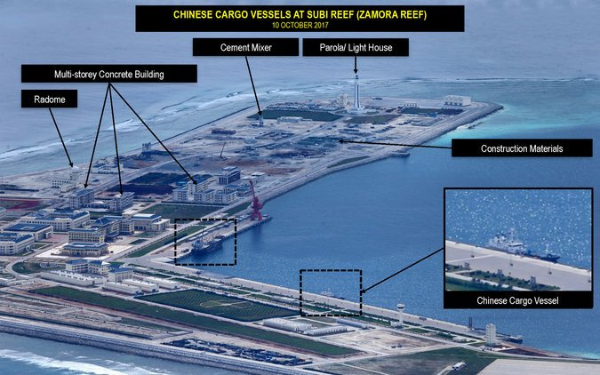
Chinese Military buildup
South Chinese sea contains no real landmass
Only sandy archipelagos
„Little blue men“
China is expanding these archipelagos
…and building military bases on them
This way, step by step, China annexes the SCS

Slide 6
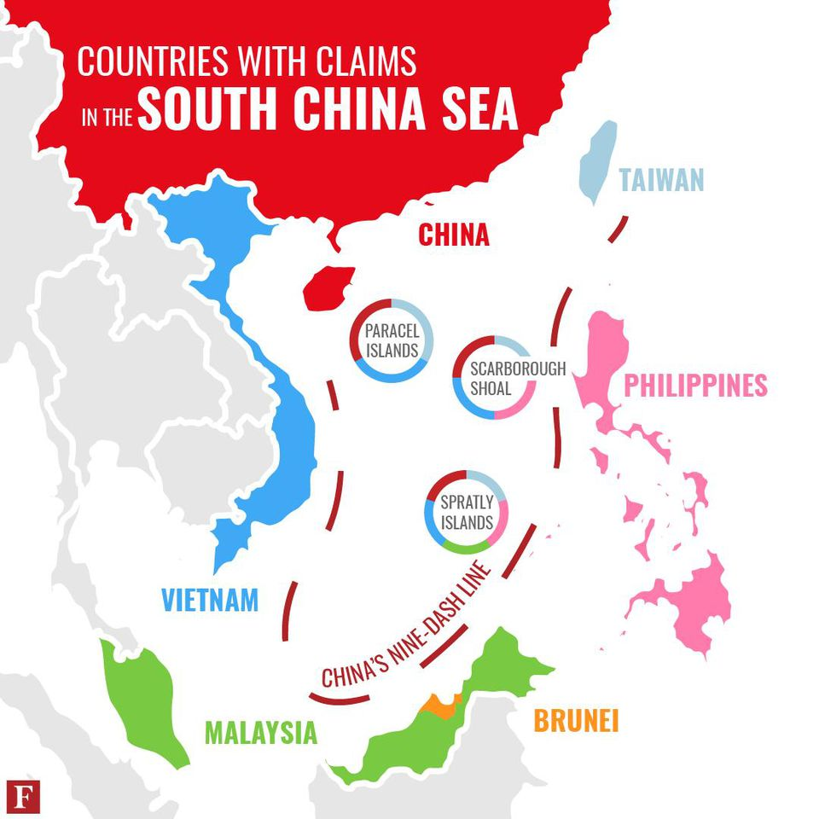
Countries at stake
Vietnam
Tai-wan
Phillipines
Brunei
Malayisia

Slide 7
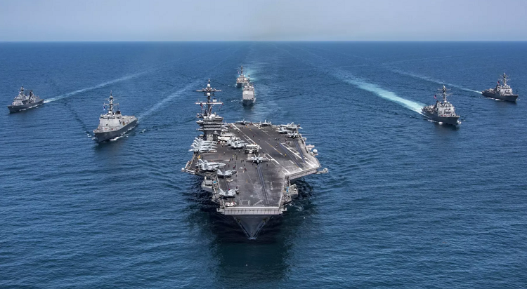
What is in stake for US?
US wants to uphold freedom of maritime navigation (SCS being vital naval trade route)
As such,US officialy backs UN Maritime Law
US backs Vietnam against China expansionism
Unspoken long term goal: Keeping its military dominance in Pacific
Unspoken long term goal: halt the chinese rise to the position of new global super power

Slide 8
USA presence in Pacific – Japan and Korea
Japan is one of the key actors of the dispute, heavily reliant on shiping lanes and fish populations
What has the US to do with the Japan?
After the WWII, Japan was occupied by USA
Japan was demilitarized
USA made the vow to be responsible for Japan‘s safety
USA stationed troops in Japan
After the end of initial occupation, US and Japan begin to build new relations, and Japan became member of US sphere of influnece
Korean War
US brought sizeable force to theatre
War never officialy ended (cease fire)
As such, similar situation as with Japan

Slide 9


The USA in Southeast Asia
Since WWII supporting Japan (others distristful)
„hub and spokes“ system (bilateral treaties since 1951)
  Japan, South Korea, Philipines
  Military alliance, economic support
  Containment of Communism
  Impossible multilateral solution (differences)
Vietnam war
  1955 – 1975
  US withdrawal (1973)
ASEAN (Association of Southeast Asian Nations)
  1967
  Regional intergovernmental organization
  Better relationships between SEA states (economy, politics, culture, military)
  USA aproaches the states as a region

Slide 10
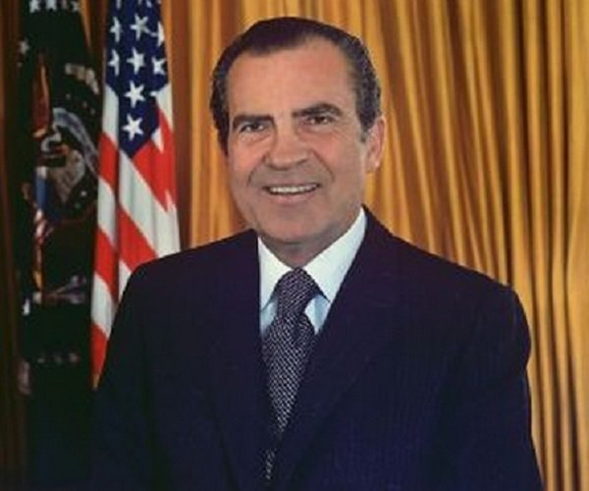
The USA in Southeast Asia
Nixon doctrine 1969 (vietnamese syndrom)
  Responsibility given to states
  Economical, military support, but….
After cold war
  „benign neglect“ aproach
    Little attention, only when needed (security threats)
    Wanted to have economical influence (not supporting East Asian Economic Group – EAEG)
    9/11
  North Korea ballistic missile tests (93, 98)
    Cooperation with Japan
    100 000 soldiers in the region

Slide 11
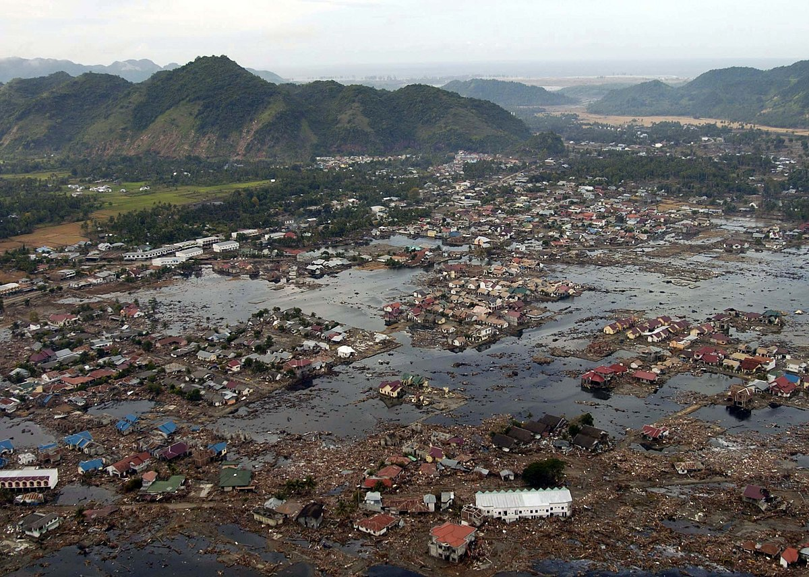
The USA in Southeast Asia
After 9/11
  Japan being the main partner
  Economical and security areas
  Lack of interrest
    Absent at regional summits
    Deeper integration
    Cooperation with China
  No interest on region building
  2004 Tsunami
  → rise of regionalism (ASEAN)
  Since 2006 more interest X rising power of China

Slide 12
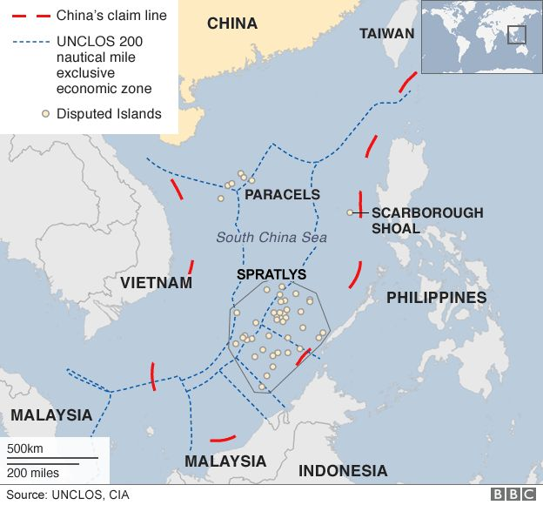
South China Sea conflict
Oil, natural gas
Fishing (10 %)
Trade - Goods worth $5.3 trillion
Claims - China, Brunei, Malaysia, the Philippines, Taiwan and Vietnam
Interests – the USA, Japan, South Korea, Indonesia

Slide 13
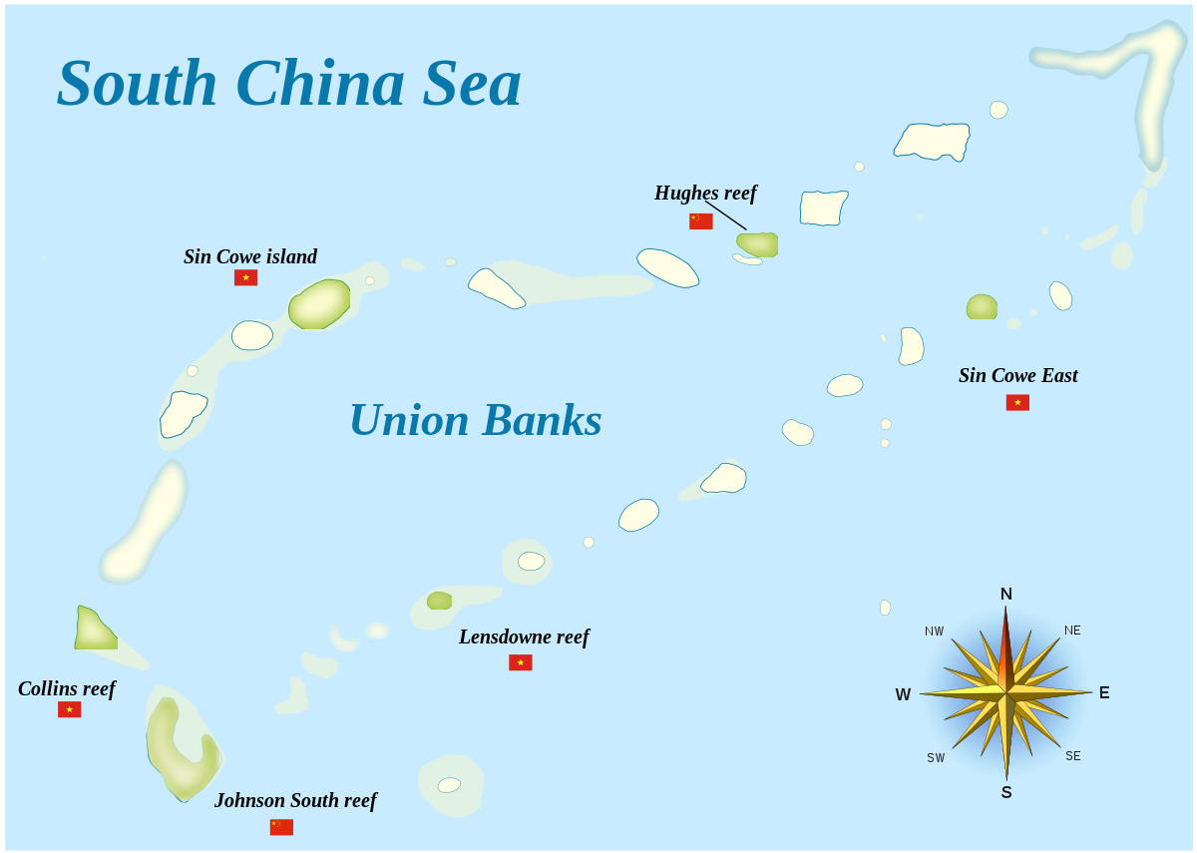
The conflict
Lots of skirmishes
ASEAN states choose diplomatic solution
Battle of Paracel islands (1974)
  After withdrawal of the USA
  China X South Vietnam
1988 battle (China X Vietnam)
Since 1990‘s two sides of the conflict
  China X Asean + USA (late 90‘s)
  China slowly but surely gains influence

Slide 14
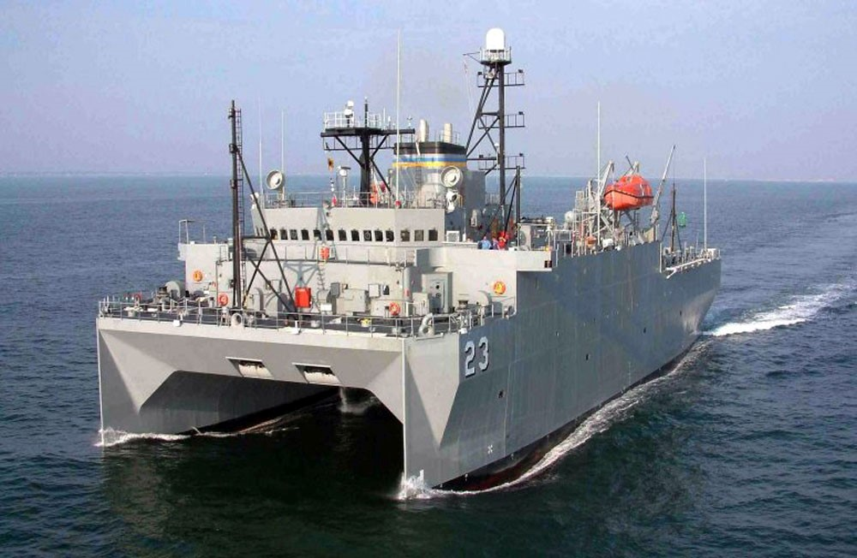
USA X China
Hainan Island incident (2001)
  collision between a US spy plane and a Chinese fighter jet
  No escalation
  „Letter of the two sorries“
USNS Impeccable (2009)
  ocean surveillance ship
  International waters
  China ordered it to leave
  US sending a guided-missile destroyer to protect the ship

Slide 15
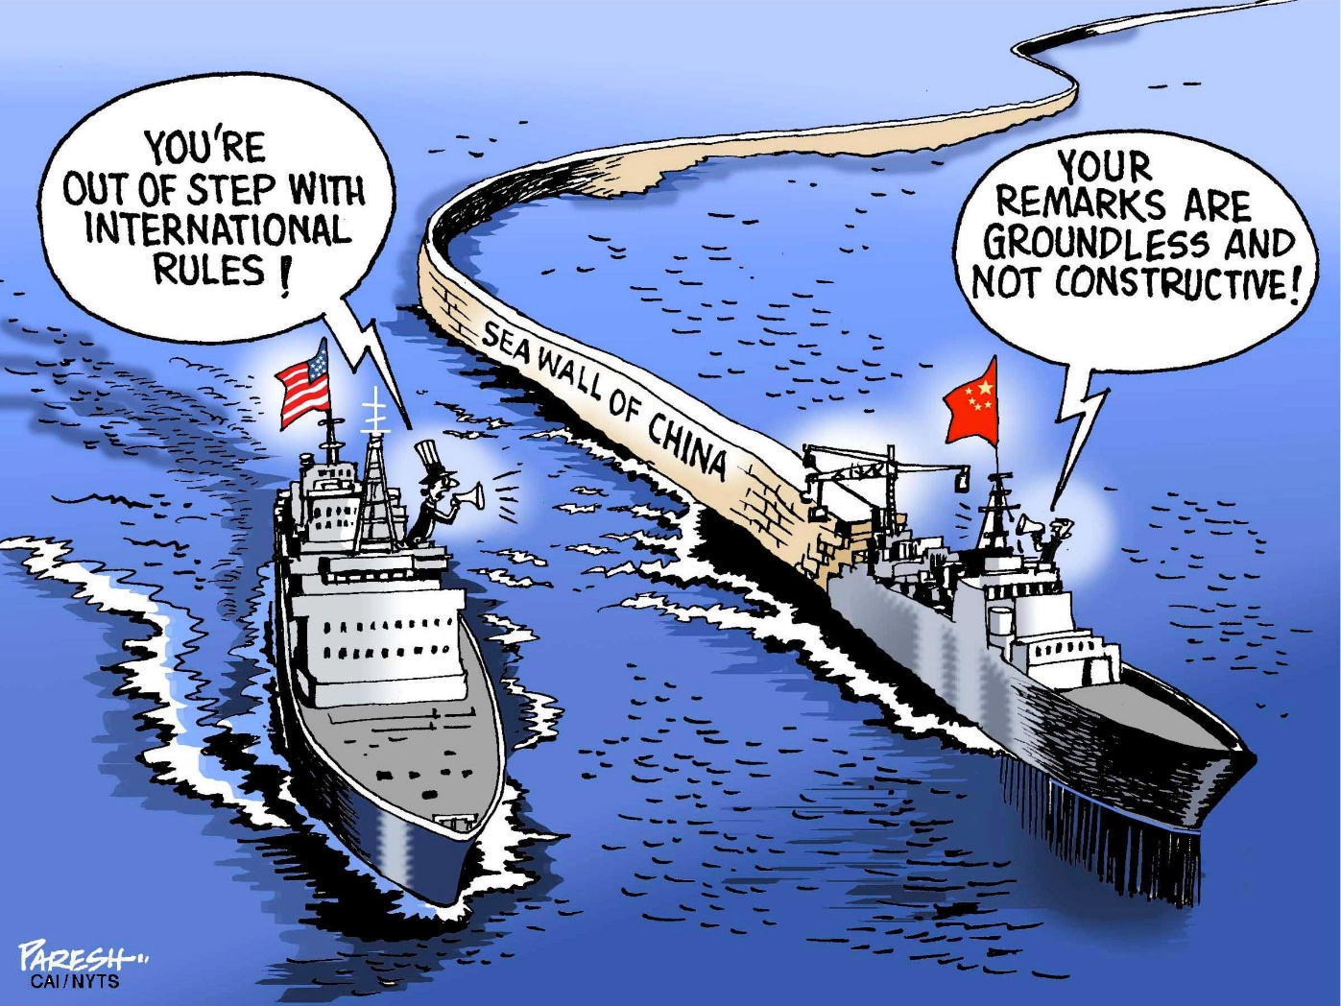
The US role in the conflict
Attention to the region in late 90‘s – oil (several explorations)
Fear of China‘s growing power
Main goals
  status quo
  Maritime freedom
  Containment of China
  2010 – Clinton – „USA are neutral and support multilateral solution“
Tools
  Supporting ASEAN states (2014 the Philippines)
  The law (UNCLOS)
Patrolling the coast
Cold war?

Slide 16
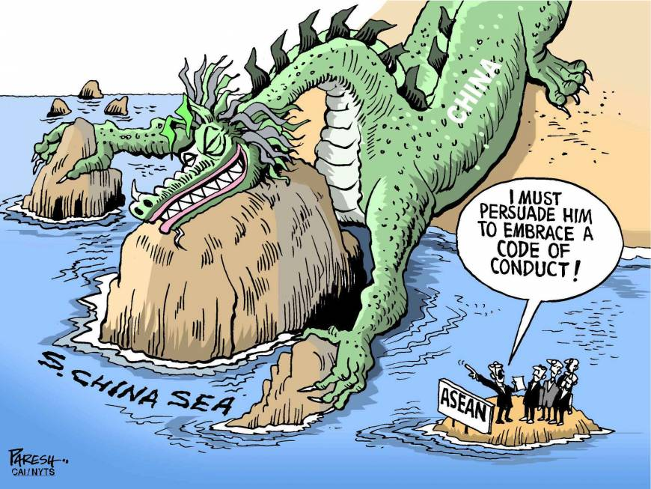
Implications
Even though the countries and UN objects, chinese takeover of SCS reached far
Diplomatic solutions doesnt seem to work
Most countires in the region dont have the might to stand against the China
As such, any strong stance on the issue, and possibly armed one, is up to US

Slide 17
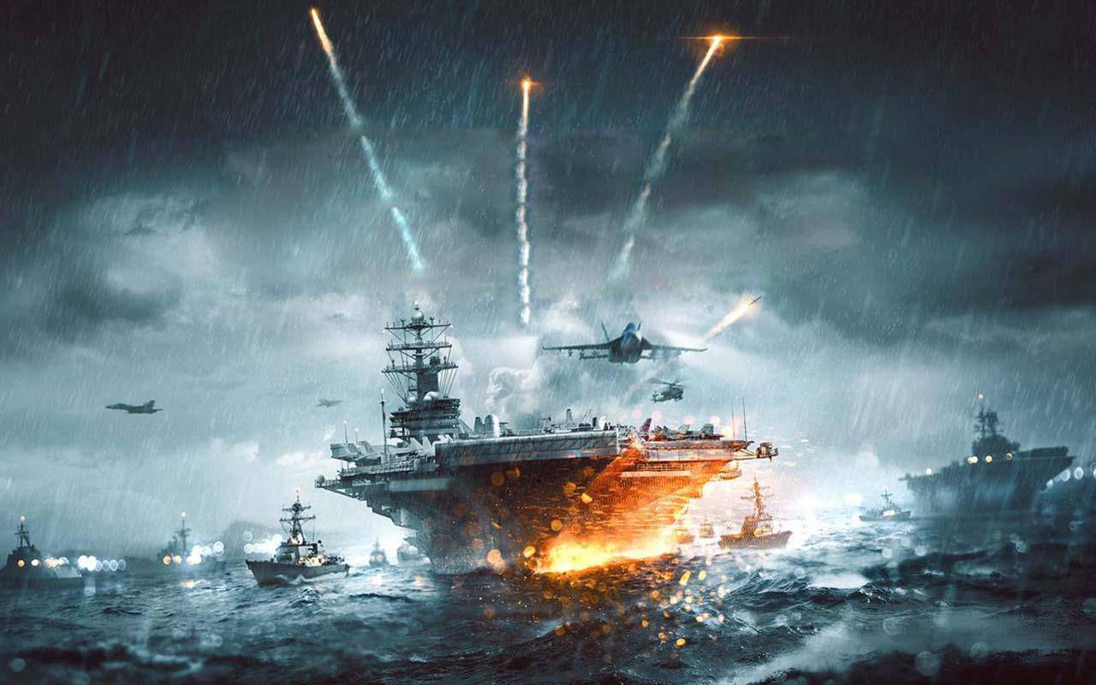
To act or not to act?
Dangerous situation
If US lets China fully take SCS, economical loses
However, more importantly, big political defeat for US and possible breaking point
Acting is however very dangerous
US Navy has enormous military advantage though
Still, there is propably not enough political will to do so.

Slide 18

Questions? Comments?

Slide 19
Sources
BBC (2016): Why is the South China Sea contentious? [online] http://www.bbc.com/news/world-asia-pacific-13748349
Beeson, M. (2009): East Asian Regionalism and the End of the Asia-Pacific: After American Hegemony. In: The Asia-Pacific Journal.
Cobus, P. (2017): Conflict and Diplomacy on the High Seas [online] https://projects.voanews.com/south-china-sea/
Frost, E. (2004): Strategic Engagement or Benign Neglect? Current and Future U.S. Policy Responses to East Asian Regionalism.
Kotani, T. (2017): Trump’s World and the South China Sea. [online] https://thediplomat.com/2017/01/trumps-world-and-the-south-china-sea/
Pham, P. (2017): What Is The United States Doing In The South China Sea? Forbes. [online] https://www.forbes.com/sites/peterpham/2017/12/15/what-is-the-united-states-doing-in-the-south-china-sea/#683e187b1a9e
Stashwick, S. (2017): Leveraging US Military Power in South China Sea [online] https://thediplomat.com/2017/08/leveraging-us-military-power-in-south-china-sea/
The Washington Post (2018): China to U.S.: It’s your fault we are in the South China Sea. [online] https://www.washingtonpost.com/world/china-to-us-its-your-fault-we-are-in-the-south-china-sea/2018/01/22/1bc25b72-ff3e-11e7-93f5-53a3a47824e8_story.html?noredirect=on&utm_term=.53f25403528e

