Slide 1
Democratization AND DE-DEMOCRATIZATION
The Russian case

Slide 2
“the pendulum” of Russian history
Imperialistic and repressive tsarist Russia (Serfdom was abolished only in 1861. Before the revolution in 1905 the majority of population had not had any political rights).
The period of liberalization, emancipatory tendencies and social experiments (between 1905 and very early soviet years)
Stalin’s repressions (30th - 1953)
Khrushchev “Thaw” (1953 - 1964)
Brezhnev “Stagnation” (1964 – 1985: L. Brezhnev 1964 – 1982, Yu. Andropov 1982 – 1984, K. Chernenko 1984-1985)
Gorbachov “Perestroyka” (1985 - 1991)
Yeltsin’s Russia (1991 - 1999)
Putin’s Russia (1999 – our days: V. Putin 2000 – 2004, 2004 – 2008, D. Medvedev 2008 – 2012, V. Putin 2012 – 2018, 2018 – to this date)

Slide 3
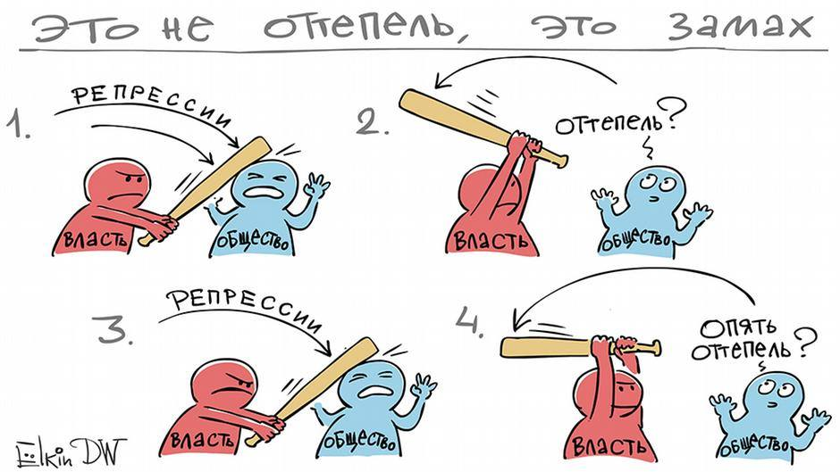
“It’s not a thaw, it’s a backswing”

Slide 4
Democratization processes in late soviet years
“Perestroyka”: the wide range of reforms aimed to democratization of social and political life, as well as liberalization of economics.
“Glasnost”: (Before becoming one of the Gorbachev’s slogans, this word had used by soviet dissidents) increasing of government transparency and decreasing of political censorship
“New political thinking”: de-ideologyzation, priority of universal values, moving toward peaceful co-existence

Slide 5
Some outcomes
In the late soviet years the range of human rights was expanded significantly.
In 1988 the Decree “On the Procedure of Organizing and Conducting of assemblies, rallies, street marches and demonstrations” was passed in the USSR.
The censorship in press and culture was considerably weakened. In 1990 political censorship was repealed.
Some human rights organizations appeared in that period:
The Moscow Helsinki Group (MHG was established in 1976, then closed and reestablished in 1989)
“Memorial” (1989)
The Committee of Soldiers’ Mothers (1989)
The Independent Psychiatric Association (1989) etc.

Slide 6
Contradictions in understanding of democratization in late soviet period
Inconsistency of the soviet ideology led to inconsistency in opposition
Lack of human rights awareness and political culture
Contradictions between interests of dissidents, nomenclature and common people: they were unsatisfied with the soviet regime but because of different reasons.

Slide 7
Yel’tsin’s Russia
The Constitution of 1993 established the post of Human Rights Commissioner.
In 1996 Russia became a member of the Europe Council
In 1998 Russia ratified the European Convention for the Protection of Human Rights. That meant that the Convention must have become a part of the Russian legislation.
Since 1998 Russian citizens have been able to apply to the European Court of Human Rights

Slide 8
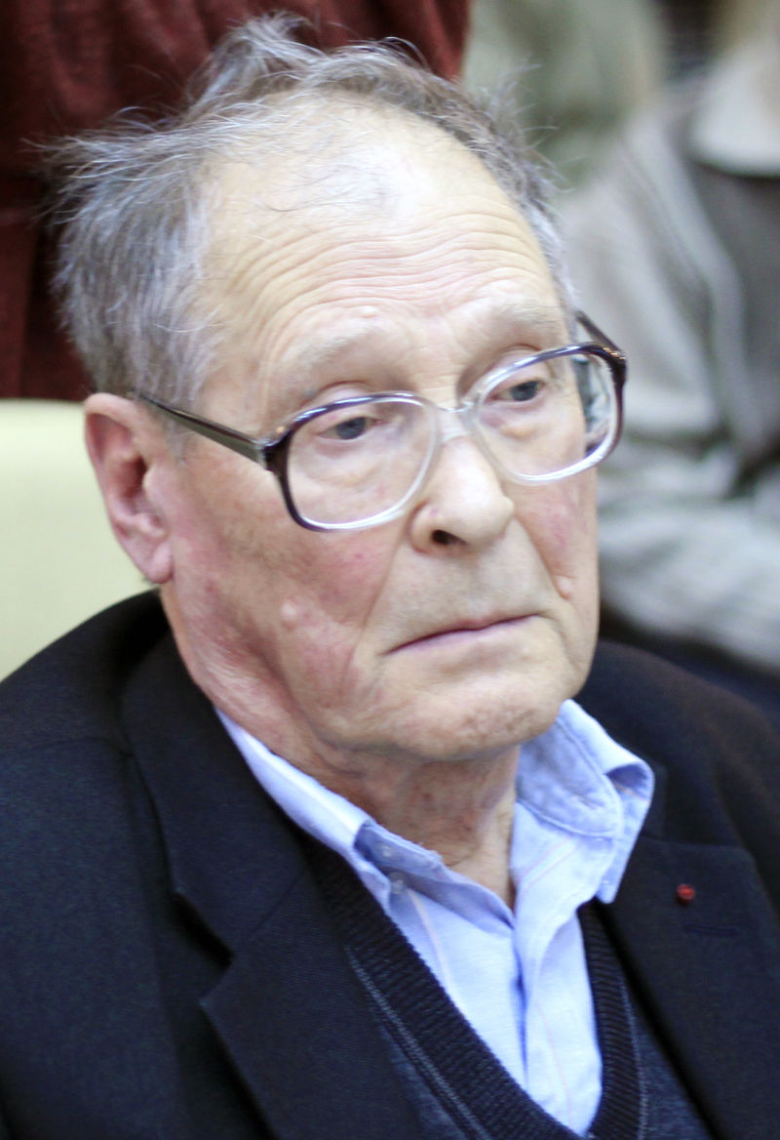
Sergey Kovalev, a participant of human rights movement in the USSR and post-soviet Russia, was a first Russian Ombudsman (1994 - 1995). He strongly criticized the government actions during the First Chechen war that caused his resignation. In 1996 he wrote an open letter to Boris Yel’tsin where expressed fears that the President was neither supporter of democracy, nor guarantor of rights and freedoms.

Slide 9
Many elements of liberal reforms associated with Yel’tsin had been prepared or even had appeared before the Yel’tsin’s presidency :
Freedom of speech and banning of censorship (1990)
Multy-party system (late 80th, 1990)
Improvement of international relations (late 80th, the Gorbachov’s strategy of new political thinking, priority for universal human values, de-igeologization)
Appearing of Human rights organizations (late 80th)
Conclusion: Yel’tsin’s reforms were aimed rather on liberalization of market than establishing a state based on the rule of law and democracy

Slide 10
Evaluation
Positive sides
Negative sides
Anti-totalitarian pathos
Using of elements of direct democracy (e.g. plebiscite)
Total recognition of human rights
Developing of civil society and NGOs
Active communication between Russian NGOs and International NGOs as well as with foreign partners
Freedom of speech and spreading information
Steps towards European integration
Convergence of criminals and power resulted in gradually increasing of corruption
Lack of political will to build the state of law
Lack of control of power structures and unclearness of their functions
Inefficient juridical protection
Courts were dependent from executive power and associated themselves as a part of the state machinery
Combating civil monitoring on the level of legislative power as well as executive branch

Slide 11
Putin’s Russia: The authoritarian twist

Slide 12
Signs of de-democratization
1. Interruption of the course toward European integration The idea of the sovereign democracy
2. Strengthening of the power vertical and centralization
Concentration of political power in hands of the President and the Presidential Administration
3. Control over the most popular media
Returning of political censorship
4. Adopting the laws that violate constitutional norms
Significant restriction of civil liberties
5. “Negative legitimation” of liberal values
Equalization of political protestants with “public enemies”

Slide 13
Legislative level
“Dima Yakovlev Act” (so-called Anti-Magnitsky Law) (2012) (suspends the activity of politically active non-profit organizations which receive money from American citizens or organizations and bans citizens from the USA from adopting children from Russia)
The “foreign agent” law (2012) (requires non-profit organizations that receive foreign donations and engage in "political activity" to register and declare themselves as foreign agents)
Criminalization of insulting of religious feelings (2013)
The “anti-gay” law (2013)
The “foreign agents” media law (2017)

Slide 14
Before his inauguration in 2000 Putin produced and signed one leaked document “Reform of the Administration of the President of the Russian Federation” which directly contradicts to the Constitution (1993). This document replaces the self-regulating nature of a democratic, market-driven and rule-by-law system with manual control from the top.
The President can control everything from the Kremlin (with help of FSB).

Slide 15
The highest-profile political killings in post-soviet russia
Vladislav Listyev (1995)
Galina Starovoytova (1998)
Pavel (Paul) Khlebnikov (2004)
Anna Politkovskaya (2006)
Alexander Litvinenko (2006)
Natalia Esterminova (2009)
Sergey Magnitsky (2009)
Boris Nemtsov (2015)

Slide 16
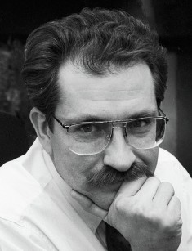
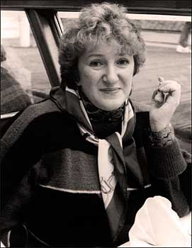
Vladislav Listyev (1956 - 1995), a journalist and head of ORT TV. He brought the voice of democracy on Russian TV.
His killing remains unsolved.
Galina Starovoytova (1946 - 1998), a Soviet dissident, Russian politician, ethnographer and protector of ethnical minorities. As a politician she monitored use of budgets and helped to return the prisoners-of-war from Chechnya. The investigation of her killing still is not completed.

Slide 17
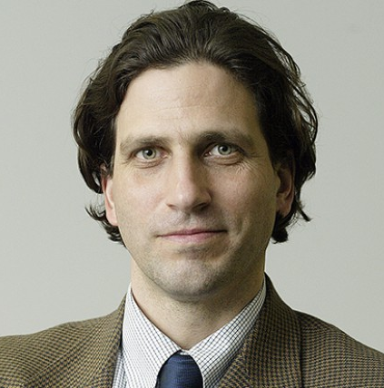
He was born in the USA and worked as a journalist specializing on Russian business. In 1996 he published the article “The Kremlin’s godfather?” where he accused Boris Berezovsky of fraud, ties to the Chechen mafia and assassinations. In 2003 he published the book “Conversation with a barbarian” based on the interview with the Chechen rebel leader Khozh-Akhmed Nukhayev. Nukhayev was accused by Kremlin in Khlebnikov’s murder but this position has been criticized.
Pavel (Paul) Khlebnikov (1963 - 2004)

Slide 18
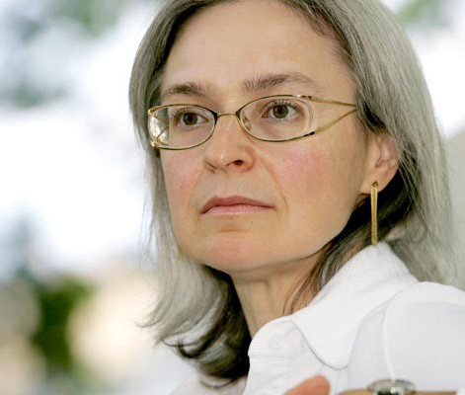
She worked in “Novaya Gazeta” specializing on investigative journalism. She wrote a lot about the Second Chechen War and repeatedly visited the war zones.
She also criticized the Russian military forces and investigated cases of hazing and corruption.
In 2004 she interviewed Ramzan Kadyrov.
“A Dirty War: A Russian Reporter in Chechnya” (2001)
“A Small Corner of Hell: Dispatches from Chechnya” (2003)
“Putin’s Russia: Life in a Falling Democracy” (2004)
“A Russian Diary: A Journalist’s Final Account of Life, Corruption and Death in Putin’s Russia” (2007)
Anna Politkovskaya (1958 - 2006)

Slide 19
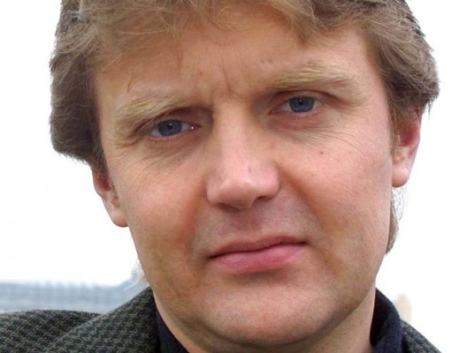
He served in FSS (FSB). In 1998 during the press conference Litvinenko said that in 1997 he and some of his colleagues were given an order to kill Boris Berezovsky. After they had refused to obey the order they experienced pressure and threats. In 2000 he was given political asylum in the UK. In 2006 he was poisoned by polonium (radioactive substance). His murder is still unsolved. Scotland Yard suspected Andrey Lugovoy, the last person who had met Linvinenko before appearing symptoms of poisoning. However the General Prosecutor of Russia refused to extradite him. In 2007 Lugovoy became a deputy of the State Duma from LDPR.
Alexander Litvinenko and Yuri Felshtinsky wrote the book “Blowing up Russia: The Return of the KGB” (the first publishing in 2002).
Alexander Litvinenko (1962 - 2006)

Slide 20
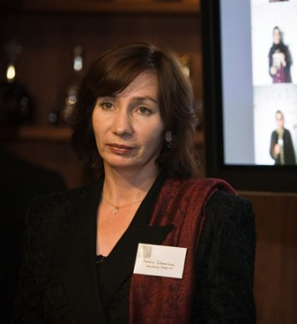
“Memorial”
Until 1998 she had worked as a school teacher in Grozny (Chechnya). Then she started working on human rights activities in Chechnya. She was a member of “Memorial” and The Commission on conditions in places of detention. She experienced threats from Ramzan Kadyrov. In 2009 she was kidnapped and killed.
Her killing remains unsolved.
Natalia Esterminova (1958 - 2009)

Slide 21
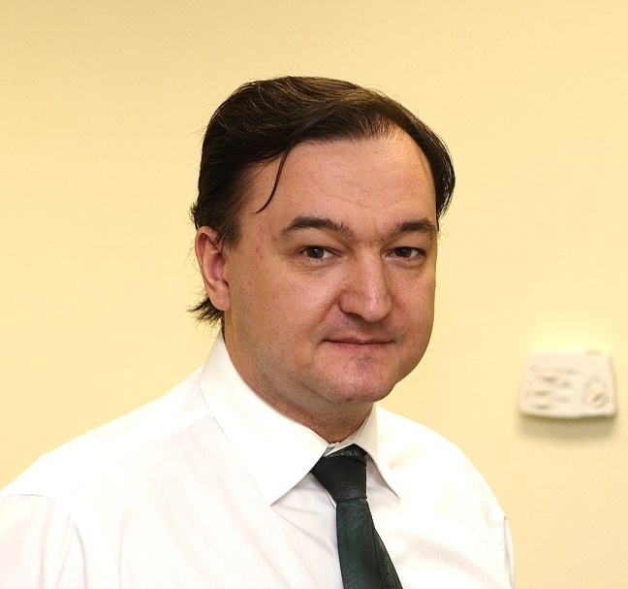
Working as an auditor of the Hermitage Capital Company he revealed the scheme of taxes misappropriation by Interior Ministry officials. He was arrested 2008. In November 2009 he died in the pre-trial detention center “Matrosskaya Tishyna” (Moscow) because of poor conditions of detention and failure to provide medical care. Before his death he had written about 100 complaints where he asked to provide him with medical help but nobody reacted. After his death the official diagnosis has been changed twice. His death is not considered by Russian authorities as a murder.
Sergey Magnitsky (1972 - 2009)

Slide 22
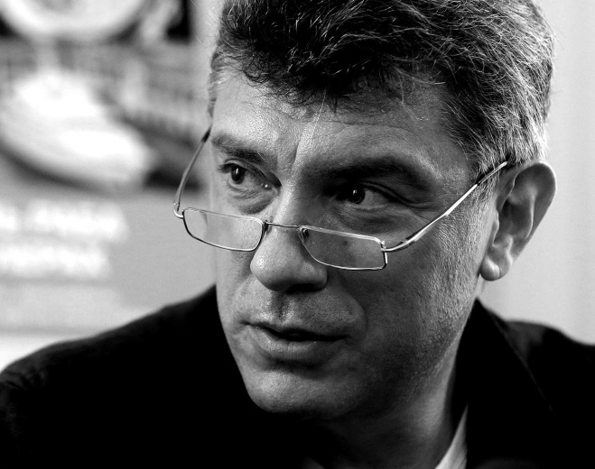
He was a politician, one of the founders and leaders of the movement “Solidarnost”, co-chair of the party PARNAS (People’s Freedom Party), one of the brightest leaders of the political opposition in Russia, the author of series of reports on corruption in Putin’s administration. He was killed in 2015. The Russian authorities do not consider his murder as a political killing.
Boris Nemtsov (1959 - 2015)

Slide 23
Protest activity in russia

Slide 24
The biggest protest movements
Dissenters’ March (2005 - 2008): series of rallies against the Putin’s regime. Leaders: Garry Kasparov, Eduard Limonov, Mikhail Kasyanov
Strategy 31 (since 2009): open-ended series of actions for the protection of freedom of assembly (the 31 Article of the Russian Constitution ). It was initiated by Eduard Limonov and supported by MHG, “Memorial” and the movement “For Human Rights” (established in 1997)
Protests movement in 2011 – 2013

Slide 25
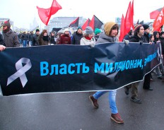
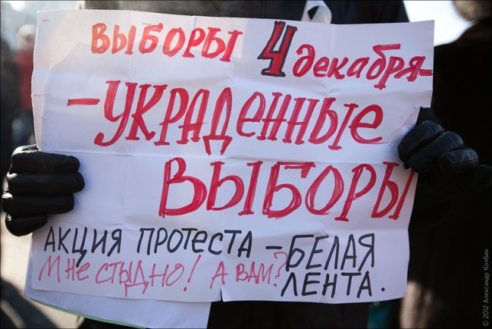
Protest movement in 2011 – 2013
Some English language media called it “ The Snow Revolution”
The protest actions started after the election campaign for the sixth call-up of the State Duma in December 2011 and continued during the Presidential election in March 2012 (but official media kept silence and did not report on it).
The main reason: multiple falsifications in both election campaigns.
The main slogan: For fair elections!
The most widespread symbol: the white ribbon.
The leaders: Boris Nemtsov, Alexey Navalny, Sergey Udaltsov and others.

Slide 26
Main Demands
Freedom of political prisoners
Annulment of the elections results
Resignation of the head of the election commission Vladimir Churov
Opening of an official investigation into vote fraud
Registration of opposition parties
New democratic legislation on parties and elections
New democratic and open elections

Slide 27
The most significant actions
10 December 2011: The rally on Bolotnaya Square in Moscow (in total more than 50 000 people in Moscow); 10 000 protesters in Saint-Petersburg, 4000 in Yekaterinburg, 3000 in Novosibirsk, 1000 in Vladivostok and smaller rallies in other cities
24 December 2011: the demonstration “For Fair Elections” on Academician Sakharov Avenue (liberals, communists, monarchists, anarchists, nationalists)
4 February 2012: Protesters March carried out in Moscow by the For Fair Elections movement (160 000 participants). Slogans: “Putin, go away!”, “Russia without Putin!” and “Putin is a person without shame and conscience”
26 February 2012: Demonstrations against Putin (30 000 participants in Moscow and 3500 in Saint-Petersburg)
5 March 2012: Protest actions in response to Putin’s re-election (25 000 protesters in Moscow and 3 000 in Saint-Petersburg)

Slide 28
6,7 and 8 May 2012: several hundreds action were conducted in Moscow including “The March of Millions”. Actions were coincided with the Putin’s inauguration. More than 400 people were arrested, about 80 were injured. The arrests continued in the following months. The authority’s reaction resulted in so-called “Bolotnaya square Case”
May – June 2012: Occupy Abay and Occupy Arbat (Moscow), Occupy Isaakievskaya (St.-Petersburg). Series of actions of the opposition including meetings, lectures, discussions, theater performances etc.
13 May 2012 “Control walking around Moscow”: action organized by writers, journalists and musicians with the purpose to check whether Russian citizens could organize peaceful actions freely. About 20 000 participants.

Slide 29
12 June and 15 September 2012: Protesters repeated “The March of Millions” in Moscow and other cities.
20 – 21 October 2012: Elections into “The Coordinating Council of the Extra-Parliamentary Opposition” (was released in October 2013)
January 2013: “The March against Scoundrels” was held in Moscow protesting passage of the “Dima Yakovlev Law” (or Anti-Magnitsky Law)
May and June 2013: Marches in support of political prisoners of the Bolotnaya Square Case.
In total more than 5000 protesters were arrested. Being asked about protests, Putin replied that protesters “act on behalf of foreign states and for foreign money”.

Slide 30
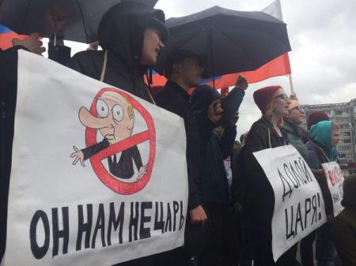
The new wave of protests has started this spring because of Putin’s re-election and inauguration.

Slide 31
Kremlin’s reaction
Persecution and harassment of the extra-parliament opposition and human rights activists
Establishing new structures and movements aimed to persecute the opposition
Passing new laws
“Informational war” against the opposition and human rights activists.

Slide 32
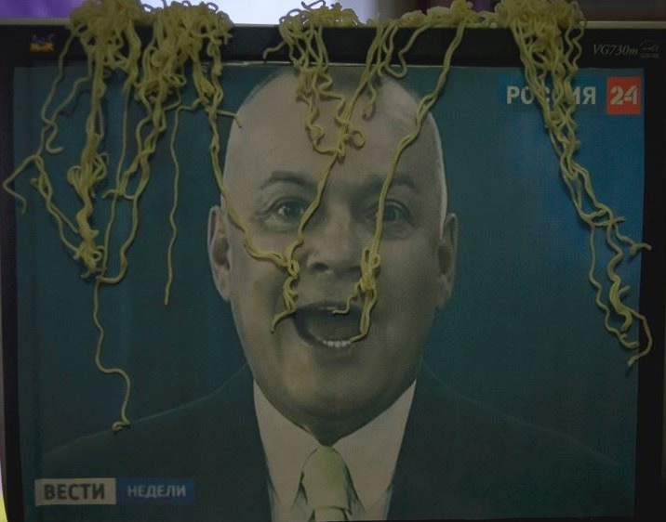
In 2017 1310 cases of disinformation were registered in Russian media (the East Stratcom report)

Slide 33
In this flow of disinformation we can identify the certain blocks (the main messages):
The Western world is undemocratic and unsafe
Russia is innocent but persecuted by the West and blamed falsely
Negative image of Ukraine (Ukraine is not a real state, Ukrainian people are fascist and xenophobes)

Slide 34
Pro-kremlin structures and movements
The Center for Combating Extremism of the Russian Ministry of the Interior (or The Center “E”) – was established in 2008. They define as “extremism” almost any political activity which does not fit official Kremlin doctrine. 'Because their targets are unclear, and the officers lack the imagination to change their methods, they arrest more or less anyone who is politically active.'
“The Young Guard” (Molodaya Gvardiya) – the pro-Kremlin youth movement organized by The United Russia in 2005. Now its leader Denis Davydov says that the organization “plans to create groups for combating political opposition in each region of Russia”.
“Nashi” (“The Ours”) - the pro-Kremlin youth movement organized by the President Administration and existed between 2005 and 2013. The main goal: combating the political opposition and “color revolution”. Methods: picketing, harassment, bullying, threatening, breakdown of oppositional activities.
“Sut’ Vremeny” (“Essence of Time”) - the youth patriotic conservative movement organized by Sergey Kurginyan in 2011. The movement has its own ideology based on Kurginyan’s works and exploits “leftist” ideas. The aim is to combat “color revolutions”. The movement positions itself as “the alternative opposition”.

Slide 35
The National Liberation Movement (NOD) - the ultra-conservative movement originated in 2012 and aimed to combat the political opposition and “the fifth column”. It looks like the hybrid of “Nashi” and “Essence of Time”.
“Antimaidan” – the pro-kremlin public movement originated in 2015. It opposes to any attempts to change the government. This movement appeared under the big influence of Kurginyan’s Essence of Time.
“Yunarmiya” (The Young Army) – the very new patriotic military movement created for work with children.

Slide 36
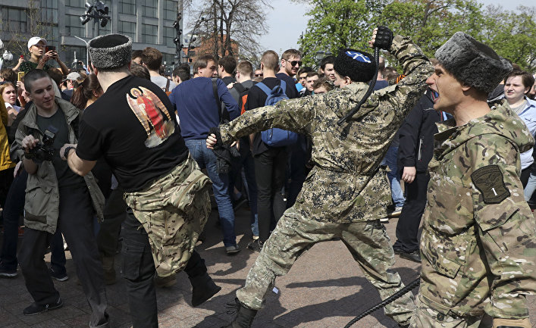
cossacks

Slide 37
“The patriotic stop-list” in Russia
“The patriotic stop-list” was released by the Federation Council in July 2015.
It is the list of foreign organizations whose activity in Russia is considered as undesirable. It means prohibition on physical presence, recruitment, promotion.
It includes amongst others MacArthur Foundation, Open Society Institute (Soros Foundation), National Empowerment for Democracy, Freedom House, Education for Democracy Foundation (polish “Fundacja Edukacja dla Demokracji”), East European Democratic Center, Crimea Field Mission on Human Rights etc.
The inclusion into the stop-list of Amnesty International and Human Rights Watch are being discussed.

Slide 38
Factors contributed to de-democratization in russia
Lack of a long tradition of democratic development
Etatism (primacy of the state over the civil society)
Weak civil society and its institutions
Institutional crisis and weak control over bureaucracy
The Russian Orthodox Church (its alliance with Putin’s regime)

Slide 39
How can we explain the political twist from democracy to authoritarianism?
1. The “resource curse” or the paradox of plenty
2. “Dilemma of simultaneity”
3. Others

Slide 40
Resource curse
The “resource curse” or the paradox of plenty. The term was introduced by Richard Auty in 1993.
Some countries with plenty of natural resources are less developed and politically more fragile than countries with a little amount of resources.

Slide 41
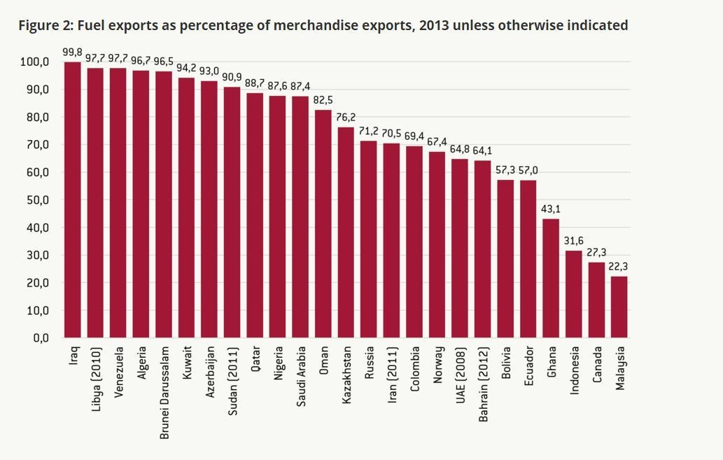

Slide 42
There are 15 countries with the most fuel-dependent economics (fuel account more than 70% of total exports): Iraq, Libya, Venezuela, Algeria, Brunei Darussalam, Kuwait, Azerbaijan, Sudan, Qatar, Nigeria, Saudi Arabia, Oman, Kazakhstan, Russia and Iran.
According to the level of oil-dependency Russian economics is located between Kazakhstan and Iran.

Slide 43
However Russia can be hardly called “the rentier state”. Over past decades the percentage of the budget delivered from oil and gas has increased from 30 % to 50 %. But it is still much less than the comparative figure of 92 % in Saudi Arabia.
Between 25 % and 35 % of export revenues still come from non-energy sources, mainly military hardware.
Thus the trap of “resource curse” cannot be considered as the main cause of the deterioration of the situation in Russia.

Slide 44
“Dilemma of simultaneity”
This term was introduced by Claus Offer to describe the specific situation for post-communistic regimes when they have to undertake multiple transformations for relatively short period.
To transform one-party regimes into competitive democracies.
To transform planned economy into market-based mechanisms.
To transform imperial structure into national states.
The Western countries had passed the long way of nation-building before they formed basis of capitalism and only after that they started democratic reforms. However Eastern-European post-communistic countries had to solve all those tasks simultaneously. Those countries that passed through transformations relatively successfully did it mostly due to external political factors. The main of these factors was the intention to become the part of Europe and dissociation themselves with Russia.
This way was hardly possible for Russia and its transformations were determined by internal factors.

Slide 45
The idea that successful economical development is possible (and even preferable and desirable) in the context of authoritarian regime appeared in Russia on the very early stage of transformation (before the USSR collapse).
The political crisis of 90th was resulted in the “super-presidential” Constitution of 1993.
Though Yel’tsin didn’t create authoritarian regime he formed all necessary circumstances for it.
Russia rejected the idea of simultaneous transformation (toward democracy and toward capitalism).
Democratic freedoms and rights were considered as less valuable in comparison with economical development.
Rejection of political modernization in favor of improving of economics.
Since the very beginning of Putin’s governance attempts of economical modernization have been gone hand in hand with restriction of political competitiveness and limitation of civil liberties.

Slide 46
How can we define the current regime in Russia?
Hybrid regime (e.g. Ekaterina Shulman)
Authoritarianism
Personalist autocracy (Barbara Geddes)
New autocracy
Authoritarian regime with elements of totalitarianism
Kleptocratic authoritarianism (Karen Dawisha)

Slide 47
Hybrid regime
Also called “particular democracy” or “empty democracy” (or even “illiberal democracy”). It is a political regime that has some formal attributes of democracy (e.g. elections, multi-party system) but in fact that is not a real democracy. The hybrid regime is a transitive form. Specifity of hybrid regimes is their flexibility and adaptiveness (in contract to pure authoritarian or totalitarian regimes). Another specific feature is ideological unclearness (unclear combination of contradictory doctrines).
Russia and Venezuela are considered as hybrid regimes by majority of scholars who use this term. Other examples: Egypt, Turkey, Indonesia, Tunisia, Malaysia, Tanzania, Uganda, Serbia.
Among Russian political scientists this term is used by Ekaterina Shulman.

Slide 48
Why does it suit for describing Russia?
There is multi-party system but parties do not participate in political decision making process. The ruling party “United Russia” implements serving functions.
There is a division on executive, legislative and juridical branches of power but in fact they are not independent. Courts associated themselves as a part of the state machinery.
High level of corruption
The Constitution guarantees all liberal rights and freedoms but many new legislative acts restrict them significantly.
These are plenty of media resources and the power seeks to control them but usually indirectly rather than directly.
The government is not accountable to the Parliament
What are the main disadvantages of this term?
It is too unclear and can be used for description of many different regimes which have little in common with each other (for instance, it can be used for authoritarian regimes as well as for “defected democracies”). It is disorienting rather than clarifying. When we use this term as an explanatory tool (not as a description) we can wrongly apply the inner logic of defected democracy to authoritarian regime. This can be resulted in unreasonable optimism.

Slide 49
Authoritarianism
This term is the most common definition used for defining the current political regime in Russia. According to The Economist Intelligence Unit’s Democracy Index Russia is an authoritarian state as Iran, Cuba, Afghanistan and Libya.
Criteria:
Political pluralism and electoral process
Civil liberties
Involving into politics
Functioning of the state
Political culture

Slide 50
Russia can be define as an authoritarian regime in many different ways.
Russia is a full-scale autocracy (Luke March, Larry Diamond, Steven Levitsky, Lucan A. Way, Graeme Gill, Vladimir Gel’man and others)
Russia is a personalist autocracy (Barbara Geddes, Joseph Wright, Erica Frantz)
Russia is a new authoritarianism
Russia is a new totalitarianism (Masha Gessen)
Russia is a kleptocratic authoritarianism (Karen Dawisha)

Slide 51
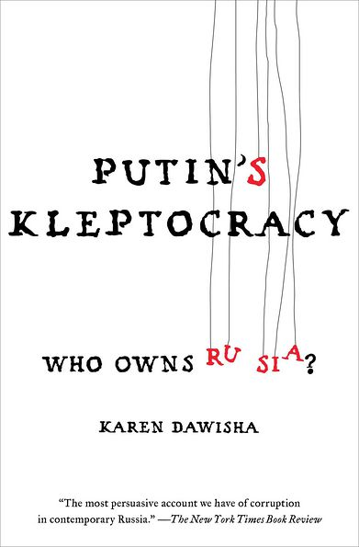
Kleptocracy
It is a government with corrupt leaders (kleptocrats) that use their power to exploit the people and natural resources of their own territory in order to extend their personal wealth and political powers.
For describing situation in Russia this term is used by the American political scientist Karen Dawisha.

Slide 52
Is Russia a real kleptocracy?
110 individuals control 35 % of country wealth.
More than 50% of adults have total household wealth of $ 871 and lower.
$ 871 is median in Russia
$ 1.040 is median in India

