Slide 1
Far Right in the Balkans
Věra Stojarová
CDS 441 Far Right and Left Parties

Slide 2
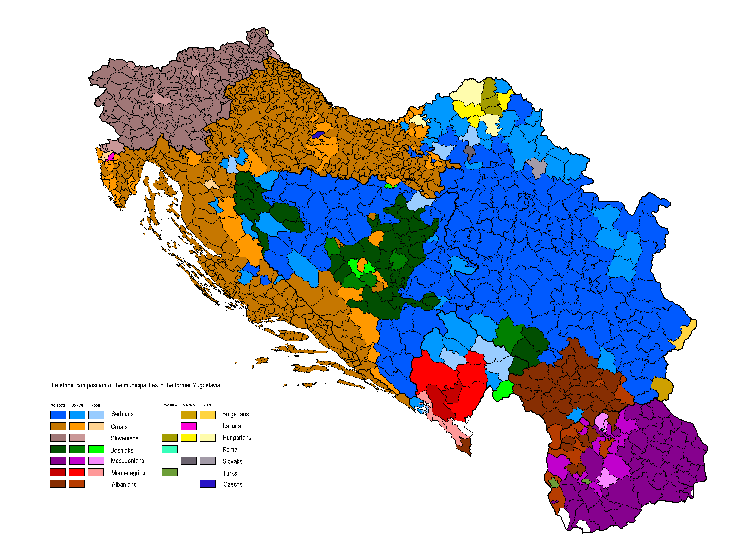
Identity and nation/state building
History
Language
Culture
Religion
Common feeling

Slide 3



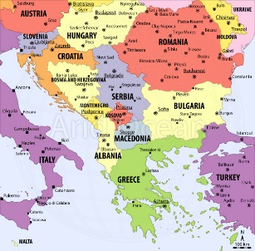


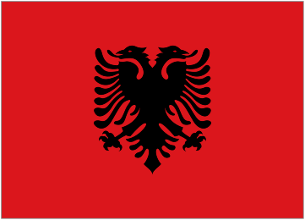
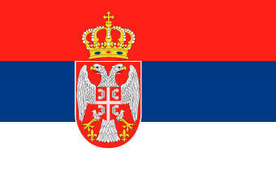
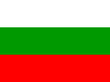

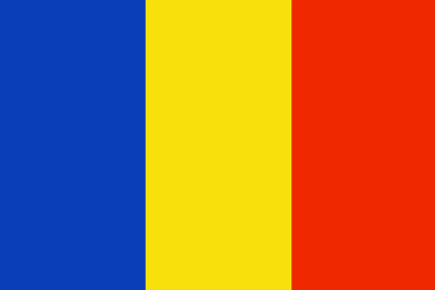
Main features of Slovenia and the Western/Eastern Balkan states
What is Balkan? Western Balkan, southern, eastern??
Dates: (395, 1054, end of 14, century, 1453)
Dissolution of yugoslavia into what??
Nations, ethnics, religions, language, script, lliteracy, life standard

Slide 4
Timeline
1991 Slovenia
1991-95 Croatia
1992-95 BiH
1997 Anarchy in Albania
1998-99 Kosovo
2000 Presevo valley
2001 Macedonia
2003 Belgrade agreement
2006 Montenegro
2008 Kosovo

Slide 5
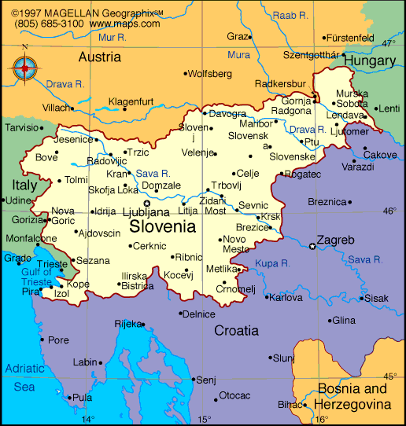
Slovenia
10 days war
Italian, Austrian, Hungarian national minority
2.3.2004 NATO
1.5.2004 EU
Slovenian national party – very weak far right
very weak coalition potential, since 2011 out of parliament
Fractions, splits
Anti-Roma, legalisation of weapons, Greater Slovenia, euroscepticism
Mainstreaming of nationalism by Slovenian democratic party

Slide 6
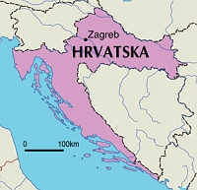
Croatia
1991-1995 civil war
12% serbian population drop 5 %
1990-1999 president Franjo Tudjman, authoritative regime, semipresidentialism, suppresion of serbian minority, strongest HDZ
NATO 2009
2013 EU
HSP – very weak
Mainstreaming of nationalism
WWII, Ustaša, state symbols, chessboard, kuna, Day of Victory, Jasenovac,Serbs, Romas, homosexuals,
Names of squares and streets
Popular culture- Thompson
https://www.youtube.com/watch?v=EdcA-lGKvmk
War veterans https://www.youtube.com/watch?time_continue=13&v=lL4jwt_1WN8

Slide 7
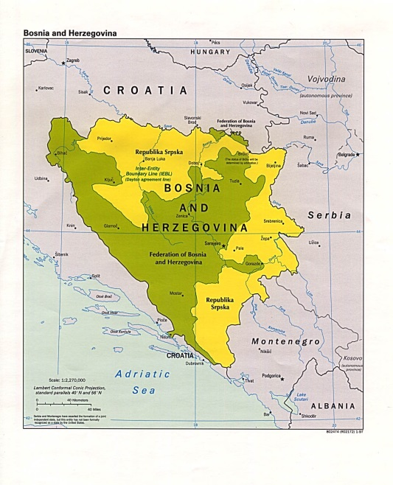
Bosnia and Herzegovina
3 ethnics: 17%Croatians, 31% Serbs,44 %Bosniaks
Civil war 1991-1995
BiH divided into 2 entities Federation of BiH and RS
High representative (since 2009 Valentin Inzko)
UN protectorate, missions NATO (IFOR, SFOR, SFOR II), EU Althea
Sarajevo agreement 2002 changed Dayton – all institution have to reflect the ethnics according to the census in 1991
3 main parties based on the ethnicity: HDZ, SDS, SDA.
All main parties based on nationalism

Slide 8
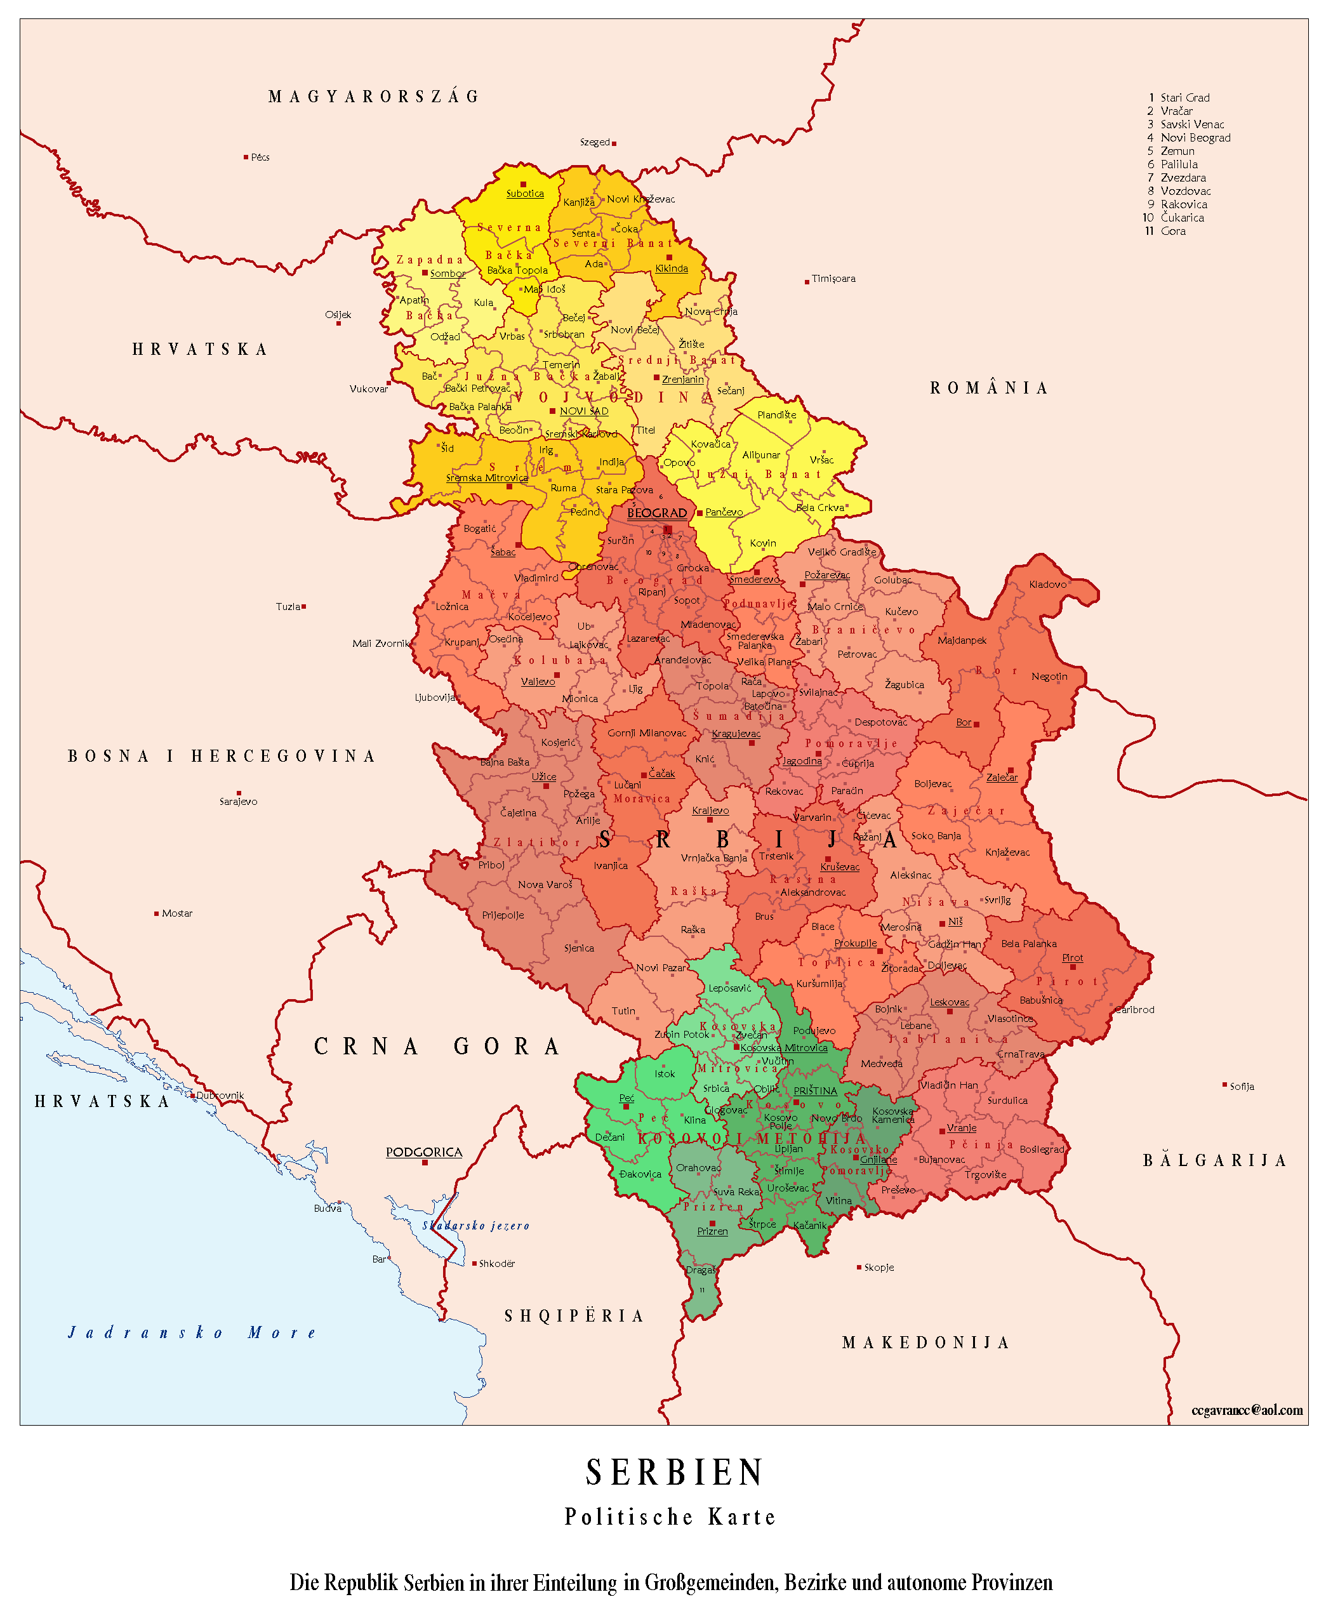
FRY: Serbia (and Monte Negro)
FRY
Slobodan Milošević (1989 -1997 president of Serbia, 1997-2000 president of FRY authoritative regime
War in Croatia, BiH
Kosovo: Serbian forces vs. KLA 1996-1998; war of NATO vs. Serbia 1999)
Decentralisation of Vojvodina
Belgrade agreement 2003
2006 – independence of Montenegro
2008 – independence of Kosovo

Slide 9
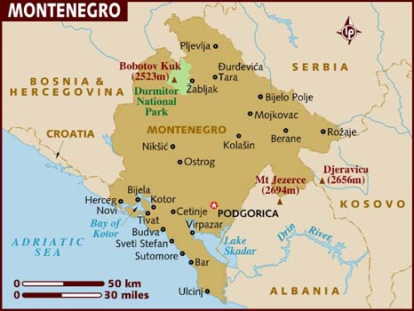
Monte Negro
Milo Djukanovic forever
Organized crime, nepotism, clientelism
Orientation towards east as well west
undemocratic régime Key to stability
No far right

Slide 10
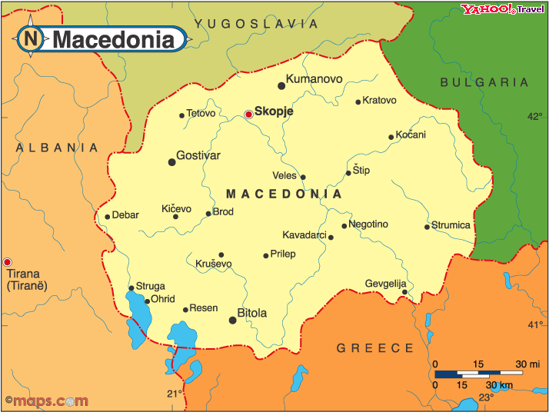
Macedonia
Independence complicated :
Greece
Bulgaria
Serbia
Albanian irredentism 2001 Ohrid peace agreement
Far right marginal

Slide 11
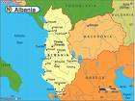
Albania
Gegs vs. Tosks
The only national minority
Far right marginal

Slide 12
Kosovo
Autonomous province of Serbia
Great powers since 1974
Limitation of the authonomy since the 1980´s
1996-99 war alb vs srb
1999 NATO air campaign (bombing)
2003 Constitutional framework
17 February 2008 self-proclaimed independence
111 UN member states recognized independence
Far right???

Slide 13
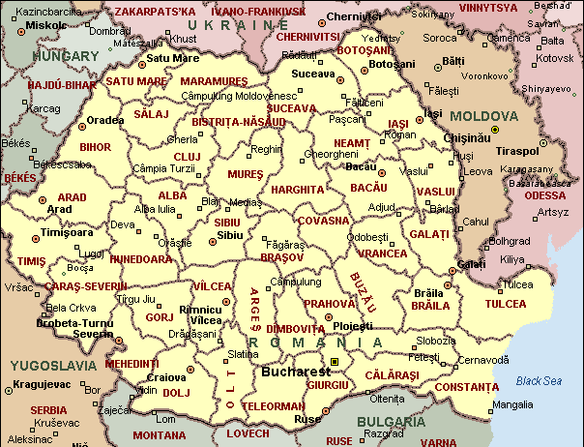
Romania
Hungarian and Roma minority
Moldova issue
Greater Romania Party

Slide 14
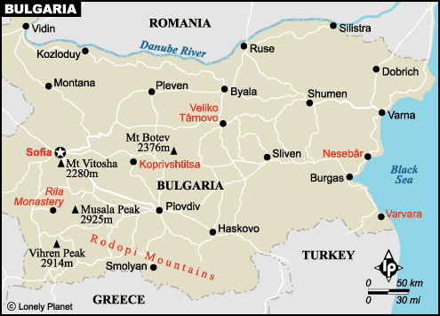
Bulgaria
2004 NATO
2007 EU
Turks
Turkish Movement for the rights and liberties
2009 GERB
Ataka

Slide 15
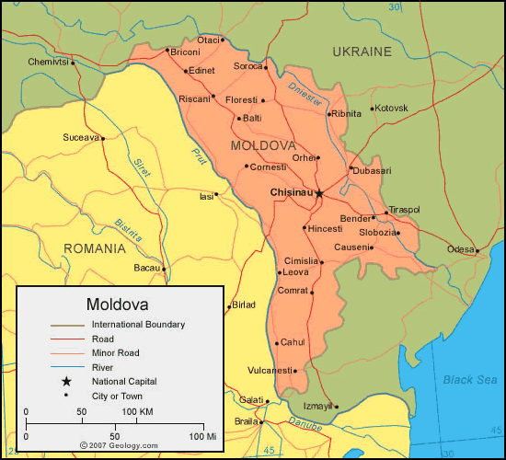
Moldova
Transnistria
Communist party in power till 2009
Demonstrations for unification with Romania

Slide 16
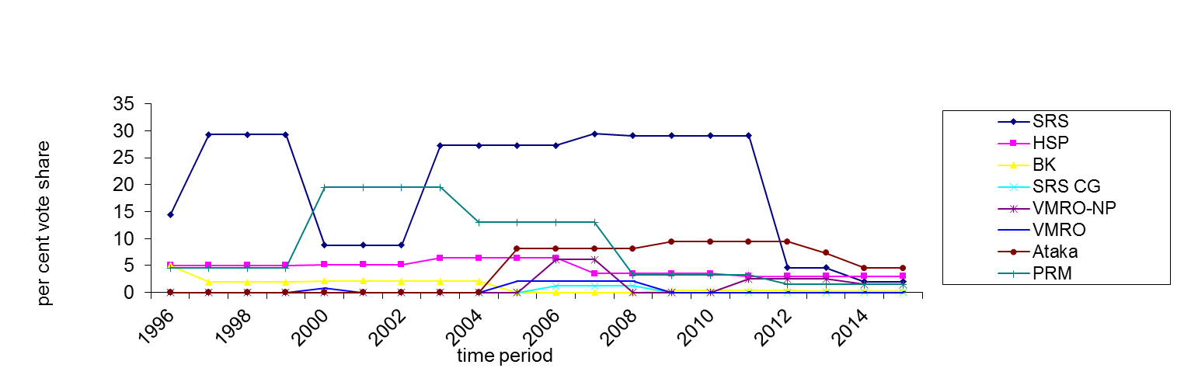
Gra I: Percentage Vote Share of Far Right Parliamentary Political Parties in the Balkans since 2000^{[1]}
^{[1]} Data retrieved from the Adam Carr Archive and Šedo 2007 and rounded up. Data for 1992 Croatia related to the proportional portion of the votes won, data for the 1997 elections in Albania to the total percent proportion (both the proportional and majority components) of seats for the party.
The most successful far-right parties--the case of Serbia, Romania and Bulgaria,
far-right parties gain a smaller number of mandates every election– the case of Croatia, Montenegro and Albania
Unsuccessful far-right parties ─ the case of Macedonia
Notes:
None government representation since 2000
Second Ataka and PRM
The only parties consistently winning seats since 1992 – SRS, HSP, PRM
Presidential elections – very close for SRS and Ataka, PRM
Weaker to their counterparts in WE
No WE party reached 29 percent as SRS (FPO 27percent 1999), SVP 26,6 in 2003

Slide 17
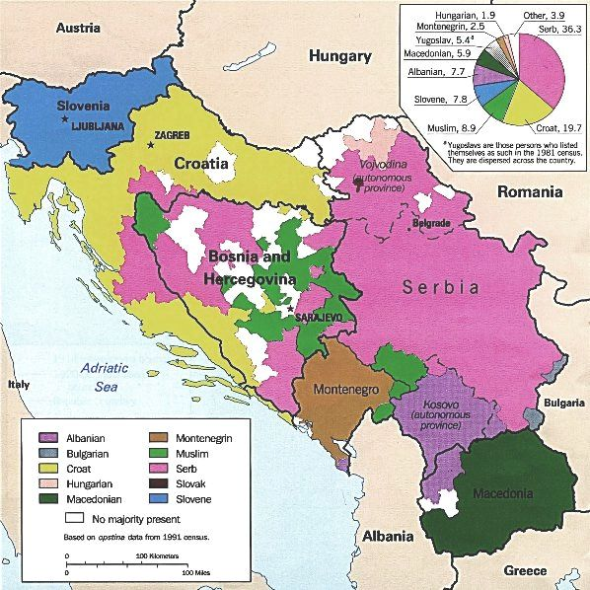
Ideology and country specifics
the position of the countries concerned during the World War II
the question of national minorities
position towards the West and globalization

Slide 18
Ideology of Balkan Far Right Parties
 | HSP* | SRS | VMRO-NP | BK | VMRO | Ataka | PRM
Nationalism – external exclusivity | X | X | - | X | X | - | X
Nationalism – internal homogenisation | X | X | X | X | X | X | X
Xenophobia | X | X | X | X | X | X | X
Law and Order | X | X | X | X | X | X | X
Welfare Chauvinism | X | X | NN | partially | partially | X | X
Populism | X | X | X | X | X | X | X
Antisemitism | - | X | - | - | - | X | X
Anti-comunism | - | X | - | X | X | - | -
Glorification of communism | - | - | - | - | - | - | X
Negative relation towards EU and NATO | X | X | - | - | - | X | -
Support for integration into EU and NATO | - | - | X | X | X | - | X
Anti-islamism | - | X | - | - | X | X | -
Economic liberalism | NN | NN | partially | - | partially | - | -
Socialist values (nationalisation, Equal wages etc.) | NN | NN | - | - | - | X | X
Notes:
Economy – secondary feature, most support nationalisation, while VMRO neoliberal partially
Similar ideological patterns as their counterparts in WE (nativism, strong state, populism revised mudde)
Not necessarily anti-NATO and EU as in WE, some even support NATO,EU
As immigration not issue, also different to WE

Slide 19
The causes of the success and political opportunity structures
Position, tactics and strategies of the main political parties
the electoral system
the political boundaries of states
ethnic boundaries
ethnic minority group with strong political representation
Other political and economic variables have supporting function.
Each country is unique and it is always a unique set of variables. Cultural variables are fundamental prerequisite in particular in the case of Romania, Serbia, and Bulgaria while the international factor is important in particular in the case of Albania and Serbia.
Notes:
Level of unemployment not important
Post-materiál dimension as in WE not important
Internatinal factor – humiliation in Serbia

Slide 20
Internal organisation and party leadership
 | HSP | SRS | VMRO-NP | BK | VMRO | Ataka | PRM
Charismatic leadership | - | x | - | - | - | x | x
Efficient mechanism for strenghtening party discipline | x | x | x | x | - | x | x
Centralized organizational structure | x | x | x | x | - | x | x
Notes:
Šešelj skilful orator in front of ICTY
Party leaders have exklusive privilages, low number of female members, the only party with woman on high rank - ´BK
Leadership of the parties not changed since the foundation
Vadim Tudor long speeches, demonizing opponents

Slide 21
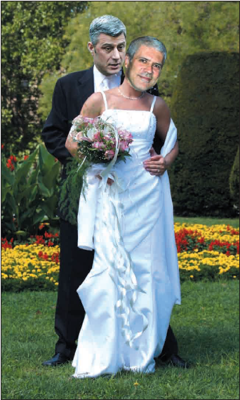

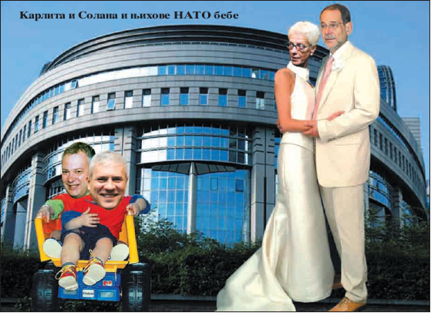
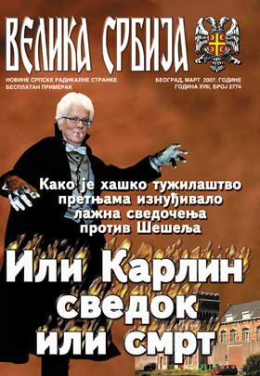
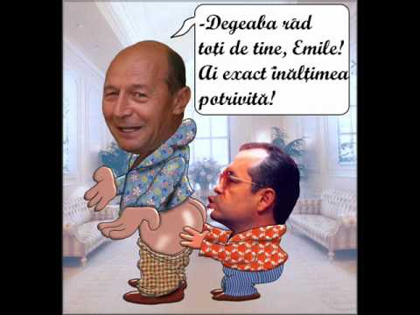
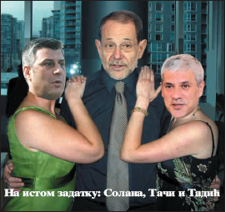
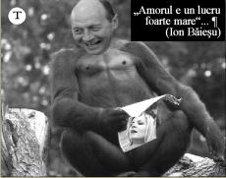
Strategy and tactics
Notes:
Media – books, tv, internet
Volen Siderov close to Skat television, PRM very influential newspapers, strong in municipalities – anti-Hungarian emotions (igen, mathias rex –hungarorum)
Language, emotions, fear, conspiracy theories
Rallies, protests

Slide 22
Voters of the Far Right
Electorate composed by young men, with the exception of Romania
Electorate strongly religious (in contrast to Far Right electorate in Western Europe)
Mainly peasants and blue – collar workers with lower level of achieved education
Notes:
Romania – old longing for ceausescu régime
Lack of university education similar with WE

Slide 23
Far Right and Legislative implementation in practice
Anti-discriminatory legislative being adopted slowly
The enforcement of hate-speech and anti-discriminatory legislation in Romania and Bulgaria the best
Rest of the countries – enforcement remains poor
Notes:
- Banning the party very rare – czech republic workers party in 2010 but setting new party
- 1966 UN INT Convention on elimination of all forms of racial discrimination
- Constitutions prohibiting formation of parties based on racial ehtnic or religious grounds
- Vadim Tudor: „during the 1993 pogrom, the Romanians were just defending their ‘ honour ’ against the ‘ gypsy rapists and thieves ’ who wanted to ‘ slaughter ’ them and called on the state
authorities to protect the ‘ peaceful villagers ’ against ‘ the bloody anger of a
few brutes ’. – Tudor having parliamentary immunity

Slide 24
In terms of conclusion…
The Far Right Party family is very heterogenous group
Softer variant: VMRO-NP, Ataka (the only parties displaying nationalism only in terms of internal homogenisation)
Harder variant: SRS, SRS CG, HSP, BK, VMRO, PRM, PNG-CD (both internal homogenisation as well as external exclusivity)
CATHEGORISATION REMAIN FLUID
Cooperation between parties utopia, only mother parties

Slide 25
In terms of Conclusion…
Far Right in WE gains higher percentages in the elections, however no WE far right party received 29 % as SRS did in 2008, 2009
the only successful parties: SRS, Ataka and the PRM
influence on the political scene has a decreasing tendency
FAR RIGHT PARTIES NOT PARTICULARLY SUCCESSFUL
Illiberal tendencies and EU fatigue

Slide 26
Seminar: Draw best multicultural/multilevel state
Choose any real or imaginatory state (yugoslavia, ussr, bih, panslavia, panbalkania, mitteleuropa, austro-hungarian empire etc..)
At least three different ethnics/religions/languages (e.g.30%,20%,50%)
political system (executive, legislative, judicial powers, based on percentage/wealth)
identity (religion, state holidays, language, schools)
IDs, passports, street signs, communication with state etc., teaching of history, state symbols,interaction and intermarriages
Belgium constitution https://www.constituteproject.org/constitution/Belgium_2014.pdf?lang=en
Yugoslavia consitution 1974 http://www.worldstatesmen.org/Yugoslavia-Constitution1974.pdf
India consituttion http://lawmin.nic.in/olwing/coi/coi-english/coi-4March2016.pdf

