Slide 1
Far Left in WE
Věra Stojarová
CDS 441 Far Right and Left Parties

Slide 2
FAR LEFT (Luke March)
»Far left« parties are those that define themselves as to the left of, and not merely on the left of social democracy, which they see as insufficiently left-wing or even as not left-wing at all. There are two main subtypes.
Radical left parties
Extreme left parties

Slide 3
Radical left parties
want »root and branch« systemic change of capitalism.
accept democracy (verbally at least), although they often combine this with (often vaguely defined) aspirations towards political reform and/or direct democracy and local participatory democracy, including incorporating the rights of the excluded and marginalised (for example, the unemployed and migrant workers) in the political system.
Their anti-capitalism involves opposition to »neo-liberal« globalised capitalism, broadly associated with the so-called »Washington consensus« – trade liberalisation, marketisation, privatisation, and so on, although these parties no longer support a planned economy but a mixed market economy with private enterprise confined to services and small and medium-sized enterprises.

Slide 4
Extreme left parties
»Extreme left« parties, in contrast, have far greater hostility to liberal democracy, usually denounce all compromise with »bourgeois« political forces, including social democracy, emphasise extraparliamentary struggle and define »anti-capitalism« far more strictly, usually regarding most market enterprise as anathema.

Slide 5
Far Left in Europe
de-radicalisation.
The extreme left is marginal in most places – except France, Portugal and Greece

Slide 6
Far left subgroups (
Luke March)
Communists
Democratic socialist parties
Populist socialist parties
Social populist parties

Slide 7
Communists
»conservative« communists certainly tend to define themselves as Marxist-Leninist,
uncritical stance towards the Soviet heritage
see the world through the Cold-War prism of »imperialism«
»Reform« communists, on the other hand, are increasingly divergent and eclectic. They have discarded aspects of the Soviet model (for example, Leninism and democratic centralism in the case of Italy, France and the Czech Republic, significant opposition to the market economy in the case of France and Cyprus), and have adopted, or at least have paid lip service to, elements of the post-1968 »new left« agenda (feminism, environmentalism, grass-roots democracy…)

Slide 8
Democratic socialist parties
both in opposition to »totalitarian« communism and »neo-liberal« social democracy
»new left« themes such as feminism, environmentalism and self-management
local participation and substantive democracy, and support for alternative lifestyles and ethnic minorities.
The chief advocates of this position are the »Nordic Green Left« parties in Iceland, Norway, Sweden, Denmark and Finland, who have most clearly articulated an »eco-socialist« position that synthesises economic and environmental critiques of capitalism

Slide 9
Populist socialist parties
with a stronger anti-elite, anti-establishment appeal, greater ideological eclecticism and emphasis on identity rather than class concerns (especially regionalism, nationalism or law-and-order issues).
Typical of this populist slant were the election slogans of the Dutch Socialist Party in the 1990s: »Vote Against!« (Stem Tegen!) and the German PDS (in 1994), arguing that »Election Day is Protest Day« (Wahltag ist Protesttag).

Slide 10
Social populist parties
classical populist movements (for example in Latin America), with a dominant personalist leadership, relatively weak organisation and essentially incoherent ideology, fusing left-wing and right-wing themes behind an anti-establishment appeal.
defunct Association of Slovak Workers, the Serbian Socialist Party under Milošević, Slovakia’s Smer (Direction), the Lithuanian Labour Party and the Russian »Just Russia« party.

Slide 11
Main European far left subtypes (Luke March)
 | Radical left | Extreme left
Reform communist | KSČM, Communist party of Spain, Italian communists, french communist party, progressive party of working people in cyprus
Conservative communist | Left Alliance (Finland) (VAS), Left Party (Sweden) (V), Socialist People’s Party (Denmark) (SF), Socialist Left Party (Norway) (SV), Left-Green Movement (Iceland) (VG), Left Bloc (Portugal) (BE), Coalition of the Left, of Movements and Ecology (Greece) (Synaspismós) | Communist party of greece, communist party of Slovakia,portuguese communist party, communist party of latvia
Democratic socialist |  | Red-green alliance denmark
Populist socialist | Socialist party netherlands, scottish socialist party, Die Linke, Sinn Fein | New anti-capitalist party france
Social populist | Association of Slovak workers, Sebian Socialist Party

Slide 12
Responses to collapse of communism
1. renounce the »communist« label. For some – the Swedish Left Party-Communists, which became the Left Party, or the German SED – this was largely a question of renaming themselves and redefining themselves as non-communist radical left parties.
2. transformed into fully-fledged social democratic parties
3. took on an increasingly nationalist–populist tinge
4. ceased to exist independently and reemerged as parts of semi-permanent coalitions either of a democratic socialist orientation – such as the Spanish Communist Party which became the United Left
5. dissolved themselves more completely into post-communist coalitions of various ideologies. For example, the Communist Party of the Netherlands
6. Many parties maintained their former names and identity but sought to adapt slowly – for example, the communist parties of Greece, Portugal, France and Cyprus –

Slide 13
Causes of electoral success
Socio-political environment (a far left predecessor, high unemployment and protest sentiment, the absence of competitor protest parties and a convergent party systém)
Exploiting transformation of social democracy
Internal party adaptation

Slide 14
Who supports far left
Far left subculture
Protest voters
Disaffected centre voters

Slide 15
Competitors strategies towards far left
Exclusion
Agressive marginalisation
Pragmatic cooperation
Aggresive cooptation

Slide 16

Die Linke
Successor party to SED (Socialit Party of Unity of GDR)
Anti-capitalism and democratic socialism as a goal
Observed by the Constitutional Court
Global disarmament
Replacement of NATO with collective security including Russia
Bundestag: 69 out of 709 MPs, on local level somewhere in the local governments

Slide 17
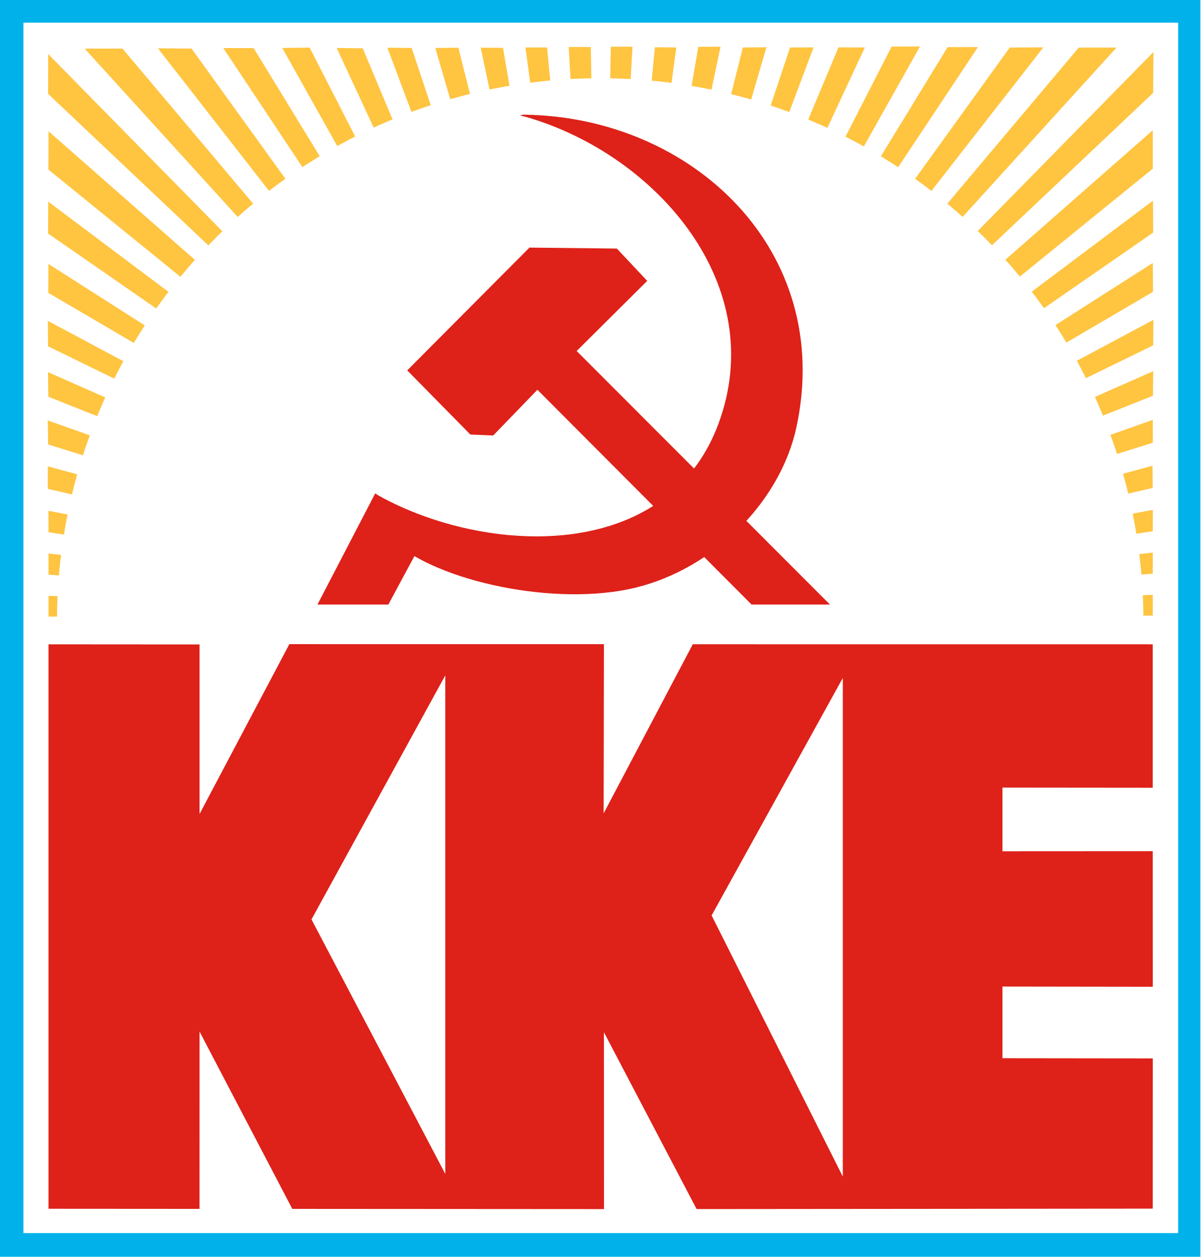
Greece Communist Party
1946-49 civil war, loss of communists
1967 Regime of the colonels and Georgios Papadoupulos
Junta régime and supresion of civil liberties
KKE outlawed till 1974
2017: 15 out of 300 MPs
Against LGBT rights
Opposing the macedonia –greece name negotiation deal
https://inter.kke.gr/en/articles/D-Koutsoumpas-the-interest-of-the-USA-NATO-EU-in-the-Balkans-is-dangerous-for-th-peoples/

Slide 18
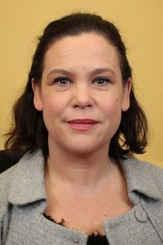
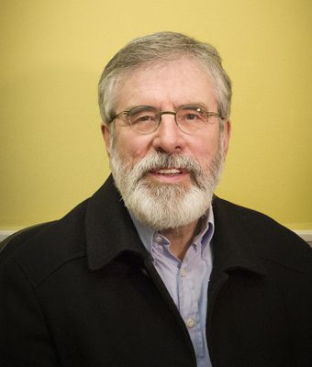
Sinn Fein
Left-wing nationalism
Both in Northern Ireland as well as Ireland
United ireland
From anti-EU to for-EU
Same sex marriage to NI
Abortions – the decisions must stay with women (rape, incest, faetal abnormalities)
Building an Ireland of equals
Mary Lou Mc Donald since 2018 (after Gerry Addams in office 1983-2018)

Slide 19

Socialist Party Netherlands
14 out of 150 MPs
Set up in 1971 as Communist Party of the Netherlands/Marxist–Leninist

Slide 20
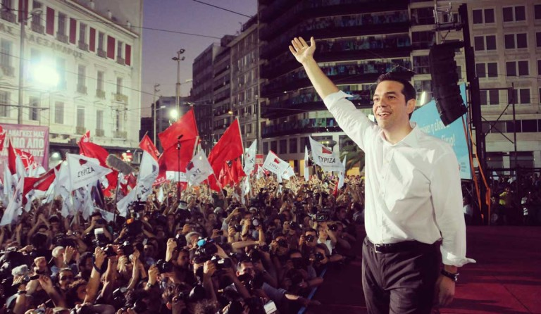
Syriza
Launched in 2004
Merger of many leftist parties : social democrats, democratic socialists, left-wing patriots, feminists, anti-capitalists, centrists, and environmentalist groups; as well as Marxist–Leninists, Maoists, Trotskyists, Eurocommunists, Luxemburgists, and Eurosceptics.
Anti-establishment party
Declares no space for euroscepticism, though seen as mildly eurosceptic
In coalition government since 2015

Slide 21
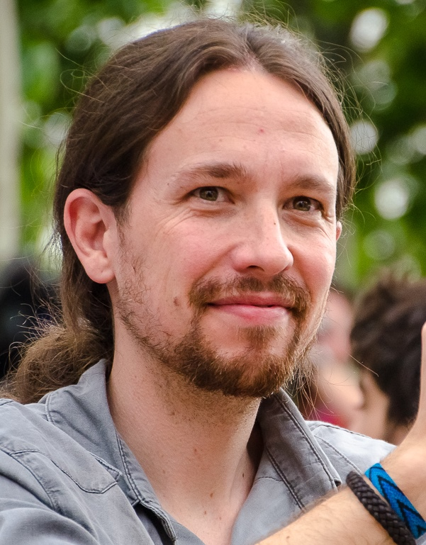

Podemos
Set up 2014 as protest party
Against inequality and corruption
Ending of traditional two party systém in spain
47 out of 350 MPs in opposition
Pablo Iglesias

Slide 22

Left Bloc (BE)
1999 as a merger of trotskyists, marxists,
For same sex marriage
Rights of workers
19 out of 230 MPs in 2017

Slide 23
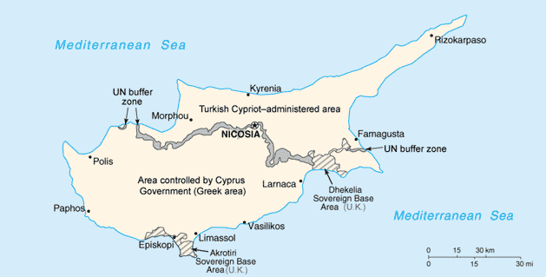
Progressive Party of Working People in Cyprus - AKEL
Independent, demilitarized, federal Cyprus
Major political player – 2001 – 22 out of 56 MPs, coming first or second in the elections
(1960 Cyprus granted independence, 1974-1983 Turkish invasion and Northern Cyprus, de iure sovereignity over the whole island, de facto partitioned 59:36 plus UN buffer zone, 2004 in the EU, 2008 eurozone

Slide 24
Seminar
Animal Farm
1984
One day in the life of Ivan Denisovitch https://www.youtube.com/watch?v=tdkvpopu0kY
Katyň https://www.youtube.com/watch?v=Q2ZYdiEE20Y
Good Bye Lenin!
Comparing totalitarian systems – hand out
Capitalism vs. Communism simulation – hand out
Choose your own advanture – hand out

Slide 25
Seminar : Find the communist!
1) There are communists in this class, and your job is to find them. You will all receive a card saying whether you are a communist or not.
2) You can win the game two ways:
a) Form the largest group of students without a single communist in your group
b) If you are a communist, you can win by infiltrating a group of non-communists
3) You may not show your card to anyone. If you show your card to anyone, you will lose the game.
4) The winning group or individual will receive a prize (candy!)
Notes:
Find the Communist!
Purpose: The purpose of this experiential learning activity was to illustrate how paranoia and suspicion impact groups of people. To get students to care, I offered a bag of candy to the winning student or students.
Procedure: Introduce it to the class as a game. Beforehand, print out slips of paper that say either “You are a communist” or “You are not a communist.” These can be very small, and should be easy to hide in one’s hand or pocket. (alternate version I tried on one class– do not give anyone a communist card)
You will want to put these rules up on the board, on an overhead or on PowerPoint:
Students will have a set amount of time (10-15 minutes) to get into groups. All members of a group must agree before they let someone in. Groups may split up and merge with other groups as necessary. In the end, the communists must reveal their identity and winners are given their prizes. In an honors class of 22 students, I assigned zero communists, but they were certain that they had identified 3.

Slide 26
Wrap-up and Discussion
1) What was your identity? Communist/not a communist
2) Were you accused of being a communist? How did it make you feel?
3) How did you convince people you were not a communist? Were you successful?
4) Did you accuse anyone else of being a communist? Why did you think they were a communist? Were they really one?
5) How did the behavior of people in our class change?

