Slide 1
Far Left in Eastern Europe
Věra Stojarová
CDS 441 Far Right and Left Parties

Slide 2
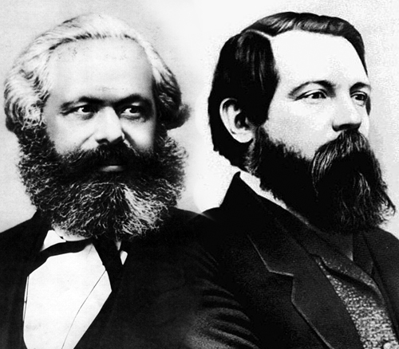
Marxism-leninism
paradigm of exploitation/Class-struggle/opressed ones proletariat (peasants) vs. Bourgeoisie (kulaks)
Leading to proletariat revolution
Goal: socialist state
revolutionaries, an organic part of the working class
"dictatorship of the proletariat", is primarily or exclusively governed by the party of the revolutionary vanguard through the process of democratic centralism
from each according to his ability, to each according to his need
Many different marxist branches

Slide 3
Communist parties
a political party that advocates the application of the social and economic principles of communism through state policy.
comunist parties are illegal in Estonia, Indonesia, Iran, Latvia, Lithuania, Myanmar, Poland, Romania, South Korea,Georgia, Hungary

Slide 4
Officially ruling communist parties
China
Cuba
Laos
Vietnam
North Korea

Slide 5
Communist parties in multi-party systems as part of ruling coalitions
Bangladesh
Chile
Ecuador
Nepal
Greece
Palestine
Portugal
South Africa
Uruguay
Venezuela

Slide 6
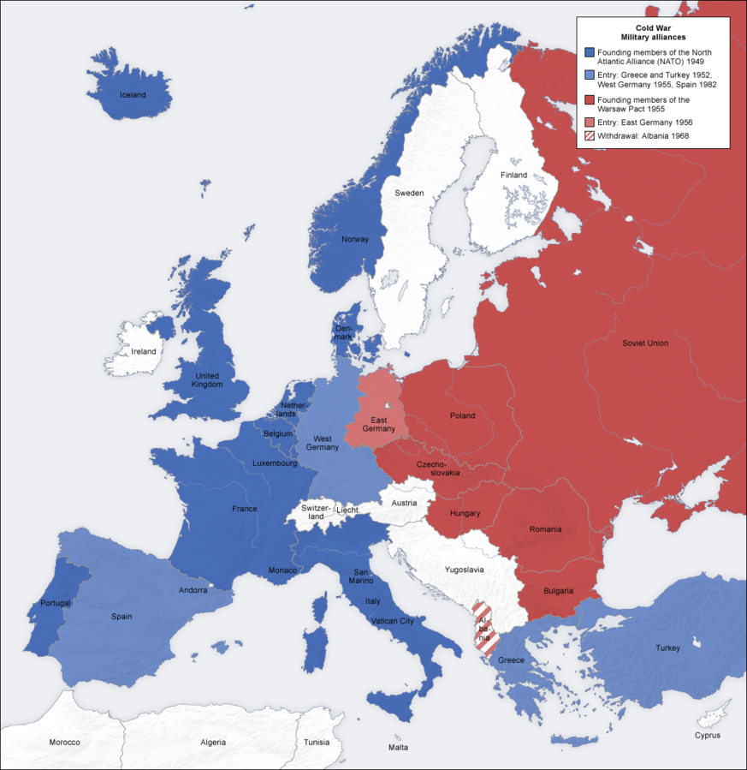

Slide 7
Soviet Union
Marxism leninism
Role of the individual as a member of the collective (not stress the individual as such)
individuals had only the right to freedom of expression if it safeguarded the interests of the collective
Centralized planned economy
Dictatorship of the proletariát
Anti-imperialism
Combat capitalism
Gulags
mass deportations of entire nationalities to uninhabited regions of the country – Soviet nationalism equals Russian nationalism
State atheism – no place for religion
Repression of kulaks
"It's not the people who vote that count. It's the people who count the votes.„
Stalin and destalinization , cult of personality
Marx – revolution will be led b y proletariat
Lenin – revolution will be led by the oprressed class therefore peasants in case of Russia
Gorbatshev and perestroika

Slide 8
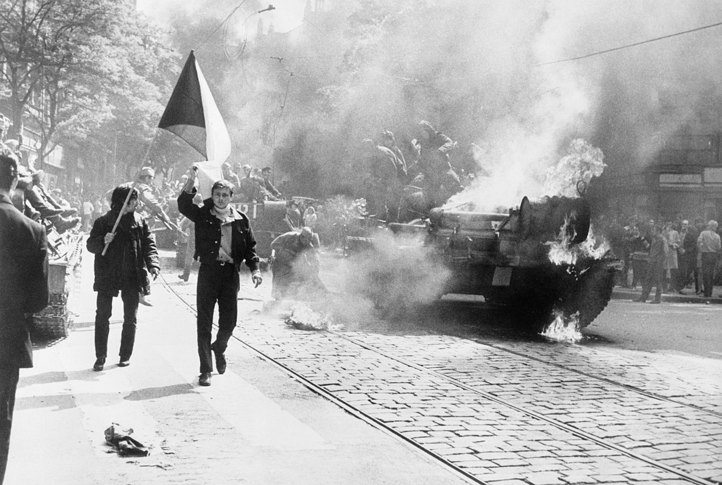
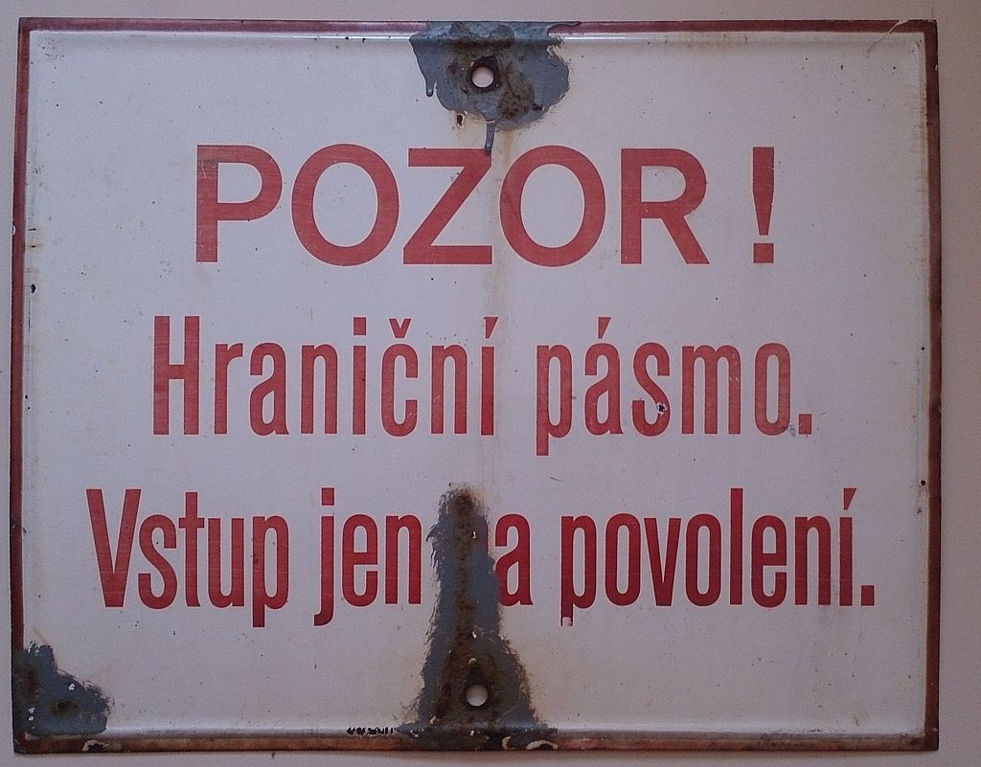
Czechoslovakia
Elections 1946
Communist coup 1948
Collectivisation
1968 Prague Spring – democratisation, federalisation
Warsaw Pact intervention
Jan Palach set himself on fire 1969
Normalization
Dissent – Charter 77
Velvet Revolution 1989

Slide 9
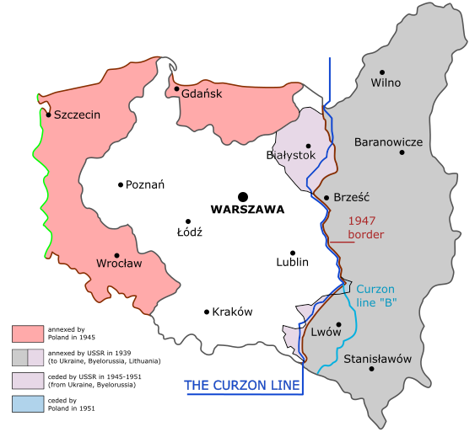
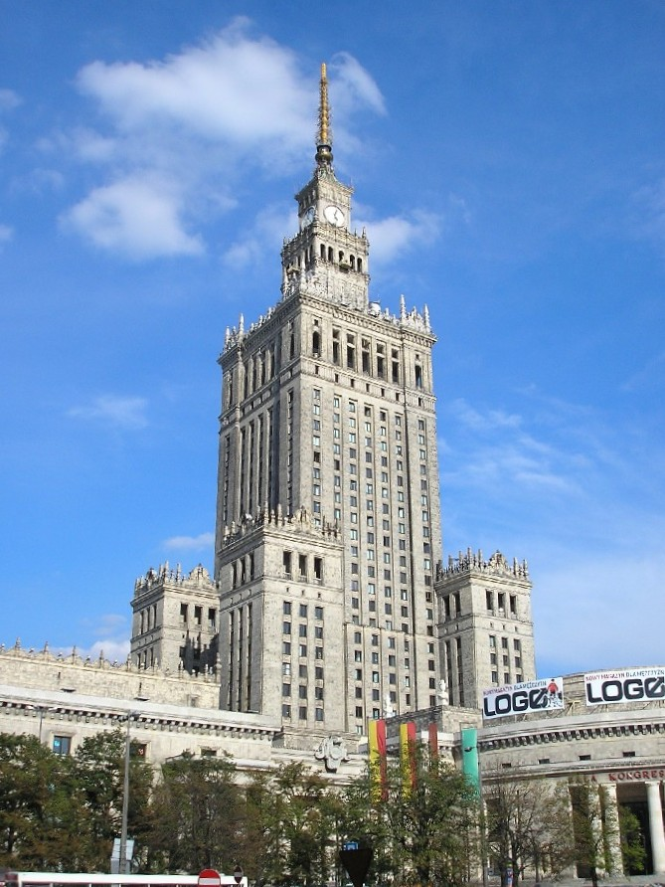
Poland
Katyň massacre
Shift of the borders, expulsion of Germans,
Destruction of Jewish community, resettlement of Ukrainians
Ethnically homogenous state
1956 protests and pragmatic relations with Soviet Union
Initial releive and then move back on the promises
Regime undder Gomulka one of the most „liberal“ in EE
1978 John Paul II
1980 Gdansk strike
round table with Solidarity

Slide 10
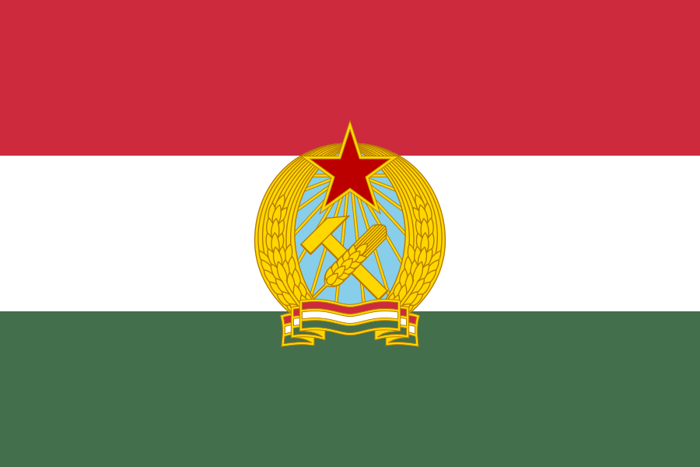
Hungary
1956 uprising and the Soviet army invasion
20,000 Hungarians killed other 20 000 imprisoned, 250 000 fled the country as the borders were briefly open
Goulash communism – introduced free market elements
Less restricted travel rights, less censozer media

Slide 11
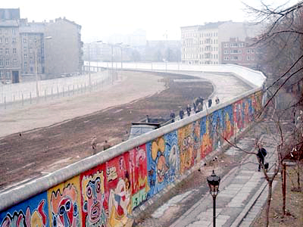
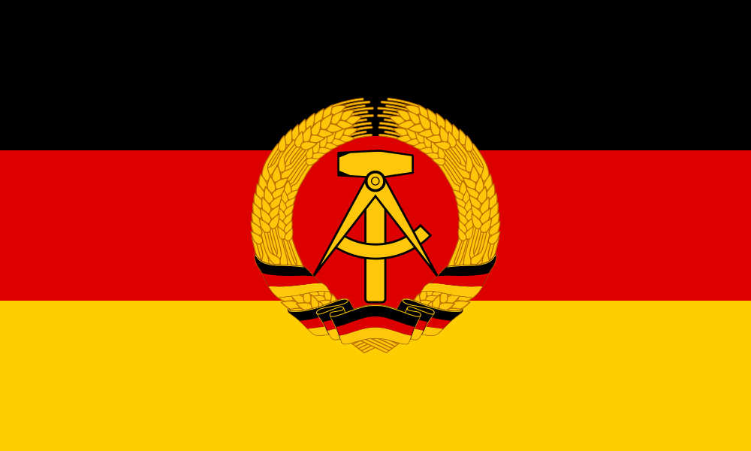
GDR
1949 DDR
1953 uprising supressed
1989 refugees from GDR in the West German embassy in Prague, Hungarian embassy
3 October 1990

Slide 12
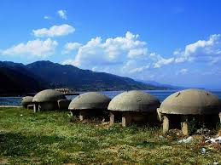

Communism in Albania
Cultural and ideological revolution
Abolition of religion
Isolation (fear of the outside world)
Repression of clan system and clan leaders
Radical change in the status of Albanian women
Stalinism, enverism, titoists (traitors)
Repression (Sigurimi)
Technological backwardness

Slide 13
Communism in Romania
independent foreign policy (protested against the invasion of Warsaw pact into Czechoslovakia
brutality of the régime, secret police, censorship, massive relocations
influenced by the Juche philosophy of North Korean President Kim Il Sung.
food rationing was introduced on a wide scale (the government promoted it as "a means to reduce obesity" and "rational eating"). Bread, milk, butter, cooking oil, sugar, pork, beef, chicken, and in some places even potatoes were rationed in most of Romania by 1989
all public spaces had to be kept to a temperature of no more than 16 degrees Celsius
ban on contraception and abortion on demand
policies to increase birth rate and fertility rate - special tax for childless after the age of twenty-five, whether married or single.
it was decreed that a marriage could be dissolved only in exceptional cases.
child abandonment
AIDS epidemic in the late 1980s - created by the regime's refusal to acknowledge the existence of the disease
pervasive personality cult

Slide 14
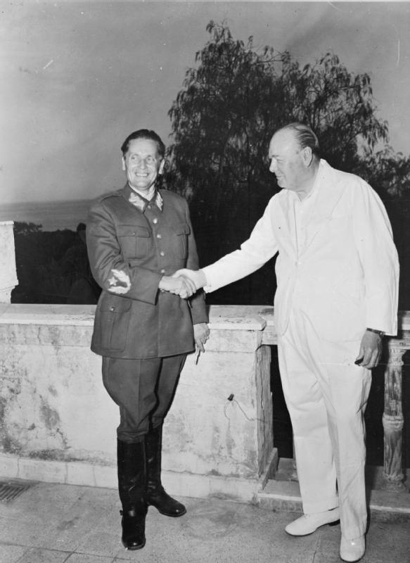
Yugoslavia
Tito
Socialist but neutral ? - relations with anti-communist governments (Pinochet under Chile, Paraguay under Stroessner..)
Market socialism
Liberal travel policy
Goli otok
Non-alignment movement

Slide 15
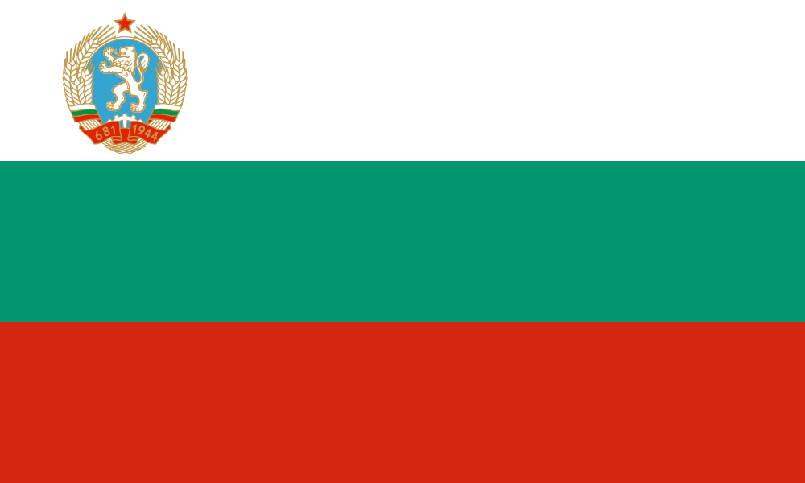
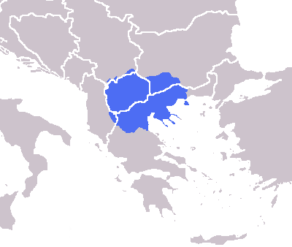
Bulgaria
Balkan federation?
subsequent macedonisation of the people and demacedonisation
Soviet Union most loyal ally
Proposal to be part of USSR

Slide 16
Contemporary Communist Parties in
Eastern Europe
Communist Party of Slovakia (marginal)
Union of Slovak Workers (marginal)
Socialist Party of Latvia (marginal, ethnic Russians)
Communist Party of Bohemia and Moravia (2013 – almost 15% of the vote)
Communist Part of Moldova – untill 2009 majority in parliament, since then in opposition 2014 : 21 out of 101 seats
Communist Party of Bulgaria (marginal)
Communist Party of Serbia (marginal)

Slide 17

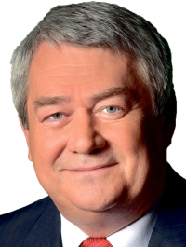
KSČM
Politically isolated for a long time as being extremist
Did not drop „communist“ from the name
After 2012 accepted as ally in regional elections with social democrats
Against quotas, sovereignity not Brussel dictate
Dissolution of NATO

Slide 18
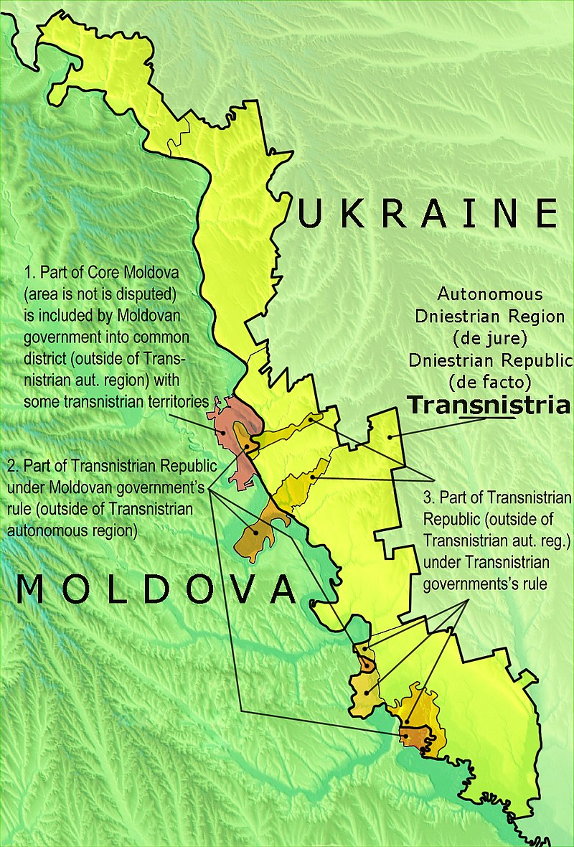
Communist Party of Moldova
Vladimir Voronin and one man show
Not really democratic
Electoral frauds, nepotism, clientelism, OC
2009 protest against the conduc of elections - coup d'état organised by "a handful of fascists drunk with anger" , r President Voronin accused Romania of being the force behind the riots in Chişină – quarrel with romania and harsher prerequisites for the romanian citizenship
Though adopting free market policies, privatization
Success story - leading party the whole „transition“
Moldovian project – strongly opposing unification of Romania and Moldova
Transnistria issue
Brain drain and country of ghosts
Europe ´s poorest country : nearly 17% of the population live below the poverty line, average wage of about $129 per month, the lowest standard of living in Europe.
Unification with Romania seen as solution to poverty

Slide 19
Seminar
Film Four months, thee weeks, two days (Romanian film)
BBC document about Ceausescu https://www.youtube.com/watch?v=2wH6PokPmXY
Book Guzel Yakhina’s : Zuleikha Opens Her Eyes (http://www.elkost.com/authors/yakhina/books/1837-zuleikha-opens-her-eyes)

Slide 20
Communism in Eastern Europe
http://chnm.gmu.edu/1989/exhibits/humor-as-resistance/essay
George Orwell: "Every joke is a tiny revolution„.
Jokes /defamation of politics/cult of personality
Notes:
In what way(s) can a joke be revolutionary?
Any risks or dangers associated with telling jokes

