Slide 1
EU in International Trade
Emerging Markets, Contemporary Position
Europe in International Economy
2019

Slide 2
Transformation of world trade patterns by Emerging Markets

Slide 3
Export - market share (2005) and its change (1995-2005) (%)
 | Market share | Change
EU15 | 18,4 | -1,77
EU25 | 19,5 | -1,33
USA | 13,0 | -4,41
Canada | 4,2 | -0,83
Mexico | 2,7 | 0,62
Japan | 9,5 | -4,12
China | 14,1 | 8,37
Korea | 4,3 | 0,68
India | 1,5 | 0,44
ASEAN | 8,7 | 0,13
Russia | 1,4 | 0,31
Brazil | 1,7 | 0,31
Export by value – share of World exports.

Slide 4
Share of total export on the main markets (2005)
and its change (1995–2005)
 | USA |  | Japan |  | China
 | share | change | share | change | share | change
EU15 | 20,1 | 1,17 | 15,6 | -2,32 | 13,5 | -2,02
EU25 | 20,8 | 1,53 | 16,1 | -2,06 | 14,0 | -1,82
USA | / | / | 16,3 | -9,76 | 9,0 | -1,28
Canada | 16,2 | -2,74 | 1,9 | -1,12 | 1,2 | -1,31
Mexico | 10,6 | 2,29 | 0,6 | 0,22 | 0,3 | 0,17
Japan | 10,1 | -8,06 | / | / | 16,6 | -1,41
China | 16,1 | 10,46 | 28,8 | 16,70 | / | /
Korea | 3,2 | -0,43 | 6,0 | -0,32 | 12,0 | 5,05
India | 1,4 | 0,52 | 0,6 | -0,28 | 0,8 | 0,53
ASEAN | 7,3 | -1,98 | 14,2 | 1,04 | 11,1 | 4,68
Russia | 0,5 | -0,08 | 0,9 | -0,72 | 1,5 | -0,85
Brazil | 1,6 | 0,33 | 0,8 | -0,30 | 1,0 | 0,06

Slide 5
World export shares by technological level (2005) and its change (1995–2005)
 | Total | H-T | M-T | L-T | R-B | P-P
EU25 change | 19,62 | 17,27 | 24,03 | 15,75 | 22,32 | 9,57
 | -1,39 | -0,57 | -1,32 | -3,29 | -1,49 | -0,84
USA change | 13,03 | 14,32 | 14,65 | 8,08 | 11,31 | 16,17
 | -4,35 | -7,63 | -3,07 | -2,29 | -3,65 | -5,87
Japan change | 9,50 | 9,51 | 15,42 | 4,75 | 4,93 | 0,68
 | -4,08 | -9,26 | -5,16 | -2,01 | -0,58 | 0,13
China change | 13,96 | 17,79 | 8,75 | 28,16 | 6,65 | 5,16
 | 8,20 | 13,94 | 5,53 | 11,55 | 3,40 | 1,03
India change | 1,46 | 0,39 | 0,83 | 3,05 | 2,65 | 2,84
 | 0,43 | 0,18 | 0,42 | 0,68 | 1,11 | 0,44
Russia change | 1,39 | 0,36 | 1,28 | 0,92 | 4,21 | 1,13
 | 0,36 | 0,18 | 0,60 | 0,35 | 0,92 | -0,35
Brazil change | 1,69 | 0,59 | 1,57 | 1,11 | 2,70 | 7,12
 | 0,32 | 0,36 | 0,42 | -0,08 | -0,05 | 3,69

Slide 6
Export structure by technological level
(2005) and its change (1995- 2005, %)
 | H-T | M-T | L-T | R-B | P-P
EU25 change | 23,7 3,4 | 42,3 1,5 | 13,8 -2,1 | 16,8 -1,5 | 2,6 -1,0
USA change | 29,6 -0,5 | 38,8 4,4 | 10,7 0,2 | 12,8 -1,1 | 6,7 -2,6
Japan change | 27,0 -0,6 | 56,1 4,8 | 8,6 -0,1 | 7,7 1,1 | 0,4 0,1
Brazil change | 9,4 5,4 | 32,1 3,6 | 11,3 -4,0 | 23,7 -8,8 | 22,7 4,4
Russia change | 6,9 2,7 | 31,8 9,4 | 11,3 1,6 | 44,7 -6,9 | 4,4 -6,1
India change | 7,1 2,3 | 19,5 6,1 | 35,9 -4,6 | 26,7 2,6 | 10,5 -6,6
China change | 34,3 18,4 | 21,7 2,7 | 34,7 -15,9 | 7,0 -2,1 | 2,0 -3,2
World change | 26,9 3,1 | 34,5 0,7 | 17,2 -0,3 | 14,8 -1,4 | 5,4 -1,9

Slide 7
World export shares by market segments (2004)
and its change 1995–2004 (%)
 | Low segment |  | Mid segment |  | Up-market segment
 | 2004 | change | 2004 | change | 2004 | change
EU25 | 15,3 | -2,27 | 17,5 | -1,95 | 30,0 | 0,40
Japan | 7,2 | -2,55 | 10,9 | -5,74 | 14,1 | -4,45
Korea | 4,8 | 0,20 | 5,0 | 1,38 | 4,4 | 0,47
India | 2,2 | 0,82 | 1,4 | 0,42 | 0,8 | 0,36
Russia | 1,5 | 0,45 | 2,1 | 0,58 | 0,8 | 0,47
USA | 12,1 | -4,42 | 12,7 | -4,11 | 14,4 | -3,47
Canada | 4,2 | -1,08 | 5,0 | -0,68 | 3,1 | 0,16
Mexico | 3,8 | -0,37 | 3,5 | 1,41 | 1,6 | 0,91
China | 19,5 | 10,56 | 9,1 | 4,84 | 4,1 | 2,42
Brazil | 2,0 | 0,32 | 2,2 | 0,21 | 0,8 | 0,01
ASEAN | 8,7 | -1,16 | 10,3 | 2,41 | 8,7 | 1,43

Slide 8
 | Low segment | Mid segment | Up-mark. Seg.
EU25 change | 20,6 -3,4 | 33,3 -1,0 | 46,1 4,4
US change | 26,61 -1,52 | 38,46 -1,59 | 34,93 3,12
Japan change | 19,64 3,32 | 42,66 -7,11 | 37,7 3,79
Brazil change | 44,99 5,23 | 36,15 -2,38 | 18,86 -2,85
Russia change | 45,12 -5,96 | 32,34 -1,53 | 22,54 7,49
India change | 39,18 -7,8 | 38,39 2,76 | 22,43 5,04
China change | 54,01 0,07 | 37,09 -0,96 | 8,9 0,89
World cahnge | 30,46 0,49 | 38,29 -0,82 | 31,25 0,33
Structure of exports by market segments (2004) and its change
1995–2004 (%)

Slide 9
EU in International Trade
2005-2011

Slide 10
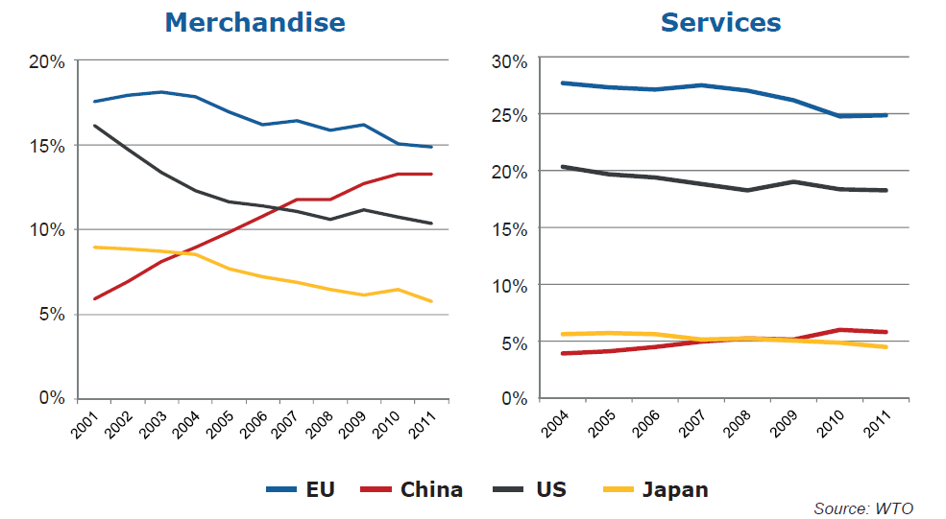
Share in world exports

Slide 11
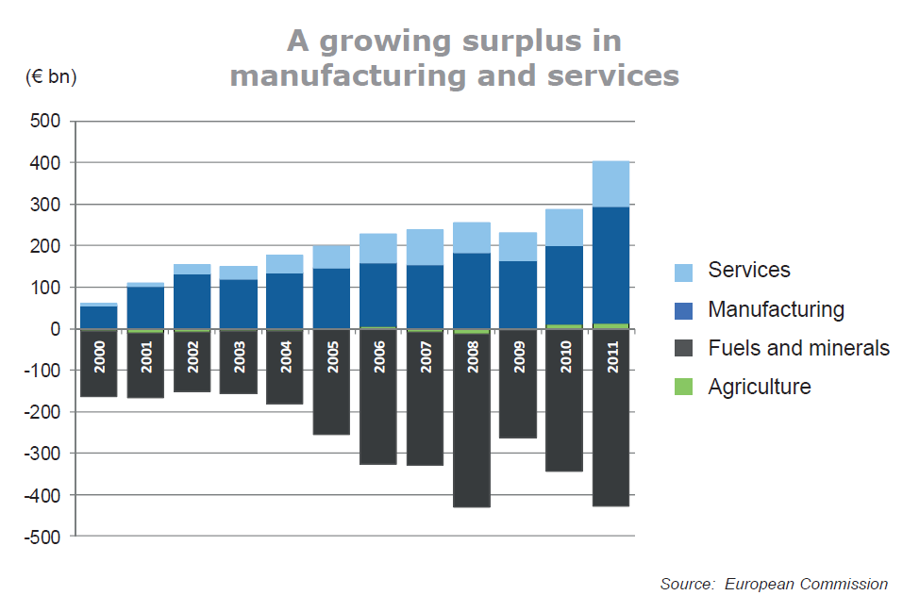

Slide 12
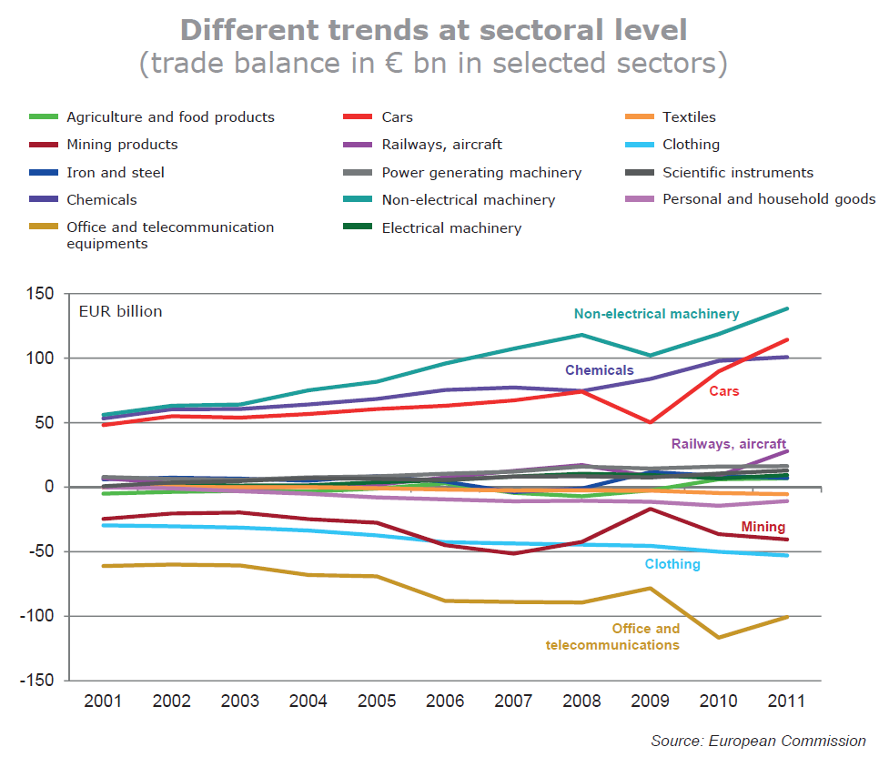

Slide 13
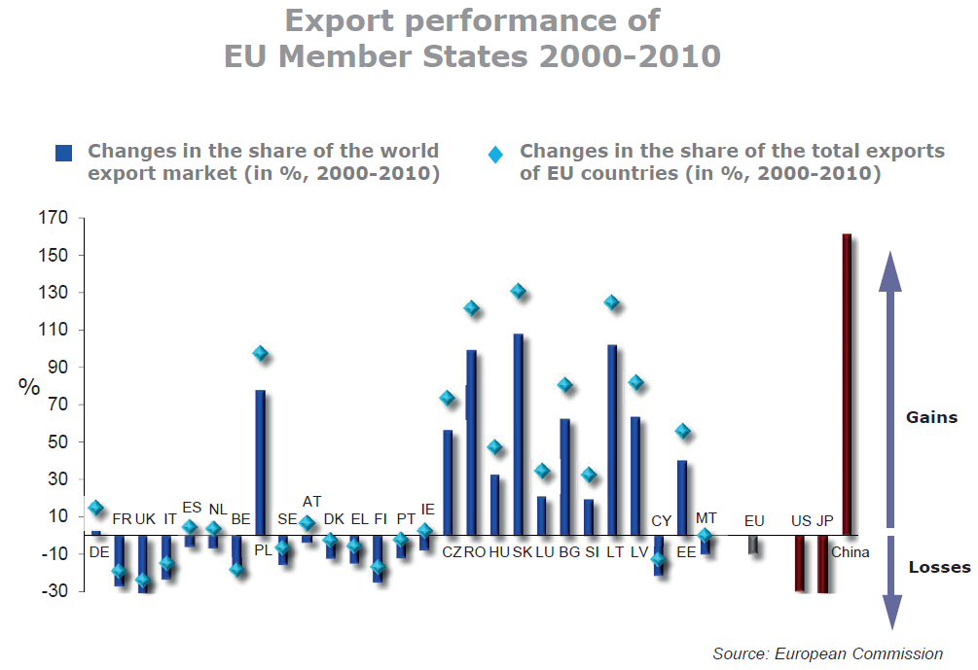

Slide 14
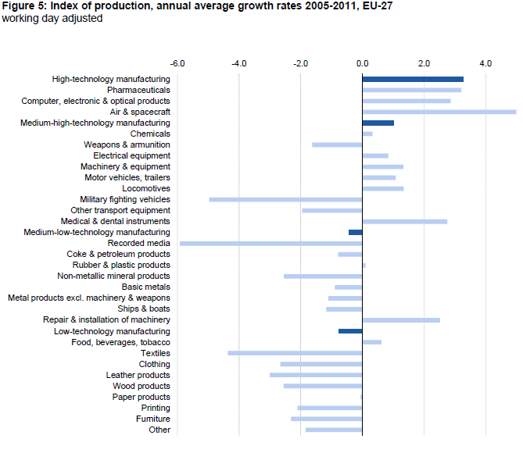

Slide 15
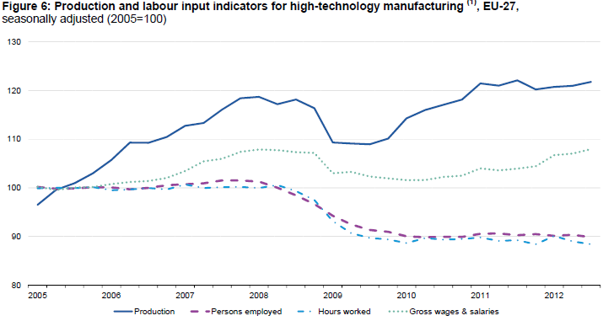

Slide 16
Comparison of World Economic Leaders
 | EU28 | USA | China
Labor force | 238 mil. | 163 mil. | 804 mil.
Product (PPP) | 23.0 trill. USD | 21.5 trill. USD | 27.5 trill. USD
GDP per capita (PPP) | 43,119 USD | 65,062 USD | 19,559 USD
Exports | 1.96 trill. USD | 1.58 trill. USD | 2.48 trill. USD
Industry value added (% GDP) | 24,5% | 18,9% | 40,5%
Export value – selected countries: Germany 1,401; Japan 683; Korea 577; UK 437; Mexico 407; Russia 337; India 303; Brazil 217; Czechia 157.

Slide 17
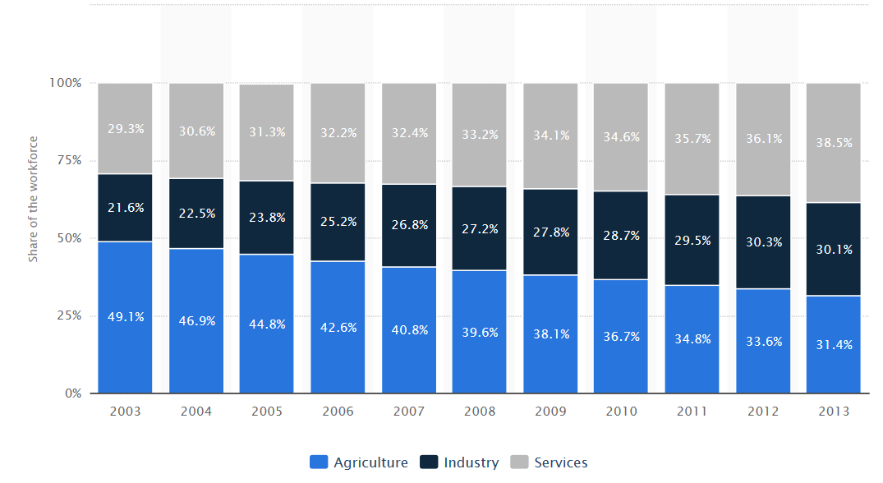
China – distribution of workforce

Slide 18
EU - World

Slide 25
EU trade (goods)
 |  | 2006 | 2008 | 2010 | 2012 | 2014 | 2016 | 2018
World | IMP | 1,368 | 1,585 | 1,532 | 1,799 | 1,693 | 1,708 | 1,980
 | EXP | 1,153 | 1,309 | 1,354 | 1,685 | 1,704 | 1,746 | 1,956
 | BAL | -216 | -276 | -178 | -114 | 11 | 37 | -25
US | IMP | 171 | 183 | 175 | 209 | 209 | 249 | 267
 | EXP | 267 | 248 | 243 | 294 | 312 | 364 | 406
 | BAL | 96 | 65 | 69 | 84 | 102 | 115 | 139
China | IMP | 196 | 249 | 284 | 292 | 303 | 352 | 395
 | EXP | 64 | 78 | 114 | 144 | 165 | 170 | 210
 | BAL | -132 | -171 | -171 | -148 | -138 | -183 | -185

Slide 26
EU trade partners – goods (2018)
 | Imports |  |  | Exports |  |  | Total trade
 | value | share % |  | value | share % |  | value | share %
CH | 395 | 19.9 | US | 406 | 20.8 | US | 674 | 17.1
US | 267 | 13.5 | CH | 210 | 10.7 | CH | 605 | 15.4
RUS | 168 | 8.5 | SWI | 157 | 8.0 | SWI | 266 | 6.7
SWI | 109 | 5.5 | RUS | 85 | 4.4 | RUS | 254 | 6.4
NOR | 84 | 4.2 | TUR | 77 | 4.0 | TUR | 153 | 3.9
TUR | 76 | 3.8 | JAP | 65 | 3.3 | NOR | 138 | 3.5
JAP | 71 | 3.6 | NOR | 54 | 2.8 | JAP | 135 | 3.4
KOR | 51 | 2.6 | KOR | 49 | 2.5 | KOR | 100 | 2.5
IND | 46 | 2.3 | IND | 46 | 2.3 | IND | 92 | 2.3
VIE | 38 | 1.9 | CAN | 41 | 2.1 | CAN | 72 | 1.8

Slide 27
EU – US trade | Imports |  | Exports
 | bil EUR | % total | bil EUR | % total
food | 12 | 4.4 | 21 | 5.2
steel | 1 | 0.5 | 7 | 1.7
chemicals | 55 | 20.7 | 99 | 24.4
- pharmaceuticals | 29 | 10.9 | 58 | 14.3
mach. and trasport eq. | 111 | 41.6 | 173 | 42.6
- transport eq. | 35 | 13.0 | 74 | 18.3
-- automotive | 9 | 3.4 | 47 | 11.6
- power gen. mach. | 33 | 12.5 | 19 | 4.6
- non elect. mach. | 19 | 7.0 | 48 | 11.7
- elect. mach. | 11 | 4.0 | 18 | 4.5
other manufactures | 29 | 11.0 | 47 | 11.4

Slide 28
EU – China trade | imports |  | exports
 | bil EUR | % total | bil EUR | % total
agri. products | 8 | 2.0 | 16 | 7.5
fuel and mining | 5 | 1.2 | 14 | 6.5
chemicals | 21 | 5.4 | 27 | 12.8
other semi. manu. | 32 | 8.0 | 10 | 4.5
mach. and trasport eq. | 209 | 53.1 | 112 | 53.4
- office and telecom. | 123 | 31.1 | 10 | 4.5
-- elect.data processing. | 50 | 12.6 | 1 | 0.6
-- telecom. eq. | 67 | 17.1 | 3 | 1.3
- transport. eq | 13 | 3.2 | 50 | 23.8
- non elect. mach. | 26 | 6.6 | 32 | 15.0
- elect. mach. | 42 | 10.7 | 16 | 7.5
clothing | 29 | 7.4 | 2 | 0.9
other manufactures | 75 | 19.0 | 19 | 8.9

Slide 29
EU – JAP trade | Imports |  | Exports
 | bil EUR | % total | bil EUR | % total
food | 0.4 | 0.5 | 7 | 10.0
chemicals | 7 | 10.3 | 15 | 22.6
- pharmaceuticals | 1 | 1.8 | 9 | 13.5
mach. and trasport eq. | 47 | 66.9 | 25 | 39.1
- transport eq. | 20 | 27.7 | 13 | 20.7
-- automotive | 14 | 20.3 | 10 | 15.9
- other machinery | 21 | 29.6 | 10 | 15.7
- non elect. mach. | 12 | 17.4 | 6 | 8.6
- elect. mach. | 10 | 4,2 | 17 | 4,6
Other manu – scientific | 4 | 6.0 | 4 | 5.4

Slide 30
EU – RUS trade | Imports |  | Exports
 | bil EUR | % total | bil EUR | % total
food | 2 | 1.3 | 6 | 6.7
fuels and mining | 125 | 74.2 | 1 | 1.6
chemicals | 6 | 3.4 | 18 | 20.8
mach. and trasport eq. | 2 | 1.3 | 39 | 45.4
- transport eq. | 0,7 | 0.4 | 13 | 15.1
- non elect. mach. | 0.4 | 0.2 | 15 | 17.3
- elect. mach. | 0.4 | 0.3 | 5 | 5.8
clothing | 0.03 | 0,0 | 3 | 3.0

