Slide 1
Political Economy of European Monetary Integration I
Europe in World Economy 2018
Vladan Hodulak

Slide 2
Schedule and readings I
18. 4. Political Economy of European Monetary Integration I
Goodhart, Ch. 1998. „The Two Concepts of Money.“ European Journal of Political Economy. Vol. 14, no. 3. Pages 407-432 (26 pp.).
Krugman, P.; Obstfeld, M.; Melitz, M.: International Economics. Boston. 2001. Pages 293-319 (27 pp.)
Cohen, B.: “The Macrofoundations of Monetary Power” in: Andrews, D. (ed.): International Monetary Power. Ithaca. 2006. Pages 31-50 (20 pp.).
Godley, W. 1992. „Maastricht and All That.“ London Review of Books. Vol. 14, no. 19. Pages 3-4 (2 pp.). On-line text (http://www.lrb.co.uk/v14/n19/wynne-godley/maastricht-and-all-that).
25. 4. Skype lecture (TTIP, Jacob Jordaan, Utrecht University)

Slide 3
Schedule and readings II
2. 5. Political Economy of European Monetary Integration II
El-Agraa, A.: The European Union – Economics and Politics. Cambridge. 2011. Pages 147-193 (47 pp.)
9. 5. Euro in the international monetary system
Bibow, J. 2013. “On the Franco-German Euro Contradiction and Ultimate Euro Battleground.” Contributions to Political Economy. Vol. 31, no. 1. Pages 127-149 (22 pp.).
Fields, D.; Vernengo, M. 2012. “Hegemonic currencies during the crisis: The dollar versus the euro in a Cartalist perspective.” Review of International Political Economy. Vol. 20, no. 4. Pages 740-759 (20 pp.).
??? The Euro Crisis (by Ales Chmelar, the Office of the Government of the Czech Republic)
TBA

Slide 4
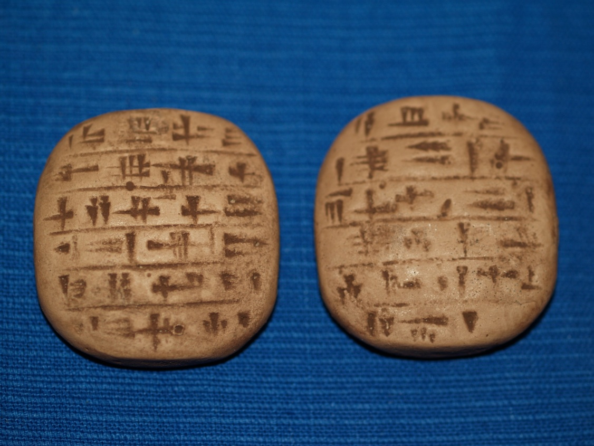

Slide 5
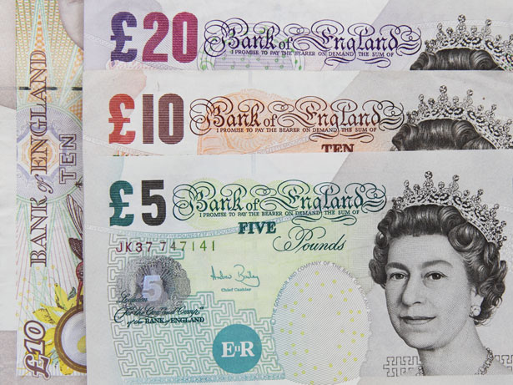
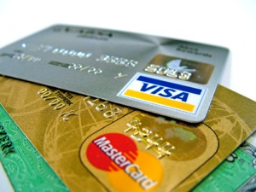

Slide 6
Money and society
What is money?
How is money produced?
How does it get/lose value?

Slide 7
The standard economic story (metallist)
Carl Menger (1892), methodological individualism
Problems of rational actors engaged in economic exchange
Double coincidence of wants
Type of an evolutionary explanation – increasing effectiveness of the economic exchange
Precious metals (gold, silver) were selected due to their properties, particularly their high exchangeability
Paper and later electronic money were introduced as a transaction cost saving device, originally they were to represent the „real money“ deposited in vaults
With this theory, money is first and foremost a means of exchange, its other functions (unit of account, store of value) are secondary
Barter -> money -> credit

Slide 8
Problems with the standard approach
The questionable role of a state
It is considered unnecessary for monetary system to operate
States have a tendency to destabilize their monetary systems
But in some cases it’s recognized that states have some important role to play (prevents counterfeiting, guarantees quality)
Theoretical problems
Hoarding of money makes it more scarce and thus less like to be used as money
Unstated presuppositions (economic exchange, property rights)
Empirical issues – anthropological surveys are at odds with the barter story, money predate coins by millennia

Slide 9
State/credit theory of money
Money is firstly a unit of account for recording debts
It is an IOU and is created when an IOU is issued
Its value depends on the credibility of the promise
Money is an institution – a generalized and formalized type of an obligation (debt)
Anyone can issue money (obligations) and almost anything can represent it (cattle, salt, wood, paper)
The crucial problem is: How to make people accept it? How to make it generally recognized? (only then a generalized means of exchange is possible)
Hierarchy of money (government > banks > firms > households)
Problems (role of the private sector, legitimacy issues)

Slide 10
Essence of money
What is money?
measure of value
It’s vital to differentiate between money and money things (what represents money)
People coordinate their economic behavior in various ways, the most common in-group coordination mechanism is some form of credit -> money usually measures debts (credits)
credit -> money (-> barter)
How is money produced?
By issuing an IOU (× destruction of money)
How does it get/lose value?
Credibility × quantity theory of money (but it’s complicated)

Slide 11
Money and states
A state is able to determine its money (unit of account) once it enforces taxes/fees in it
Governments use money to mobilize resources for public purpose
Money is accepted for several reasons: trust, habit, authority, but the ultimate reason is power
The fact that a state issues its money and declares that it will accept it back in the form of taxes is an expression of power (+legal tender)
Governments can buy anything that is for sale in its currency and is in theory able to overbid anyone
Money has distributional consequences and is therefore prone to be abused for political gains
Debtor × creditor interests

Slide 12
Modern money
Usually one state – one currency rule
Governments owing in their own currency can’t be forced to go bankrupt but they can decide to do so
Fallacy of composition – what is true for a part (an individual) doesn’t have to be true for the whole
Individuals × states
Expenditure = income
Governments are for historical and political reasons limited in their power to exploit their monetary systems
Most money today is issued by private commercial banks
Exogenous money – money multiplier
Endogenous money – credit creation ex-nihilo

Slide 13
Limits of domestic monetary power
Political and institutional constraints
Central bank independence
Deficit limit
Debt ceiling
Limited money supply (metal standard, currency peg)
Inflation and real constraints (output level)
International constraints
Balance of payments constraints
Debt in a foreign currency

Slide 14
Balance of payments
Accounting accord of all monetary transactions between a country and the rest of the world
The sum of all accounts has to be equal 0 by definition
Composition (IMF × USA!)
Current account – trade + factor income
Financial (capital) account (including the reserve account) – net change of ownership of international assets
Balancing item (statistical errors)
Relations between individual accounts
Net international investment position
Accumulated CA, asset price changes, currency moves

Slide 15
Source: The Czech National Bank

Slide 16
Source: The Czech National Bank

Slide 17
Net international investment position (% of GDP in 2014)
Switzerland | 119,6 | United States | -39,7
Japan | 74,8 | Slovakia | -70
Germany | 36,4 | Spain | -94,5
China | 17,1 | Ireland | -106,7
Russia | 16,7 | Portugal | -111,6
CZ | -35,6 | Greece | -121,9
Source: IMF

Slide 18
Balance of payments adjustment
Most countries can’t run CA deficits for prolonged periods of time
Relationship to government deficits and debts
Balancing mechanisms
Exchange rate adjustment
Internal prices adjustment
Various others (debt forgiving, war, emigration)
Adjustment cost
Transitional cost
Continuing cost

Slide 19
Monetary power
Аutonomy × influence
Power to delay
Liquidity
Borrowing capacity
Special cases
Power to deflect
Sensitivity (openness)
Vulnerability (adaptability)
Who adjusts?
Deficit × surplus countries
Distributional consequences

