Slide 1


Food, sustainability and
alternative food networks
Session 1 – Introduction
Dr Daniel Keech
Countryside and Community Research Institute
University of Gloucestershire, UK
dkeech@glos.ac.uk
@CCRI_UK
Masaryk University, Brno, Aril 9th – 13th 2018

Slide 2
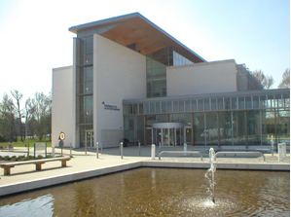
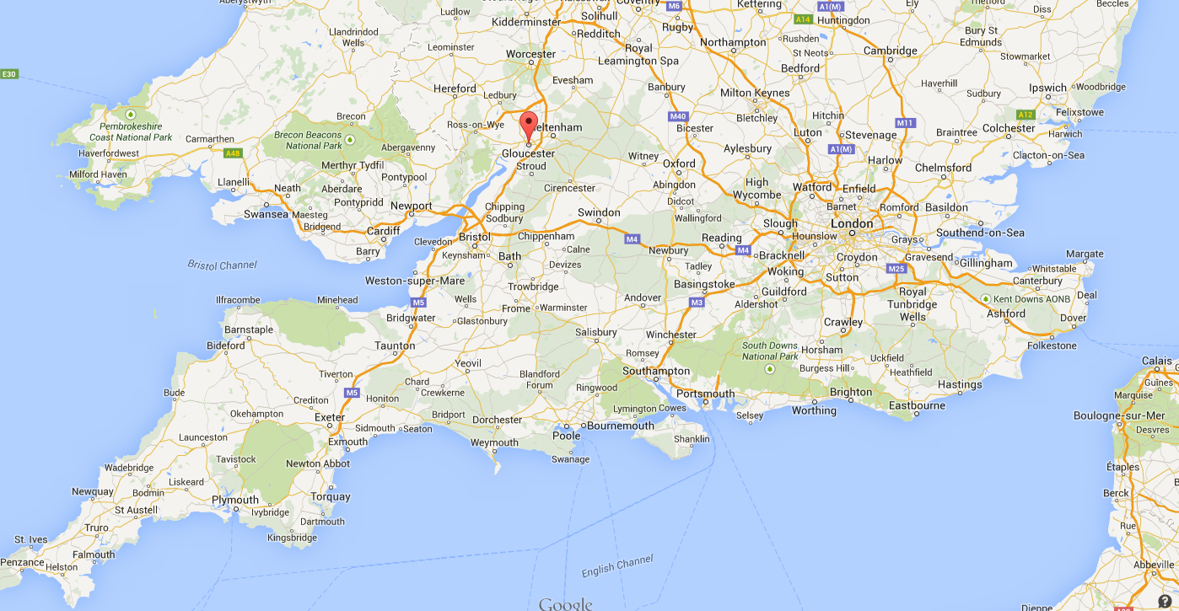
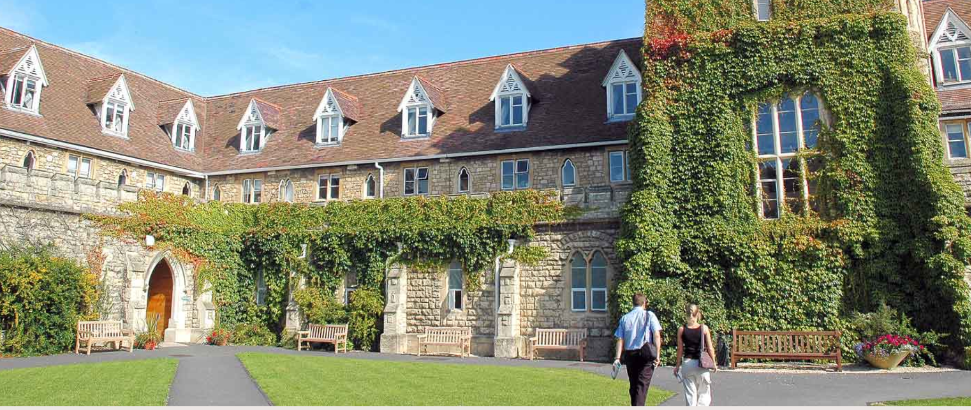
University of Gloucestershire
Small university in SW England
Originally est. in 1847
8000 students, 1000 PG, 45/55 M/F
  Specialisms: fine arts, applied sciences, sport, business, education
Four campuses in two adjacent towns
Countryside & Community Research Inst
Since 1986 one of UK’s largest rural research centres. Now more broadly based around social innovation, food, sustainability and renewables.
Masters teaching and PhD
Research within EU partnerships

Slide 3
Introductions (2-3 mins)
Your name
Where are you from?
Study areas
Areas of interest in this module

Slide 4
Overview of the week
Together we will:
Explore the changing roles of food over recent decades.
Critically consider some public, scientific and policy debates around food supply, production and consumption, including the complexities and inter-connectedness of local and global food.
Explore multi-disciplinary methodological approaches which can help us, as researchers, make sense of these difficult issues.
Examine ‘alternative’ and community food provision models.
Carry out independent research which aims to help students demonstrate and communicate their grasp of issues covered.
Notes:
4

Slide 5
Course progression (1)
Session 1: Tues 10th April 2018 13.30 (U32)
Introductions, overview, research exercise.
Changing narratives: debates about sustainability and food security
Session 2: Wed 11th April 9.45 (U42)
Community Supported Agriculture
Environmental Enterprises
Notes:
5

Slide 6
Course progression (2)
Sessions 3: Thurs 12th April 17.00 (U32)
Cities as spaces of food citizenship – examples from Bristol, Bamberg, Ghent, Riga.
Additional time for diary issues?
Session 4: Fri 13th April 8.00 (U53)
Student presentations of food diary and assessment.
Notes:
6

Slide 7
Working together
Small group: allows flexibility and informality; but relies on attendance and adequate preparation.
We have a course structure, but please feel free to ask questions as they arise; discussions may develop and be pursued where time allows. We have a lot to get through!
I appreciate that English is not your first language and that my examples are often from UK/Germany.
Please ask for clarifications where necessary. If there are problems talk to me after the class, or to Nadia.
Are you happy? If not, don’t suffer in silence.
Notes:
7

Slide 8
Food diaries/diet records as a research tool
Food diaries are highly useful ways of gathering research data in fields including psychology, marketing, cultural geography, sociology, nutrition. For example:
  Harrington et al. 2001 – comparison between eating habits in the north and south of Ireland
  Bellisle et al. 2003 – dietary contrib’n of snacks vs. meals in France
  Kniazeva and Ventakesh 2007 – symbolism of food in US
  Brown and Paszkiewicz 2016 – role of food in Polish migrant journey
  Sadella and Burroughs 1981 (quoted from Almerico 2014) – ‘People who eat fast food and synthetic food were classified as religious conservatives who often wore polyester clothing. Health food personalities were characterised as antinuclear activists… Vegetarians were likely to be … pacifists who drive foreign cars…’
Notes:
The purpose of this exercise is to get students to reflect on what social, cultural, political, ethical… values they attach to food in theory. On Friday we will recall this exercise when students present their diaries.
8

Slide 9

Research exercise
Keep a diary keep of what you eat from Saturday 7th April until Thursday 12th April (I hope this has started). When you are buying food and eating, what things do you look for, which contexts inform your actions?
The table shows some examples of considerations:
Preference | Reason | Indicator
I buy ready-meals. | I don’t enjoy cooking. | Cooking instructions
I buy the cheapest food available. | I am a student with not much money. | Price
I try to buy organic food. | I believe it’s better for your health. | Certification label
Notes:
The purpose of this exercise is to get students to reflect on what social, cultural, political, ethical… values they attach to food in theory. On Friday we will recall this exercise when students present their diaries.
9

Slide 10
Research exercise – food diary
Buying: What decisions were involved in making your purchases? Did you make any compromises or trade-offs?
Menu: What did you cook and eat and what decisions were linked to this?
Consequences: Consider the sustainability issues of your meals and purchasing in this period (food chains; human and non-human actors; areas of tension etc…).
Changes: What would you change? What would you need to achieve that? What who is responsible for the changes (state regulation, consumer choice, commercial practice…?)
Notes:
10

Slide 11
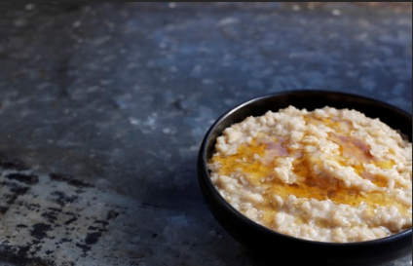
Example of food diary
record
Monday 27th March
Breakfast – Tea, oatmeal porridge with honey.
Lunch – Vegetarian meal from university canteen: soup, potato salad and cheese sandwich. Chocolate bar.
Evening meal – Frozen pizza and frozen chips from the supermarket.
Comments – My aunt’s honey. Always buy fair-trade tea. I’m a vegetarian. Just can’t resist chocolate! Quick evening meal, I am going out with friends tonight. Afternoon coffee plus rhubarb cake at new local produce café run by people I know. (THIS IS AN INVENTION!!!)
Pic: https://www.jordanscereals.co.uk/news/a-short-history-of-porridge
Notes:
The exercise is intended to reveal a number of influences on food intakes and purchasing decisions. In this case, fair-trade coffee displays ethical concern for distant commodity farmers; evening meal is likely to be high in fat and suggests familiarity with Italian foods (see lunch). Vegetarianism may be a political choice.
Chocolate cake may carry guilt associations, unlike the coffee. Support for acquaintances shows social structures in some market situations. Tues is not a day for food hedonism, or perhaps reflects work-life balance issues.
11

Slide 12
Food diary verbal report
This is based on your diary in the form of an oral presentation to the rest of the group. Need to divide into groups.
Can be simply presentation, power-point, video, excel sheet… all this is fine. But draw out critical questions or dilemmas which you have encountered or find interesting. For example:
Health: do labels help you make healthy choices?
Environment: did you throw lots of food away? Packaging?
Ethics: fair-trade is an apology for neo-liberalism…
Social: no fresh fruit and veg in my neighbourhood; grow my own…
Lifestyle/gender – class of 2016… vegan/protein.
Economic: does sustainable food cost more?
Be honest – this is auto-ethnographic data collection

Slide 13
Food diary oral presentation
Don’t just describe what you bought/ate. Draw out critical reflections based on what we have discussed. Do you need a structure for the presentation? For example:
Introduction: who is in your group? Same/different?
What method did you use in data recording/analysis/presentation and why?
2 or 3 key findings from your data (quotations, pictures…)
Conclusions
But you can decide how you present your work. Remember you have about 10 mins per group.

Slide 14
Any questions so far?
Happy?
Notes:
14

