Slide 1
Evropský přístup k lidským právům?
EVS450 EU a lidská práva
Hubert Smekal
(hsmekal@fss.muni.cz)
26. února 2018

Slide 2
LP kontroverze
Proč máme práva?
Generace práv
Relativismus a universalismus
Kolektivní práva

Slide 3
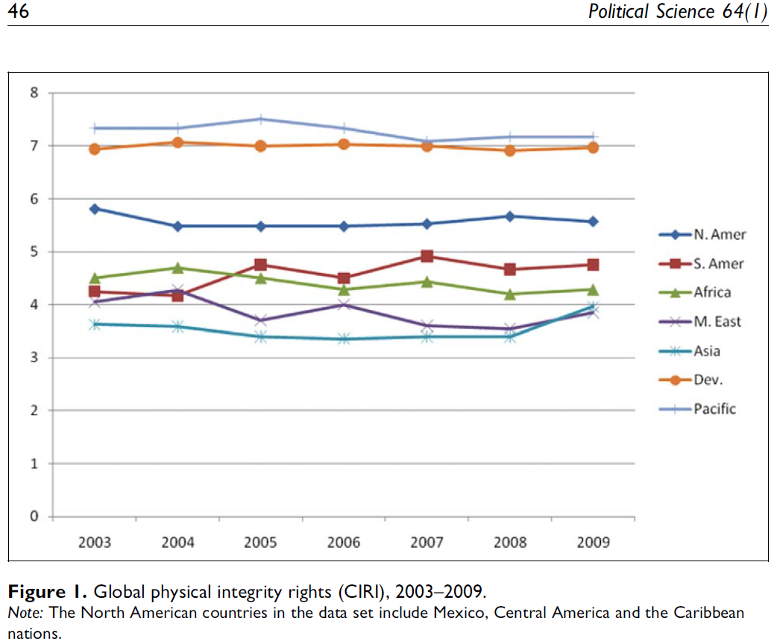
Walker (2012) PS

Slide 4
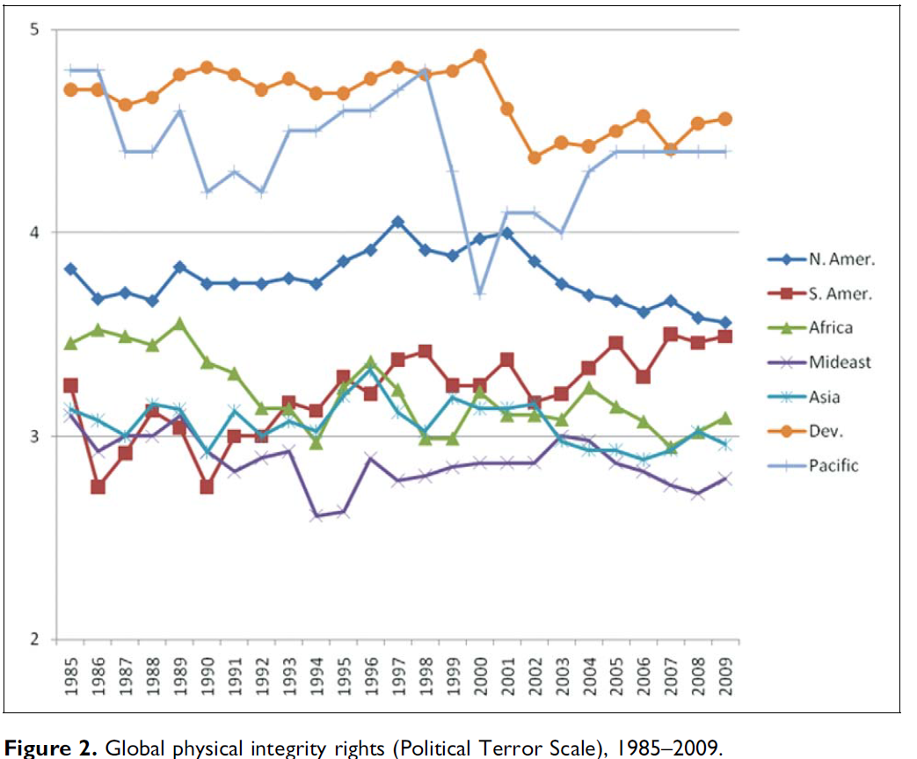
Walker (2012) PS

Slide 5
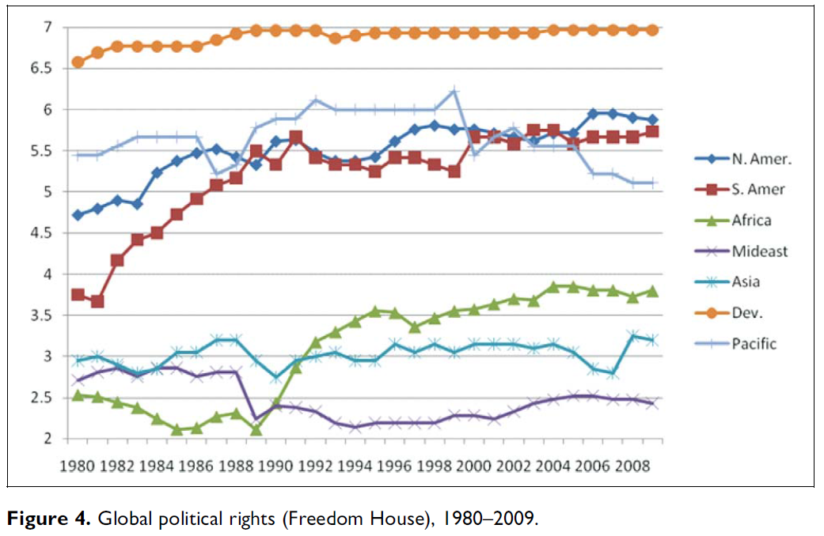
Walker (2012) PS

Slide 6
Regionální LP ochrana
(globální systém OSN)
Evropa
Ameriky
Afrika
Islámský svět
Evropské státy nejvíce otevřeny mezinárodním závazkům

Slide 7
Rozdíly mezi regiony
V normách
V kontrolním mechanismu

Slide 8
Organizace amerických států
Bogota: Charta OAS + Americká deklarace práv a povinností člověka (1948)
San José: Americká úmluva o LP (1969, 1978)
Protokol ze San Salvador (1988, 1999)
+ úmluvy proti mučení (1985, 1987), zmizení (1994), násilí na ženách (1994)
Meziamerická komise pro LP (1959)
Meziamerický soud pro LP(1979)
Impunity

Slide 9
Americká deklarace o právech a povinnostech člověka
All men are born free and equal, in dignity and in rights, and, being endowed by nature with reason and conscience, they should conduct themselves as brothers one to another.
The fulfillment of duty by each individual is a prerequisite to the rights of all. Rights and duties are interrelated in every social and political activity of man. While rights exalt individual liberty, duties express the dignity of that liberty.
Duties of a juridical nature presuppose others of a moral nature which support them in principle and constitute their basis.
Inasmuch as spiritual development is the supreme end of human existence and the highest expression thereof, it is the duty of man to serve that end with all his strength and resources.
Since culture is the highest social and historical expression of that spiritual development, it is the duty of man to preserve, practice and foster culture by every means within his power.
And, since moral conduct constitutes the noblest flowering of culture, it is the duty of every man always to hold it in high respect.

Slide 10
Americká úmluva o LP
Preamble
Recognizing that the essential rights of man are not derived from one's being a national of a certain state, but are based upon attributes of the human personality,
Reiterating that, in accordance with the Universal Declaration of Human Rights, the ideal of free men enjoying freedom from fear and want can be achieved only if conditions are created whereby everyone may enjoy his economic, social, and cultural rights, as well as his civil and political rights; and

Slide 11
Americká úmluva o LP
Article 17. Rights of the Family
1. The family is the natural and fundamental group unit of society and is entitled to protection by society and the state.
2. The right of men and women of marriageable age to marry and to raise a family shall be recognized, if they meet the conditions required by domestic laws, insofar as such conditions do not affect the principle of nondiscrimination established in this Convention.
3. No marriage shall be entered into without the free and full consent of the intending spouses.
4. The States Parties shall take appropriate steps to ensure the equality of rights and the adequate balancing of responsibilities of the spouses as to marriage, during marriage, and in the event of its dissolution. In case of dissolution, provision shall be made for the necessary protection of any children solely on the basis of their own best interests.
5. The law shall recognize equal rights for children born out of wedlock and those born in wedlock.

Slide 12
Americká úmluva o LP
Article 18. Right to a Name
Every person has the right to a given name and to the surnames of his parents or that of one of them. The law shall regulate the manner in which this right shall be ensured for all, by the use of assumed names if necessary.

Slide 13
Americká úmluva o LP
CHAPTER III - ECONOMIC, SOCIAL, AND CULTURAL RIGHTS
Article 26. Progressive Development
The States Parties undertake to adopt measures, both internally and through international cooperation, especially those of an economic and technical nature, with a view to achieving progressively, by legislation or other appropriate means, the full realization of the rights implicit in the economic, social, educational, scientific, and cultural standards set forth in the Charter of the Organization of American States as amended by the Protocol of Buenos Aires.

Slide 14
Americká úmluva o LP
CHAPTER V - PERSONAL RESPONSIBILITIES
Article 32. Relationship between Duties and Rights
1. Every person has responsibilities to his family, his community, and mankind.
2. The rights of each person are limited by the rights of others, by the security of all, and by the just demands of the general welfare, in a democratic society.

Slide 15
Meziamerická komise pro LP
(počet stížností)

Slide 16
Meziamerický soud pro LP
(počet případů)

Slide 17
Africká unie (2002)
Charta africké jednoty 1963, Addis Ababa
Africká charta o právech člověka a národů
Banjulská charta (1981, 1986)
Zakládací akt AU (Lomé, 2000)
  Africká komise pro práva člověka a národů (1987)
  Africký soud pro práva člověka a národů(2004, 2006, 2009)

Slide 18
Africká charta
Convinced that it is henceforth essential to pay particular attention to the right to development and that civil and political rights cannot be dissociated from economic, social and cultural rights in their conception as well as universality and that the satisfaction of economic, social and cultural rights is a guarantee for the enjoyment of civil and political rights;

Slide 19
Africká charta
Conscious of their duty to achieve the total liberation of Africa, the peoples of which are still struggling for their dignity and genuine independence, and undertaking to eliminate colonialism, neo-colonialism, apartheid, zionism and to dismantle aggressive foreign military bases and all forms of discrimination, language, religion or political opinions;

Slide 20
Africká charta
ARTICLE 18
1. The family shall be the natural unit and basis of society. It shall be protected by the State which shall take care of its physical health and moral.
2. The State shall have the duty to assist the family which is the custodian of morals and traditional values recognized by the community.
3. The State shall ensure the elimination of every discrimination against women (…)
4. The aged and the disabled shall also have the right to special measures of protection in keeping with their physical or moral needs.

Slide 21
Africká charta
ARTICLE 20
1. All peoples shall have the right to existence. They shall have the unquestionable and inalienable right to self-determination. They shall freely determine their political status and shall pursue their economic and social development according to the policy they have freely chosen.
2. Colonized or oppressed peoples shall have the right to free themselves from the bonds of domination by resorting to any means recognized by the international community.
3. All peoples shall have the right to the assistance of the State Parties to the present Charter in their liberation struggle against foreign domination, be it political, economic or cultural.

Slide 22
Africká charta
ARTICLE 21
1. All peoples shall freely dispose of their wealth and natural resources. This right shall be exercised in the exclusive interest of the people. In no case shall a people be deprived of it.
4. State Parties to the present Charter shall individually and collectively exercise the right to free disposal of their wealth and natural resources with a view to strengthening African Unity and solidarity.

Slide 23
Africká charta
ARTICLE 23
All peoples shall have the right to national and international peace and security. The principles of solidarity and friendly relations implicitly affirmed by the Charter of the United Nations and reaffirmed by that of the Organisation of African Unity shall govern relations between States.
2. For the purpose of strengthening peace, solidarity and friendly relations, State Parties to the present Charter shall ensure that:
b) their territories shall not be used as bases for subversive or terrorist activities against the people of any other State Party to the present Charter.

Slide 24
Africká charta
ARTICLE 24
All peoples shall have the right to a general satisfactory environment favourable to their development.

Slide 25
Africká charta
DUTIES
ARTICLE 27
1. Every individual shall have duties towards his family and society, the State and other legally recognised communities and the international community.
2. The rights and freedoms of each individual shall be exercised with due regard to the rights of others, collective security, morality and common interest.
ARTICLE 28
Every individual shall have the duty to respect and consider his fellow beings without discrimination, and to maintain relations aimed at promoting, safeguarding and reinforcing mutual respect and tolerance.

Slide 26
Africká charta
ARTICLE 29
The individual shall also have the duty:
1. To preserve the harmonious development of the family and to work for the cohesion and respect of the family; to respect his parents at all times, to maintain them in case of need.
2. To serve his national community by placing his physical and intellectual abilities at its service;
3. Not to compromise the security of the State whose national or resident he is;
4. To preserve and strengthen social and national solidarity, particularly when the latter is strengthened;
5 To preserve and strengthen the national independence and the territorial integrity of his country and to contribute to his defence in accordance with the law;
6. To work to the best of his abilities and competence, and to pay taxes imposed by law in the interest of the society;
7. To preserve and strengthen positive African cultural values in his relations with other members of the society, in the spirit of tolerance, dialogue and consultation and, in general, to contribute to the promotion of the moral well being of society;
8. To contribute to the best of his abilities, at all times and at all levels, to the promotion and achievement of African unity.

Slide 27
Západní přístup
Rozdíly s USA
  Trest smrti
  Svoboda projevu
  Sociální práva
  „Affirmative action“
  Americká neaktivita v mezinárodním zavazování

Slide 28
Evropský přístup?
Rozdíly mezi státy?
Rozdíly uvnitř států
Nejvyšší difúze norem – úmluvy, ústavy; supranacionální soudy + ústavní soudy (vzájemné odkazy); konference, univerzity, aktivisté, …

Slide 29
Evropský systém ochrany LP
EU
COE
OSCE

Slide 30
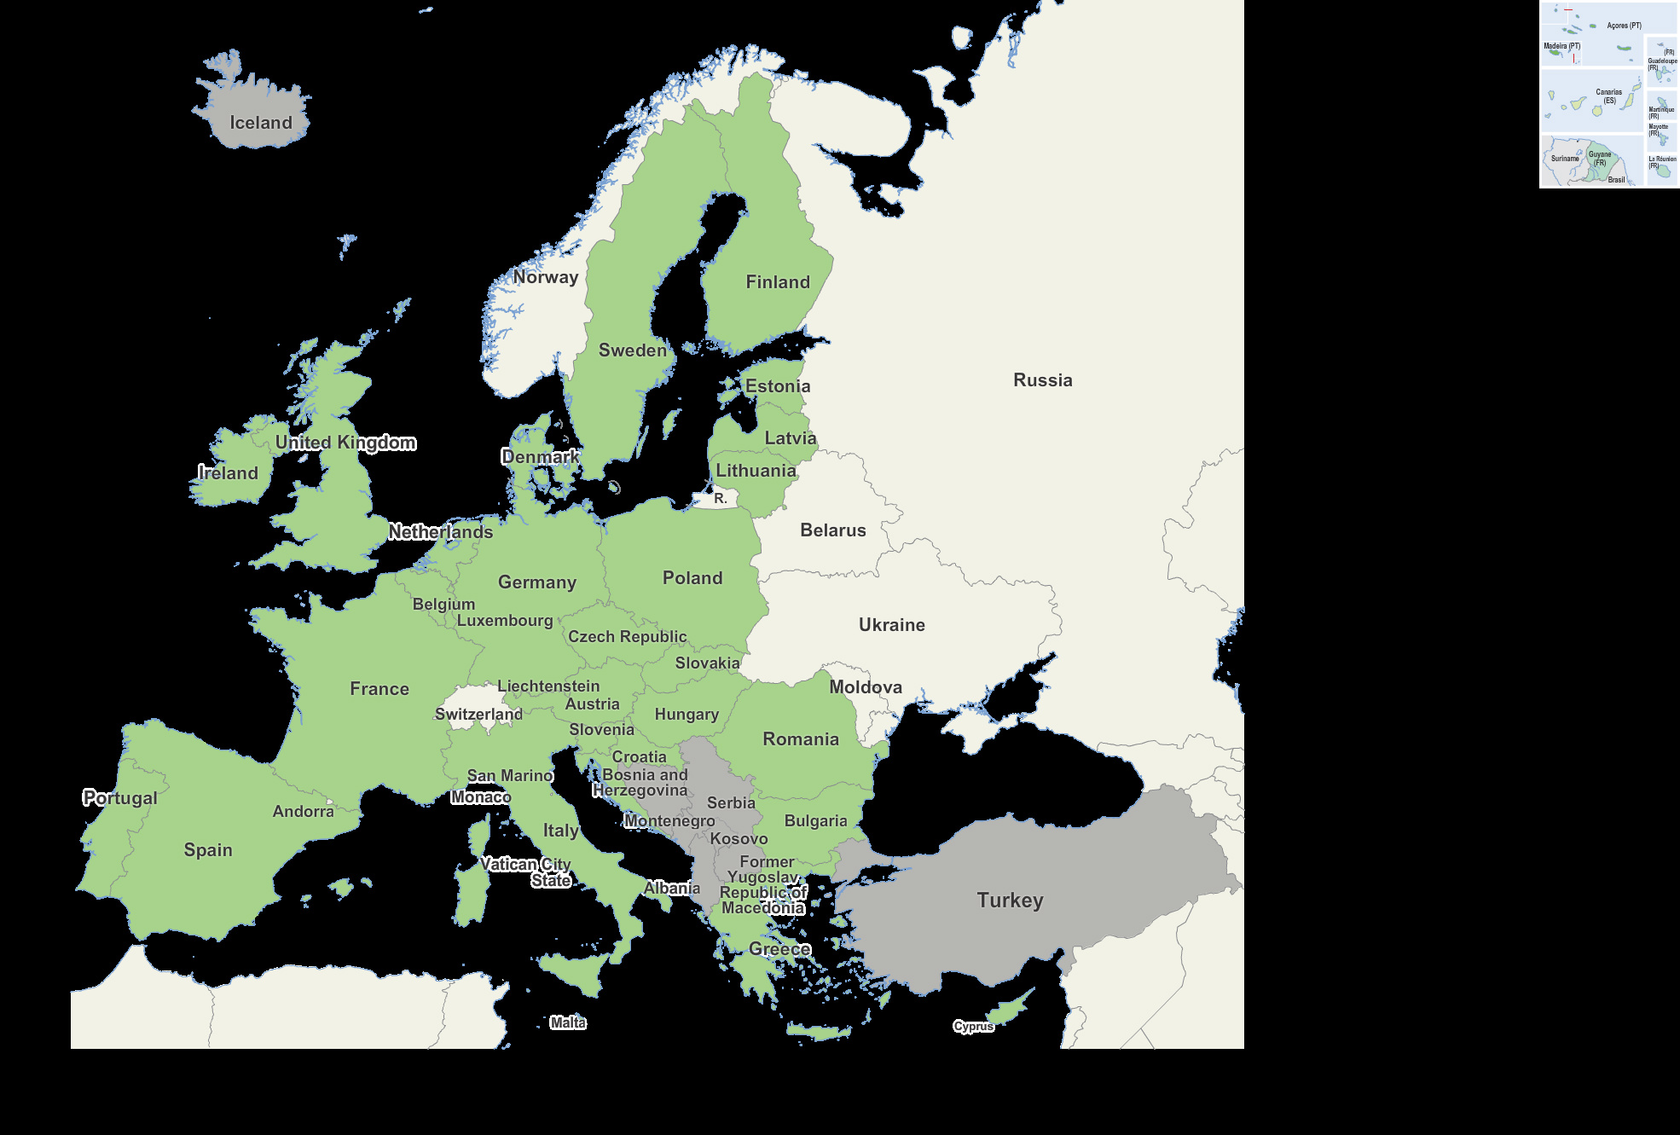
EU

Slide 31
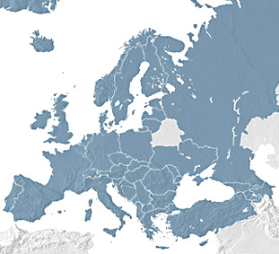
COE

Slide 32
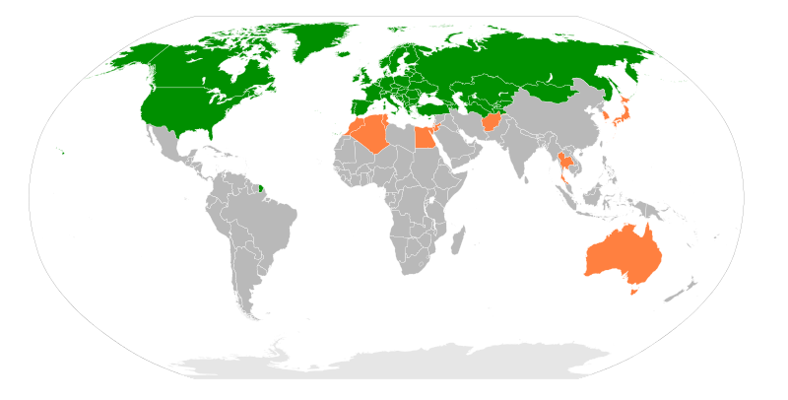
OSCE
Wikimedia Commons, Sven

Slide 33
COE

Slide 34
Proč vznikají mez. LP režimy?
A. Moravcsik (IO, 2000; EJIR, 1995)
Proč by jakákoliv vláda preferovala zřízení efektivní nezávislé mezinárodní autority, která omezuje její domácí suverenitu?
  Realistický pohled
  Idealistický pohled
  „Republican liberalism“ – „domestic political self-interest of governments“, „lock in“. Když přínos redukce budoucí politické nejistoty > „sovereignty costs“
Doporučeno: Eric VOETEN

Slide 35
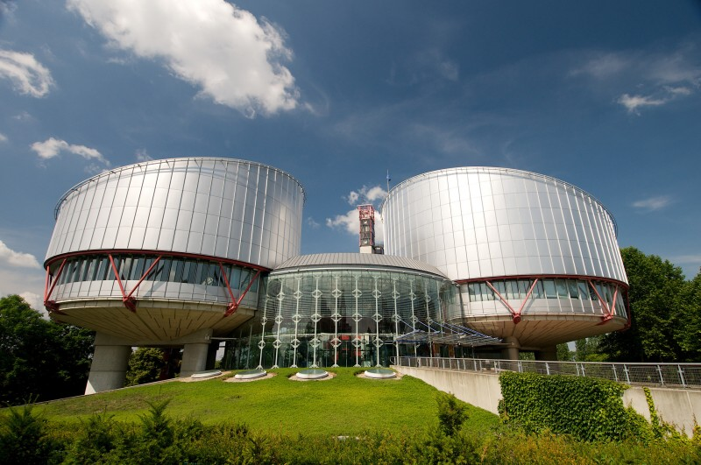
Source: echr.coe.int

Slide 36
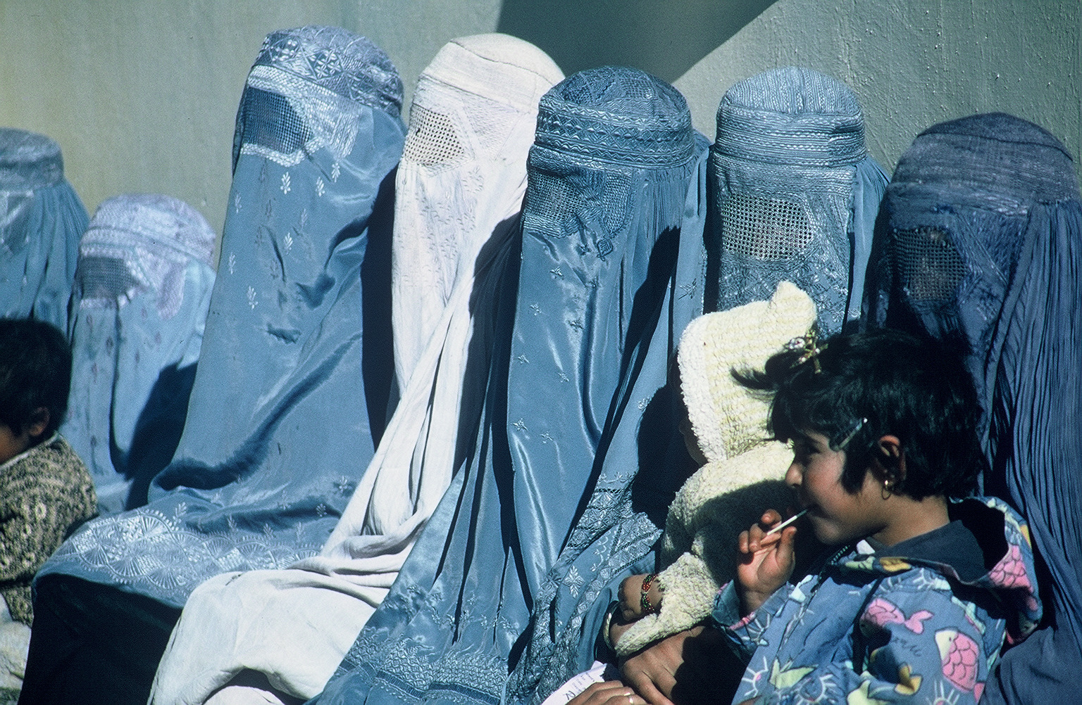
S.A.S. v. FRANCE
Wikipedia (photo by USAID)

Slide 37
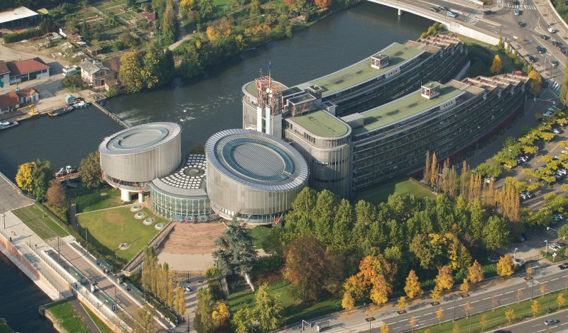
Council of Europe Credit

Slide 38
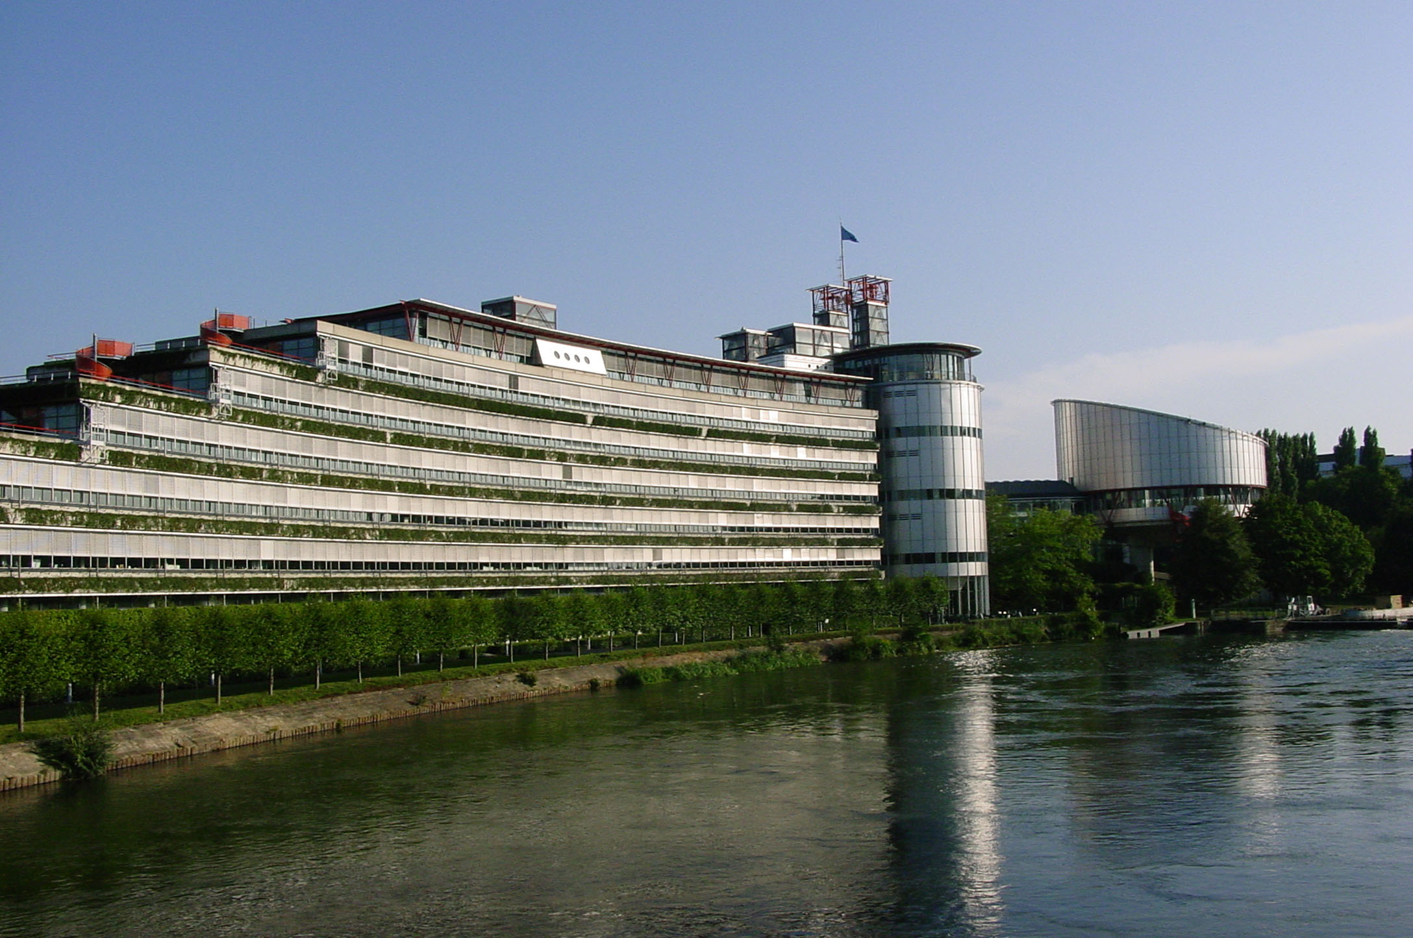
Council of Europe Credit

Slide 39
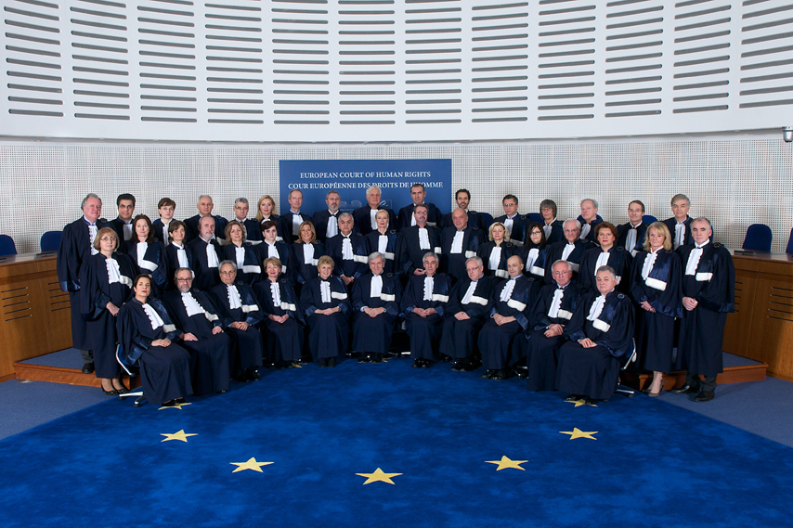
Council of Europe Credit

Slide 40
ECHR – Analysis of Statistics 2014

Slide 41
ECHR – Analysis of Statistics 2014

Slide 42
ECHR – Analysis of Statistics 2014

Slide 43
ECHR: Overview 1959-2014

Slide 44
ECHR: Overview 1959-2014

Slide 45
ECHR: Overview 1959-2014

Slide 46
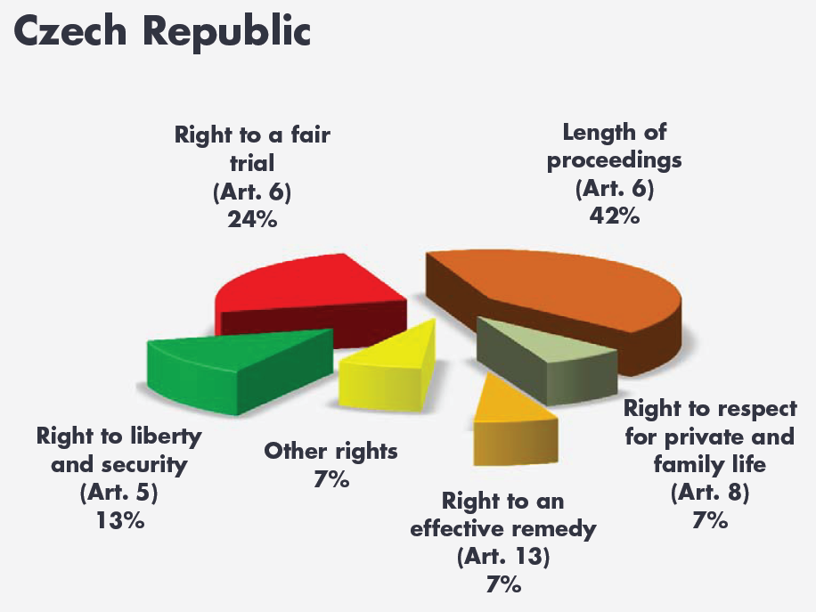
Subject-matter of the Court’s violation judgments

Slide 47
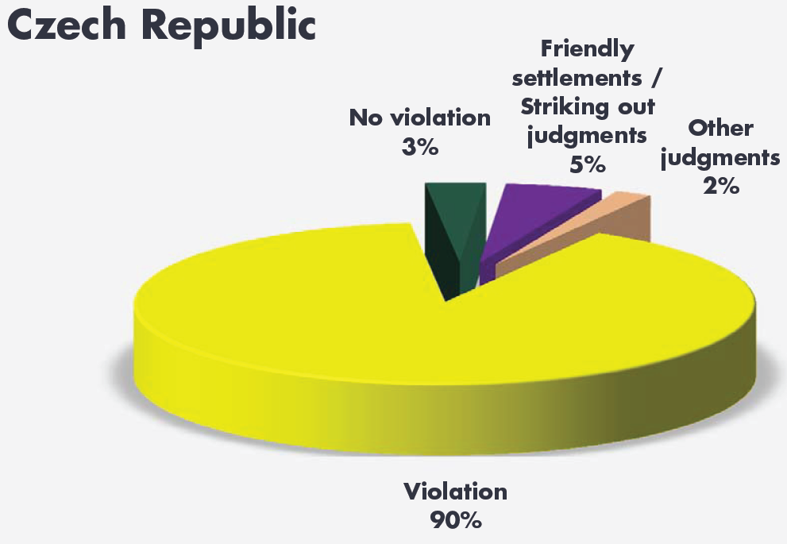
Type of judgment

Slide 48
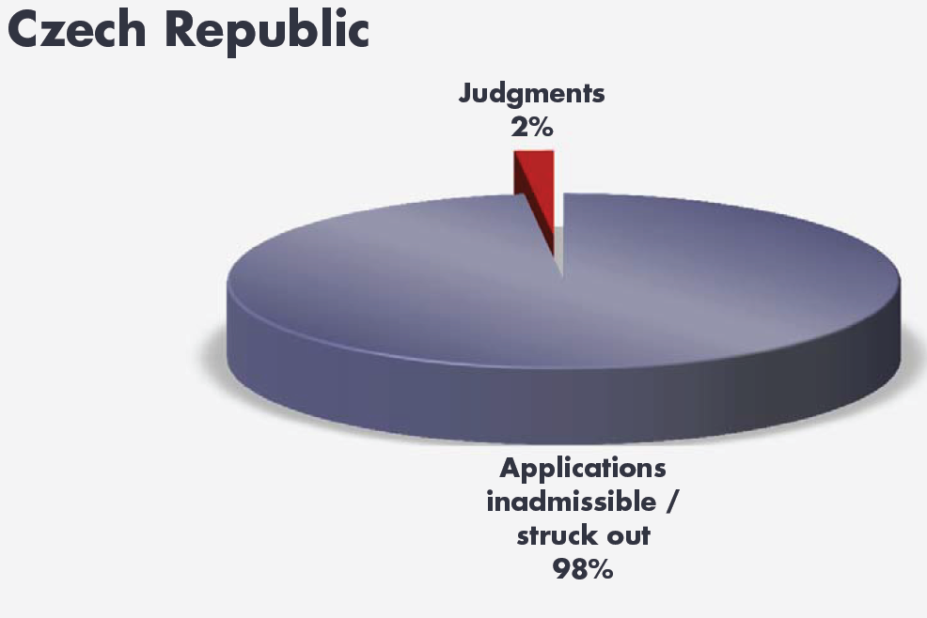
Judgments and decisions

Slide 49
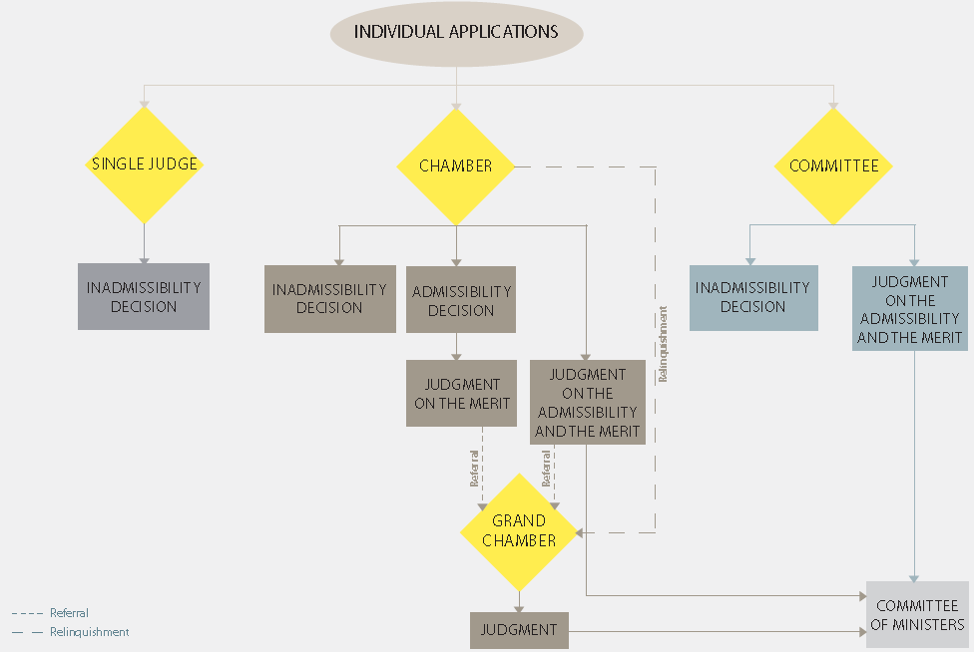
Zdroj: echr.coe.int

Slide 50
OSCE
Wikimedia Commons, Sven

Slide 51
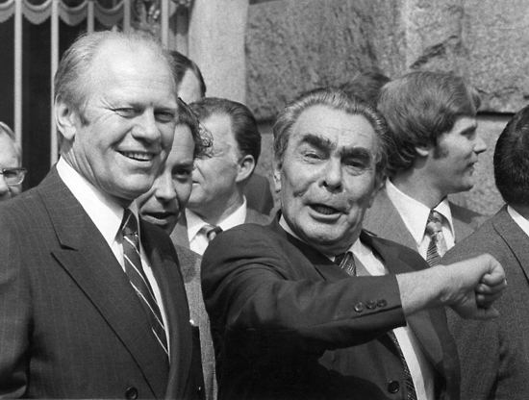

Slide 52
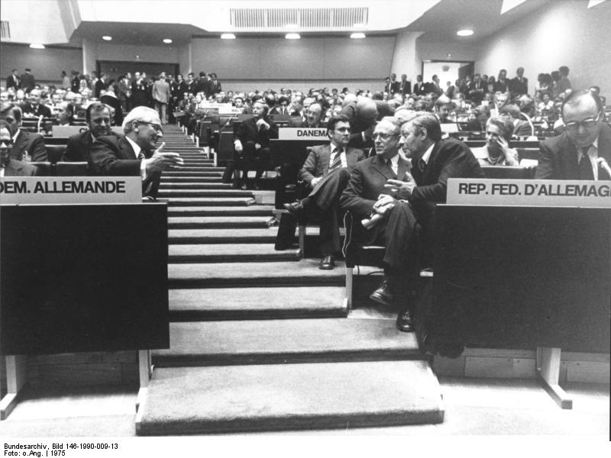
Bundesrepublik Deutschland - Fotodienst 1985 / Nr. 1877

Slide 53
Decalogue
1. (a) Declaration on Principles Guiding Relations
between Participating States
I. Sovereign equality, respect for the rights inherent in sovereignty
II. Refraining from the threat or use of force
III. Inviolability of frontiers
IV. Territorial integrity of States
V. Peaceful settlement of disputes
VI. Non-intervention in internal affairs
VII. Respect for human rights and fundamental freedoms, including the freedom of thought, conscience, religion or belief
VIII. Equal rights and self-determination of peoples
IX. Co-operation among States
X. Fulfilment in good faith of obligations under international law

Slide 54
VII. Respect for human rights and fundamental freedoms, including the freedom of thought, conscience, religion or belief
The participating States will respect human rights and fundamental freedoms, including the freedom of thought, conscience, religion or belief, for all without distinction as to race, sex, language or religion.
They will promote and encourage the effective exercise of civil, political, economic, social, cultural and other rights and freedoms all of which derive from the inherent dignity of the human person and are essential for his free and full development.
Within this framework the participating States will recognize and respect the freedom of the individual to profess and practice, alone or in community with others, religion or belief acting in accordance with the dictates of his own conscience.
The participating States on whose territory national minorities exist will respect the right of persons belonging to such minorities to equality before the law, will afford them the full opportunity for the actual enjoyment of human rights and fundamental freedoms and will, in this manner, protect their legitimate interests in this sphere.
The participating States recognize the universal significance of human rights and fundamental freedoms, respect for which is an essential factor for the peace, justice and well- being necessary to ensure the development of friendly relations and co-operation among themselves as among all States.
They will constantly respect these rights and freedoms in their mutual relations and will endeavour jointly and separately, including in co-operation with the United Nations, to promote universal and effective respect for them.
They confirm the right of the individual to know and act upon his rights and duties in this field.
In the field of human rights and fundamental freedoms, the participating States will act in conformity with the purposes and principles of the Charter of the United Nations and with the Universal Declaration of Human Rights. They will also fulfil their obligations as set forth in the international declarations and agreements in this field, including inter alia the International Covenants on Human Rights, by which they may be bound.

