Slide 1
Soudní dvůr jako aktér evropské integrace
EVS450 EU a LP
Hubert Smekal
(hsmekal@fss.muni.cz)
12. března 2018

Slide 2
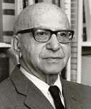
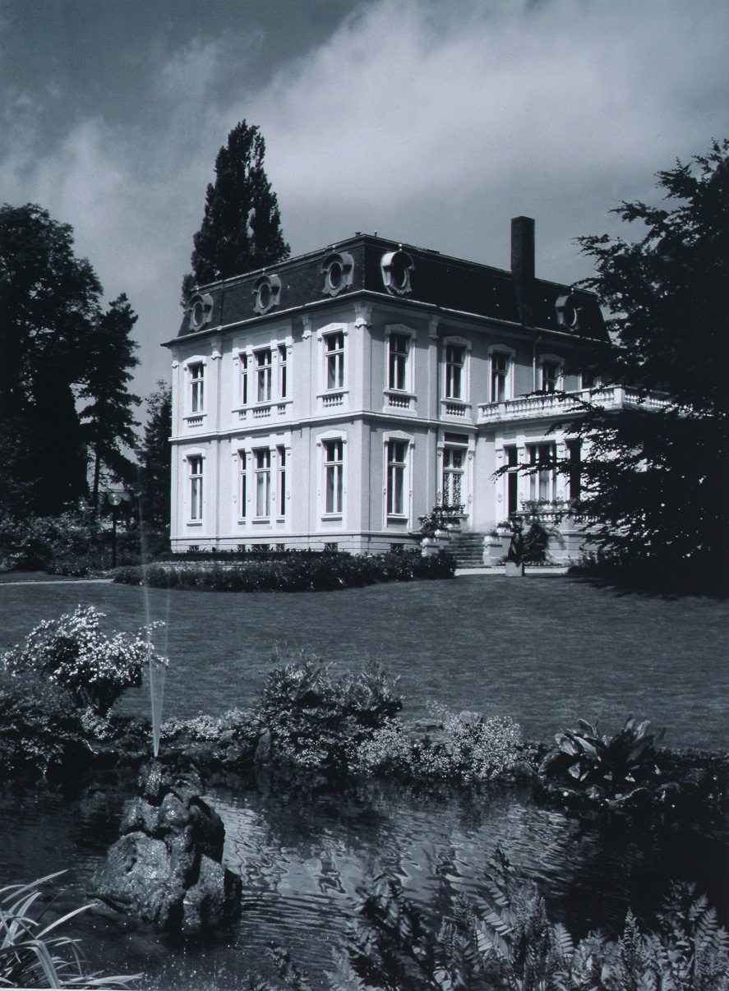
Eric Stein (1981) AJIL
“Tucked away in the fairyland Duchy of Luxemburg and blessed, until recently, with the benign neglect by the powers that be and the mass media, the Court of Justice of the European Communities has fashioned a constitutional framework for a federal-type structure in Europe.”

Slide 3
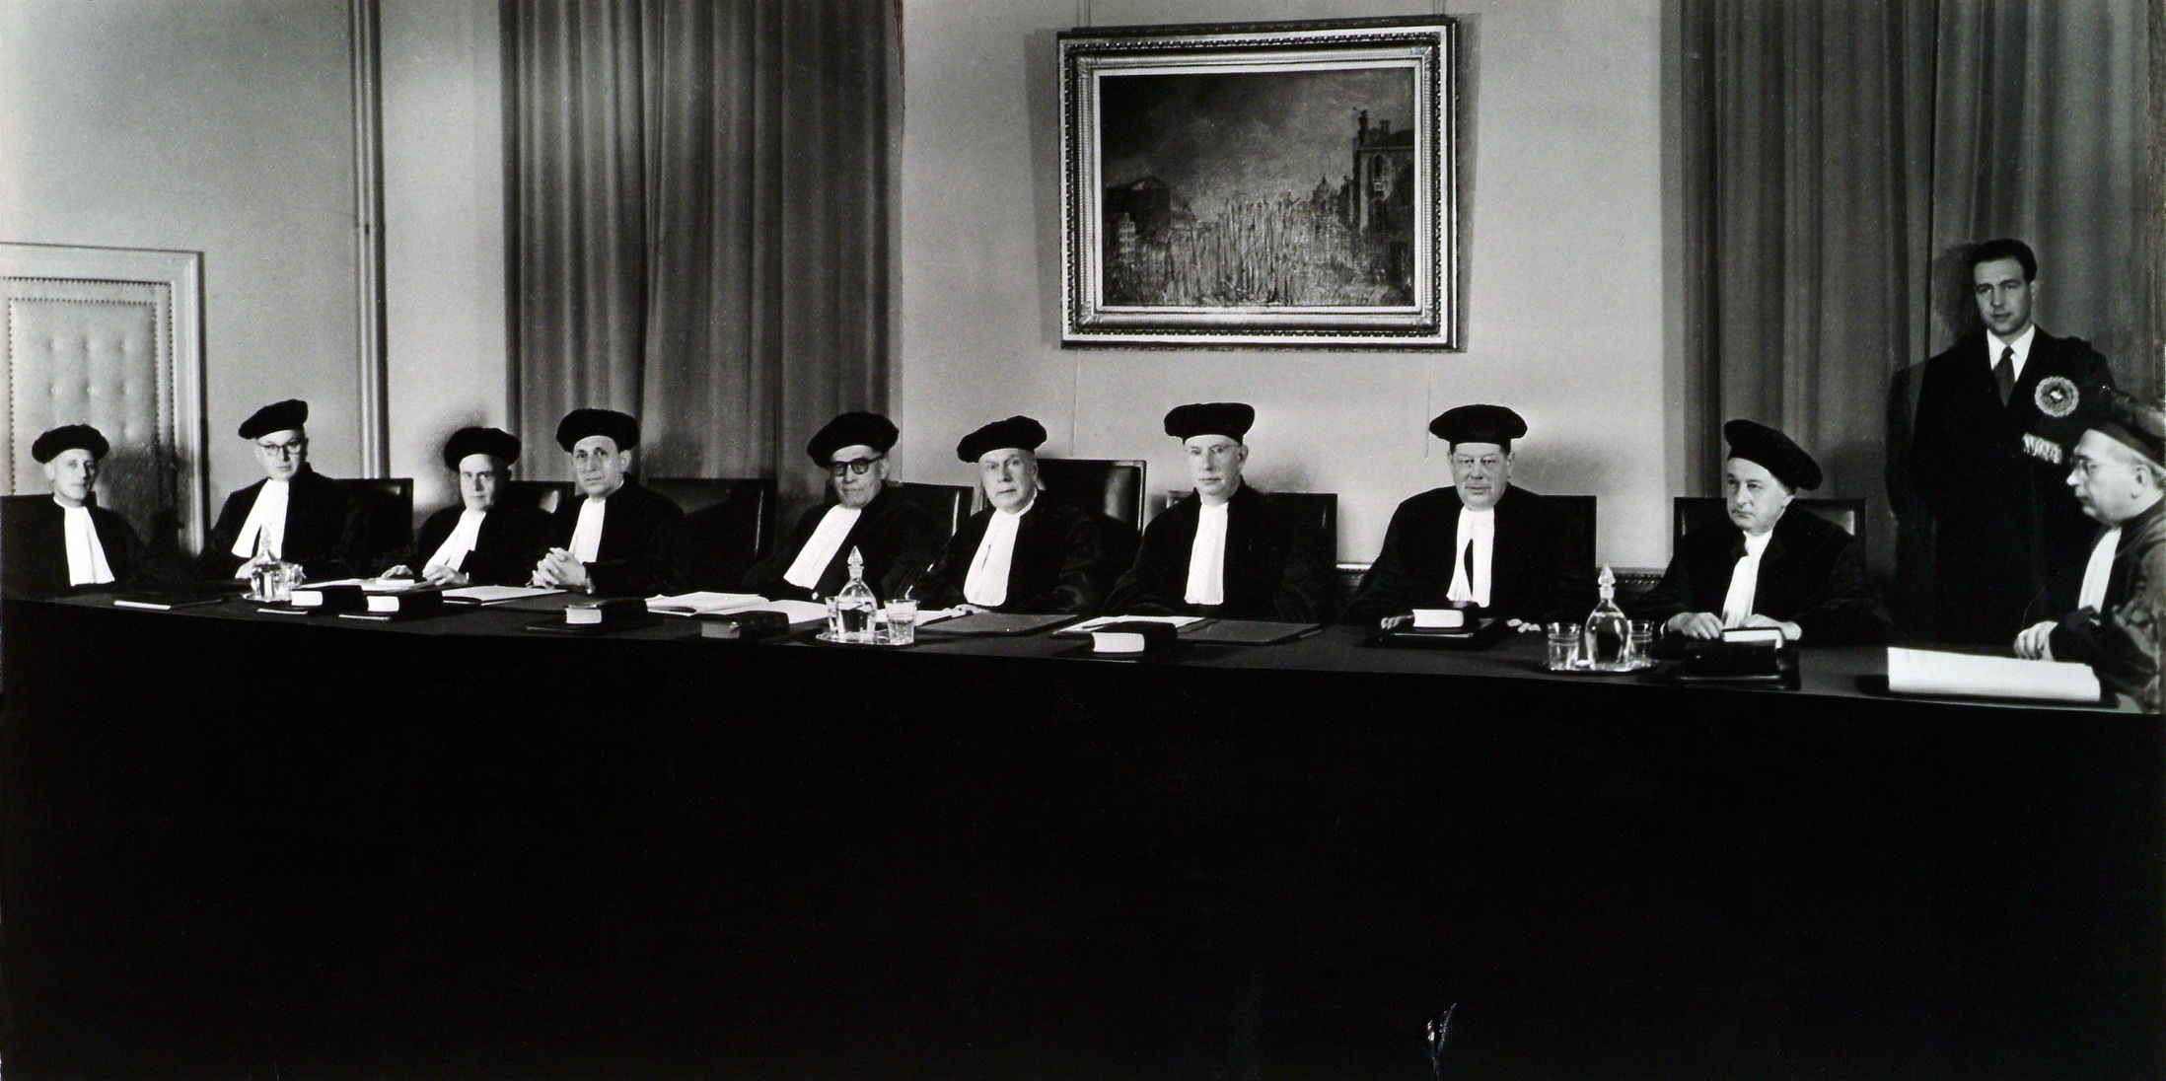
http://curia.europa.eu/jcms/upload/docs/image/jpeg/2012-11/1952-2high.jpg

Slide 4
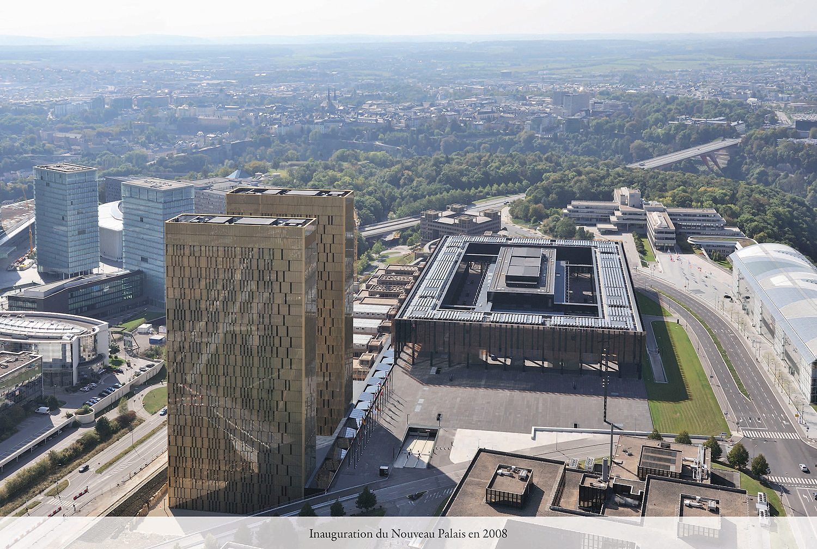
http://curia.europa.eu/jcms/upload/docs/image/jpeg/2012-11/2008-1high.jpg

Slide 5
SDEU
SD
Tribunál (SPI 1988)
SVS (2004)
Dnešní situace

Slide 6
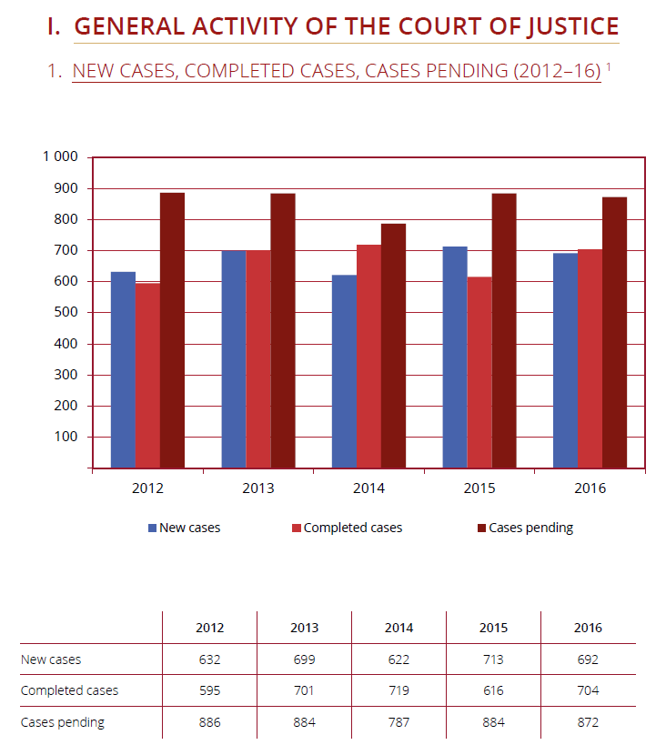
Annual Report 2016 – CJ

Slide 7
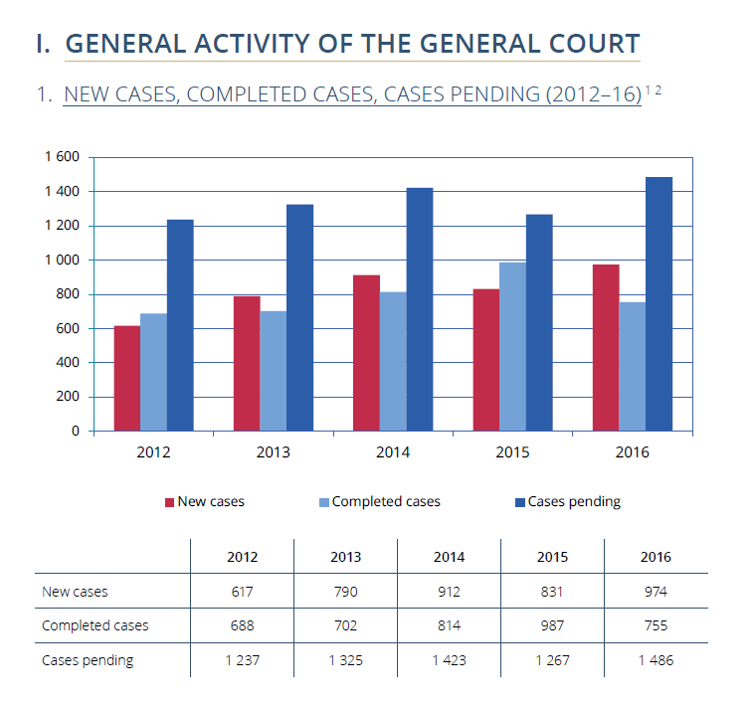
Annual Report 2016 – General Court

Slide 8
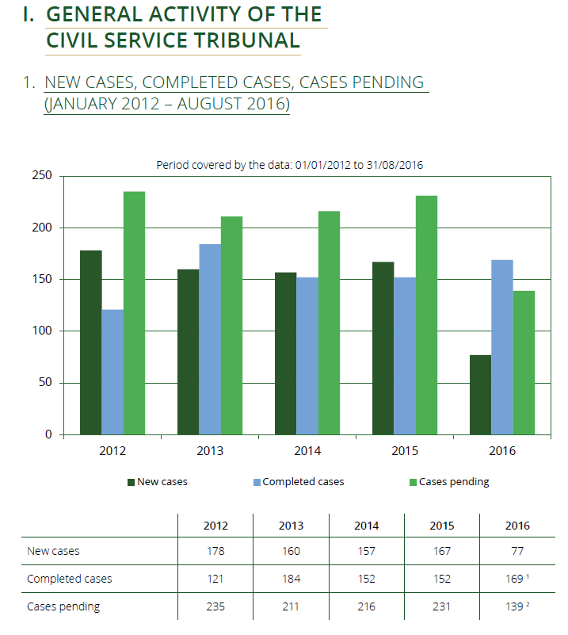
Annual Report 2016 – CST

Slide 9
CJ (Annual Report 2016)

Slide 10
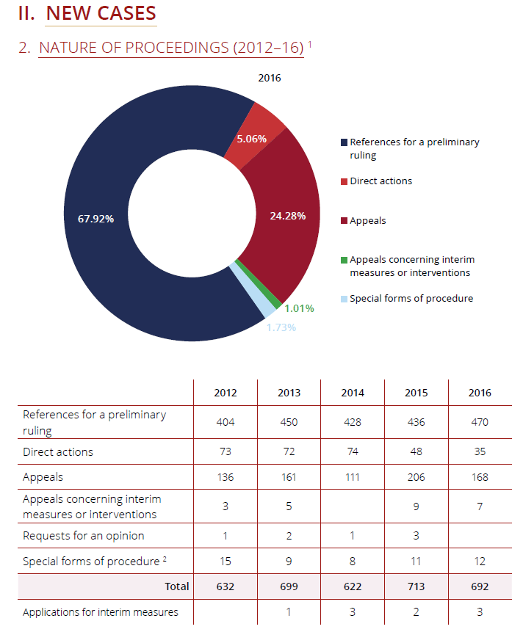

Slide 11
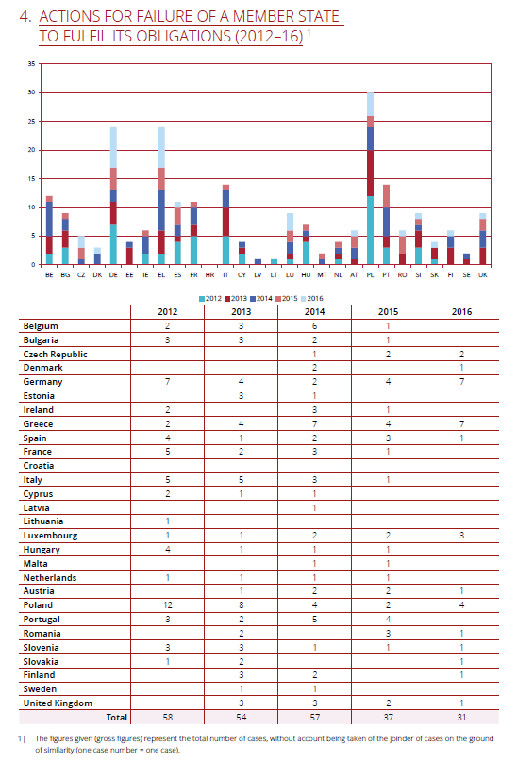

Slide 12
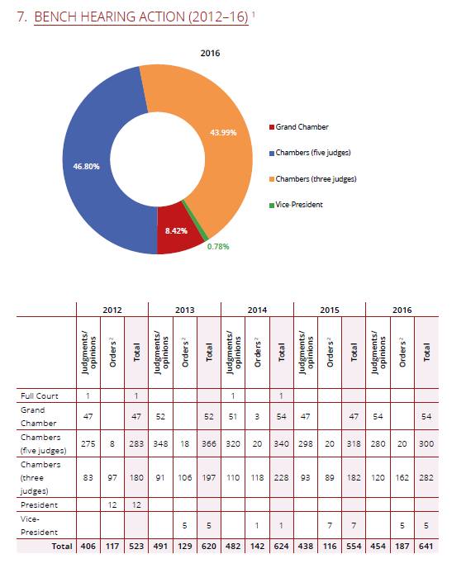

Slide 13
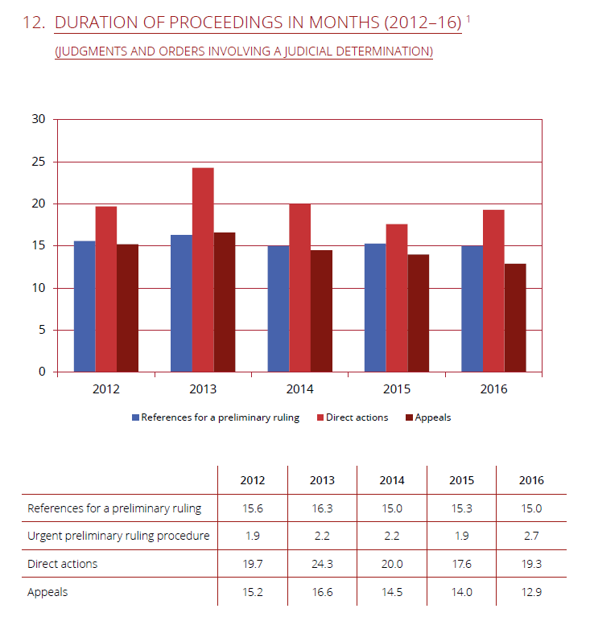

Slide 14
General Court (Annual Report 2016)

Slide 15
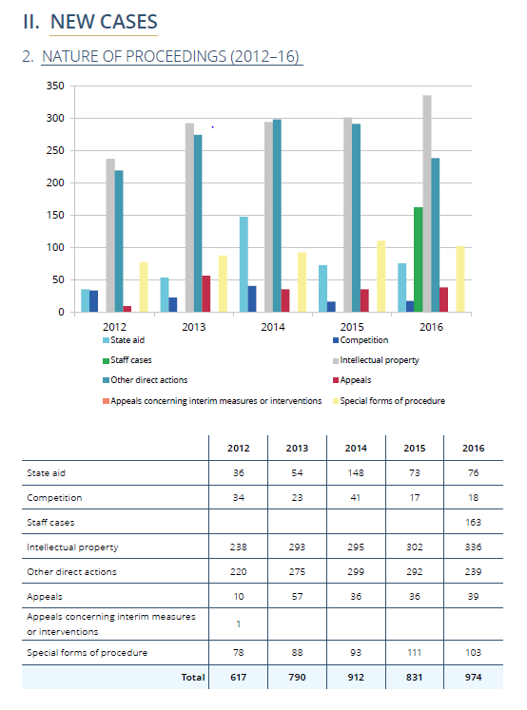

Slide 16
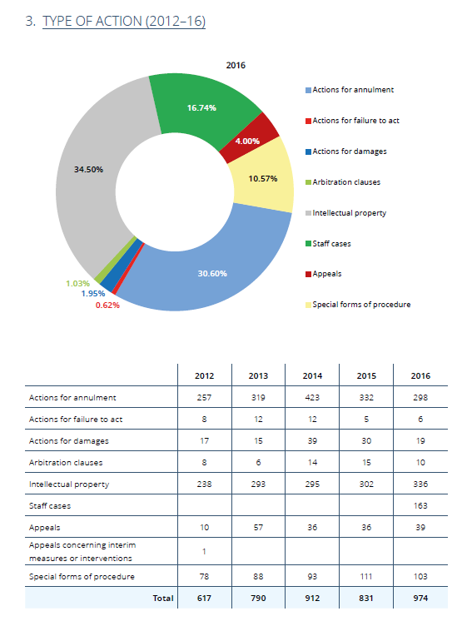

Slide 17
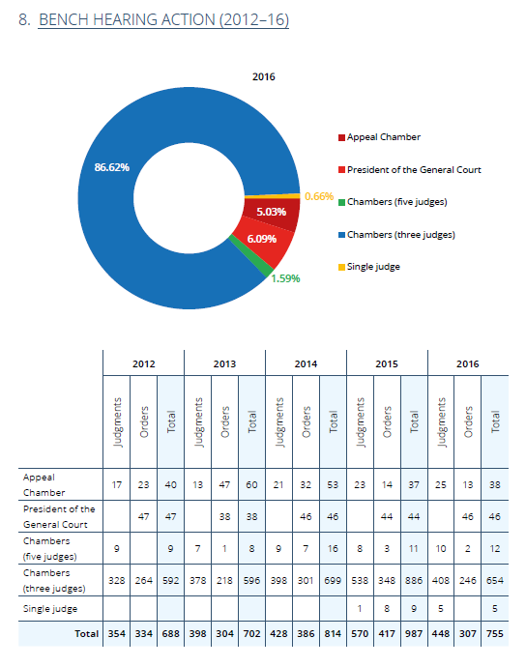

Slide 18
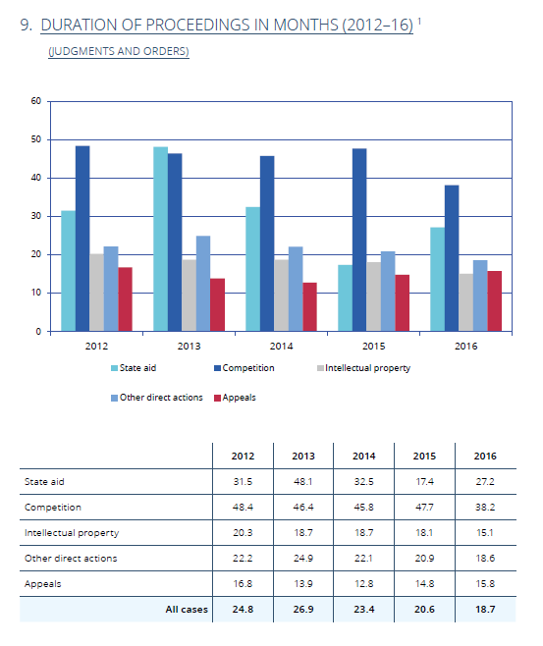

Slide 19
CST (Annual Report 2016)

Slide 20
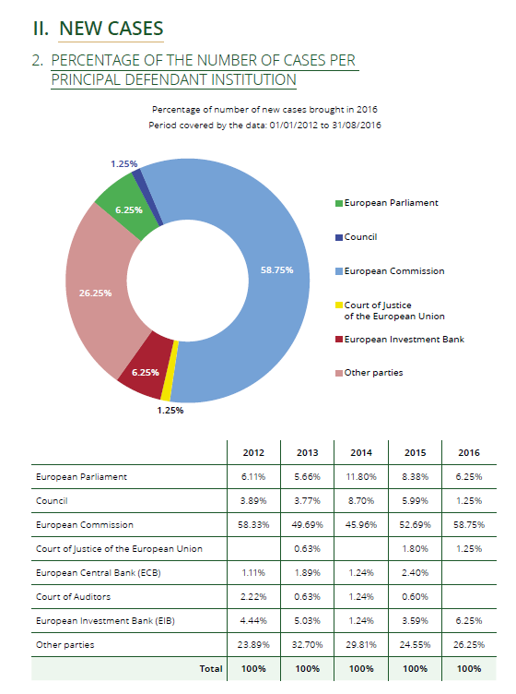

Slide 21
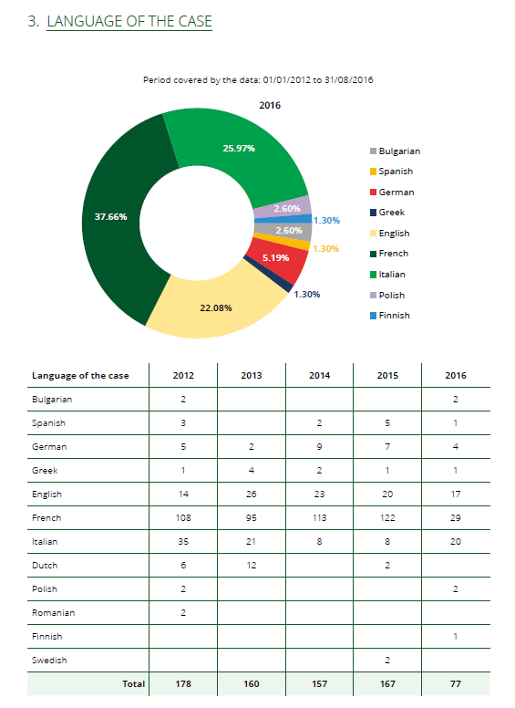

Slide 22
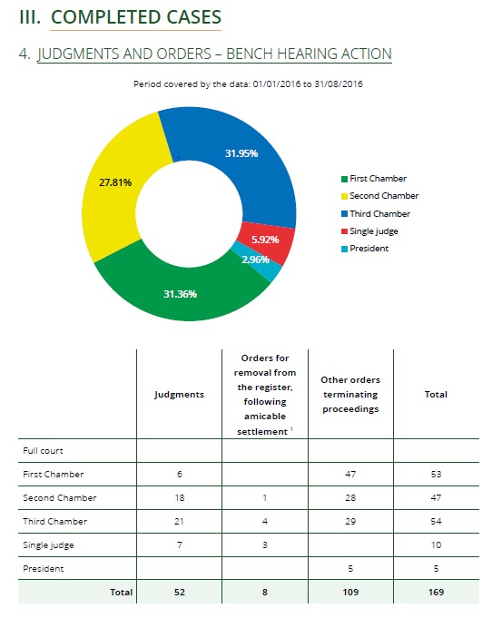

Slide 23
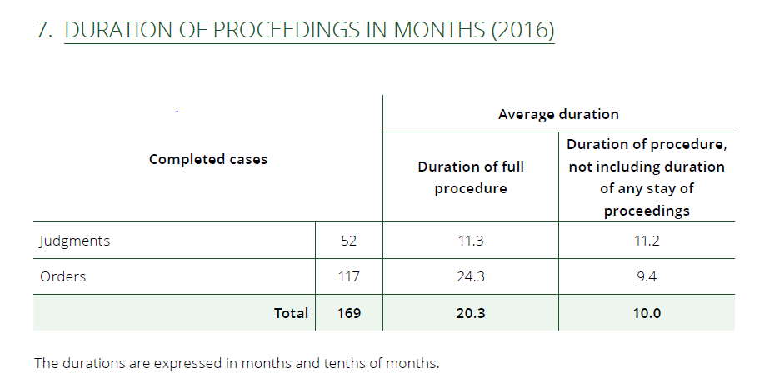

Slide 24
Eric Stein (1981) AJIL

Slide 25
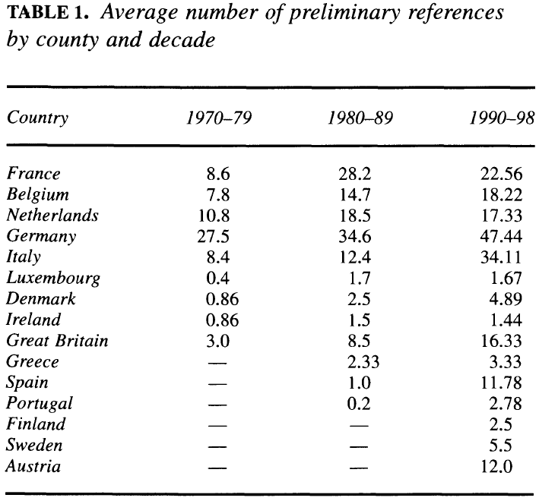
Carrubba - Murrah(2005) IO

Slide 26
Stone Sweet – Brunell (1998). APSR.

Slide 27
Stone Sweet – Brunell (1998). APSR.

