Slide 1
The Lean Years
MVZ248 Week 3

Slide 2
Building an Economy
Lacked foreign currency reserves
Export revenues was less than a third of costs of Imports
Deficit covered by Jewish loan system “Collections”
Financing obtained by foreign banks and gas companies who refused by 1952 to expand available credit.
Austerity implemented (1949-59)
Failure but with advantages of integration

Slide 3
Economic test
1950 immigration brought total 700,000 (doubled size)
Israeli government controlled and distributed necessary resources
Rationing (1,6000 calories a day)
Black market (success dispite Govt. Office and Courts)
War reparations
Germany

Slide 4
Reparations Test
Practical and Logical
Needed money + Foreign relations (enemy)
“Two approaches...one is the ghetto Jew’s approach and the other is of an independent people. I don’t want to run after a German and spit in his face. I don’t want to run after anybody. I want to sit here and build here. I’m not going to go to America and take part in a vigil against Adenauer”
David Ben Gurion (Mapai central committee, 1952)

Slide 5
Agreement
Resettled 500,000 Holocaust survivors, absorbing costs
$3,000 per person (approx. $27,700 today)
Israel owed $1.5 billion dollars by Germany. Additionally, 6 billion dollars worth of Jewish property had been pillaged by the Nazis
West Germany, Government of Israel, representatives of World Jewish Congress
Over 12 years, West Germany paid 3 billion marks ($111.5bn today)

Slide 6
Reparations Test: Protests and Riots
Public debate was fierce. “Did it forgive Germany and Nazis of crime?”
Against reparations were Herut and Mapam notably.
M. Begin led protesters after passionate speech.
Turned violent with arrests following stone throwing and police using gas
Riots resulted in 200 protesters and 140 police injured
Source: Yossi Sarid, “Israel’s great debate” Haaretz
Notes:
passionate and dramatic speech, Menachem Begin led the protesters towards the Knesset. Begin referred to the Altalena Affair in 1948, when the IDF shelled a ship carrying arms for the Irgun by order of Ben Gurion, saying, "When you fired at me with cannon, I gave the order: 'Don't [return fire]!' Today I will give the order, 'Do!'" The demonstration turned violent as protesters began throwing stones at the building's windows while the police used force to disperse them. After five hours of rioting, the police took control of the situation using hoses and tear gas. Hundreds were arrested; about 200 protesters and 140 policemen were injured.^{[6]}
Sarid, Yossi. "Israel's great debate". Haaretz.

Slide 7
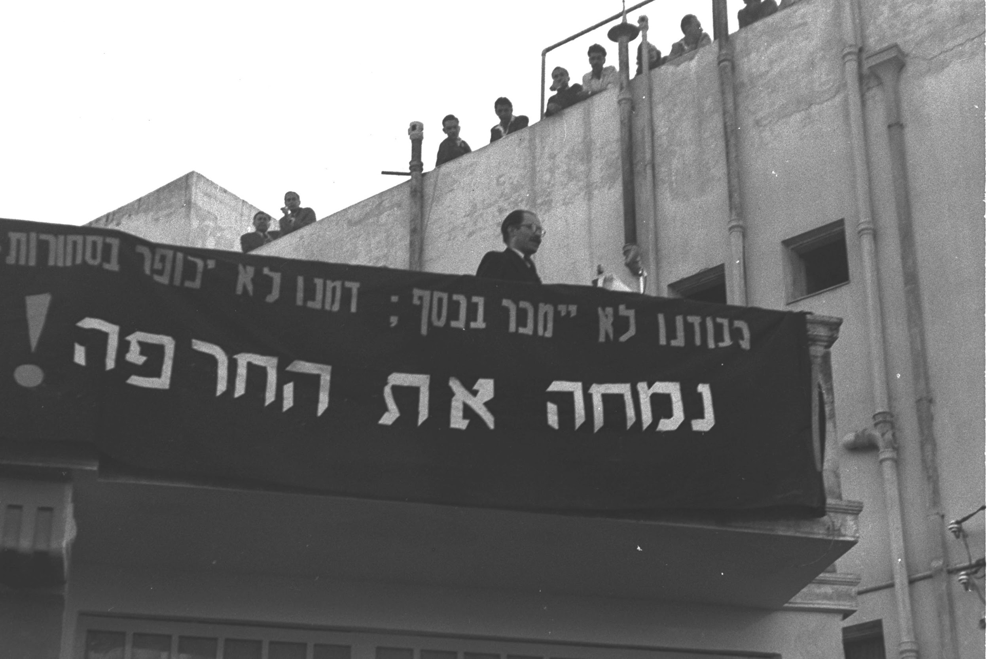
Notes:
March 1952. The sign reads: "Our honor shall not be sold for money; Our blood shall not be atoned by goods. We shall wipe out the disgrace!"

Slide 8
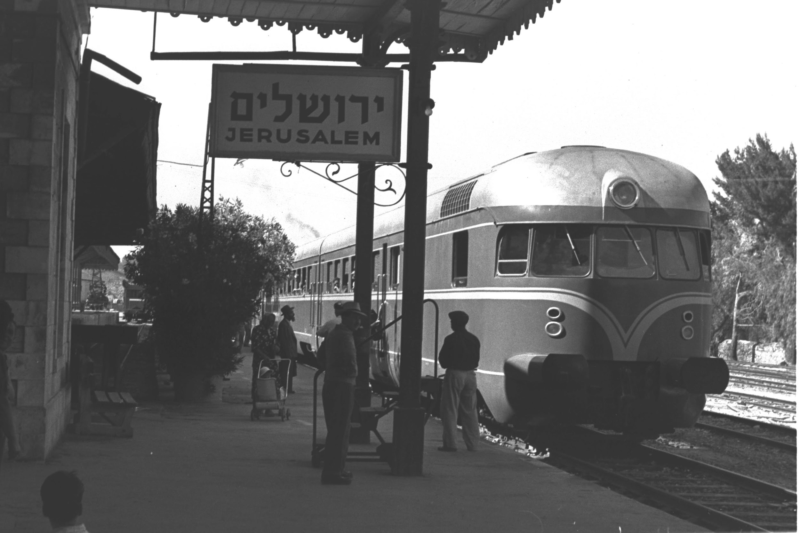
Notes:
Old railway station in Jerusalem. Train constructed from German company, 1956

Slide 9
Put to Good use
Reparations and loans and bonds paid for industrial and agricultural projects leading to economic self-sufficient.
Aid paid for Hadera power plant and port development in Haifa, Ashdod and Eliat
Infrastructure projects
Industrial areas such as Ashkelon, the Negev and Galilee
Textile industry (cotton very profitable) one of the largest industrial branches
Notes:
The proceeds from these sources was invested in industrial and agricultural development projects, which allowed Israel to become economically self-sufficient. Among the projects made possible by the aid was the Hadera power plant, the Dead Sea Works, the National Water Carrier, port development in Haifa, Ashdod, and Eilat, desalination plants, and national infrastructure projects.
After statehood, priority was given to establishing industries in areas slated for development, among them Lachish, Ashkelon, the Negev and Galilee. The expansion of Israel's textile industry was a consequence of the development of cotton growing as a profitable agricultural branch. By the late 1960s, textiles were one of the largest industrial branches in Israel, second only to the foodstuff industry.

Slide 10
1950s and 1960s
Economic growth (10% annually)
International loans, also bonds
Reparations ( example 87% of Israeli income in 1956)
‘Pioneer ideal’
Political monopoly
Mapai (Labour)
Sinai and Suez campaigns

Slide 11
Foreign relations test: Suez
British and French
Economic and diplomatic positions
Strategic position
Canal (shipping, influence)
Military success
International humiliation
End of Empires
Notes:
invasion of Egypt in late 1956 by Israel, followed by the United Kingdom and France. The aims were to regain Western control of the Suez Canal and to remove Egyptian President Gamal Abdel Nasserfrom power.^{[17]} After the fighting had started, political pressure from the United States, the Soviet Union, and the United Nations led to a withdrawal by the three invaders. The episode humiliated Great Britain and France^{[18]} and strengthened Nasser

Slide 12
Foreign Relations: objectives
Canal was conduit of oil (UK and France). Additionally, stop anti-colonial Egypt.
Israel wanted re-open to Israeli shipping and strengthen its southern border and weaken a dangerous, hostile state, attacks from Egyptian Gaza against Israeli citizens (1,3000).
Narrow window of opportunity for all three nations to achieve its goals.
Realism theory
National self-interests
Chaim Herzog and Shlomo Gazit, The Arab-Israeli wars: War and peace in the Middle East from 1948 to the present (2008)
Notes:
Britain was anxious lest it lose efficient access to the remains of its empire. Both Britain and France were eager that the canal should remain open as an important conduit of oil.
Both the French and the British felt that Nasser should be removed from power. The French "held the Egyptian president responsible for assisting the anti-colonial rebellion in Algeria".^{[134]} France was nervous about the growing influence that Nasser exerted on its North African colonies and protectorates.
Israel wanted to reopen the Straits of Tiran leading to the Gulf of Aqaba to Israeli shipping, and saw the opportunity to strengthen its southern border and to weaken what it saw as a dangerous and hostile state. This was particularly felt in the form of attacks injuring approximately 1,300 civilians emanating from the Egyptian-held Gaza Strip.^{[135]}
The Israelis were also deeply troubled by Egypt's procurement of large amounts of Soviet weaponry that included 530 armored vehicles, of which 230 were tanks; 500 guns; 150 MiG 15 jet fighters; 50 Ilyushin Il-28 bombers; submarines and other naval craft. The influx of this advanced weaponry altered an already shaky balance of power.^{[136]} Israel was alarmed by the Czech arms deal, and believed it had only a narrow window of opportunity to hit Egypt's army.^{[137]} Additionally, Israel believed Egypt had formed a secret alliance with Jordan and Syria.^{[138]}
Chaim Herzog and Shlomo Gazit, The Arab-Israeli wars: War and peace in the Middle East from the 1948 War of Independence to the present (3rd ed. 2008) pp. 113–117

Slide 13
Enter America
Kennedy and Meir
‘Special relationship’
The 1967 Six-Day War
Neutrality ended
Hawk missile sale

Slide 14
Further reading
Nana Sagi (1986). German Reparations: A History of the Negotiations. Palgrave Macmillan.
No. 2137 and No. 4961 (PDF) Treaties and international agreements. United Nations Treaty Series.
Patrick Tyler (2012). Fortress Israel: The Inside Story of the Military Elite Who Run the Country. Farrar, Straus and Giroux
Zeev Maoz (2008). Defending the Holy Land. The University of Michigan Press.
Barry Turner (2006). Suez 1956 The World’s First War for Oil. Hodder & Stoughton.
Notes:
Patrick Tyler (2012). "Fortress Israel: The Inside Story of the Military Elite Who Run the Country"(Hardcover ed.). Farrar, Straus and Giroux
Zeev Maoz (2008). "Defending the Holy Land"(Paperback ed.). The University of Michigan Press.
Turner, Barry (2006). Suez 1956 The World's First War for Oil. London: Hodder & Stoughton
Sagi, Nana. 1986. German Reparations: A History of the Negotiations. Palgrave Macmillan.
"No. 2137: ISRAEL and FEDERAL REPUBLIC OF GERMANY Agreement (with schedule, annexes, exchanges of letters and protocols). Signed at Luxembourg, on 10 September 1952" (PDF). Treaties and international agreements filed and recorded from 20 March 1953 to 31 March 1953 (PDF). United Nations Treaty Series (in English and French). 162. pp. 205–311.
"No. 4961: ISRAEL and FEDERAL REPUBLIC OF GERMANY Agreement. Signed at Luxembourg, on 10 September 1952." (PDF). Treaties and international agreements registered from 7 November 1959 to 9 December 1959 (PDF). United Nations Treaty Series (in English and French). 345. pp. 91–97.

