Slide 1
Women and party politics
POL612 March 27, 2018

Slide 2
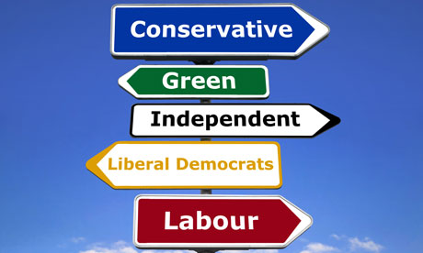
Why parties?

Slide 3
Political parties
Key political actors
Key gatekeepers
Structure of opportunities
“an implicit goal of feminist infiltration of parties is to secure changes in attitudes about gender, mainly by increases in understanding and awareness of gender differences and their implications for power relations“(Lovenduski 1995)
Descriptive representation
Substantive representation and feminization of party programs

Slide 4
How parties shape women‘s opportunities?
Party competition can spur effort to get women
Most influence in relation to money and votes (Young 2000)
Scandal or major election failure (Beckwirth 2007)
Weaker electoral competition and smaller parties (leaders) (Bashevkin 2010)
Labour Party: after years of losses, women‘s votes matter
Contagion of pro-women measures (eg. Canada, Norway, South Africe)

Slide 5

Case study

Slide 6
Belgium
Measures for gender balanced participation
Parties compete to outperform each other in meeting the standard
Opens way for new laws on quotas
More effective than if only individual parties adopt quotas
Belgium adopted quota in 1994 (updated in 2002)
Pre quota: 2 parties had quota
After the change of law: parties adopt internal measures (target figures); mostly go further than the 1994 quota: more balanced or double quota
Existence of party measures paved way to 1994 quota, the quota imposed incentive to parties to adopt further rmeasures, these aved way to the 2002 reform

Slide 7
Party ideology
The main predictor of inclusion of women
Duverger 1955: Political Role of Women
  Rural/urban areas
  Electoral systems
  Time
  Different parties: Left (Communists and Socialists) and Christian Democrats give women a better chance. Center and Right put significantly less female candidates

Slide 8
IDEOLOGY
Traditional cleavage: left-right
But does it matter less today?
Right-wing parties also include more women, e.g. D. Cameron,, Latin America, CDU..
Is ideology losing its power?
Not exactly….

Slide 9
Erzeel and Celis 2016: Ideology and women‘s substantive representation
Abandon the one-dimensional measure of ideology
Two dimensions: socio-economic and post-material
Post-materialist left more connected to feminist post-materialsims
2008-2012 PARTIREP comparative survey among MPs
(AT, BE, DE, FR, HU, IT, NL, NO, PL, PT, ES, SE, UK)

Slide 10
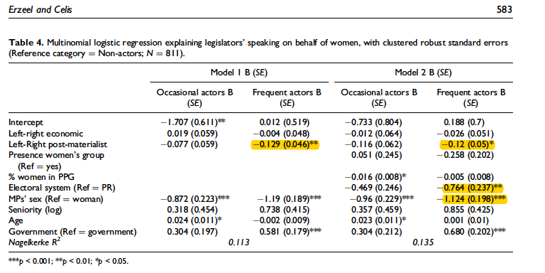

Slide 11
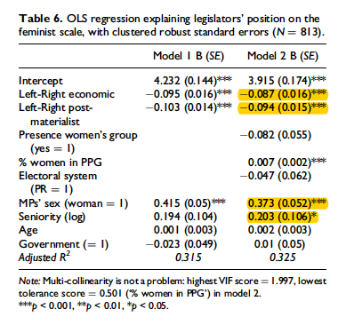

Slide 12
Circumstances contextual factors
1. Are some political institutions more hospitable to the promotion of women?
2. Are parties more likely to promote women when there is a strong women‘s movement present?
Comparison of Germany (Western) and the UK in 1980s and 1990s
Similarities: class-based partisanship, strong soc.dem. parties, experience of second wave feminism
Differences: pol. system and electoral system (at that time West Germany had proportional electoral system)

Slide 13
UK and West germany
UK in 1970s: 3,7% female MPs; in 1980s 6,5%
GER in 1970S: 6,6 %; in 1980s 15,4%
What brings change?
1) if necessary to secure majority
2) not doing it would mean loss of electoral support
3) change of system (Lovenduski 1997)
All three happened n 1908s

Slide 14
UK and West germany
UK, neglect of women issues by all parties, in 1980s change:
1) women no longer more likely to vote Conservative
2) Labour women strengthened organization, pressure on party
3) Third party appeared in 1981, efforts to win women‘s votes, strategies to nominate women
Process of competitive bidding began
Labour: new strategies to promote women‘s rights, Shadow Minister of Women, promise of 50 % quotas within three electoral cycles
Conservatives: slower, momentum when threat of losing re-election, Shadow Minister of Women, promise to increase number of candidates

Slide 15
UK and West germany
West Germany, female voters volatile, SPD tried targeting women in 1983, weak feminist presence in the parties, few women in the parties. But then..
The Green Party, mobilizing feminist constituency
Representation of women became issue, six women in the leadership of the parliamentary wing
CDU: 1985 Congress as opportunity to highlight the need to promote women in the party, promis to nominate women in proportion to membership
SPD: radical reaction of women, positive action, 50 % of female candidates by 1990s, in 1988 40% quota
More successful than UK because of the system is more open
Institutions matter! But feminism as well

Slide 16
The Big jump in the UK
The big jump came with NEW LABOUR in 1997
Labour had incentives to promote women candidates (after 18 years in opposition)
All-women shortlist
And the result?

Slide 17
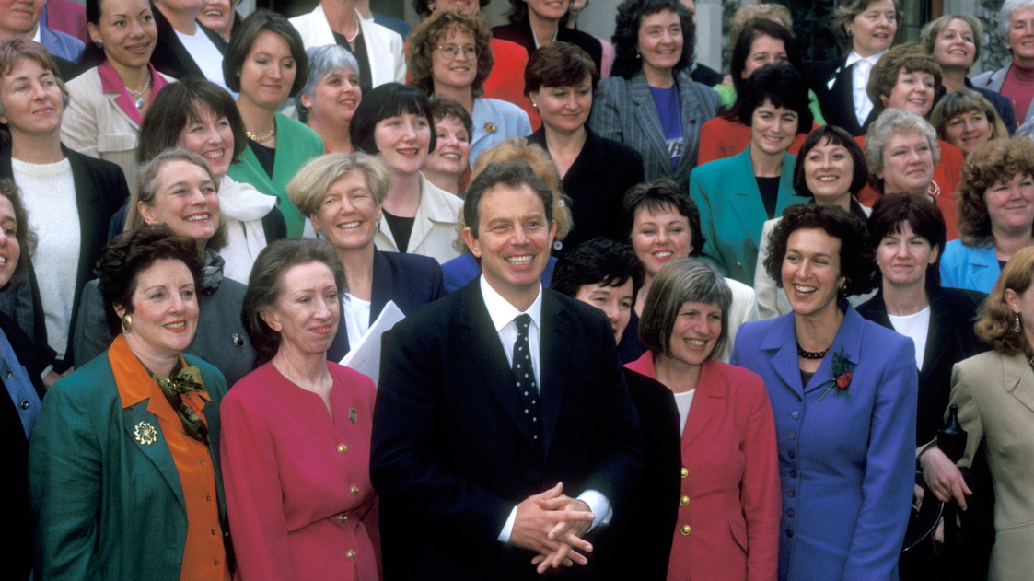
The Blair babes: 101 out of 120 female MPs

Slide 18
Conservative party progress slower
David Cameron stated underrepresentation as a major problem for his party in 2009
Discussions of all-female shortlists
Factor Theresa: inspiration by Theresa May in 2017, half of the seats available for women

Slide 19
How about women party member‘s organizations?
Women‘s section important in the past
Mobilization
Even before female suffrage
In 1980s rise of women‘s activites and demands
Dilemma: party structures or movement?
Scandinavian countries as an example
Change of the role of the sections

Slide 20
women party member‘s organizations
Do women‘s sections prevent women from integration?
Not a modern feature
Arties abolishing these

Slide 21
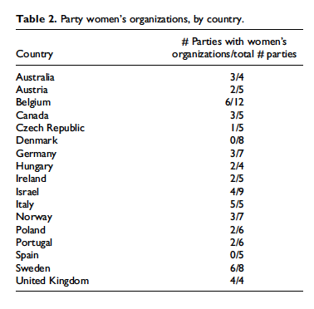
Kittilson and childs 2016

Slide 22
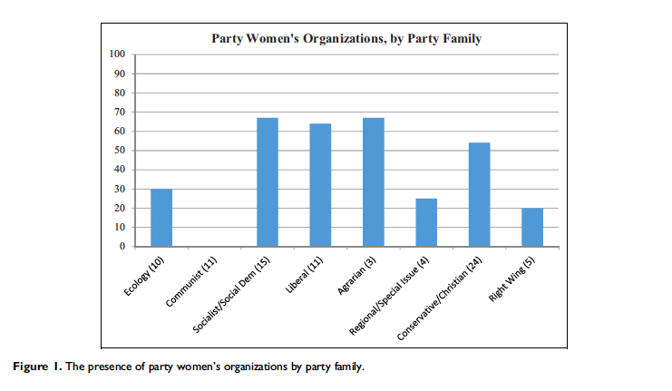
Women‘s sections by party family

Slide 23
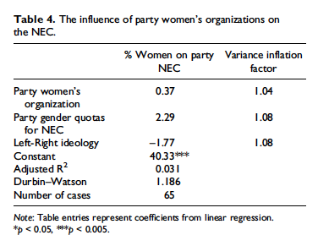

Slide 24
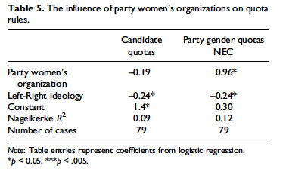

Slide 25

Differences across parties
Conservative Women‘s Organization (CWO);
Women2win;
CWO Muslim Women Group; Women‘s Summits and Forum;
Vice-Chairman for Women
Shadow Minister for Women
Women‘s Policy Group of MPs

Slide 26
SOCIAL MOVEMENT
What is the role of women‘s movement?
Feminist critique of parties and partisanship
Parties unresponsive, hollowed out institutions (critique from the left)
Feminist movement blames parties from lack of representation of women
E. Evans (2016) interviewed feminist activists in the UK and US
  Parties run by men, serving men‘s interests,
  Real politics takes place outside electoral legislative sphere
  Pursue change beyond legislative sphere
  Parties represent only mainstream interests, pragmatic players

Slide 27
Feminist allies and Strategic allies
1) individual politicians (across parties) pursuing progressive agenda
2) strategic partners on the right, pursuing the same goals (mostly for different reasons
Non-partisan status enables feminist activists to collaborate strategically with all relevant actors
Alliances between radical feminism and conservative rigt; same policy ends, different motivations

Slide 28

More topics
ELECTORAL SYSTEMS
WOMEN‘S PARTIES
…… all on your reading list

