Slide 1
Seminar: Quota Politics
1840559440
POL612 April 10, 2018

Slide 2
Do we need quota?
How do you understand quota? What does it mean?
Why is this controversial?
What about quota and democracy?
What is the dominant discourse in your country?
Quota: yay or nay?

Slide 3
Mansbridge, jane: Quota problems: combat the dangers of essentialism

Slide 4
Mansbridge, jane: Quota problems: combat the dangers of essentialism
Descriptive representation necessary for substantive and symbolic representation
Lower than proportional representation caused by discrimination against the group
Quotas are the most effective way to achieve desc.rep.
Group interests cannot be effectively represented when:
  Representatives who are member of the group tend to respond to group relevant issues with greater concern than others (concern)
  They can communicate better among themselves, with other representatives, constituents from that group (communication)
Major challenge: quota reinforce stereotypes and essentialism
What is the way to fight essentialism? (representation of women/men, what about different women?)
  To talk about the ways in which the differences between groups are caused by structural biases

Slide 5
Baldez, lisa: the pros and cons of gender quota laws: what happens when you knock men out and let women in?

Slide 6
Baldez, lisa: the pros and cons of gender quota laws: what happens when you knock men out and let women in?
Quota fever since 1990s
Quota effect: increase of number of women (in the right conditions)
But how about democratization of process of candidate selection?
Quotas can challenge the status quo, destroy monopoly of (male) dinosaurs
But in centralized nomination processes it can strengthen the current structures as well (new legitimacy to the old process)
Gender quota n Latin America strengthen highly centralized undemocratic process
More women, but the dynamics remains the same
Example: Mexico 2002 (70:30%), in case of primary elections quotas don‘t apply
The effects are not straightforward
But it can „fuel our political imagination“

Slide 7
Krook, mona Lena: Gender Quotas, NoRms, and politics

Slide 8
Krook, mona Lena: Gender Quotas, NoRms, and politics
More countries adopt quota despite normative objections
Increase in women‘s representation despite social and economic prerequisites
Broad shift in international norms, quota as global trend
Normative concerns: political equality and representation vs. privilege of one group, undermining equality of opportunities ignoring more salient cleavages
Objections:
  Quota women can‘t pursue women-friendly policy change
  Undermining female actors even those who won on their own
Quota lead to broad positive changes (political agenda, ender consciousness,, engagement of female constituencies)
Holding office has effects on 1) women who believe they have not been victims of discrimination, 2) second-class citizens
Quota show the biases of prior recruitment processes
Shift in responsibility for women‘s underrepresentation from women to political elites

Slide 9
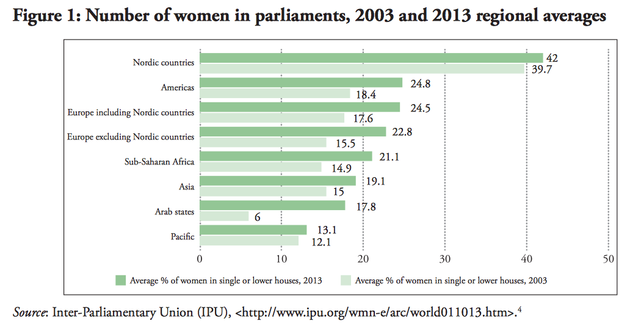
Politics of gender quota
Some type of quota in over half of the countries in the world
Increase of women in elected offices after 2000
Project IDEA

Slide 10
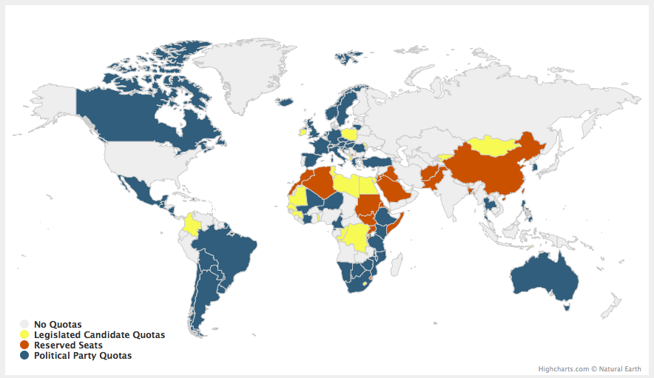
Source: www. IDEA.int

Slide 11
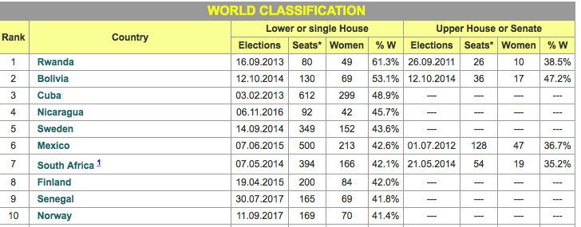
TOP 10 Countries right now

Slide 12
Defining quotas
Affirmative measure which ensures that there should be certain number or proportion of women among those who are nominated or elected
Numbers and percentages
Fast-track policy goal
Quotas either for women or gender neutral

Slide 13
Types of quotas
PARTY CANDIDATE QUOTA
LEGISLATIVE QUOTA
RESERVED SEATS

Slide 14
Quota measures
Most common in PR electoral systems
France and Mexico – plurality systems, single-member constituencies
Rank order rules (double quota): placement of mandates on the list
Legal sanctions for non-compliance, refusing of list is the most effective

Slide 15
Quota discourse
Traditionalists deny that there is a problem of underrepresentation
Resistance to quota, conviction that its women's‘ free choice
Quota, affirmative action etc. = special treatments
VS.
Promotion of justice in society
International organizations support affirmative action
“Temporary special measures” (UN CEDAW 1975)
“Measures against discriminative practices” (UN Beijing Action Platform 1995)
High legitimacy of these documents

Slide 16
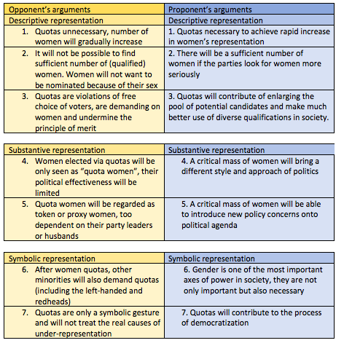
Arguments pro and against quota (dahlerup 2017)

Slide 17
Should there be quotas for men???
Rainbow Murray 2014
Need to reframe the debate
Problem of overrepresentation of men!
There is no merit in current system

Slide 18
The big quota controversy
A Czech female Senator (ongoing research):
“We are thinking about (intra-party) mechanisms, how to bring them (women) there. We don‘t want quotas. I don‘t think that would be the ideal model. But our ideal model is to have at least one third of eligible positions occupied by women. That is, when the six first positions are eligible, there should be at least two women.“

Slide 19
Waves of quota measures
1st wave: 1970s and 1980s Scandinavia (and Communist regimes)
2nd wave: after 1991 (Argentina) in Latin America, Beijing Action Plan 1995
3rd wave: current reforms of quota measures (to make them effective)

Slide 20
Quotas world wide
Reserved seats: Asia, Middle East, North Africa
Legislative quota: Latin America, Europe, Africa
Party quota: Europe, South Africa
EU countries form party to legislative quota: France, Belgium, Portugal, Slovenia, Spain, Croatia, Poland

Slide 21
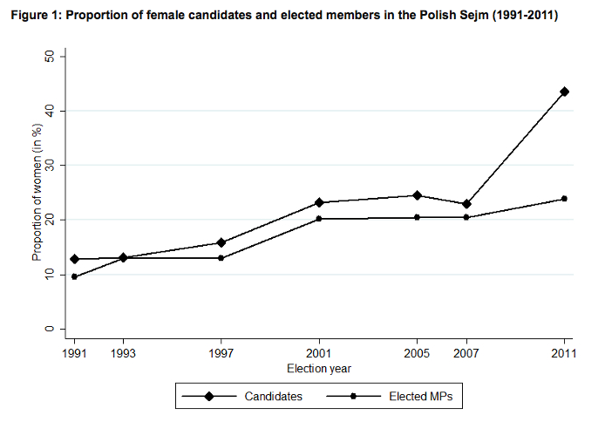
POLISH CASE

Slide 22
Driving forces
1) regional adoption of gender quotas
2) international organizations
3) domestic women‘s movement, intervention within parties
Number of structural factors not important
(Gender Quota Database 2014)

Slide 23
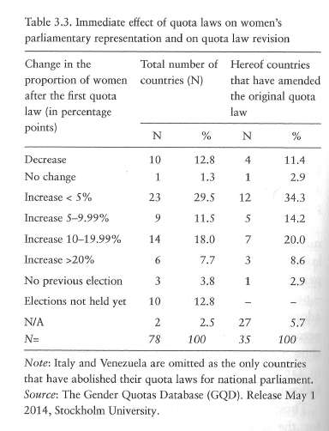
Effectiveness

Slide 24
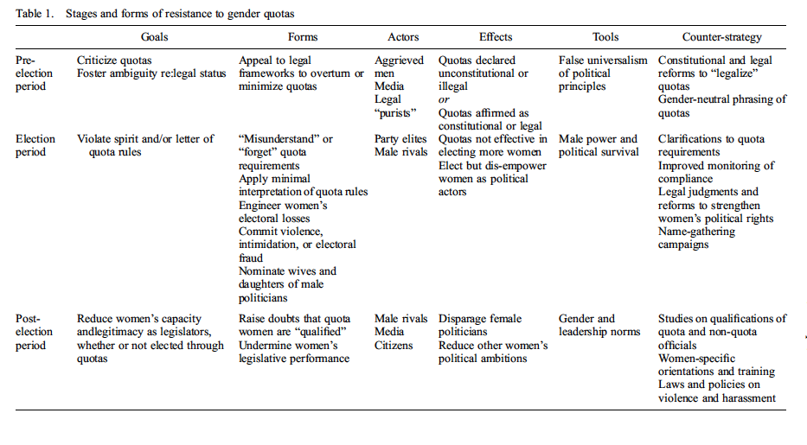
Quota resistance (Krook 2016)

