Slide 1
SOC606 – Sociologie rodiny
Martin Kreidl
27.2.2018

Slide 2
Druhá demografická tranzice
Lesthaeghe, van de Kaa (1986): 2DT = „interrelated changes in fertility, family formation, and partnership behaviour, which started in the late 1960s in many countries of Western and Northern Europe“
1. Fertility below replacement levels (higher order parties are reduced)
2. Massive postponement of parenthood (Modern contraception+ other goals)
3. Cohabitation+union instability: rising out of wedlock births

Slide 3
Zdroje a koreláty
structural changes (modernization, the growth of the service economy and the welfare state, the expansion of higher education)
cultural changes (secularization, the rise of individualistic values, the importance of self-expression and self-fulfilment)
technological changes (the adoption of modern contraception, the advances in assisted reproduction, the explosion of new information technologies) (van de Kaa 1994)

Slide 4
Current fertility levels
Source: Frejka, Sobotka (2008)

Slide 5
Current fertility levels
Source: Frejka, Sobotka (2008)

Slide 6
Current fertility levels
Source: Frejka, Sobotka (2008)

Slide 7
Age at 1st birth
Source: Frejka, Sobotka (2008)

Slide 8
Completed cohort fertility
Source: Frejka, Sobotka (2008)

Slide 9
Completed cohort fertility ii.
Source: Frejka, Sobotka (2008)

Slide 10
Childlessness

Slide 11
Childlessness

Slide 12
Childlessness

Slide 13
Diskuze k 2DT

Slide 14
Rozdíly od 1DT
van de Kaa (1996: 425) 2DR is a “quintessential narrative of ideational and cultural change,”
main distinction from the first demographic transition - “overwhelming preoccupation with self-fulfillment, personal freedom of choice, personal development and lifestyle, and emancipation“
„as reflected in family formation, attitudes towards fertility regulation and the motivation for parenthood.”

Slide 15
Re-definice
van de Kaa (2002: 29) “while below replacement fertility currently is a crucial element of the Second Transition, this need not be a permanent state.”

Slide 16
Kritiky
Cliquet (1991): there is no apparent discontinuity between the first and the second demographic transition
Recent changes are “a new acceleration in relational and reproductive patterns, associated to modernization”

Slide 17
Terminologie
The idea of a ‘transition’ suggests that there is a ‘final state,’
  a new demographic regime
  convergence
Lesthaeghe and van de Kaa
  did not formally define a starting point
  did not envision any quantifiable endpoint of the transition

Slide 18
Micro-macro paradox
Individual level – growing plurality of family forms and trajectories
Macro-level: convergence in demographic indicators

Slide 19
But
Historically – Europe had diverse (regional) types of family behavior
  They persist
  Hence – no convergence
de Beer, Corijn and Deven (2000: 124): different types of changes in F&F do not fit into „one model of the second demographic transition”

Slide 20
Lack of synchronicity
synchronicity between the behavioural and value changes is (often) missing (e.g. Romania, early 1990s)

Slide 21
2DT is centered on (North-western) Europe
Is it going to spread to other parts of the world?
  But evidence from the US (Lesthaeghe and Neidert 2006) & Japan (Matsuo 2001, Rindfuss et al. 2004)
Q: Do new values also spread into CEE?

Slide 22
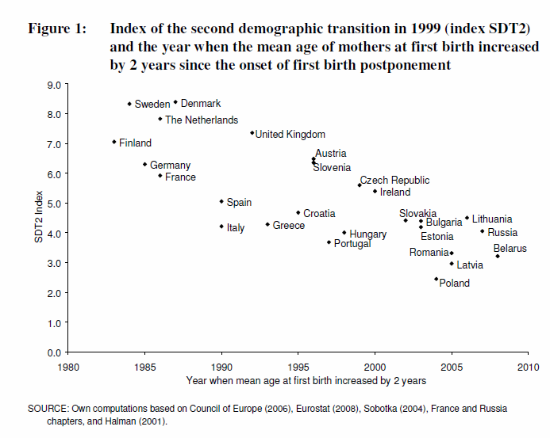
Sobotka, T. 2008a. Overview Chapter 6:The diverse faces of the Second Demographic Transition in Europe. In Demographic Research. 19 (8): 171-224.

Slide 23
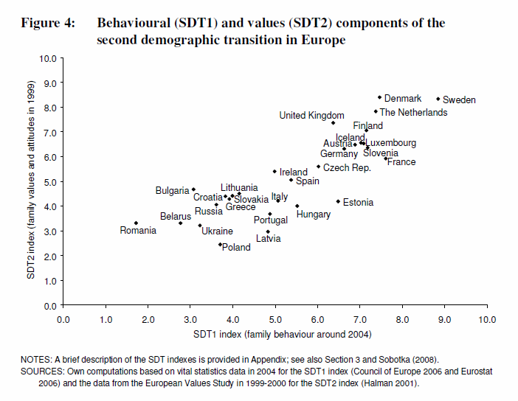

Slide 24
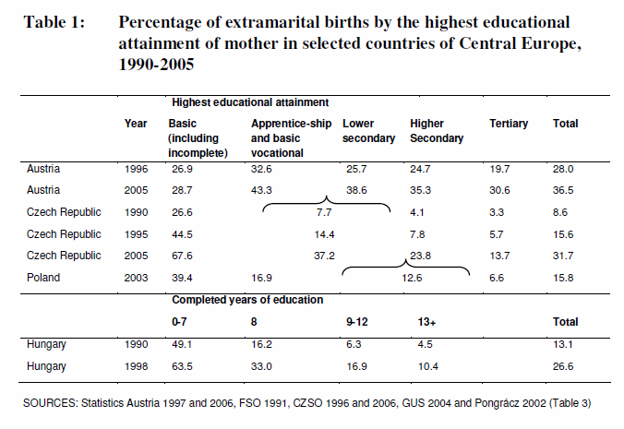

Slide 25
Explanations
RWA (readiness, willingness, ability, Coale, 1973) framework
  Readiness: ‘cost-benefit calculation’ (there exist economic, social, and psychological advantages of adopting new behaviour)
  Willingness - cultural and ethical acceptability; legitimacy of the new behavior
  Ability refers to the technical or legal means that enable individuals to adopt new behaviour

