Slide 1
Antonio Gramsci
Culture and Media
Barbora Sittová
Patricija Fašalek
Martina Valentíková

Slide 2
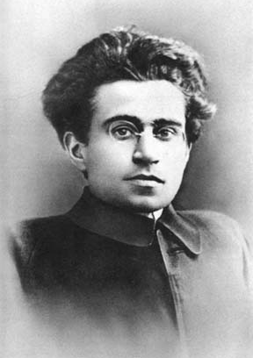
1891 – 1937
Italian philosopher and politician
inspired by: Karl Marx Niccolo MachiavelliVilfredo Pareto Georges Sorel Benedetto Croce
co-founder of the Communist Party of Italy (1921)

Slide 3
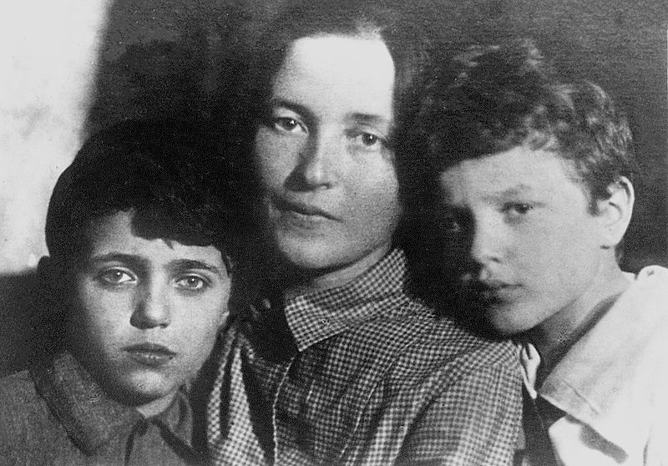
Personal & political
canceled his studies at the University of Turin due to his poor health
1913 member of the Italian Socialist Party
as a representative of the Communist Party travelled to Moscow to learn, how to fight against fascism (Benito Mussolini)
he got married in Moscow, but his wife and two sons stayed there, while Gramsci travelled back to Italy as a chief leader of the Party

Slide 4
In prison
despite his parliamentary immunity he was arrested and imprisoned in 1926
at the trial, Gramsci’s prosecutor stated: „For twenty years we must stop this brain from functioning“
Gramsci actually received a sentence of 20 years‘ imprisonment, but due to his state of health he was released in 1937, only several days before he died
the sentence however didn’t stop Gramsci from „this brain functioning“ – he wrote more than 3000 pages of essays, first published in 1950s as Prison Notebooks

Slide 5
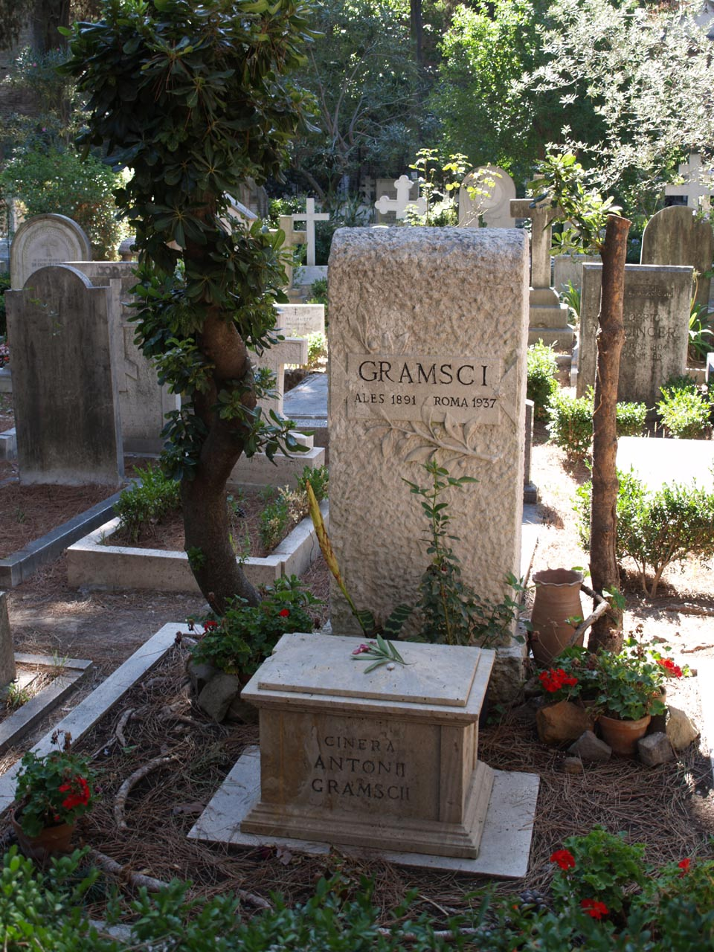
After death
he never saw his second son
his essays were first published in 1950s as Prison Notebooks
thus Althusser, another Marxist theorist, influenced cultural studies before Gramsci, although the latter had an mental influence on the former

Slide 6
Ideology - History of Subaltern Classes
- A historical method for understanding how the subaltern classes are formed.
- 2 groups: the ruling classes and the subaltern classes
- Ruling classes: historically united and their unity is realized through their control of the State
- Subaltern classes: part of the civil society, not united.

Slide 7
Subaltern classes can unite - in phases
It is therefore necessary to study:
1. the objective formation of the subaltern social groups, their developments and transformations occurring in economic production; their quantitative diffusion and their origins in pre-existing social groups
2. their active or passive affiliation to the dominant political formations, their attempts to influence the programmes of these formations, and the consequences of these attempts;
3. the birth of new parties of the dominant groups to maintain control over subaltern;
4. the formations which the subaltern groups themselves produce
5. new formations which assert the autonomy of the subaltern groups, but within the old framework;
6. those formations which assert the integral autonomy

Slide 8

Social groups come to power in two ways: as “domination” and as “intellectual and moral leadership” - ideological control, given by consent (hegemony)

Slide 9
The Concept of “Ideology”
“Ideology”: first aspect of “sensationalism”, “science of ideas” or “analysis of ideas”, “investigation of the origin of ideas”.
The meaning changed with Marxist philosophy: now negative value judgment, suggests that “Ideology” itself must be analysed historically and as a superstructure.
Gramsci: ideology is distinct from the structure: structure can change the ideology using different means such as mass media.
2 types of ideology – 1. historically organic, psychological, which organize masses, acquire consciousness of their position, struggle etc., 2. arbitrary, which create individual movements and controversy.

Slide 10

Cultural Themes: Ideological Material
Material organizations: aimed at maintaining, defending and developing the theoretical or ideological:
- press (books, newspapers, publishing houses).
Ideology is moulded by culture and everything which influences or is able to influence public opinion, directly or indirectly, belongs to it:
- libraries, schools, associations and clubs of various kinds, architecture, names of streets

Slide 11
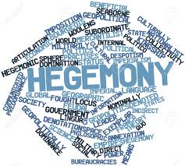
Hegemony
the word hegemony originally comes from Greek
it means domination and leadership
he uses this concept for indication of more difficult domination type than was used traditionally
Gramsci makes his concept of hegemony as the answer to the question: How is it possible that the western ideology could stay alive?
Gramsci explains functioning of ideology in modern capitalist countries by the specific principle of domination in concept of hegemony

Slide 12
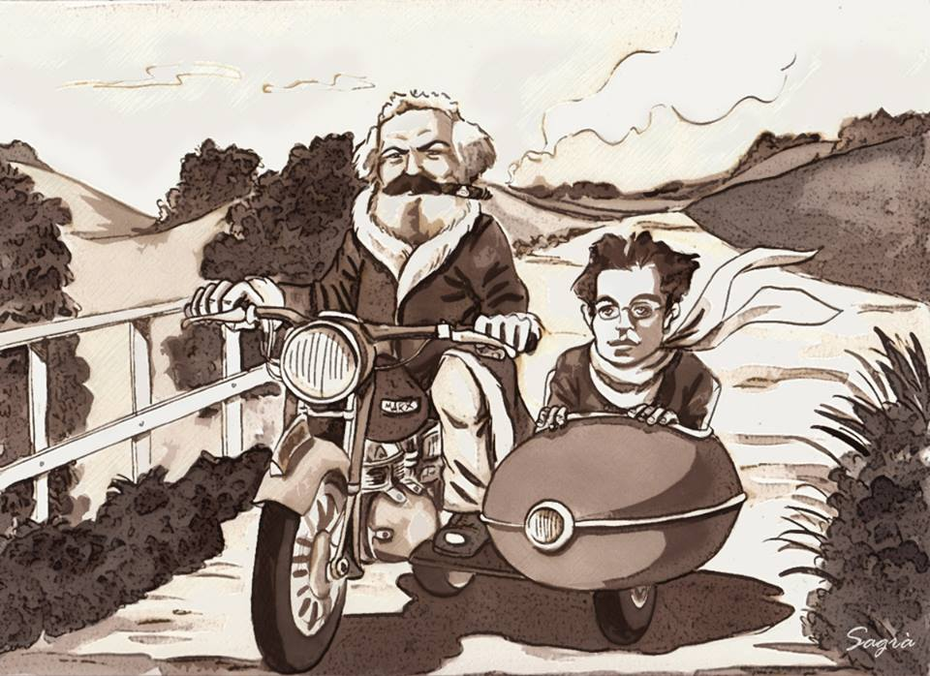
Gramsci vs. Marx
in line with Marx Gramsci can see the simple fact that predominant ideas or ideologies of the epoch are identical to the ruling class ideology
Gramsci did not want to argue with his claim that every form of government is a dictatorship
but he does not share the claim that the dictatorship is the only form of government that directs the masses
he asks why the Marxist movement did not win and did not control the society

Slide 13

Cultural Hegemony
dominance of one one social group over another
it means that a diverse culture can be ruled or dominated by one group or class
the theory claims that the ideas of the rulling class come to be seen as the norm
everyday practises provide the foundation for complex systems of domination

Slide 14

What else?
the stability of Gramsci‘s concept of cultural hegemony is provided by three basic pillars which are in continuous interaction
they are ideological, institutional and process pillars
a social class can dominate through cultural norms
how media may serve as a propaganda tool to promote the dominant ideology of the power elite

Slide 15
Thank you for your attention!

Slide 16
Resources
Bates, Thomas. Gramsci and Theory of Hegemony. In: Journal of the History of Ideas.
Critical and Cultural Theory Resources. Gramsci, A. (2006). (i) History of the subaltern classes; (ii) The concept of “ideology”; (iii) Cultural themes: Ideological material. (2013, December 3) Retrived from: https://criticalculturalresources.wordpress.com/2013/12/03/gramsci-a-2006-i-history-of-the-subaltern-classes-ii-the-concept-of-ideology-iii-cultural-themes-ideological-material-in-m-g-durham-d-kellner-d-eds-medi/
Gramsci, A. (1967). Základy politiky. (Out of edition). Prague: Mladá fronta.
Gramsci, A. (2006). (i) History of the subaltern classes; (ii) The concept of “ideology”; (iii) Cultural themes: Ideological material. In M. G. Durham &amp; D. Kellner, D. (Eds.), Media and cultural studies keyworks (pp.13-17). Malden, MA: Wiley-Blackwell.
Jones, S. (2006). Antonio Gramsci. Abingdon: Routledge.
Louai, El Habib. (2013). African Journal of History and Culture. Retracing the concept of the subaltern from Gramsci to Spivak: Historical developments and new applications.Vol. 4(1), pp. 4-8.
Pinto, Anil. (2011, February 10). "History of the Subaltern Classes" "The Concept of Ideology" "Cultural Themes: Ideological Material"- Antonio Gramsci. Retrived from: http://anilpinto.blogspot.cz/2011/02/history-of-subaltern-classes-concept-of.html
Radice, L. L., & Carbone, G. (1953). Život Antonia Gramsciho (1st ed). Prague: Státní nakladatelství politické literatury.
Strinati, D. (1995). An introduction to theories of popular culture. (1st ed.). London: Routledge.
Turner, G. (1996). British Cultural Studies: An Introduction (2nd ed.). London and New York: Routledge.
Williams, Cherly. (2016, June 15). Gramsci (1930) “History of the Subaltern Classes” “Ideology” “Ideological Material”. Retrived from https://cherylwilliams.wordpress.com/2016/06/15/gramsci-history-of-the-subaltern-classes-ideology-ideological-meterial/
Woolcock, A. Joseph. (1985). Social and Economic Studies. Politics, Ideology and Hegemony in Gramsci's Theory.Vol. 34 No.3, pp.199-210.

