Slide 1
Pierre Bourdieu:
The Forms of Capital
Martina Bořutová, Tereza Holotíková and Michaela Vaisová

Slide 2
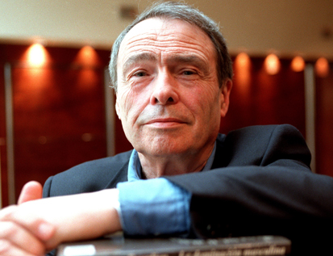
Pierre Bourdieu
Pierre Bourdieu was born in 1930 in southern France
He received classical philosophical education
Bourdieu changed relatively soon philosophy for social sciences
Bourdieu published about thirty books
His work is the result of the synthesis of the knowledge ethnological field research with a theoretical concept
Structuralism and existentialism Bourdieu rejected
Bourdieu is considered as a poststructuralist
His sociological views were formed of his own experience and life career

Slide 3
Timeline of Pierre Bourdieu
Bourdieu began his scientific career as an ethnologist of the Maghreb community
In the 1960s he continued ethnological study of rituals, kinship and social change in Kabyle
Since 1964 Bourdieu worked as a professor of sociology at the École pratique des hautes études en sciences sociales
During the seventies, he continued to research a wide range of interconnected themes, such as culture, class, and power
In 1975 he founded a periodical Actes de la Recherche en Sciences Sociales
From 1981 until his death in 2002, he worked as a professor of sociology at the College de France

Slide 4
Pierre Bourdieu – Main Ideas
Bourdieu in his work presents an original synthesis of theory, methodology and epistemology
Bourdieu says the social world has its own objective and subjective side
Sociology according Bourdieu is not only a reconstruction of objective relationships, but also researching of the subjective experience and orientation of the participants
The concept of Bourdieu consists of several basic concepts such as habitus, field, and capital
The term habitus indicates to the appearance, the image, the way of expression and the unusualness of the personal style of behavior
With this concept is related a term of dispositions, which means a tendency to certain behavior
Practice forming from habitus is realized in a structured framework called a field

Slide 5
The forms of capital
What is capital?
Economical capital
Social capital
Cultural capital
  The embodied state
  The objectified state
  The institutionalized state

Slide 6
https://www.youtube.com/watch?v=5DBEYiBkgp8&t=3s

Slide 7
Distinction:
A Social Critique of the Judgement of Taste
Culture – anthropological sense
Cultural capital - A person's education (knowledge and intellectual skills) that provides advantage in achieving a higher social-status in society
Society as a judge
Class fractions
Taste

Slide 8
Is the institutionalized state (which includes diploma or degree) important today?
Does society respect more economical or social capital (it means for example relationships)?

Slide 9
Resources
BOURDIEU, Pierre. The Forms of Capital [online]. 1986 [cit. 2018-04-15]. Dostupné z: https://is.muni.cz/auth/el/1423/jaro2018/ZUR436/um/readings/week_9/bourdieu_forms_of_capital.pdf
ŠUBRT, Jiří. Postavy a problémy soudobé teoretické sociologie: sociologické teorie druhé poloviny 20. století. Praha: ISV, 2001. Sociologie (ISV). ISBN 80-858-6677-3.
RŮŽIČKA, Michal a Petr VAŠÁT. Základní koncepty Pierra Bourdieu: pole – kapitál –habitus. AntropoWebzin [online]. 2011 [cit. 2018-04-15]. Dostupné z: http://www.soc.cas.cz/sites/default/files/publikace/ruzicka-vasat-2-2011.pdf
LACHMANN, Filip. Loïc Wacquant: teorie a dílo Pierra Bourdieu [online]. 2012 [cit. 2018-04-15]. Dostupné z: http://socialniteorie.cz/loic-wacquant-teorie-a-dilo-pierra-bourdieu/#ref2
Pierre Bourdieu. In: Culture on the Edge [online]. 2015 [cit. 2018-04-16]. Dostupné z: https://edge.ua.edu/tag/pierre-bourdieu/

