Slide 1
Queer Theory
Alana Fiero, Tomáš Hambálek, and Fabián Sosa

Slide 2
The Beginning
1990s, Teresa de Laurentis
Roots
  Gay and Lesbian activism
  AIDs activism
  Feminism
  Poststructuralist theory

Slide 3
Key Concepts
Challenge heteronormativity
Deconstruct social norms
Interdisciplinary and intersectional
  Race, gender, class, etc.

Slide 4
Additional Contributions
Michael Foucault
Gayle Rubin
Eve Kosofsky Sedwick
Judith Butler

Slide 5
Readings
Susanne Freimüller
Adrienne Shaw

Slide 6
“Queer” term
A vague umbrella term
Unifies different sexual identities that are not normative
Ignoring other differences (race, class…)
Solidifies the binary conservative approach

Slide 7
Categorization in Relation to Sexual Identity
Heterosexual
Queer
Binary conception

Slide 8
“Masculine Continuum”
(Halberstam, 1998)
Borders between identities
Overlapping of identities can cause border wars
  Lesbians - FTMs

Slide 9
Categorization
Involves two different processes
being categorized by outsiders
being categorized by oneself
This categorization may contradict
One can identify as a man, but pre-transition look to society as a butch (masculine lesbian)

Slide 10
Putting the Gay in Games: Cultural production and GLBT
Critics to the evolution narrative of GLBT representation
“Gaymers” tend to think it will come gradually.
Stakeholders invest money in queer representation
Western world based study.
In Japan and Korea ,games with homoerotic content is more common.
    Video games are not seen as children’s toys.

Slide 11
Stereotypical representation
Members of the collective would prefer not to be represented at all than to be represented stereotypically
Representation pretends to normalize and make these identities more common
Symbolic annihilation

Slide 12
Money first
Game companies fear that if their product is labelled as “gay” or “queer” on the market, they might miss sales from the heterosexual majority.

Slide 13
How to represent them
When you need a character to hold a gun or kill zombies, developers may not pay much attention to their sexual orientation
Shaw suggests adding queer characteristics just in case it benefits the game itself.
Having a game just about being queer could be counterproductive

Slide 14
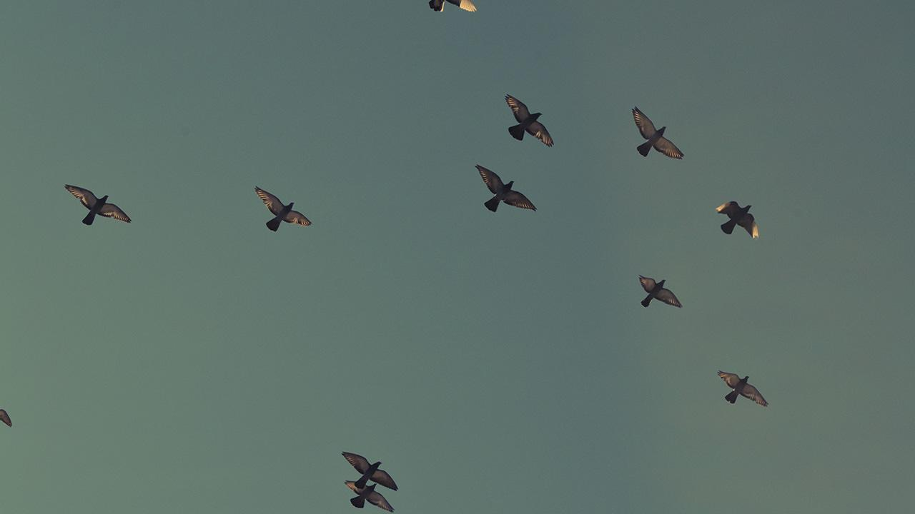
Future & Conclusion
Constantly
transforming
Fear that it has
already peaked
Any questions?

Slide 15
Works Cited
Dyer, R. (1999). Stereotyping. In L. Gross, & J. D. Woods (Eds.), The Columbia reader on lesbians & gay men in media, society & politics. New York: Columbia University Press.
Freimüller, S. Categorization in Relation to Sexual Identity. 8-12.
Gerbner, G., & Gross, L. (1976). Living with television: The violence profile. Journal of Communication, 26, 172-199.
Halberstam, J. (1998). Transgender Butch. GLQ: A Journal of Lesbian and Gay Studies 4(2), 287-310.
Hall, S. (1992). The Question of Cultural Identity. Modernity and its Futures. 277.
Halperin, D. (1995). Saint Foucault: Towards a Gay Hagiography, New York: Oxford University Press.
Jagose, A. (2005). Queer Theory. In M. C. Horowitz (Ed.), New Dictionary of the History of Ideas 5, 1980-1985.
Jagose, A. (2009). Feminism's Queer Theory. Feminism & Psychology, 9(2), 157–174.
Shaw, Adrienne. (2009). Putting the Gay in Games. Games and Culture 4(3), 228–253.
Watson, K. (2005). Queer Theory. Group Analysis 38(1), 67–81.

