Slide 1
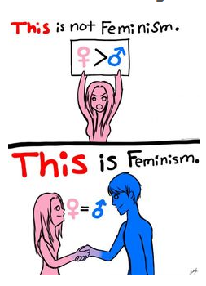
Feminism
feminism is not man hating

Slide 2
Feminism is About Equality for the both gender
Feminism is a range of political movements, ideologies, and social movements that share a common goal: to define, establish, and achieve political, economic, personal, and social equality of sexes

Slide 3
Waves of Feminism
First-wave feminism (roughly the 19th century to the beginning of the 20th century) is characterized by the critique of de iure inequality and thus the struggle for basic human rights as well as for women and their incorporation into legislation
Second-wave (roughly 60-80s of the 20th century) focused primarily on combating inequalities , fight for equality in society (primarilly working one)
Third-wave of feminism (began in the early 1990s) focuses on gender differences and includes issues of domestic violence, maternity leave, equal pay, women's suffrage, sexual harassment, and sexual violence
Fourth-wave feminism (from 2012 to today) is the resurgence of interest in feminism that began around 2012 and is associated with the use of social media

Slide 4
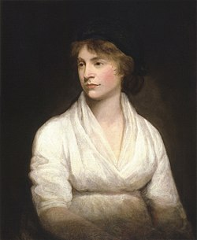
First- wave
The aim of the first wave of feminism was to grant the right to vote, the right to education and property ownership
The inspiration for feminist movement were the Great French Revolution and the American Revolution, which ensured equality of voting rights, but only for men and women began to demand the same rights
Mary Wollstonecraft – most important feminist of this period, she is regarded as the "fore-mother" of the British feminist movement and her ideas shaped the thinking of the suffragettes - women which ones campaigned for women's vote
Women's electoral law – New Zealand 1893, United Kingdom 1918, Czechoslovakia1919, a, 1920 USA and France 1945

Slide 5
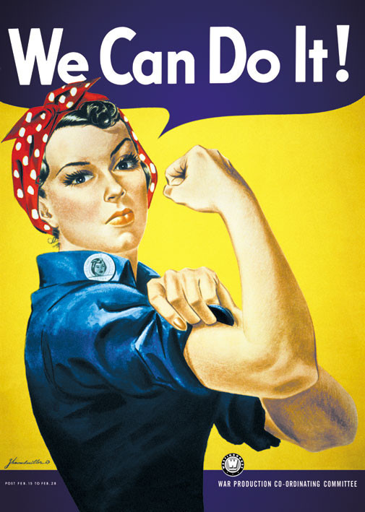
Second-wave
Second-wave feminism is a period of feminist activity and thought that began in the United States in the early 1960s and lasted roughly two decades
The main theme of this wave is the position of a woman in society, disagreement with their exclusion from public life and disagreement with their housewife position
Betty Friedan - important feminist of this wave wrote the bestselling book The Feminine Mystique. She explicitly objected to how women were depicted in the mainstream media, and how they placed them at home limited their possibilities and wasted potential
Women have gained access to all professions

Slide 6
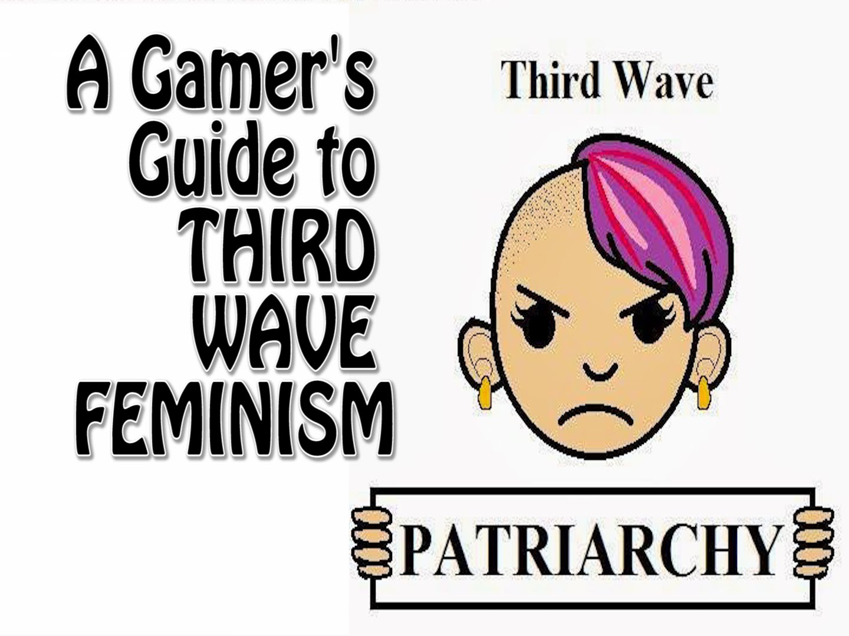
Third-wave
Arose as response to the the failure of the second wave
multiple feminism
heavily influenced by academic investigations of queer theory
→ gender and sexuality are fluid categories, do not easily map into “men” and “female”
increased understanding of bisexuals and transgender identities
has been critiqued for its focus on individual emanciation
“individualism”

Slide 7
Fourth-wave
due to Internet, there us a shift from third wave – mainly social media
internet has created a “call-out” culture
Still influenced by the third wave
internet has facilitated the creation of a global community of feminists - discussion and activism
feminism is being reinvigorated by the Internet

Slide 8
Pro and cons
enables to start the discussion X does it have any result?
feminist discussion can be often ‘hidden’ from those who are not sufficiently networked.
Not enough support in political represention (internet needs to help)
giving the biggest voice to those who can afford and use technology (digital divide)

Slide 9
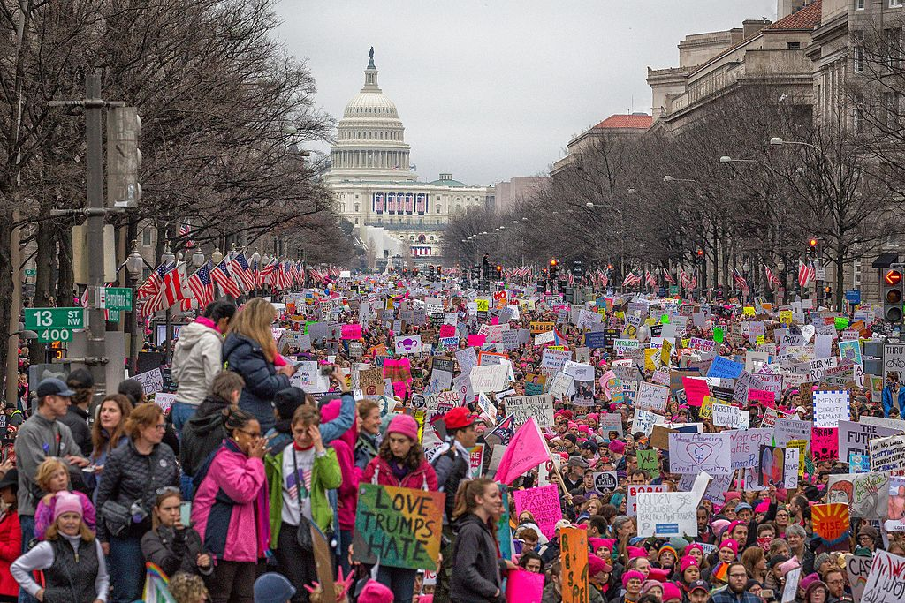
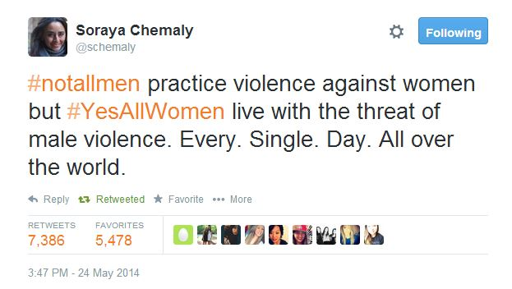
Examples
#MeToo
2017 Women's March
#YesAllWomen

Slide 10
Contested feminism
Simona fojtová

Slide 11
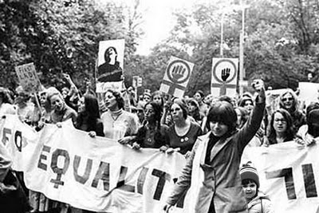
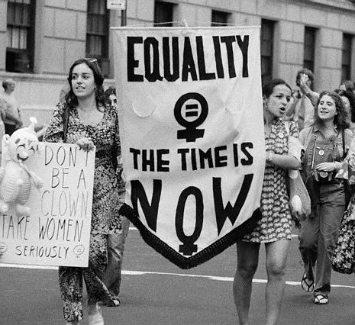
the Western feminism

Slide 12
The east/west feminist Encounters in the 1900s
Political program
Accept it or reject it
National Organization for Women sponsors a protest in front of the US capitol, October 7, 1985

Slide 13
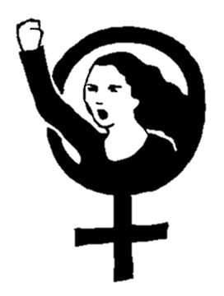
“PLEASE GIVE US TIME FOR OUR SELF-DISCOVERY”

Slide 14
“Now it has become fashionable in the West to talk of “race, class and gender” as intersection lines of oppression, but this doesn’t offer a framework for East European women’s experience“
Laura Busheikin (1993)

Slide 15
EaSTern FEMINISM
”We have not demonstrated, we do not revolt as woman…
...Czech women were obligatorily organized for too long, hence, they tend to connect liberty with the liberty not to be organized in any way.“
Jiřina Šiklová (1997)

Slide 16
“The old prejudices of some people that women belong to the household are long overdue. This is proved by the women themselves, which we see in different workplaces. They take an example of tough Soviet women.”

Slide 17
Women in the Czech Republic
1964
1951
22-year-old Terka Čičová, after graduating from chemical industry, joined a plant for the production of polystyrene, she has leadership post.
Agronomic Training for State Machine Stations. Women are also among the trainees who want to know the agronomy. Among them is Maria Rusnáková.

Slide 18
Women in the Czech republic
1950
1951
First 24 women had passed their driving test for Czechoslovak Automobile Transport. They proved that women are able to replace men even in places where they have not worked. CSAD will have another 900 women drivers to release men to other places.
On the International Women's Day, state paid homage to the mothers, women were awarded maternity badges. The government's offices invited the best women workers of different professions in their offices.

Slide 19
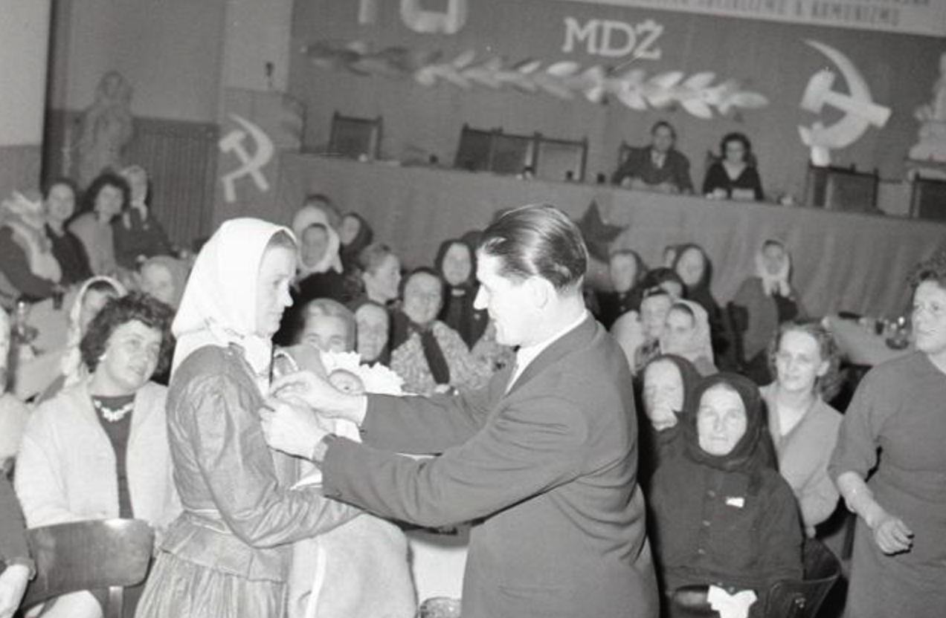
International Women's Day “The greatest feast day of working woman!”
“Czechoslovak women are an important component of the International Democratic Women's Federation.“
“About 40% of the total number of workers in Slovakia are women. They are fully applicable to all sections of our national economy and have a large share in the development of our country.”
“They achieved success in building socialism in our country, their political activity and interest, the influence on solving public issues are an example for the women of the capitalist world to fight even more for their rights.”

Slide 20
sources
Ealasaid Munro - Feminism: The Fourth Wave - https://is.muni.cz/auth/el/1423/jaro2018/ZUR436/um/readings/week_10/Feminism_Fourth_Wave.pdf
Simona Fojtová: Contested Feminism: The East/West Feminist Encounters in the 1990s

