Slide 1
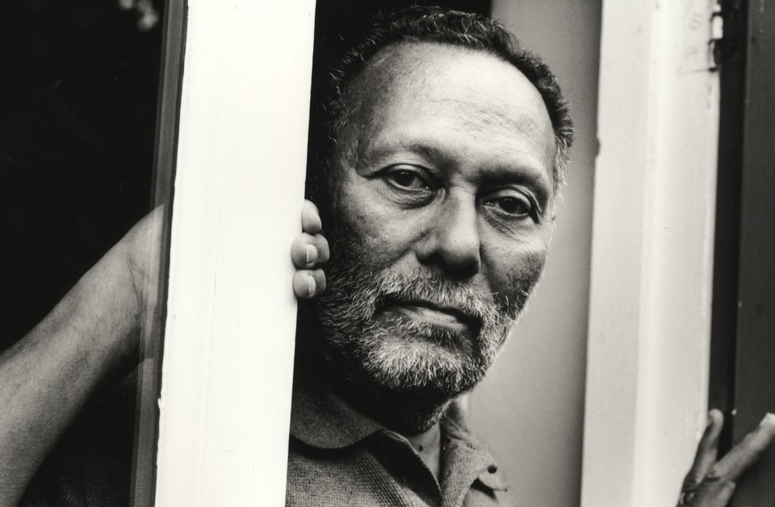
Stuart Hall – Cultural identity
Damián Moreno
Petra Filanová
Klára Bečáková

Slide 2
Stuart hall
Born in 1932 in Jamaica
Cultural theorist, political activist and sociologist
One of the founders of British Cultural Studies or The Birmingham School of Cultural Studies
Hall´s work covers issues of hegemony and cultural studies
Developed Hall´s theory of encoding and decoding. => This means that the audience does not simply passively accept a text- social control. The media play a central role in the „social production of news“.
He had a major influence on cultural studies, and many of the terms his texts set forth continue to be used in the field today
He also widely discussed notions of cultural identity, race and ethnicity, particularly in the creation of the politics of Black diasporic identities.
Hall believed in identity to be an ongoing product of history and culture, rather than a finished product.

Slide 3
Cultural identity – aspects of our identities which arise from our belonging to ethnic, religious, racial or linguistic culture.
Identity is formed through life, from experiences of its way of interacting and communicating with others. Nobody perceives the same world.
3 types of identity – enlightenment subject, sociological subject and post-modern subject
- Enlightenment subject speaks about human person as fully centered = unified individual. The center is an inner core which emerged with being born and unfolded. => Essential center of self is person‘s identity.
- Sociological subject sees identity as interaction between self and society – real „me“ is formed by „outside“ (public). Subject is fragmented which means that we have more identities.
- Post-modern subject is about having no fixed, permanent or essential identity. Identity is moveable and formed continuously in relation we are represented in cultural systems which surround us. Fully unified and coherent identity is a fantasy.

Slide 4
Modern identities (identities in modernity) are „decentered“ = dislocated, fragmented – this means a loss of our stable self. Individuals are discentered from both their place in the cultural and social world as well as themselves — constitutes a crisis of identity for the individual
Important thoughts:
- Marxist – Individuals couldn‘t be the authors of history sonce they could only act on the basis of historical conditions made by previous generation.
Discovery of the unconscious – Identity is something formed throuhg unconscious processes over time, remains incomplete, is always in process. Arises from a lack of wholeness which is filled from outside us.Subjectivity is a product of unconscious psychic processes.
Saussure – language is a social systém and we cannot be it‘s authors
Foucault – create a human being which can be treated like a docile body.
Impact of Feminism – a theoretical critique and a social movement. Birth of identity politics

Slide 5
National culture and it‘s formation was a key to industrialization and modernity
English, Welsh, Jamaican, Czech, Spanish – this is just a metaphore to a nationality
Globalisation – the base of globalisation is TIME (can be crossed by jet, fax, satellite) and SPACE (remains fixed, bounded)
-G. is a matter of inserting a multiplicity of localities into the overall picture of a new global systém
Three consequences of globalization
1. National identities are being mined as a result of the growth of cultural homogenization and "the Postmodern global".
2. National and other identities, "local" or private, are being strengthened by resistance to globalization.
3. National identities are declining, but new hybrid identities are taking their place.

Slide 6
Questions
How the new identities affect the countries? In a good or bad way?
[if in term of countries (the case of Catalonia in Spain for exaple, that they want to be independent and have their own identity) - Is it a good or bad effect in countries?]
How many identities do you think you have? Which one do you use most of the time?
[do you have just one or use more identities (depending on the society you are surrounded by - parents, friends, teachers,...)]

