Slide 1
Foucault:
Archaeologies of Knowledge
Week 6

Slide 2
Confession
Church Confession
Personal Confessions
Reality TV Confessional Camera
#Metoo

Slide 3
Foucault: Main Ideas
Wrote on eccentric subjects: Sex, Madness, Prisons, Clinics, Categorization
Knowledge
  Organization
Power
  Power is brought more broadly into being in play of relationships; classifications
Discourse/Discursive Formations
  Enables, constrains, constitutes (Language)
  Normal/Abnormal – naming brings disciplinary mechanisms into play
Gaze
  Surveillance
  Prison, Panopticon = order, body, discipline (professions); marking of subjects
  Technologies

Slide 4
Michel Foucault:
Discipline and Punish (1977)
Culture = Discursive formation of power relations
Torture; Prison, Power, Discourse, Discipline
    Discipline creates "docile bodies", ideal for the new economics, politics and warfare of the modern industrial age - bodies that function in factories, ordered military regiments, and school classrooms
    Modalities of Control/New Technologies of Power
Communism; the incredible becomes credible and the credible becomes incredible
Today?
Truthiness; Post-Truth Moment

Slide 5
How America Went Haywire (Discourse/Archaeology)
All approximations of truth, science as much as any fable or religion, are mere stories devised to serve people’s needs or interests. Reality itself is a purely social construction, a tableau of useful or wishful myths that members of a society or tribe have been persuaded to believe. The borders between fiction and nonfiction are permeable, maybe nonexistent. The delusions of the insane, superstitions, and magical thinking? Any of those may be as legitimate as the supposed truths contrived by Western reason and science. The takeaway: Believe whatever you want, because pretty much everything is equally true and false.
These ideas percolated across multiple academic fields. In 1965, the French philosopher Michel Foucault published Madness and Civilization in America, echoing Laing’s skepticism of the concept of mental illness; by the 1970s, he was arguing that rationality itself is a coercive “regime of truth”—oppression by other means. Foucault’s suspicion of reason became deeply and widely embedded in American academi
Today, each of us is freer than ever to custom-make reality, to believe whatever and pretend to be whoever we wish. Which makes all the lines between actual and fictional blur and disappear more easily. Truth in general becomes flexible, personal, subjective.
Digital technology empowers real-seeming fictions of the ideological and religious and scientific kinds.

Slide 6

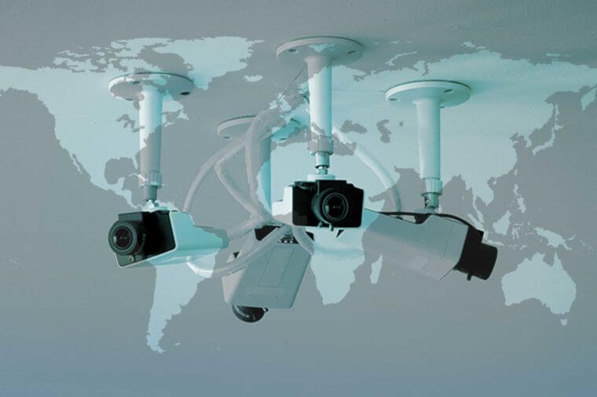
Michel Foucault
Poststructuralist/Postmodernist;
IDEAS:
  Culture is a discursive formation
  Structure/Agency
    A relationship of power is a mode of action which does not act directly and immediately on others but instead it acts upon their actions on existing actions and on those which may arise in the present or in the future; Power requires that the person upon whom it is exercised be thoroughly recognized and maintained to the very end as a person who acts so that a whole field of responses, reactions, results and possible interventions may open up; resistance to power is always possible.
  Extrapolations:
    Education (Marshall)
      Power as it operates systemically
        Sex Education; What is “Normal”
        Media: (Self) Surveillance

Slide 7
Movies and the Impact of Images
Film as evolving technology
Film within economic structures/cultural articulations
Film as narrative/genre
Film as ideological/political
  Consensus narratives
  Whiplash

Slide 8
Film
System; Narratives, Images,
  European Film/American Film tropes
Logics of film production = logics of self-production (Blurring of Film/Reality)
  What structures our understanding of our self-representations?
Film: As Discourse/Discursive Formation
Film as Culture/Cultural Moment: #Metoo

