Slide 1
Debord: Society of the Spectacle
Week 7

Slide 2
Whiplash
Discipline
Gaze
Discourse
Power
Film

Slide 3
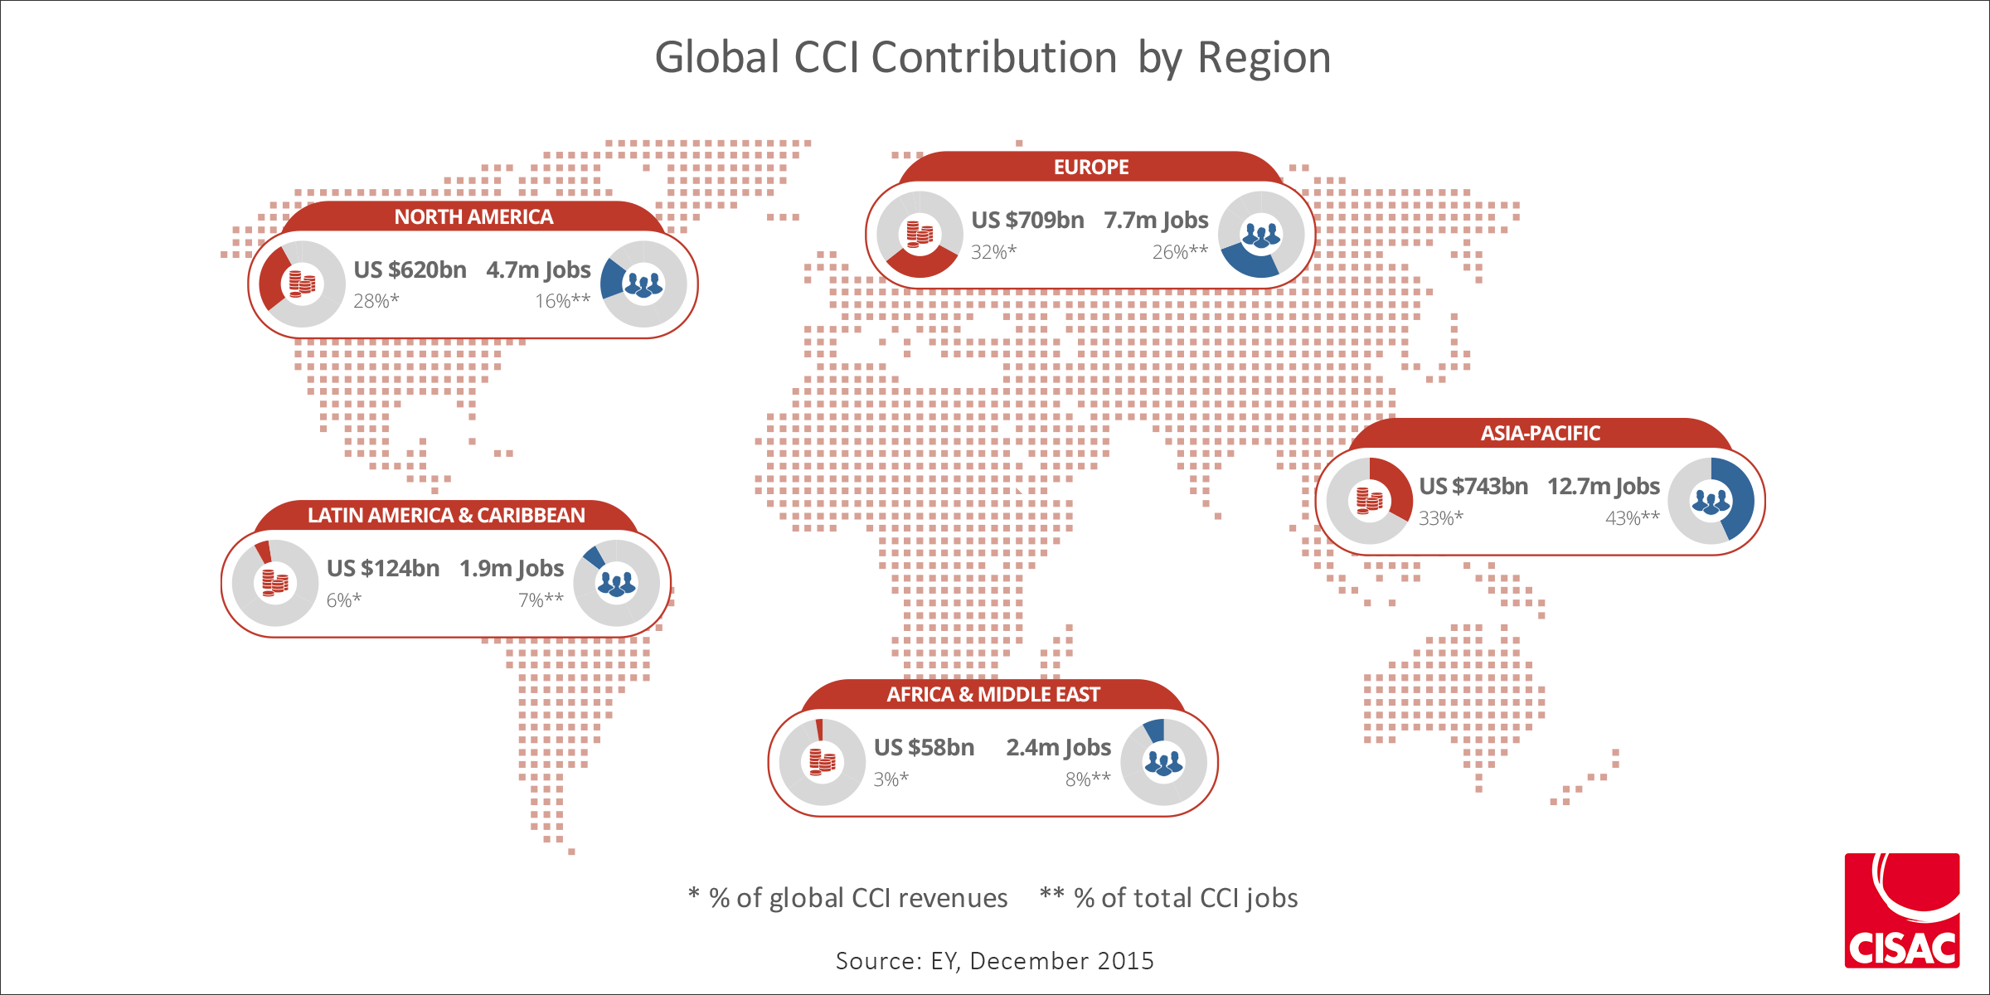
Media Economics: Cultural Industries

Slide 4
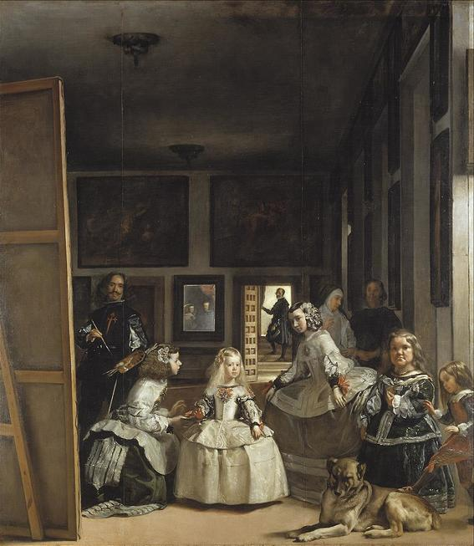
Media Images: Visual Culture

Slide 5
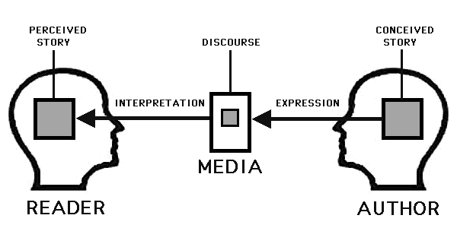
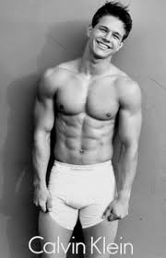
Media Narratives: STorytelling

Slide 6
Debord: Main Ideas
Spectacle – Commodities have supplanted human relationships
Obfuscates history/past – the ever-present
Yesterday’s religion is today’s advertising
Quality of life, knowledge, critical thinking is degraded; “what was lived is now represented”
Mass media stimulating consumer culture and commodity fetishism serve to stupefy public
What binds the spectators together is the very center which maintains their isolation. The spectacle reunites the separate, but reunites it as separate" (29) With people trying to understand themselves through a representation, they in fact lose all hope of coherently and unitarily living their own life. "This is why the spectator feels at home nowhere, because the spectacle is everywhere" with representation ruling over "the society of the spectacle", the unified direct human relations are replaced with the fragmented adherence to the spectacle which isolates us
A society which no longer needs a developing economy for its survival, but rather one which has to provide for the survival of the ever developing economy

Slide 7
Debord: Society of the Spectacle (1967)
Deeply distressed by the hegemony of governments and media over everyday life through mass production and consumption.
Criticized both the capitalism of the West and the dictatorial communism of the Eastern bloc for the lack of autonomy allowed to individuals by both types of governmental structure.
Postulated that Alienation had gained a new relevance through the invasive forces of the 'spectacle = a social relation between people that is mediated by images" consisting of mass media, advertisement, and popular culture
a self-fulfilling control mechanism for society
notions of reification; semiotics
probed the historical, economic, and psychological roots of the media and popular culture
alienation is a consequence of the mercantile form of social organization that has reached its climax in capitalism

Slide 8
Advertising and Commercial Culture
History & Discourse; Transition to Consumer Society; Pros/Cons
Shift in Techniques; shift in Experience; Promoting Values
Shift to Visual Culture; Target marketing; Cultural Differentiation
Ad Agencies: Size, Structure (demographics, lifestyle brands, produser incentives
Techniques: snob-appeal, bandwagon, hidden-fear, irritation, association principle
Stereotypes, Myths and Stories, product placement
Limitations: Children, Schools, Health, Politics

Slide 9
The Branded Self
Self as something produced discursively
Different form of exploitative labour: “If we see the self as both a product and a reflexively constituted brand subject to a transaction and exchange, we see a notion of self deeply marked by the discourses and practices of post-fordist modes of capitalist production”
Brand =ultimate image-commodity; value-generating (logics of capitalist accumulation); empty language (flexible)
Sits at the nexus of discourses related of neoliberalism, flexible accumulation, radical individualism and spectacular promotion
Entrepreneur of the self; whole way of life;
Reality TV, Media Life

