Slide 1
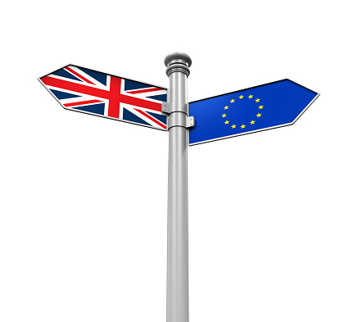

British politics and the Brexit challenge
Dr Monika Brusenbauch Meislová
EVS465: Brexit: Politics, Policies and Processes
7 May 2019

Slide 2
Brexit challenge: basic timeline
June 24, 2016: The referendum result is announced, David Cameron resigns as British prime minister, the pound plunges to a three-decade low. European Commission President Jean-Claude Juncker, European Council President Donald Tusk, European Parliament President Martin Schulz and Dutch Prime Minister Mark Rutte (representing the EU presidency), issue a joint statement on the outcome: “We regret this decision but respect it."
June 28, 2016: David Cameron’s last European Council summit.
June 30, 2016: Home Secretary Theresa May formally declares her candidacy for the Conservative Party leadership “to unite the party and country.”

Slide 3
Brexit challenge: basic timeline
July 13, 2016: May becomes prime minister (the UK will “forge a bold new positive role for ourselves in the world.”)
  Boris Johnson as foreign secretary, David Davis as Brexit secretary, Liam Fox as international trade secretary and Philip Hammond as chancellor of the exchequer.
July 27, 2016: Frenchman Michel Barnier nominated by the European Commission to lead the EU’s Brexit negotiations.
December 7, 2016: The House of Commons votes 461 to 89 in favor of May’s plan to trigger Brexit by the end of March 2017 (David Davis: it will be “the most important and complex negotiations in modern times.”)
December 15, 2016: EU leaders meet in Brussels without the UK at an informal summit and adopt guidelines for negotiating procedures during the talks.

Slide 4
Brexit challenge: basic timeline
24 January, 2017: Supreme Court rules in favour of campaigner Gina Miller, that the Government must obtain the approval of Parliament before starting the Brexit process.
29 March, 2017: UK delivers formal notice of its intention to leave the bloc under Article 50 of the EU’s Lisbon Treaty, to European Council President Donald Tusk.
18 April, 2017: May calls a snap General Election.
9 June, 2017: Election results show a hung Parliament (Labour gains and the Tories lose their majority)
13 June, 2017: May secures a deal with the DUP to support her in Parliament

Slide 5
Brexit challenge: basic timeline
19 June, 2017: Then-Brexit Secretary David Davis and Michel Barnier meet to begin formal Brexit negotiations
22 September, 2017: May gives landmark Brexit speech in Florence, where she outlined the UK’s proposals to the EU
8 December, 2017: Joint report published outlining early details of the Withdrawal Agreemen
19 March, 2018: Details of the Transitional Period agreed in principle
6 July, 20198: May hosts Cabinet at her country retreat Chequers to launch her Brexit plan (named the Chequers deal) → several ministerial resignations

Slide 6
Brexit challenge: basic timeline
25 September, 2018: Labour conference votes to consider option of a second Brexit vote
14 November, 2018: Government publishes 585-page Draft Withdrawal Agreement and Political Declaration
11 December, 2018: ECJ rules that UK can unilaterally revoke Article 50, and thus reverse Brexit
10 December, 2018: May delays a planned Meaningful Vote on the Brexit deal
12 December, 2018: May survives a vote of no confidence from within her own party

Slide 7
Brexit challenge: basic timeline
15 January, 2019: Theresa May loses Meaningful Vote (432 MPs voted against it while 202 voted for it - a majority of 230, making it the biggest government defeat since 1924).
16 January, 2019: Theresa May wins second no confidence vote
7 February, 2019: EU rejects changes To Withdrawal Agreement
18 February, 2019: MPs split from Labour Party to form "The Independent Group“
12 March, 2019: MPs reject Theresa May's Withdrawal Agreement for the second time

Slide 8
Brexit challenge: basic timeline
18 March, 2019: Speaker John Bercow tells Theresa May Meaningful Vote 3 must be different
21 March, 2019: EU accepts Brexit delay to April 12 unless Theresa May‘s deal passes by MPs
29 March, 2019: MPs reject Withdrawal Agreement in 'Meaningful Vote 2.5‘
10 April, 2019: Emergency EU summit (flexstation, flexible delay until 31 October)

Slide 9
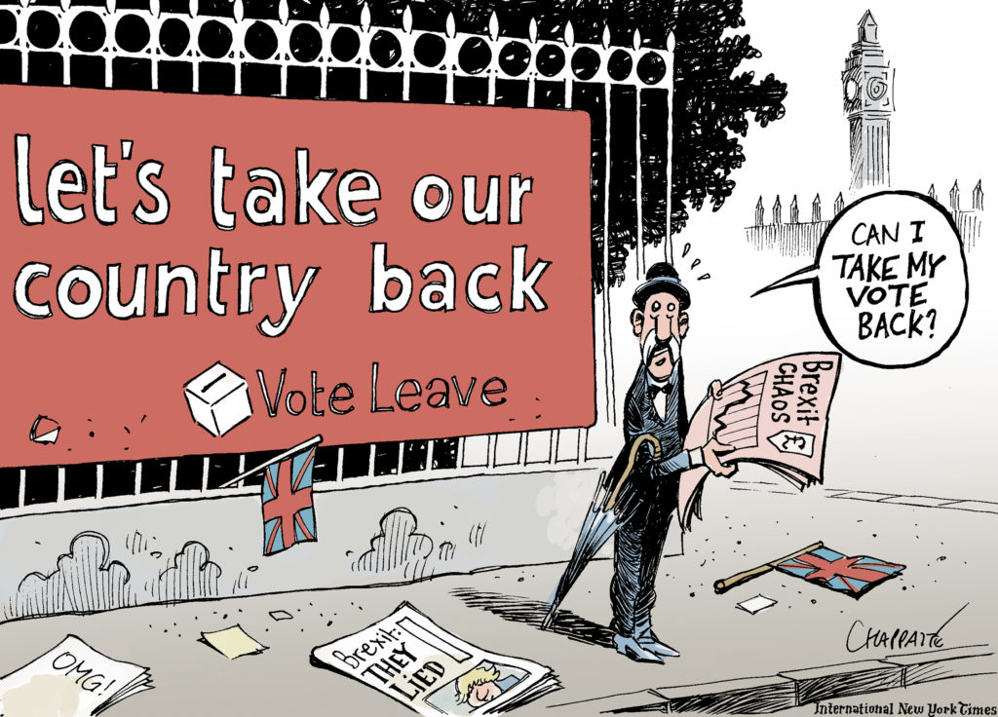

Slide 10
Defining Brexit narrative
UK referendum triggered a series of processes in the UK (not just about handling the exit but also about defining what sort of country the UK wants to be).
British politics defined by a fight to define the Brexit narrative
Why has the process of defining Brexit narrative been so difficult?
  Theresa May struggling to find unity within her govt over what Brexit should mean.
Churchill: history is written by the victors. Is it really so in the case of Brexit?

Slide 11
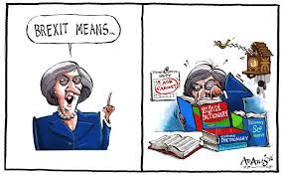
Defining Brexit narrative
‘Brexit means Brexit‘ motto sounds self-explanatory but is meaningless unless Brexit itself is defined.

Slide 12
Defining Brexit narrative
TM’s Brexit narrative defined in “big speeches on Brexit“ (Lancaster; Florence etc.)
  Three most important aims:
    Ending immigration from elsewhere in the EU
    Ending the jurisdiction of the CJEU
    Opting for free trade agreements with European markets
Her Brexit narratives challenged from many sides.

Slide 13
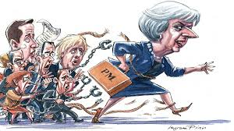

Slide 14
Defining Brexit narrative
Global Britain narrative

Slide 15
HM Government and Brexit
Brexit = for the government, it is an unprecedented peacetime challenge in terms of political unity, administration and delivery
Unity/collective responsibility
TM’s premiership struggled bc of Conservative divisions over Europe (something many of her predecessors faced)
In appointing her first cabinet she tried to bring in some balance into this by appointing leading pro-Leave campaigners
TM‘s leadership overshadowed by doubts from the very beginning
  She won the leadership race without a vote.
Her leadership has been a sore point for many – not least bc of the centralisation of decision making in Downing Street 10 around her two closest advisors: Nick Timothy and Fiona Hill.

Slide 16
HM Government and Brexit
Her decision to call snap elections (in part on the advice of some of her advisors) caught many in her cabinet by surprise.
  Her weak campaining skills and dire campaign – left her even more vulnerable post-election.

Slide 17
HM Government and Brexit
The administrative challenge
Brexit = the biggest set of administrative, legal, negotiating and constitutional task since 1945
Organising British govt for Brexit = a formidable task: i.a. because new departments had to be established:
  Department for Exiting the EU (DexEU)
  Department for International Trade
  Some departments busier than others
Enormous stretch of UK-EU links

Slide 18
HM Government and Brexit
The search for strategy
The inability of British decision makers to know what they want and whether they can get it.
No clear ends and confused ways (no surprise the UK has struggled to prepare)
TM triggered Article 50 on 29 March 2017: by choosing this time she made time an ally of the EU
Quick realization that the UK lacked the ways and means to secure a ‘quick victory‘.
Repeated failures to analyse and understand the position of the rest of the EU

Slide 19
Parliament and Brexit
Brexit and the notion of parliamentary sovereignty in the UK
  Dilemma for Remain-backing MPs (nearly three quarters of MPs voted Remain in the 2016 referendum)
  Impact of 2017 snap elections
UK’s legislative system – nothing more than an elected dictatorship?
Brexit highlighted the centralisation and high degree of power exercised by the UK government
Parl. = site of intense arguments and differences over what the UK’s vote to leave should mean
The deep divisions in the Conservative and Labour parties reflect similar divisions in British society!

Slide 20
Parliament and Brexit
Parliament’s role in constant flux, as demonstrated by the three roles it has played in the Brexit negotiations: approving, scrutinising and instructing Brexit.
  EU Withdrawal Act 2018 gave parliament a defined role in approving any deal with the EU and in scrutinising and approving any course of action in the event of there being no agreement.
Approving Brexit
Implementing withdrawal could not be done through Royal Prerogatives (powers government wields without much parliamentary oversight) → Britain’s Supreme Court ruled in January 2017 against the British government.

Slide 21
Parliament and Brexit
Tensions between the executive and legislature clearer when the Conservative Party lost its majority in the 2017 general election (confidence and supply arrangement with the ten MPs of Northern Ireland’s Democratic Unionist Party/DUP).
Meaningful vote on Brexit (one that is more than simply rejecting or accepting any agreement put forward)
  So far 3 (2.5) meaningful votes on the Withdrawal agreement.
Cross-party talks (difficult bc of the majoritarian nature of politics in the House of Commons - a single party system of governing has long prevailed; consensus politics between parties does not come easy in the UK)

Slide 22
Parliament and Brexit
Scrutinising Brexit
Parliament has succeeded in scrutinising the handling of Brexit by the British government (which has a long-standing reputation for being centralised and secretive).
  E.g. House of Commons successfully compelled the British government to reveal more than 58 internal government studies on the economic effects of Brexit.

Slide 23
Parliament and Brexit
Instructing Brexit
Brexit has raised some unique questions about the ability of parliament to instruct government (traditionally the role of parliament, especially in international negotiations, has been to react to the executive instead of defining what policy should be).
Late March 2019: MPs have finally taken control of the Brexit process (question for you: how successful was it?)

Slide 24
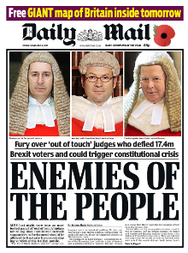
Judiciary and Brexit
Brexit → series of legal challenges that eventually reached the UK’s Supreme Court.
24 January, 2017: Supreme Court rules in favour of campaigner Gina Miller, that the Government must obtain the approval of Parliament before starting the Brexit process.
Press attacks on the judiciary
Can a second referendum be called?

Slide 25
Party politics and Brexit
All parties (and their leader) have struggled to cope with the referendum result.
Conservative Party
Divided over Britain’s EU membership more than ever
Theresa Ma proved incapable of bringing order to the party (her agenda pushed to a more traditional right wing in British politics, incl. hard Brexit)
TM: “If you believe you’re a citizen of the world, you’re a citizen of nowhere“ (2016)
2017 elections – the result of hung parliament reignited challenges to her leadership

Slide 26
Party politics and Brexit
The Labour Party
Conservative divisions over the EU have distracted attention from Labour’s own problems with the issue
Jeremy Corbyn’s pathetic efforts (according to many)→ leadership challenges
2017 elections changes the narrative on Corbyn’s leadership → Corbyn emerged a strengthened and popular leader (but still facing the issue about how to approach the EU)

Slide 27
Party politics and Brexit
Liberal Democrats
Have failed to benefit from the Brexit vote (despite the surge in new members)
Reasons for this failure?
Large number of members in the House of Lords = a pivotal position in votes over Brexit legislation in the upper house.
UKIP
A party in search of both unity and a cause
Is UKIP doomed?

Slide 28
The Union and Brexit
Brexit = a test to the constitutional, legal, political and social frameworks that hold the union together.
A United Kingdom?
Implementing Brexit requires the UK govt to make decisions on behalf of the whole UK (in some policy areas legally required to consult with devolved bodies).
Supreme Court ruling: the UK govt did not have to consult devolved administrations over triggering Article 50 (setback for devolved administrations)
UK govt holds meetings through the Joint Ministerial Committee + representatives of the devolved bodies have sought meetings with EU negotiators BUT the power to negotiate Brexit firmly in the hands of the UK govt.
  Since 1973 significant changes to the UK’s constitutional set-up (devolution has happened within a framework of UK membership of the EU).

Slide 29
The Union and Brexit
Scotland
Possibility of the second Scottish independence referendum (dampened by 2017 election result)
Exiting the UK and rejoining the EU= many political, economic, social, constitutional and legal questions
Northern Ireland
Unique place within the UK; unique politics
The Irish border issue (about much more than just trade)
London
England

