Slide 1
EU in International Trade
Contemporary Position
2019

Slide 2
EU in International Trade
2005-2011

Slide 3
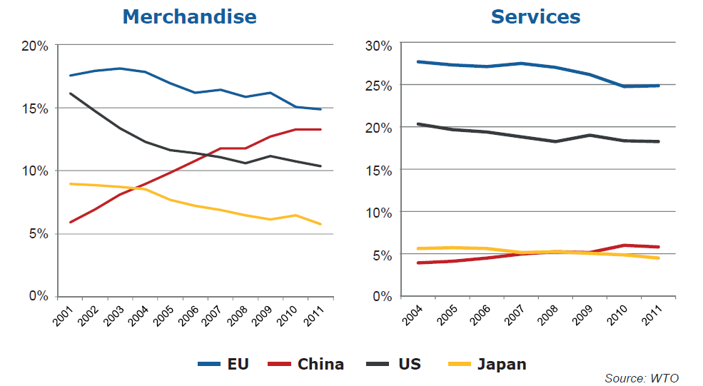
Share in world exports

Slide 4
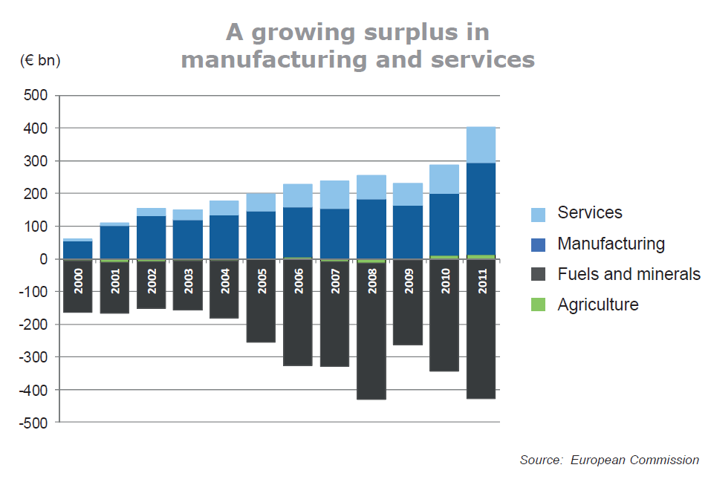

Slide 5
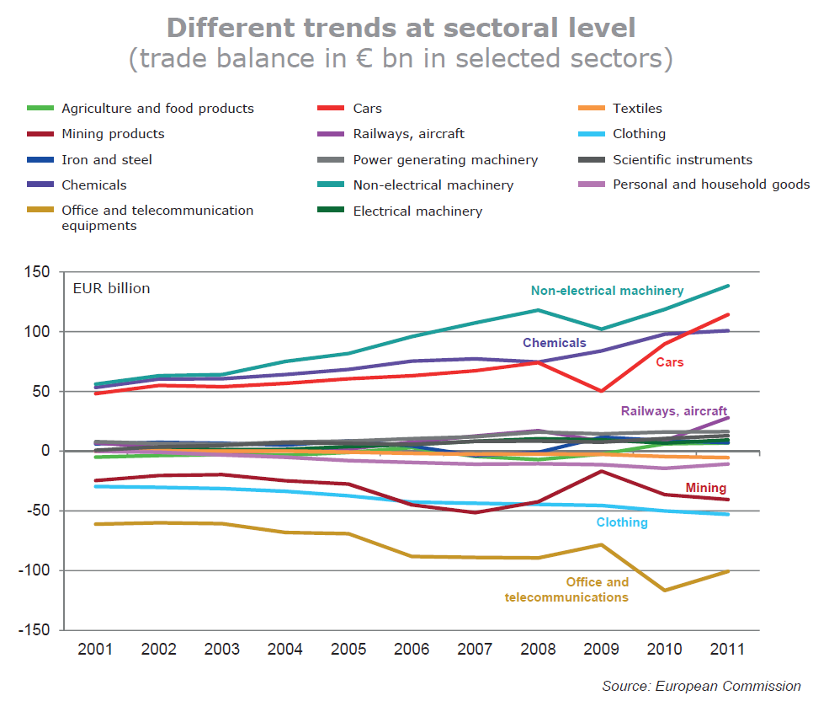

Slide 6
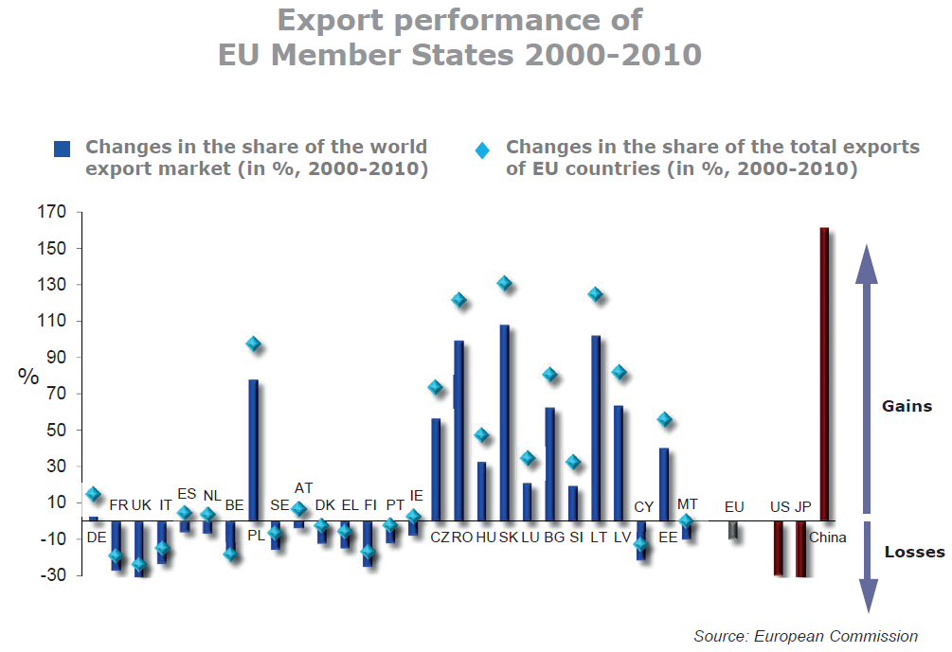

Slide 7
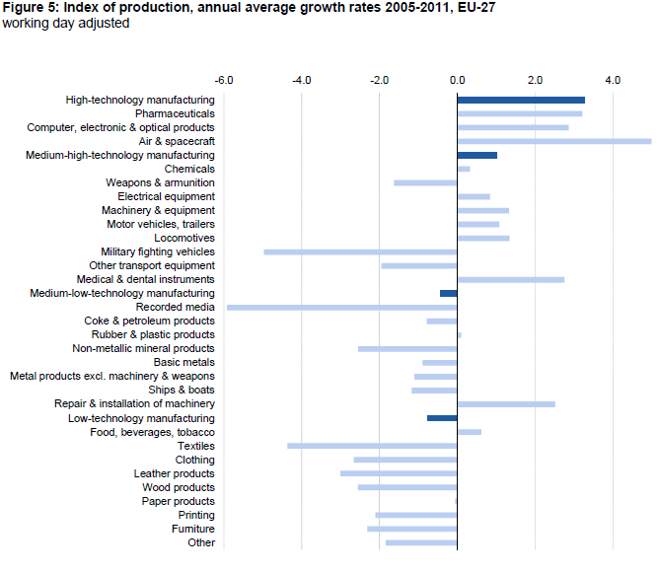

Slide 8
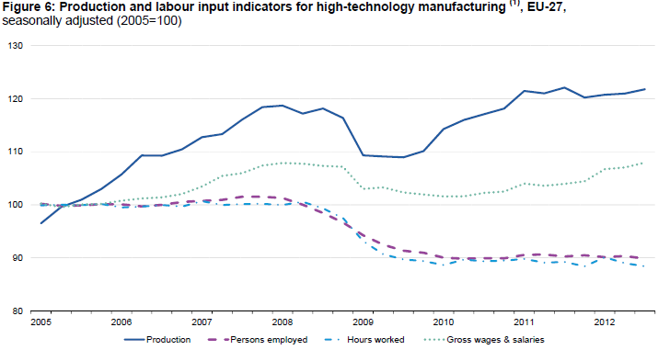

Slide 9
Comparison of World Economic Leaders
 | EU28 | USA | China
Labor force | 238 mil. | 163 mil. | 804 mil.
Product (PPP) | 23.0 trill. USD | 21.5 trill. USD | 27.5 trill. USD
GDP per capita (PPP) | 43,119 USD | 65,062 USD | 19,559 USD
Exports | 1.96 trill. USD | 1.58 trill. USD | 2.48 trill. USD
Industry value added (% GDP) | 24,5% | 18,9% | 40,5%
Export value – selected countries: Germany 1,401; Japan 683; Korea 577; UK 437; Mexico 407; Russia 337; India 303; Brazil 217; Czechia 157.

Slide 10
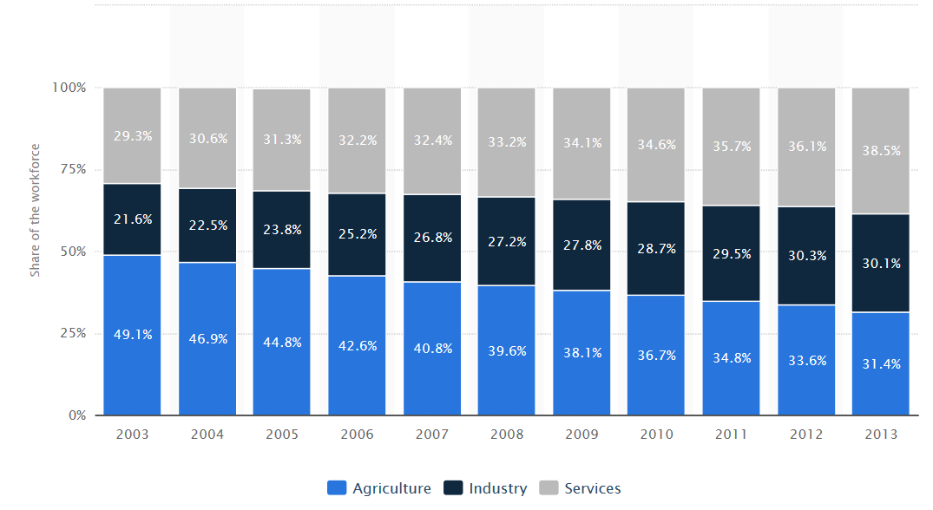
China – distribution of workforce

Slide 11
EU – World
2017-2018

Slide 18
EU trade (goods)
 |  | 2006 | 2008 | 2010 | 2012 | 2014 | 2016 | 2018
World | IMP | 1,368 | 1,585 | 1,532 | 1,799 | 1,693 | 1,708 | 1,980
 | EXP | 1,153 | 1,309 | 1,354 | 1,685 | 1,704 | 1,746 | 1,956
 | BAL | -216 | -276 | -178 | -114 | 11 | 37 | -25
US | IMP | 171 | 183 | 175 | 209 | 209 | 249 | 267
 | EXP | 267 | 248 | 243 | 294 | 312 | 364 | 406
 | BAL | 96 | 65 | 69 | 84 | 102 | 115 | 139
China | IMP | 196 | 249 | 284 | 292 | 303 | 352 | 395
 | EXP | 64 | 78 | 114 | 144 | 165 | 170 | 210
 | BAL | -132 | -171 | -171 | -148 | -138 | -183 | -185

Slide 19
EU trade partners – goods (2018)
 | Imports |  |  | Exports |  |  | Total trade
 | value | share % |  | value | share % |  | value | share %
CH | 395 | 19.9 | US | 406 | 20.8 | US | 674 | 17.1
US | 267 | 13.5 | CH | 210 | 10.7 | CH | 605 | 15.4
RUS | 168 | 8.5 | SWI | 157 | 8.0 | SWI | 266 | 6.7
SWI | 109 | 5.5 | RUS | 85 | 4.4 | RUS | 254 | 6.4
NOR | 84 | 4.2 | TUR | 77 | 4.0 | TUR | 153 | 3.9
TUR | 76 | 3.8 | JAP | 65 | 3.3 | NOR | 138 | 3.5
JAP | 71 | 3.6 | NOR | 54 | 2.8 | JAP | 135 | 3.4
KOR | 51 | 2.6 | KOR | 49 | 2.5 | KOR | 100 | 2.5
IND | 46 | 2.3 | IND | 46 | 2.3 | IND | 92 | 2.3
VIE | 38 | 1.9 | CAN | 41 | 2.1 | CAN | 72 | 1.8

Slide 20
EU – US trade | Imports |  | Exports
 | bil EUR | % total | bil EUR | % total
food | 12 | 4.4 | 21 | 5.2
steel | 1 | 0.5 | 7 | 1.7
chemicals | 55 | 20.7 | 99 | 24.4
- pharmaceuticals | 29 | 10.9 | 58 | 14.3
mach. and trasport eq. | 111 | 41.6 | 173 | 42.6
- transport eq. | 35 | 13.0 | 74 | 18.3
-- automotive | 9 | 3.4 | 47 | 11.6
- power gen. mach. | 33 | 12.5 | 19 | 4.6
- non elect. mach. | 19 | 7.0 | 48 | 11.7
- elect. mach. | 11 | 4.0 | 18 | 4.5
other manufactures | 29 | 11.0 | 47 | 11.4

Slide 21
EU – China trade | imports |  | exports
 | bil EUR | % total | bil EUR | % total
agri. products | 8 | 2.0 | 16 | 7.5
fuel and mining | 5 | 1.2 | 14 | 6.5
chemicals | 21 | 5.4 | 27 | 12.8
other semi. manu. | 32 | 8.0 | 10 | 4.5
mach. and trasport eq. | 209 | 53.1 | 112 | 53.4
- office and telecom. | 123 | 31.1 | 10 | 4.5
-- elect.data processing. | 50 | 12.6 | 1 | 0.6
-- telecom. eq. | 67 | 17.1 | 3 | 1.3
- transport. eq | 13 | 3.2 | 50 | 23.8
- non elect. mach. | 26 | 6.6 | 32 | 15.0
- elect. mach. | 42 | 10.7 | 16 | 7.5
clothing | 29 | 7.4 | 2 | 0.9
other manufactures | 75 | 19.0 | 19 | 8.9

Slide 22
EU – JAP trade | Imports |  | Exports
 | bil EUR | % total | bil EUR | % total
food | 0.4 | 0.5 | 7 | 10.0
chemicals | 7 | 10.3 | 15 | 22.6
- pharmaceuticals | 1 | 1.8 | 9 | 13.5
mach. and trasport eq. | 47 | 66.9 | 25 | 39.1
- transport eq. | 20 | 27.7 | 13 | 20.7
-- automotive | 14 | 20.3 | 10 | 15.9
- other machinery | 21 | 29.6 | 10 | 15.7
- non elect. mach. | 12 | 17.4 | 6 | 8.6
- elect. mach. | 10 | 4,2 | 17 | 4,6
Other manu – scientific | 4 | 6.0 | 4 | 5.4

Slide 23
EU – RUS trade | Imports |  | Exports
 | bil EUR | % total | bil EUR | % total
food | 2 | 1.3 | 6 | 6.7
fuels and mining | 125 | 74.2 | 1 | 1.6
chemicals | 6 | 3.4 | 18 | 20.8
mach. and trasport eq. | 2 | 1.3 | 39 | 45.4
- transport eq. | 0,7 | 0.4 | 13 | 15.1
- non elect. mach. | 0.4 | 0.2 | 15 | 17.3
- elect. mach. | 0.4 | 0.3 | 5 | 5.8
clothing | 0.03 | 0,0 | 3 | 3.0

