Slide 1
Prof. Carol Wise

Slide 2
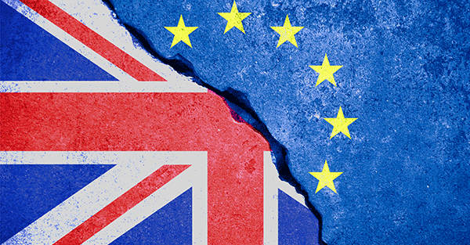
What is Brexit?
(short for “Britain Exit”) is the June 23, 2016 referendum where British citizens voted whether or not to exit the European Union

Slide 3
The Roots of Brexit (Jensen & Snaith)
Contrary to standing theories, it was political party realignments, NOT elite bargaining between vests interests and the government that gave rise to Brexit
It started with “back benchers” in the Conservative party, scapegoating the EU for UK’s problems, that were challenging David Cameron’s leadership
To appease these Eurosceptic agitators, Cameron offered to hold referendum on Brexit by 2017
Conservatives also trying to beat back the xenophobic UKIP dissidents
“…referendum decision principally driven by the internal politics of the Conservative Party, not elite intergovernmental bargaining

Slide 4
Racial argument (Virdee & McGeever)
Nostalgia over the “English Empire” & imperial longing
Drew on post 9/11 anti-Muslim sentiment
Retreat from globalization (good luck with that!)
Cross-class coalition of middle aged and old white men and women favored Brexit most
Racism implicitly endorsed by mainstream parties across the spectrum
Eruption of considerable racial strife following the June 2016 vote

Slide 5
Conservative Party Complaints about EU
Not enough focus on economic competitiveness. Regulatory burdens, etc.
Eurozone states unilaterally deciding on policies that influence the European Single Market (ESM)
UK Brexiters wanted to broker a different arrangement (Norway, Iceland, and Liechtenstein belong to ESM, but not EU or Eurozone; Turkey belongs to EU Customs Union; Switzerland highly integrated with the EU market but belongs to nothing). However, none of these small countries occupy the huge economic space that the UK occupies in the EU
Wanted a reduction in migrant workers’ rights to social benefits

Slide 6
Results (Quantitative)

Slide 7
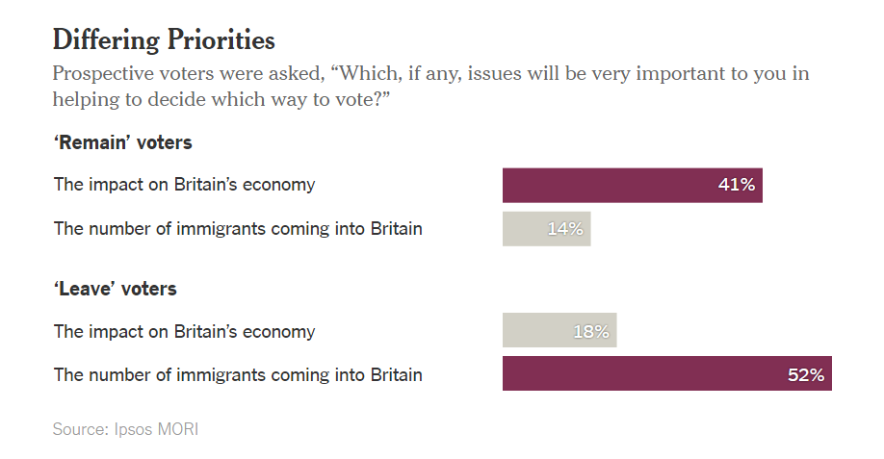
Taub, Amanda. 2016. "Making Sense Of ‘Brexit’ In 4 Charts". Nytimes.com.
http://www.nytimes.com/2016/06/24/world/europe/making-sense-of-brexit-in-4-charts.html.

Slide 8
Results (Geographic)
Leave won by 51.9% to 48.1%. The referendum turnout was 71.8%, with more than 30 million people voting” (BBC)

Slide 9
Referendum results also driven by….
Demographics: largely British Anglo voters
Level of education: less schooling
Age: older voters who felt left behind
Poor economic conditions: relative deprivation---looking at all the prosperity around them but not included
Immigration pressures (even by those not exposed to immigration): notion the “others” coming in and taking their jobs

Slide 10
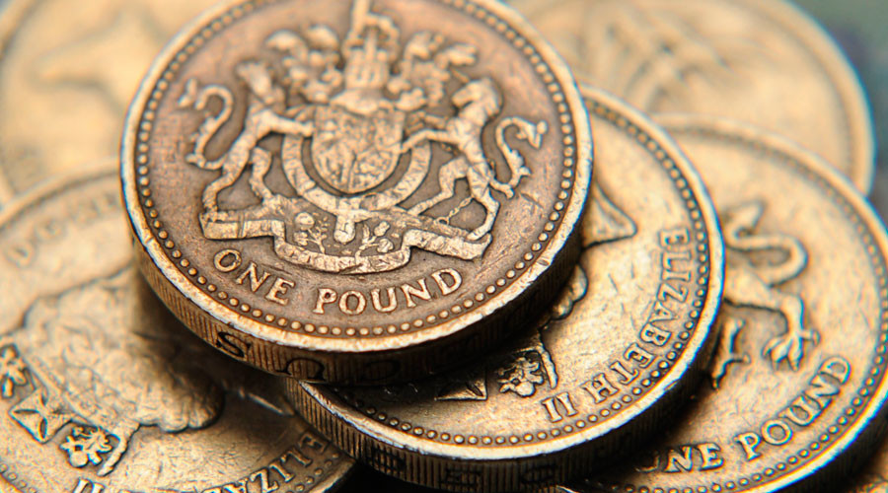
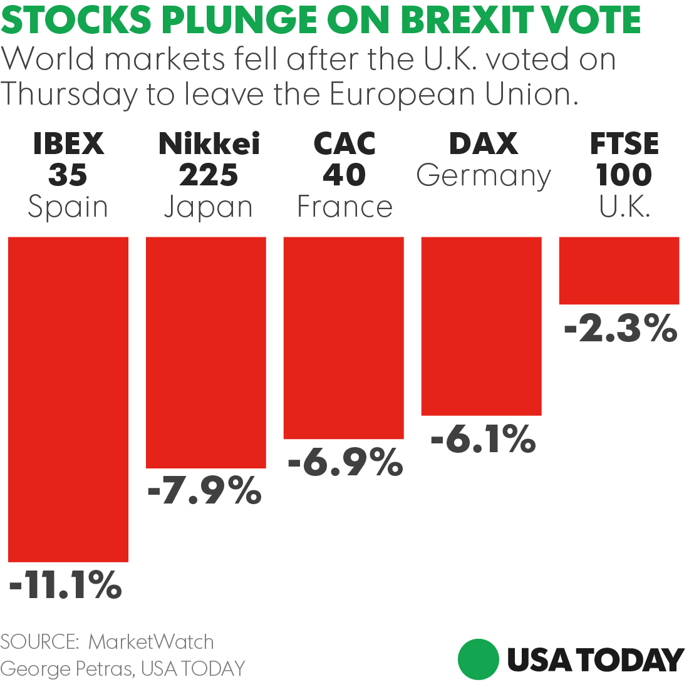
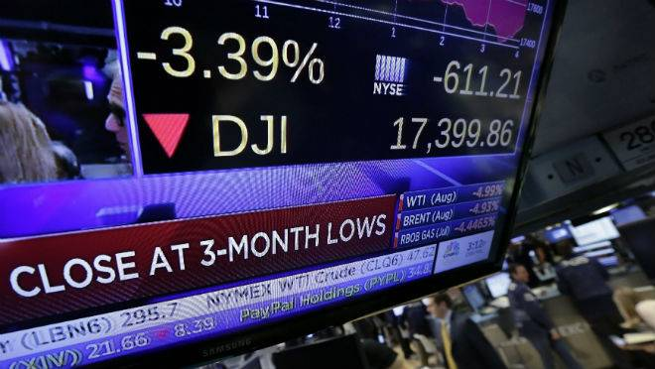
World markets respond drastically
Financial Markets across the world decline sharply
DJIA loses 610 points
British Pound declines 10% against the US Dollar
Many other currencies lose significant value
Stock prices of European banks such as Credit Suisse and Barclays tank

Slide 11
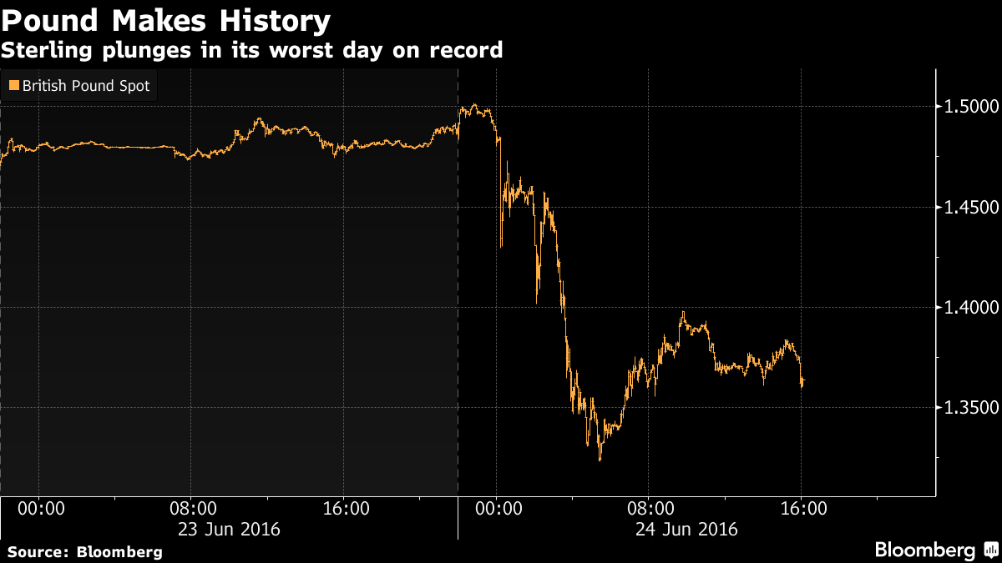
The British pound crashes…

Slide 12
Other Economic implications
UK inflation up 1.7% since vote
Economic costs have been realized at 2.1% of GDP as of June 2018
Reduced income by 1.3% (350 million pounds/week)
Short term
Uncertainty in financial markets, although banks remain optimistic
Reduction in consumer confidence
Long term
Uncertainty among economists without definite separation agreement
New barriers to trade are imminent

Slide 13
Article 50 of Lisbon Treaty (2007)
Lays forth process of seceding
Consists of 5 parts
Article 50(1) - Any Member State may decide to withdraw from the Union in accordance with its own constitutional requirements.
On 29 March, 2017 Theresa May officially wrote a letter to Donald Tusk initiating Article 50(2) and, subsequently, the two year grace-period to iron out the exit details

Slide 14
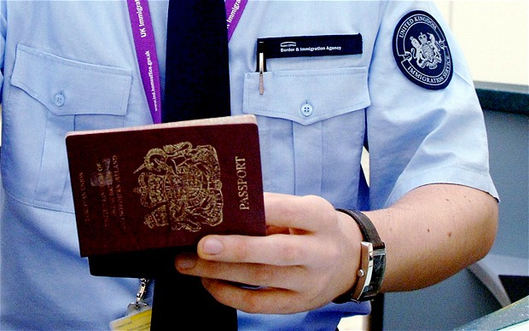
Arguments FOR Brexit
Reduces Britain’s fiscal pressures
Controls immigration
More jobs available
Diversifies trade
Lower prices

Slide 15
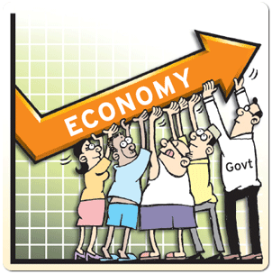
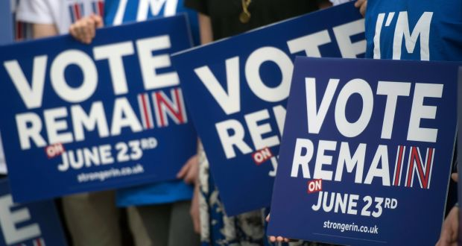
Arguments AGAINST Brexit
Bad for the economy
Less secure nation
Lower household income
Higher uncertainty

Slide 16
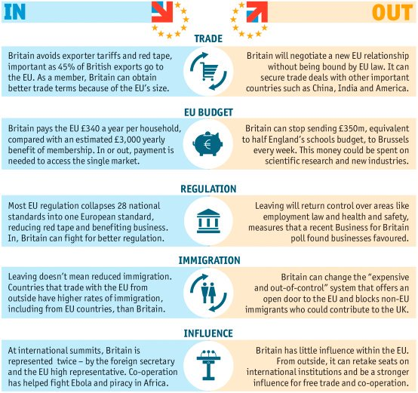
Leave vs Remain: 5 Main Conflicts

Slide 17
Moving forward: Options
’Hard’ vs ‘Soft’ separation / exit strategy
Hard – leaving without a deal, nullifying any existing agreements
Soft – Deal to retain some trade and market access privileges some; free movement for EU members
No Middle Ground

Slide 18
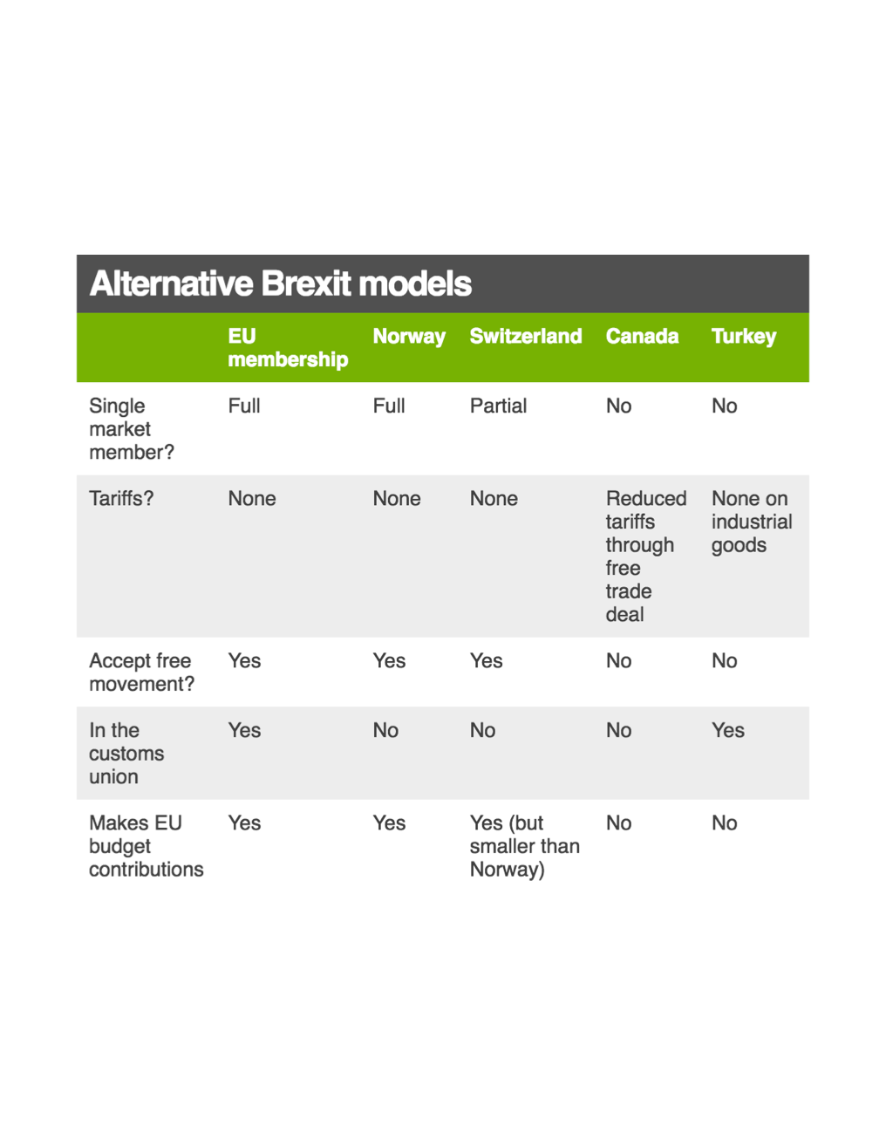
Post-BREXIT UK?
Alternative Models (BBC)

Slide 19
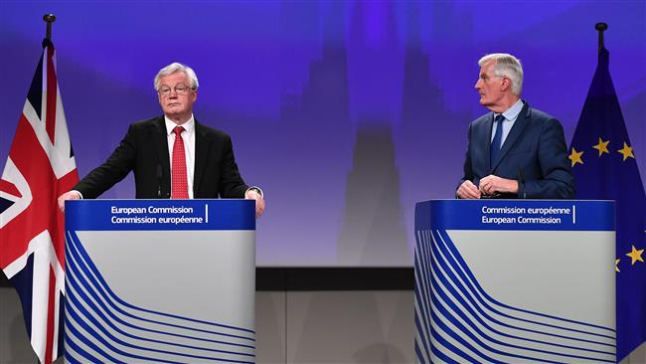
Potential outcomes
European Council president Donald Tusk: “good deal, no deal, or no Brexit”
Implications of recent election
The Dream Scenario
Most realistic outcomes
No deal
Divorce-only agreements
Limited-tariff free trade deal

Slide 20
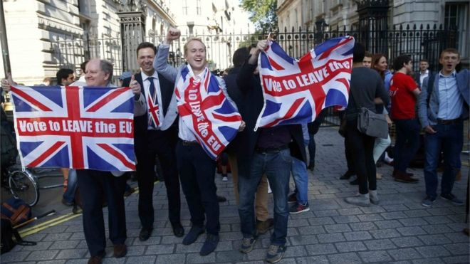
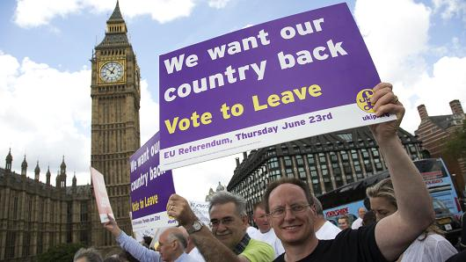
Why it happened
Economics
Sovereignty
Immigration

Slide 21
UK and EU

Slide 22
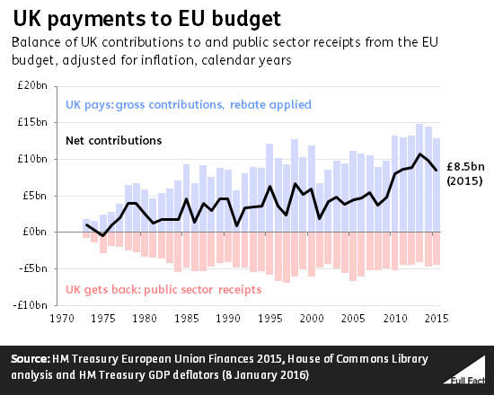
Economics
EU membership is expensive (according to UK)
-In 2015, the UK paid £13 billion to the EU budget, and only received back about £4.5 billion
-EU rules cost every part of the economy
Notes:
Mention graph

Slide 23
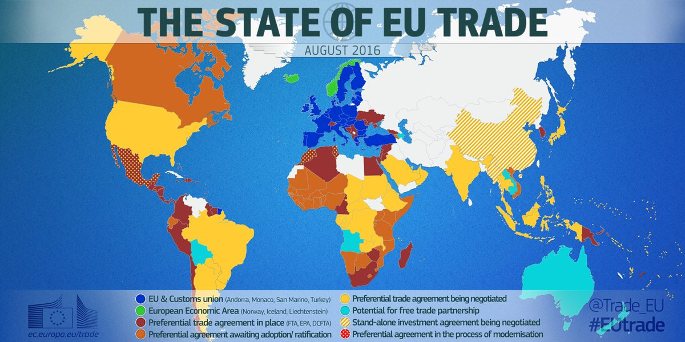
2. Trade negotiations back in UK hands
-External relations, including trade, conducted partly or wholly by the EU
-ie. tariffs
-EU extremely slow at negotiating trade deals
-It has failed so far to strike deals with the US, Japan, India, and ASEAN
-UK would be faster at striking trade deals on its own
-could create 284,000
new jobs

Slide 24
3. The Euro is flawed
-the Eurozone (the EU members who have adopted the euro as their official currency) is a political project rather than an economic one
-without shared economic institutions, European economies are too big and diverse to thrive under a single currency
-deeper fiscal and political integration is needed for the euro to work, but Britain is unlikely to approve of this
-the argument: it would greatly reduce transaction costs to be on the Euro, but Britain does not want to give up its own monetary policy

Slide 25
Sovereignty: EU laws > UK’s laws
-European Communities Act of 1972
-National laws are overridden by EU rules

Slide 26
Sovereignty: lack of EC accountability
-European Commission (EU’s executive branch) is not accountable to British voters (or voters in any member state)
-The 28 commissioners (one from each member state) are appointed every 5 years
-EC members are bound by oath to represent general EU interests and not their home states’ interests

Slide 27
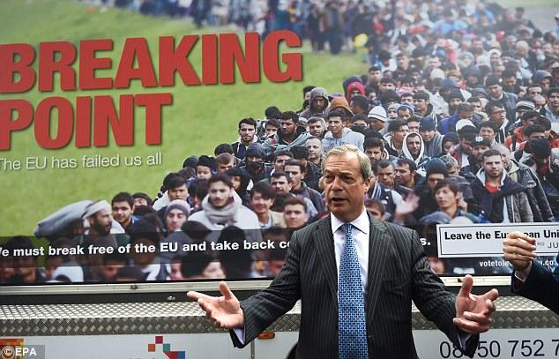
Immigration

Slide 28
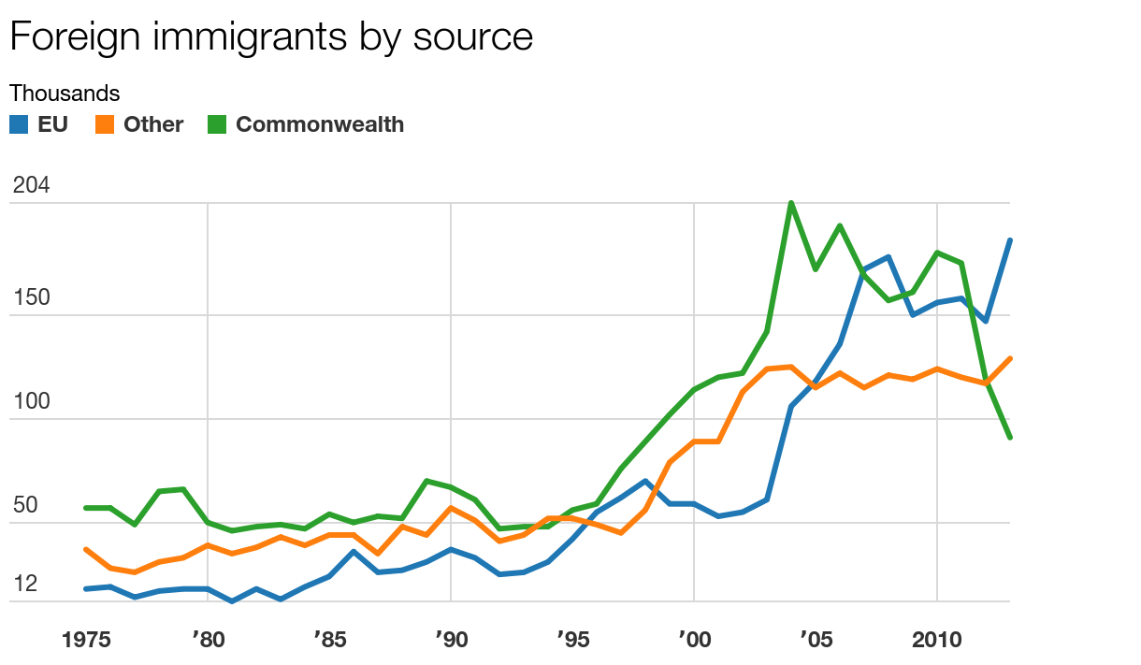
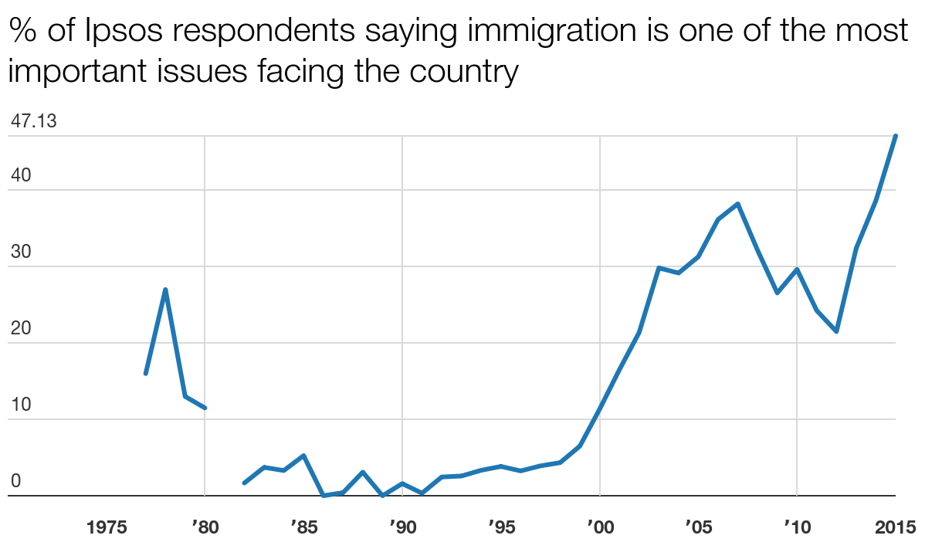
Evans, Geoffrey and Jonathan Mellon. 2015. "Immigration And Euroscepticism: The Rising Storm". The Guardian.
https://www.theguardian.com/news/datablog/2015/dec/18/immigration-euroscepticism-rising-storm-eu-referendum.
Notes:
Recent rises in concern about immigration appear to be linked closely with trends in EU immigration and not with immigration from other sources: concern increases along with increasing EU immigration rates whereas levels of immigration from other sources are falling or flat.
In itself, however, this aggregate relationship isn’t compelling evidence that individuals are linking their attitudes to immigration with those to the EU.

Slide 29
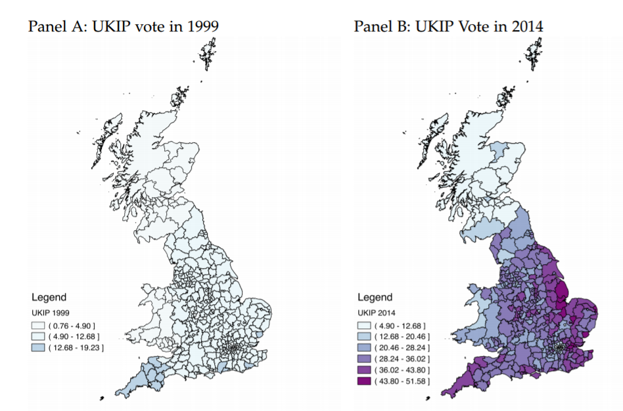
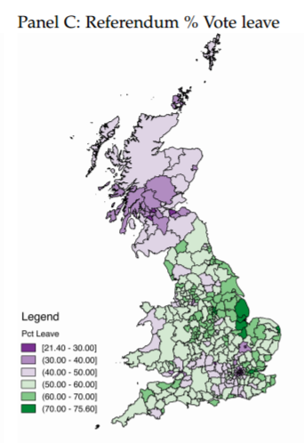
Becker, Sascha O. and Thiemo Fetzer. 2016. “Does Migration Cause Exteme Voting?”. CAGE Working Paper 306.
http://www2.warwick.ac.uk/fac/soc/economics/research/centres/cage/manage/publications/306-2016_becker_fetzer.pdf

Slide 30
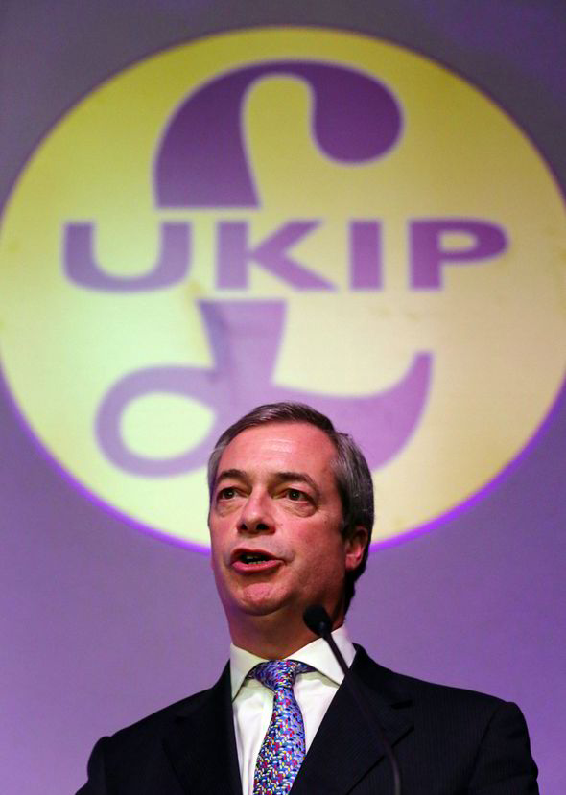
Employment
Wage
Housing
Healthcare

Slide 31
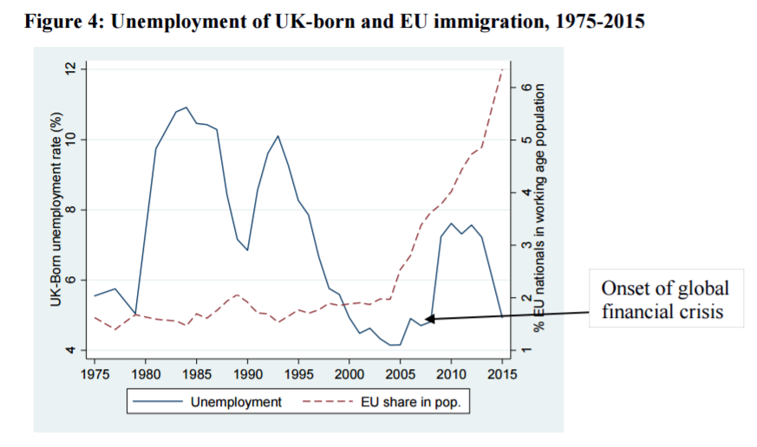
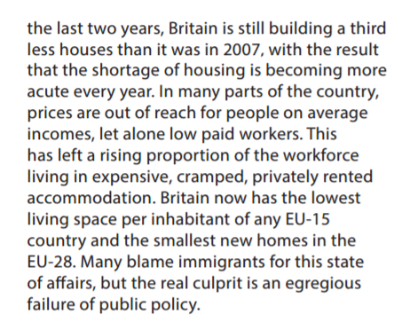
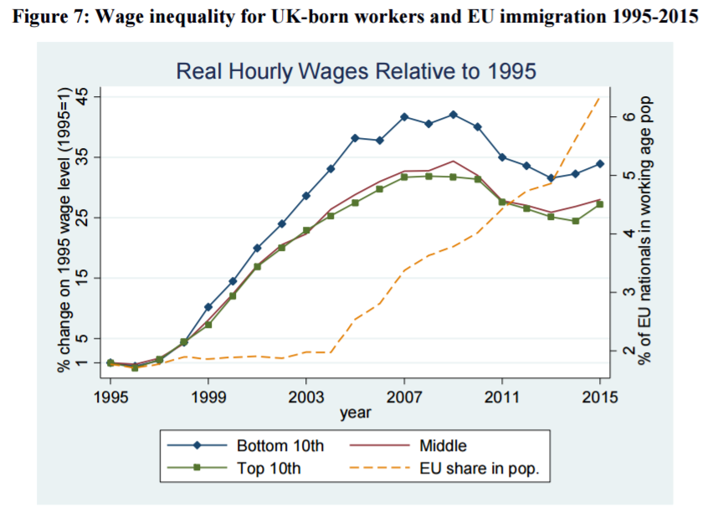
Tilford, Simon. 2015. “Britain, immigration and Brexit”. CER Bulletin.
https://www.cer.org.uk/sites/default/files/bulletin_105_st_article1.pdf
Dhingra, Swati et al. 2015. “Brexit and the impact of immigration on the UK”. The Center for Economic Performance.
http://cep.lse.ac.uk/pubs/download/brexit05.pdf

Slide 32
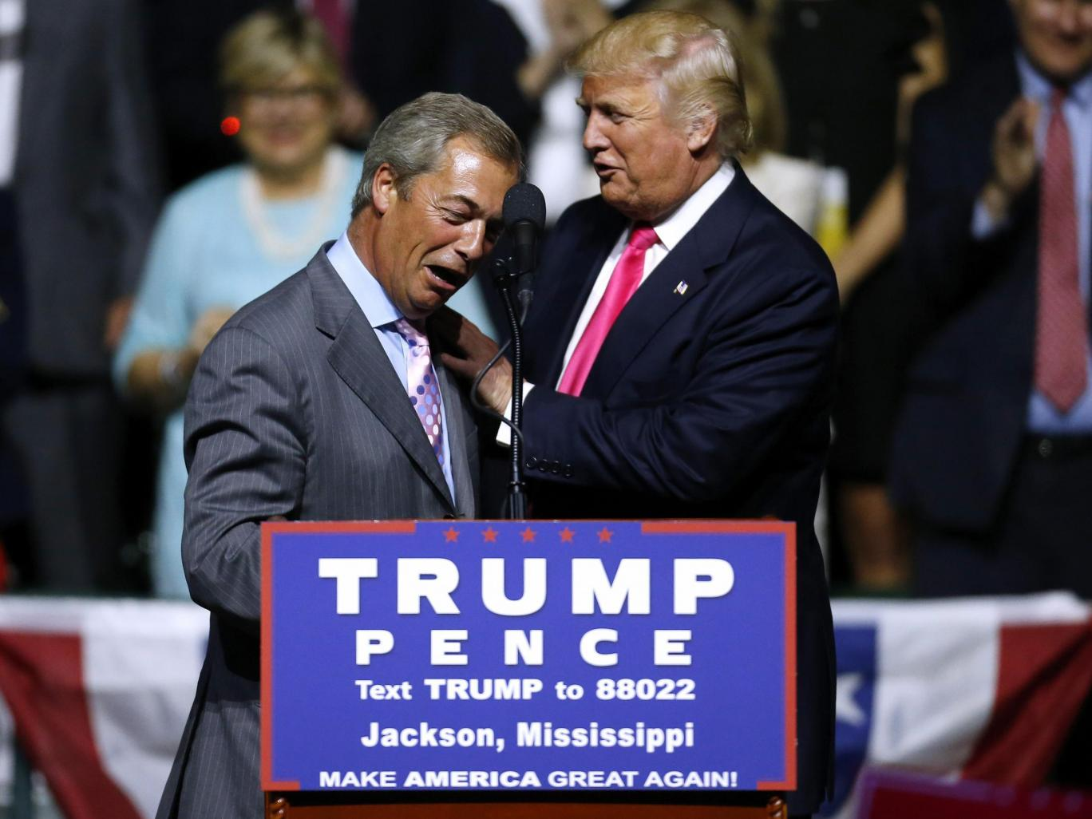
It’s all about framing! Did voters know what they were really in for?
Notes:
“The problem … was not ignorance; it was preconceived ideas.”
Fear of immigration
Cleverly utilized public preconceived ideas on immigrants and turned immigrants into scapegoat
Not immigration but fear of immigration that drives the whole brexit thing

Slide 33
Reversing Brexit?
Article 50 (5) - If a State which has withdrawn from the Union asks to rejoin, its request shall be subject to the procedure referred to in Article 49.
Article 49 - Any European State which respects the values referred to in Article 2 and is committed to promoting them may apply to become a member of the Union.
Petition calling for second referendum garnered 4 million votes but was rejected by the government
A Theresa May BREXIT deal needs MP approval
Parliament has rejected all deals thus far…….
Laid forth nearly impossible criteria
Notes:
http://www.lisbon-treaty.org/wcm/the-lisbon-treaty/treaty-on-european-union-and-comments/title-6-final-provisions/137-article-50.html

Slide 34
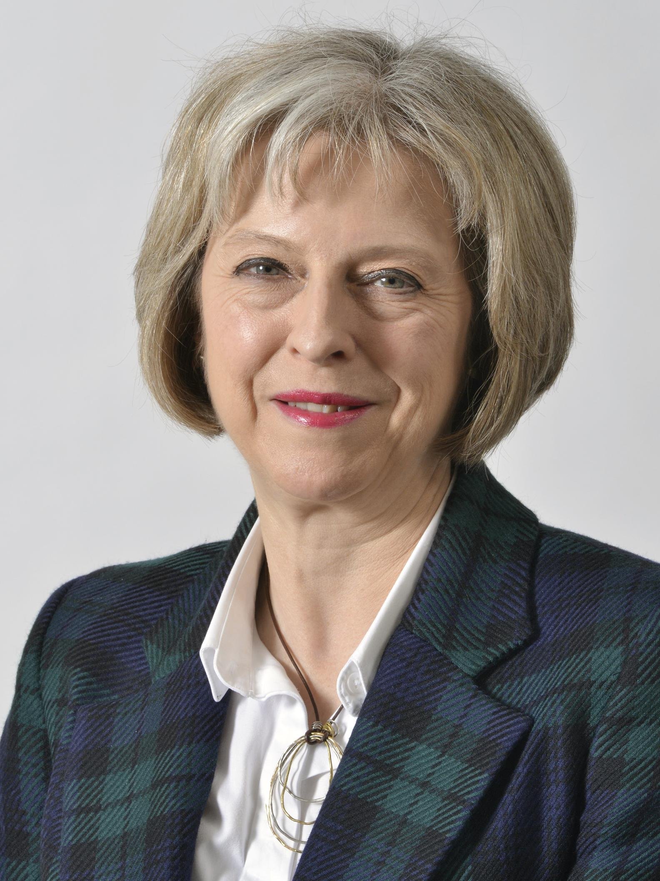
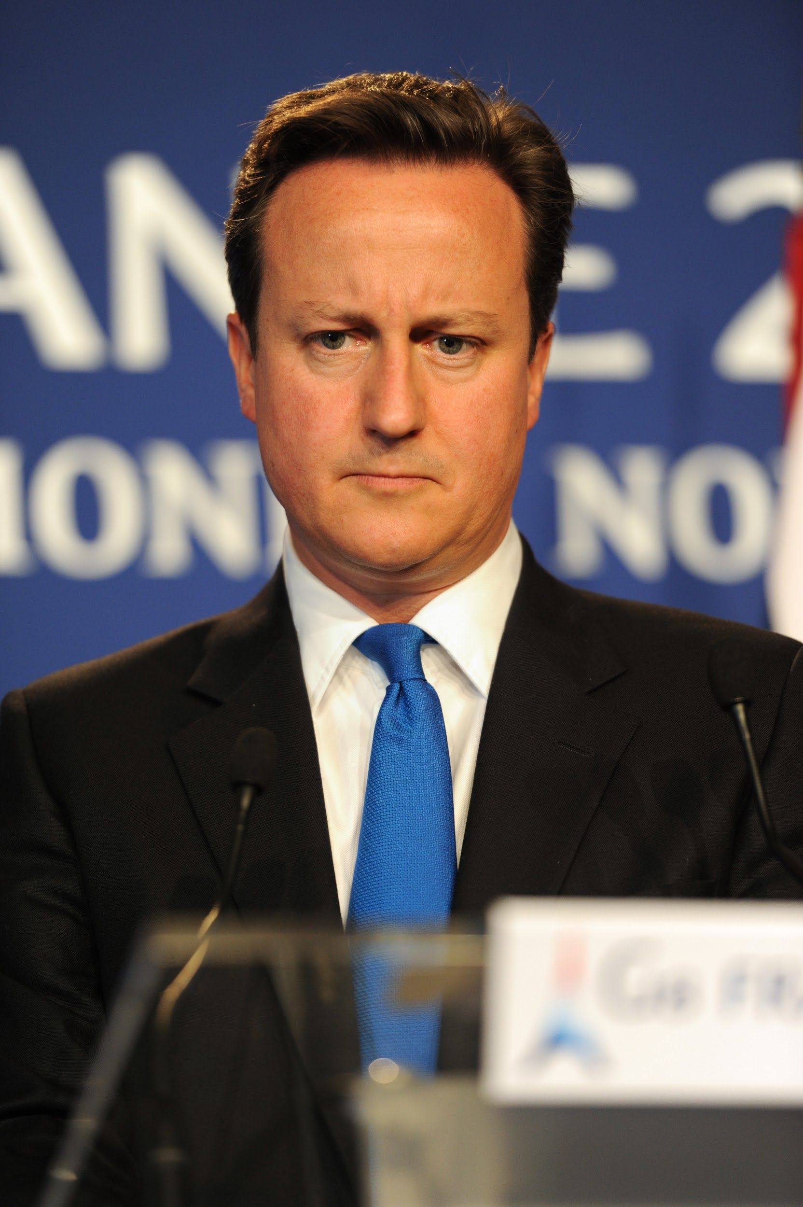
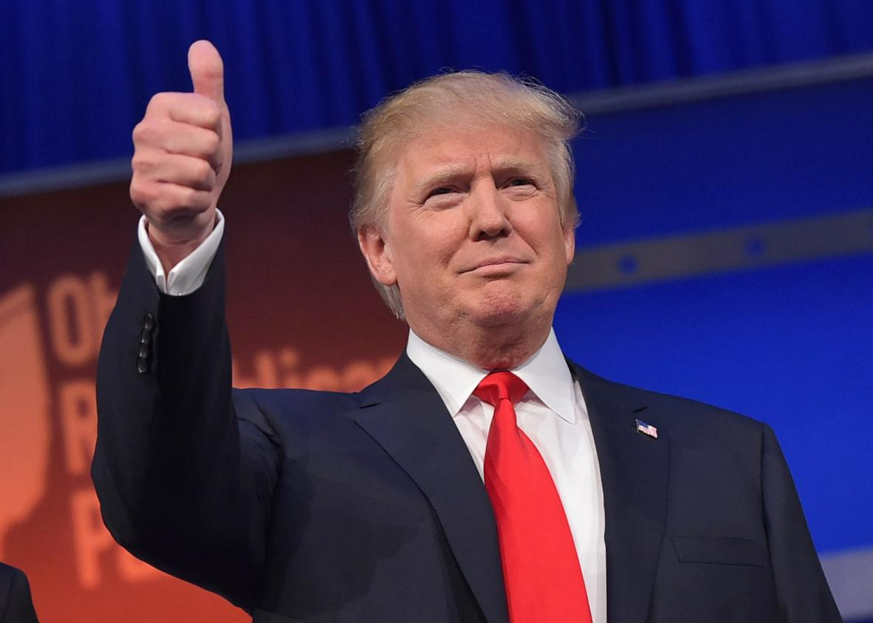
Politics
UK Prime Minister David Cameron follows through with his promise to resign if the Leave campaign won
Home Secretary Theresa May is elected by the Conservative Party and replaces Cameron
Weakened status of Labour Party
US President Elect Donald Trump praises the vote

Slide 35
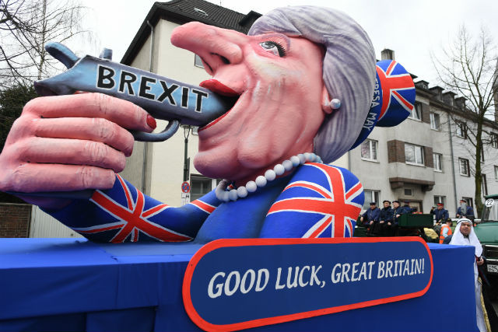
Current Climate
Currently, 69% of Britons think BREXIT is going badly so far (YouGov)

Slide 36
UK Appearing to be heading for a “hard exit”

Slide 37
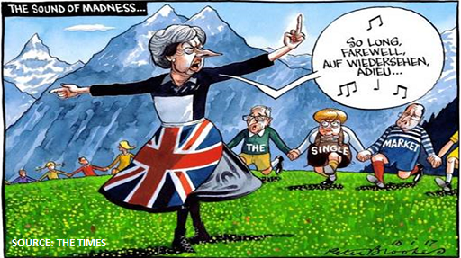
Hard Brexit at hand: What this means
What Hard Brexit would look like:
Leaving without a deal in place
Focus is on giving UK full control of its border and ability to negotiate new trade deals
UK gives up full access to EU single market and customs union, no compromise on issues like free movement of people
Likely that the UK would initially fall back on WTO rules while negotiations occur

Slide 38
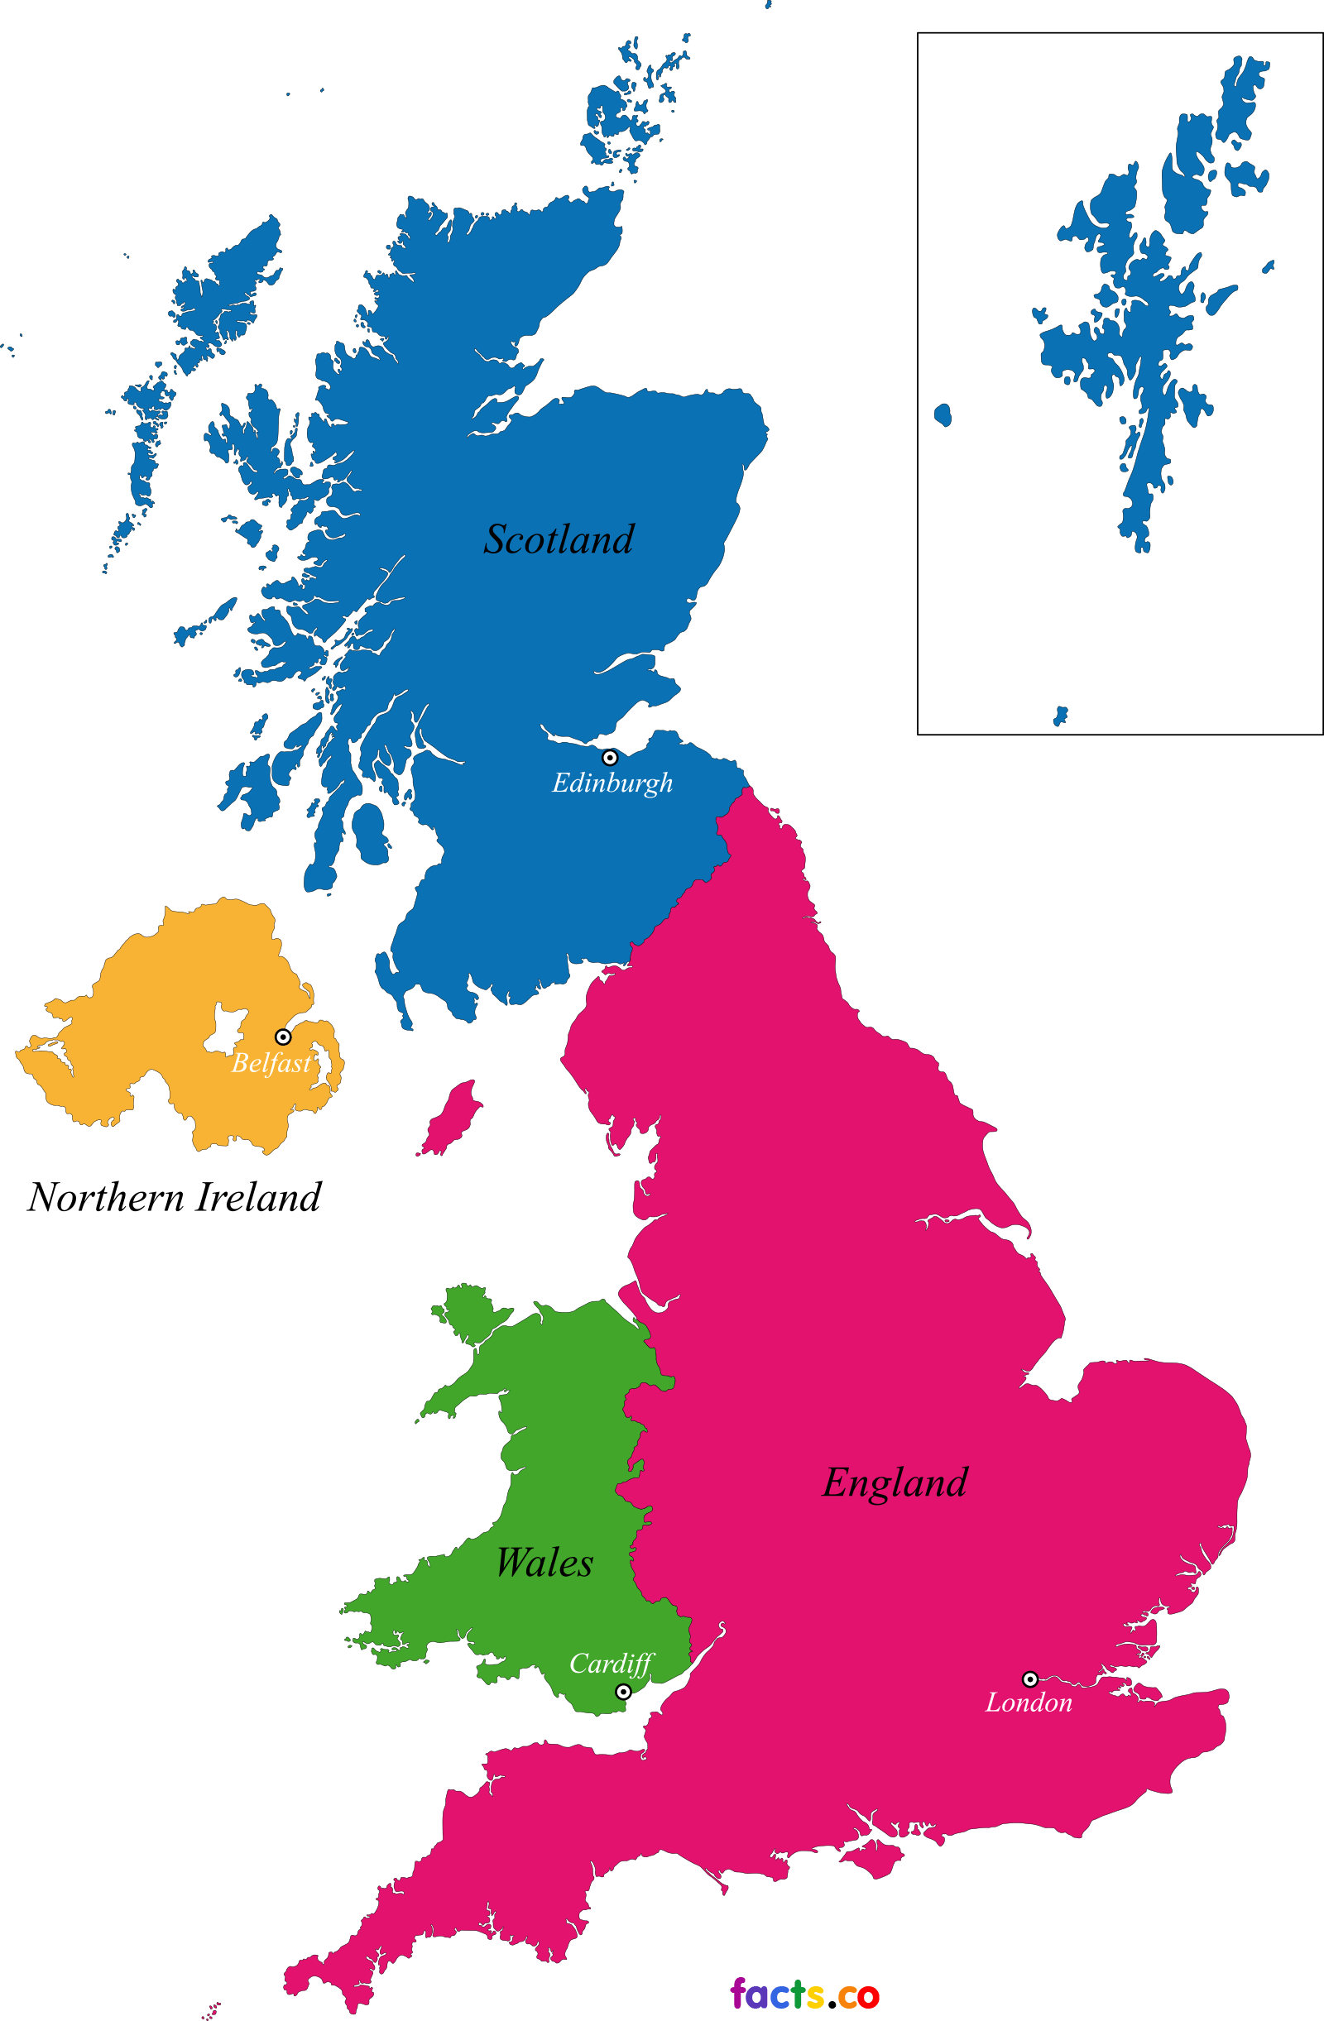
Politics
Japan and US rejecting trade deals wirh UK
Scotland threatening to leave the UK
Northern Ireland could vote to also leave the UK and join the Republic of Ireland
Notes:
gWA

Slide 39
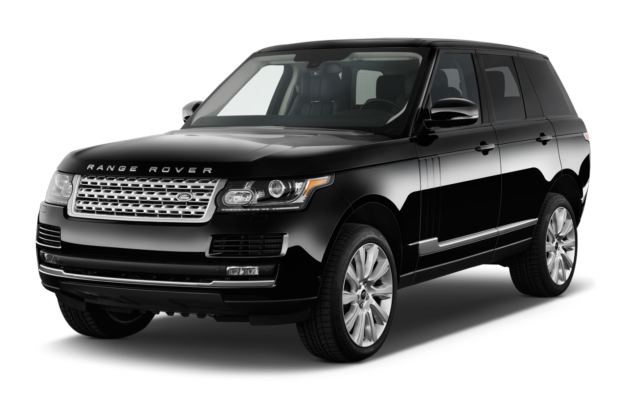
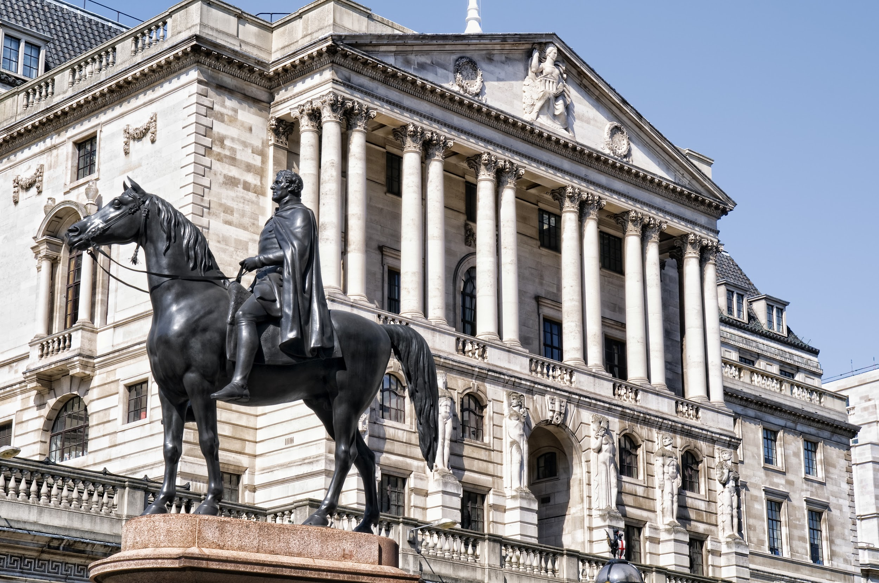
Business and Economics
Major challenges for EU business - especially manufacturing
Finance and services fleeing Lodon and going to EU
Increased likelihood of recession in both EU and UK
Forecasts from the Bank of England already project slower growth
Growth will depend on future trade agreements, but no takers

Slide 40
Useful links
http://www.vox.com/2016/6/22/11992106/brexit-arguments
http://blogs.ft.com/ftdata/category/brexit-2/
http://www.strongerin.co.uk/#ugK4pwYoqhy0ag00.97
http://www.voteleavetakecontrol.org/why_vote_leave.html#collapseOne
http://www.cnn.com/2016/05/18/europe/eu-referendum-timeline/

