Slide 1
“One Belt, One Road”
Prof. Carol Wise
April 9, 2019
Notes:
Ferdinand’s article describes the process moving China Dream to OBOR and foreign policies under Xi Jinping. Aoyama’s article describes the OBOR policy and the relations with different countries under the policy. The article by Du describes the initiative of the policy.

Slide 2
3 principles of “Great rejuvenation of the Chinese nation”
1) Attaining stability in Sino-American relations (Due to U.S.’s increasing in its military cooperation with allied nations in the Asia-Pacific)
2) Creating a sphere of influence and increasing its own influence in the international community (”Continue to keep a low profile, actively seek to achieve something”. The shift in focus to “achieve something”)
3) Not compromising on its “core interests” (Tibet, Xinjiang, the South China Sea, and the attempt to increase its influence in the international community)
Notes:
Introduced by the Xi Jinping administration. Another slogan “New normal” aims for stable growth while making structural reforms instead of pursuing a high rate of growth. The drop in economic growth in 2015 indicates the risk of increasing dissatisfaction with the administration and a resulting spread of social instability.

Slide 3
CHINA DREAM
China Dream: negotiation between collective identity and individual aspirations. It is like a large body of water––the dream reveals the Chinese people as having a collective will and identity shaped by a difficult history but at the same time if individuals and communities took closely into the dream they should be able to see their own reflection in it.
“The China dream is the inner meaning of upholding and developing socialism with Chinese characteristics”.
The essence is a rich and powerful country, revitalizing the nation and enhancing the well-being of the people.
It reflects China as a superior country and surpassing the western development path.

Slide 4
Initiative of “one belt, one road”
President Xi came up with the initiatives of the land-based “Silk Road Economic Belt” and oceangoing “maritime Silk Road of the 21st Century” while visiting Kazakhstan and Indonesia, respectively.
Xi Jinping’s possible initiative was to remind his Kazakhstani host about their shared commercial ties along the Silk Road, stretching back millennia.
Chinese president hopes to bind together 65 countries and 4.4 billion people from Xi’an, a western city in China.
The strategy is not intended to make a fresh start, but to integrate China’s existing multilateral and bilateral mechanisms into a broader framework.

Slide 5
Focus of SILK RoAd Initiative and msr
1) Policy Coordination: calls for frequent diplomatic communications among the countries along the Silk Road with a view to promoting the “mind-meeting” of governments in these countries.
2) Facility Connectivity: requires prioritizing the key projects such as ASIIB and the Silk Road
3) Unimpeded Trade & 4) Financial Integration: engender formidable work of institution-building among all the countries along the Silk Road
5) People-to-People Bond: requires intercourse and interaction between people of all countries along the Silk Road.
Keywords: Connectivity and Cooperation
Notes:
Under SREB/MSR

Slide 6
Institutions under sreb/msr
Shanghai Cooperation Organization (SCO): the economic integration among the SCO member countries is slow and has no apparent accomplishments. This is due to the members lacking the incentive to promote a free trade agreement (FTA) among themselves.
ASEAN Plus China (10+1): CAFTA: a low standard FTA, although used by China to offer “Early Harvest Package” to ASEAN members, it lacks visibility in the arena of FTAs.
Asia Infrastructure Investment Bank (AIIB): 57 countries have committed to join the AIIB, making it an authentic international development bank and serving the economic development of Asia.
Notes:
For SREB/MSR

Slide 7
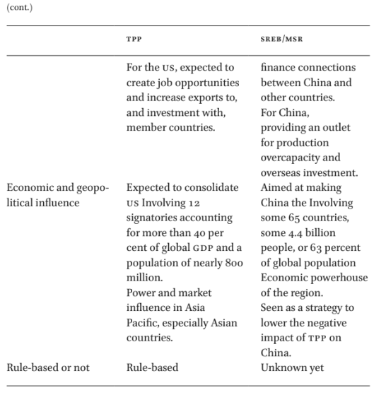
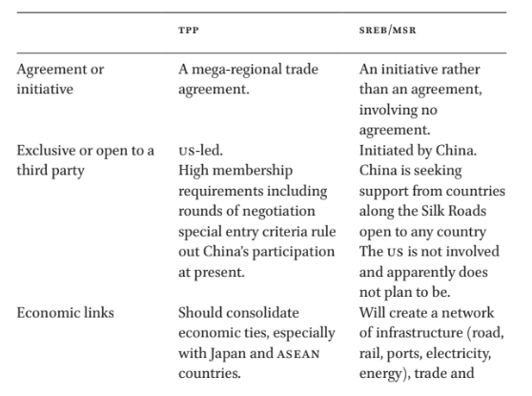
Highlights of sreb/msr goals
Notes:
TPP stands for Tran-Pacific Partnership

Slide 8
Implications of sr/msr for china
SR/MSR strategy will secure the transport of oil and gas and other essential goods
Due to end of economic boom, China has overcapacity in industry and construction, deflation and rising debt management problems. The strategy can ease the entry of Chinese goods into regional markets, help make use of China’s industrial overcapacity to offset the results from falling investment rate.
SR/MSR can improve internal economic integration between the country’s advanced coastal and the underdeveloped western provinces.

Slide 9
Implications of serb/msr for partners and global governance
SREB/MSR strategy will improve region’s economic architecture-––infrastructure development, patterns of regional trade and investment. But SREB/MSR is very China-centric and that other participating states will gain only marginal benefits.
SREB/MSR strategy is an upgraded version of China’s opening-up policy as well as its strategy for globalization.
Chinese globalization needs to nurture shared interests, shared system and effective dispute settlement mechanism.
Western officials also fear that a flood of Chinese development money will undermine governance standards at existing lending institutions like the World Bank to politically motivated projects or to environmentally damaging ones.

Slide 10
One belt, one road
Introduced due to “China’s surrounding environment has worsened dramatically, with escalated confrontation between Japan and China, and an increase in tensions with surrounding nations due to issues regarding territorial waters” South China Sea
Started off as a concept and gradually turned into specific measures.
Not only a regional strategy, but also a global strategy for China.
China is seeking opportunities for foreign relations both to the south and the west
  Developing infrastructure
  Creating a large economic market by strengthening relations between China and other countries
  Easing excess domestic productions through exporting to stimulate its economy

Slide 11
Xi’s Foreign policy “concepts”
“New type of Great Power relations”: characterize Sino-American relations since Xi met Obama
Issue of relations with states around China’s borders
“One Belt, One Road” initiative (OBOR): potentially involves over 60 countries with a combined population of over 4 billion people, whose markets currently account for 1/3 of global GDP.
Maritime Silk Road: Prime Minister Li Keqiang announced the plan linking south-east China with south-east Asia, Bangladesh, India, the Persian Gulf and the Mediterranean, ultimately also ending up in Germany and the Netherlands.

Slide 12
Six international economic corridors
China-Mongolia-Russia Economic Corridor
New Eurasia Land Bridge (Second Eurasia Land Bridge) Economic Corridor
China-Central Asia-West Asia Economic Corridor
China-Indochina Peninsula Economic Corridor
China-Pakistan Economic Corridor
BCIM Economic Corridor
21st-Century Maritime Silk Road: Routes from the South China Sea and the Indian Ocean to Europe and Africa, and routes from the South China Sea to the South Pacific.

Slide 13
Differences with previous policies
1) Large geographical scope: No reduction in economic disparity between eastern and western China because of the difficulty in opening up western China due to ethnic issues.
The policy aims to expands China’s economic sphere to both Central Asia and Europe and Arab nations in the west.
2) Simultaneous progression of efforts to open up east and west as well as land and sea efforts.
Through the policy, the Chinese government hopes to stimulate the economies of the northeast, central, and western regions of China, whose economies have fallen behind, and open up the eastern region of China to the outside world to an even greater degree.

Slide 14
Chinese relations with other nations under obor
China-America: Only agreed to create a channel for dialogue. Emissions trading system
China-ASEAN: Resolve the South China Sea issue through dialogue with concerned parties, and to maintain security in the South China Sea with the concerned parties. Remove American influence and promote security cooperation.
China-Brunei: Signed a bilateral agreement to strengthen maritime cooperation and promote joint development
China-Vietnam: Had strong disagreements concerning territorial waters in the past. Agreed to establish an “infrastructure cooperation working group” and a “finance and currency cooperation working group”
Sino-Japanese relations have improved. Various security talks, talks between the legislative bodies, New Japan-China Friendship Committee and the Energy Conservation and Environment Forum.

Slide 15
Chinese relations with other nations under obor CONT.
China-Korea: There were competing claims for exclusive economic zones between China and South Korea in the Yellow Sea as well as a territorial dispute regarding Socotra Rock. But they strengthened cooperation regarding the North Korea issue and opened up a national defense hotline in Dec. 2015
China-North Korea: There was a cool-down in the relationship between China and North Korea. China tried to revive the “traditional friendship” with North Korea but the phrase received criticism. The relationship between China and North Korea did not improve as shown by the Moranbong Band cancelling their event in Beijing and returning to North Korea.
China-Taiwan: A cabinet-level hotline was opened between the Taiwan Executive Yuan’s Mainland Affairs Council, which handles relations with China, and China’s Taiwan Affairs Office of the State Council.

Slide 16
Chinese relations with other nations under obor CONT.
China-France: EU members signed an agreement with France to develop third party markets, and agreement regarding China-France joint fund.
China-UK: Not only reaffirmed a strengthening of cooperation in finance, but also agreed on Chinese investment in a power company in Hinkley Point, as well as the installation of Chinese nuclear reactor in the UK.
China-Germany: Cooperation agreements in finance, energy, information and communications, industry and agriculture, and education.
China’s projects: Railway linking Serbia and Hungary. Macedonian high speed rail. Bridge over the Danube River in Serbia. Wind farms in Bosnia and Herzegovina.
China-Africa: China promised to provide aid to communications companies in Africa while calling for media cooperation to weaken the influence of Western media in Africa. China-Africa Cooperation Summit (Dec 2015): China promised $60 billion in financial assistance over next 3 years, a $10 billion China-Africa Fund for Production Capacity Cooperation, and $6 million over the next 5 years to the African Union (AU).

Slide 17
OBOR as Global strategy
China plans to strengthen 5 areas with OBOR: 1) policy, 2) finance, 3) trade, 4) infrastructure, and 5) people-to-people exchanges.
Challenges: 1) Chinese economy has slowed down; therefore, making OBOR commitments less certain; 2) A large portion of the regions covered by OBOR have unstable security and political situations.
Despite an increase in cooperation between China and many other nations and regions, the progress on economic corridors has slowed.

Slide 18
Geopolitical implications
OBOR initiative demonstrates a Chinese concern to compete with the U.S. through strategic economic policies and military buildup.
OBOR also diverts some Chinese attention away from the Pacific and towards the west: Can potentially make Europe more dependent economically upon China .
There are more potential openings for trade with countries to the west than in east Asia. Already, China is becoming both a global and an Asian power.

Slide 19
Requirements & economic corridors
Will require US$6 trillion funding, US$1 trillion from China
Cooperation with involved nations:
  Construction of the pipeline from Gwadar Port, Pakistan to Kashgar, Xinjiang Uyghur Autonomous Region suddenly became more realistic.
  BCIM Economic Corridor pertaining to Bangladesh, India, and Myanmar has proposed routes: north, central, and south. However, the routes are still undetermined because of the difficulty to reach an agreement.
  China and Belarus agreed to create an industrial park as a symbol for cooperation on the Silk Road.
  China and Russia issued a joint statement concerning a link between the Silk Road Economic Belt led by China and the Eurasian Economic Union (EEU). Aim to create a transportation route from Heilongjian to Vladivostok.

