Slide 1
Zionism: Keeping the Dream
MVZ247: Week 1

Slide 2

Basic?
A movement for (originally) the re-establishment and (now) the development and protection of a Jewish nation in what is now Israel.
First established as a political organization in 1897 under Theodor Herzl, and was later led by Chaim Weizmann

Slide 3
Complicated Beginnings
The mid-nineteenth century saw the development of a variety of Jewish national movements. Zionists competed with Bundists and Autonomists that offered competing ideologies and solutions to the issues of Jewish nationhood and individual nationality and to problems posed by modernity.
Among these problems was the breakdown of the parochial molds of Jewish life and the fragmentation of the traditional Jewish community.
  displacement and assimilation
  Zionism was the most radical of all modern Jewish national movements

Slide 4
Revolutionary times
Zionism’s revolutionary character stemmed from its emphasis on the need to construct a Jewish national life in response to modernity and to do so only in Eretz Israel — the Land of Israel.
Additionally, Zionists believed that policies on the major issues confronting Jewry should be subject to free and open debate.
  not confined to rabbi and schools
Furthermore, due to the catastrophic condition of East European Jewry, they were the first to assert that the solution to the “Jewish Problem” hinged on migration to a homeland (Vital, 1998, p. 208-9).

Slide 5
The role of Nationalism
Zionism provides an example of the role of nationalism in the reconstruction of nations.
  Smith (2004), argues that nationalism relies on an historical, primordial identity connected with religion, history and territory.
Zionism is observed in Anderson’s (1983) argument that nationalism refers to a dynamic process of remembering and forgetting fundamental concepts of collective identities.
A classic example in the case of Zionist thought, the negation of exile (shlilat hagalut), the denial of a collective memory.

Slide 6
Long struggle
Tension between the personal life of a Jew and the public life amongst secular society was the main challenge facing European Jewry.
Zionism was a reaction to the attempts of Jews to bridge this gap. The tension was exacerbated by the rise of anti-Semitism as a strong political force following the major financial crisis of the late nineteenth century.
Anti-Semitism was felt by those Jews living in Europe who had to cope with pogroms in Russia (1881-82), riots in Kishinev (1903), the murder of Jews throughout western and southern Russia (1905), accusations of betrayal (the Dreyfus Affair in France), the emergence of racist approaches in France and Germany and official anti-Semitic policies in Russia and other Eastern European countries.
As a result of the long-term process Jews attempted to resolve the tension between their personal and public lives in a secular society.
  little to no success (Dreyfus Affair, Nuremberg Code)

Slide 7
Emergence of Identity
The main premise of Zionist ideology was that the solution for a viable Jewish communal existence in modern times could be implemented only in Eretz Israel.
Eretz Israel, the land in which the identity of the Jewish people had originally formed, constituted a continuous component within the Jewish collective consciousness.
It was the only place in which a Jewish collective entity and environment could be reconstructed, and the only place in which the Jews could reenter history and become a productive, normal and unified community, responsible for its own destiny.
  one must remember the familiar toast “next year in Jerusalem”

Slide 8
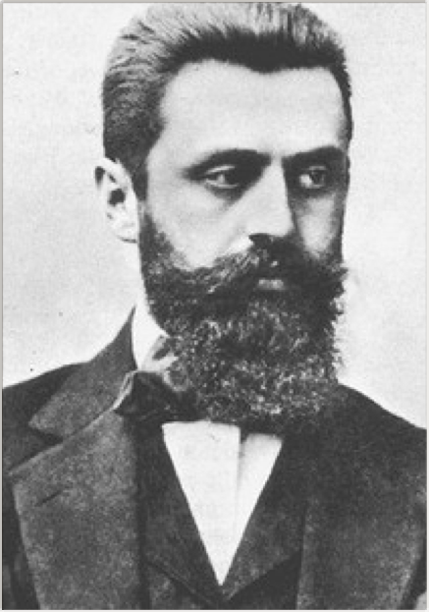
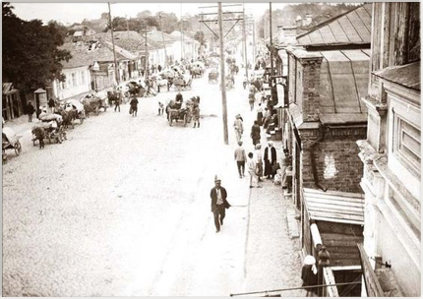
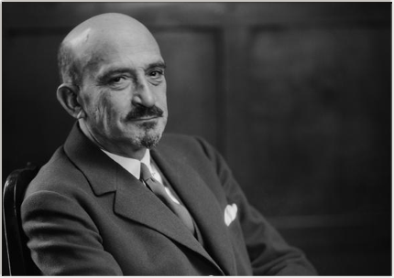

Slide 9
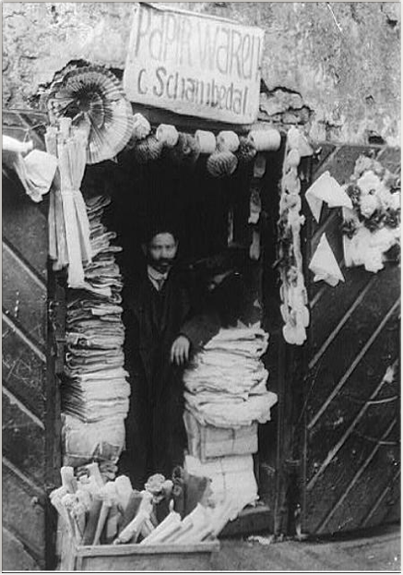
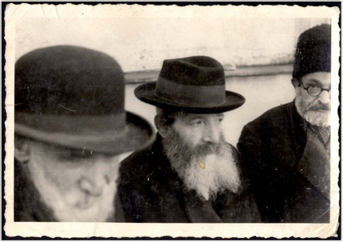
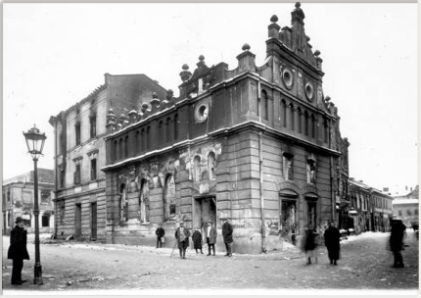

Slide 10
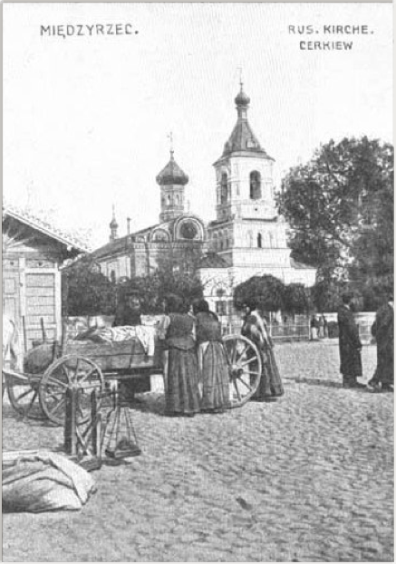
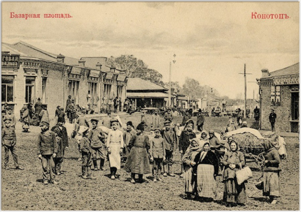
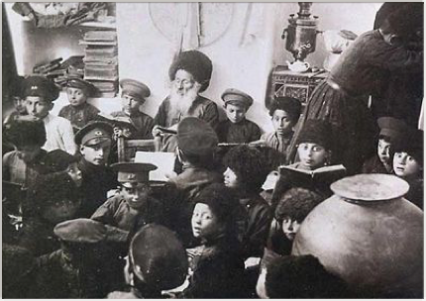

Slide 11
Roots
Rabbi Yehudah Shlomo Alkalay (1798-1878) and Rabbi Zevi Hirsch Kalischer (1795-1874) appeared in the mid-nineteenth century and were among the first proponents of Zionism to argue that Jewish settlement in Israel was a preparatory stage for the coming of the Messiah.
A more modern utopian version of Zionism — based on a socialist perspective and framed in terms of moral necessity —was developed by Moses Hess (1812-1875). In his Rome and Jerusalem (1862), Hess argued that Jews were not a religious group but rather a separate nation characterized by a unique religion whose universal significance should be recognized.
The attempts of religious reformers to mold Jewish ceremonies into a version of Christianity left only the skeleton of a once magnificent phenomenon in world history. The response, according to Hess, should be a political organization of Jews as well as the establishment of a Jewish state in Palestine that would act as a spiritual center and a base for political action, embodying socialist principles within its institutions.
    source: Jewish Virtual Library

Slide 12
Streams of Zionism
Within the Zionist movement there were many different streams competing for the attention of the Jewish public. Each stream contributed its own ideology regarding the future of the Zionist movement, how it should be built, appropriate goals it should set and the order it should attempt to accomplish these goals.
Practical
  Leon Pinsker (1821-1891), articulated the view of practical Zionists in his book Auto-Emancipation (1882) arguing that the Jewish national goal need not be Eretz Israel but rather a land large enough to include Jews who are deprived of their political, economic and social rights. Only later did Practical Zionists shift their stance and begin stressing settlement in Palestine.
Political
  Dynamic force under Theodor Herzl and the convening of the First Zionist Congress in Basel, Switzerland, in 1897.

Slide 13
Streams
Spiritual and Cultural
  Provided spiritual Jewish values to both the individual Jew in Western Europe who was unable to integrate into the liberal culture of his home country and the East European Jew unable to identify with the nationalist culture of his home country.
Religious (Mizrahi)
  Prominent rabbis helped in the national reawakening process and influence the reconstruction of a new Jewish identity. the Mizrahi party early in the history of the Zionist Movement signified the entry of the religious and rabbinic world into the realm of institutionalized politics.

Slide 14

Home
Home-rule, was achieved following the appearance of Theodor Herzl and the convening of the First Zionist Congress in Basel in 1897.
  the World Zionist Organization (WZO) was established.
This organization replaced Baron de Rothschild who had been the main funder of settlement activities in Palestine
  (Ettinger and Bartal, 1996).

Slide 15
Protecting Identity = Defense
Earliest forms of Israeli foreign policy (un-categorized as such) was gaining financial and political recognition and support for Jewish home.
After 1947 it was in the form of bi-lateral treaties
After 1956 it was maintained of legitimacy of claim to land and UN Res.242.

