Slide 1
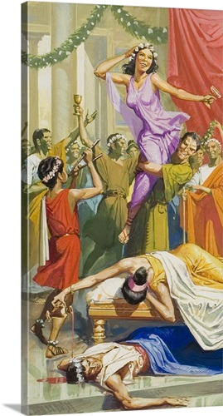
Episodic intoxication in traditional societies
Substance use known throughout time and cultures
Limited access – psychoactive substances are rather rare and expensive
Heavy societal control for who, when and where can have access to. E.g.:
heavy drinking during festivals and important social situations
altered states of mind during religious rituals
use for medical purposes (e.g. pain relief)

Slide 3
Epidemic spread of drugs
16th century
New discoveries and globalisation of trade
Cheap and slave labour
Advancement in agricultural technology
Intensification of substances – more potent, cheaper, easily transportable, available worldwide
1) introduction of tobacco in Europe and Asia, 2) export of cheap alcohol to Europe, 3) export of opium to far east Asia and Europe
First attempts to solve the problem: taxation and market limitation

Slide 4
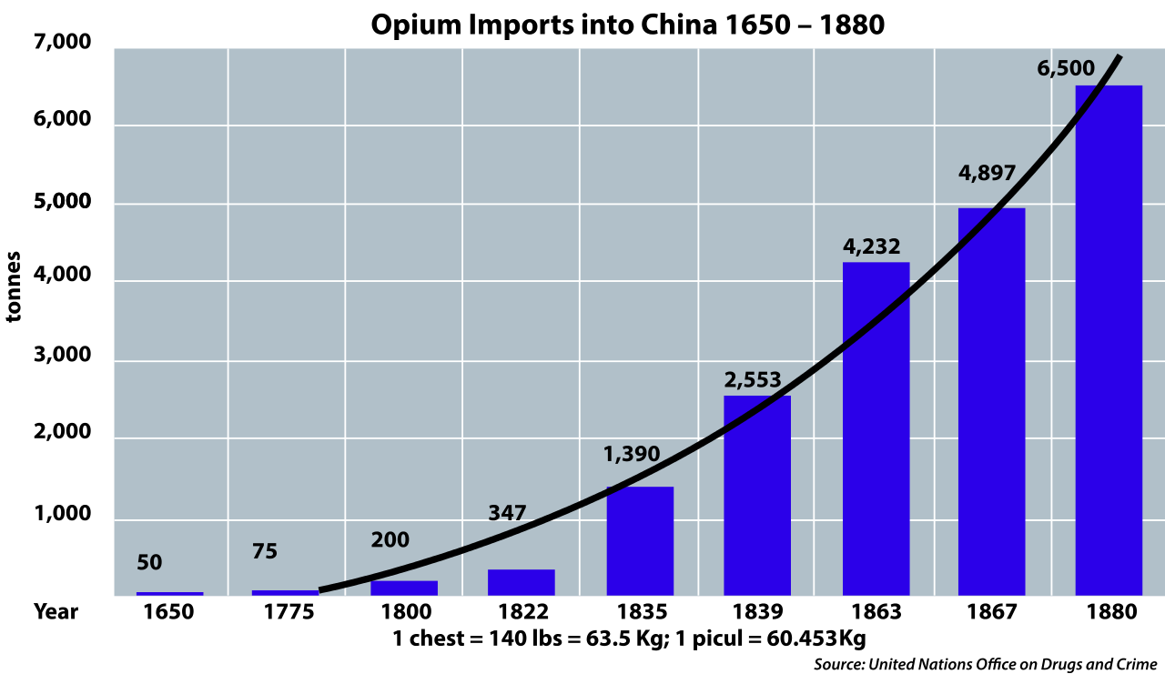

Slide 5
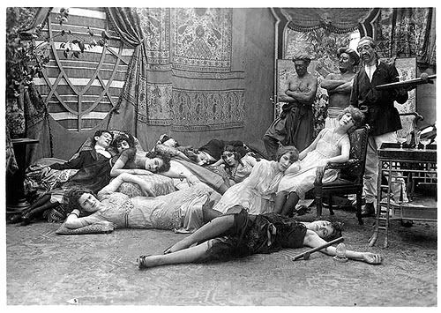

Slide 6
Addiction as immoral/criminal conduct
The first model of addiction (appeared in 16th century) and still living today
Substance use is not seen as a disease but as a personal moral failure, sinful and criminal act
Excessive substance use is considered as a behaviour of choice and not as loss of control and thus subject of legal action and punishment
Understanding still preferred right-wing political ideology. E.g. war on drugs
It is simple, clear and straightforward
BUT it is oversimplification and in contradiction to current knowledge (e.g. genetic predisposition). And leading to even bigger problems - escalation of violence, organized crime networks, prisons overload

Slide 8
http://www.nytimes.com/interactive/2016/12/07/world/asia/rodrigo-duterte-philippines-drugs-killings.html?_r=0

Slide 11
Addiction as immoral conduct
Believe in just world (just world hypothesis)
Consequences are result of one's actions (you reap what you sow)
Often used as blaming of the victims of crimes, poverty etc. (raped woman was too seductive; poor people are too lazy,…)
Connected to believe in destiny and higher order - often found in right-wing and religious ideology
Guilt reduction, discomfort reduction (discomfort caused by empathy with victims), anxiety reduction (anxiety caused by uncertainty and unpredictable world)
The poor homosexuals — they have declared war upon nature, and now nature is exacting an awful retribution (Pat Buchanan, 1983) – summary of why not doing anything with spreading HIV epidemic in US during Reagan‘s administration

Slide 12
Temperance model of addiction
In the most primitive form – preternatural model – the substances are demonic and can take possession over human mind (demon alcohol)
Addict does not have ability to control him/herself
Addiction is a form of involuntary mental condition
It is the substance to be blamed
It is reasonable to abstain from the use completely
Sympathize with addicts but rejects mild users

Slide 13
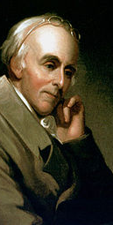
Temperance model of addiction
Benjamin Rush (1745-1813)
Founding fathers of the United States
Founding father of American Psychiatric Association
Alcohol use is behind poverty, health issues, violence, crime, family disruptions
Addiction is also a disease – addicts should be treated
Taste not, handle not, and touch not!

Slide 14
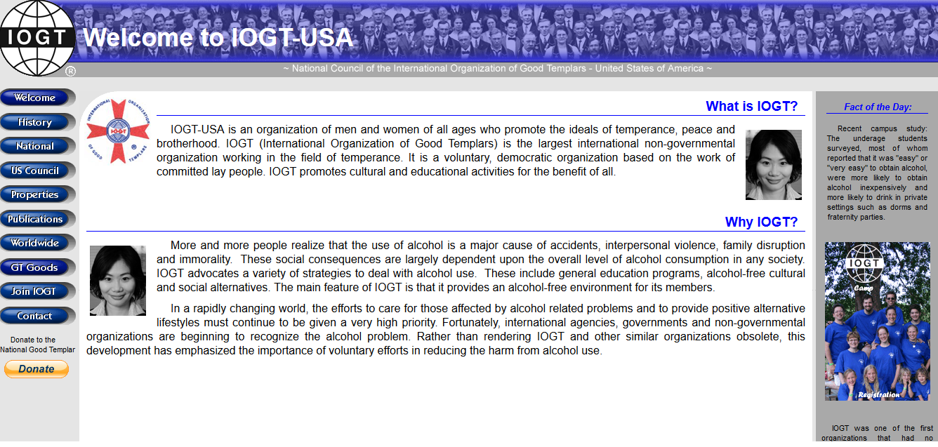
International Organization of Good Templars

Slide 15
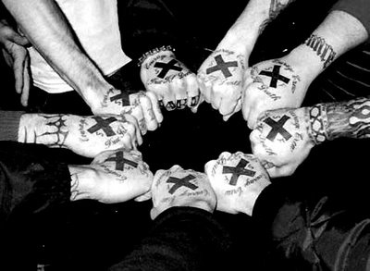
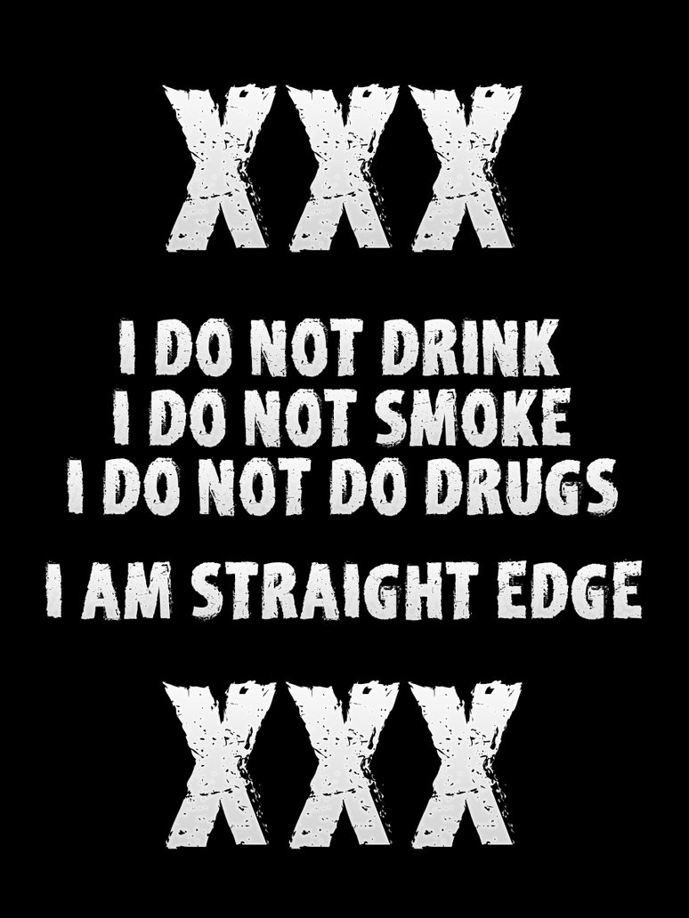
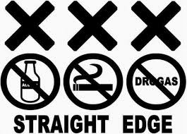

Slide 16
Illness & personality disorder models of addiction
Evolved in 1800s in USA – asylums in rural areas that supported people with food and shelter. No access to the substance
People in such treatment where in miserable conditions and had to accept themselves as ill. Often moral semi-religious treatment
Addict has a personality disorder – excessive substance user often shows array of antisocial and maladaptive behaviours.
The person is untreatable and unrepairable
Rise of self-help communities

Slide 17
12 step program – Alcoholics Anonymous
1939 - Alcoholics Anonymous: The Story of How More Than One Hundred Men Have Recovered from Alcoholism
self-help group
admitting that one cannot control one's alcoholism, addiction or compulsion;
recognizing a higher power that can give strength;
examining past errors with the help of a sponsor (experienced member);
learning to live a new life with a new code of behavior;
helping others who suffer from the same alcoholism, addictions or compulsions.
newcomers to becoming aware of their lack of ability to control their behaviour (steps 1 through 3 )
to expand self-examination and incorporate the outcomes of self-reflection into actions (steps 4 through 9 )
focus on maintaining positive changes in behaviour and the recovery process. The recovery process includes attending meetings, listening to other members at different recovery stages and working with a sponsor, who is an experienced member who is encouraged to complete all of the steps (steps 10 through 12 )

Slide 18
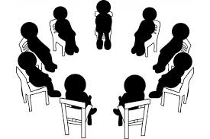

Slide 19
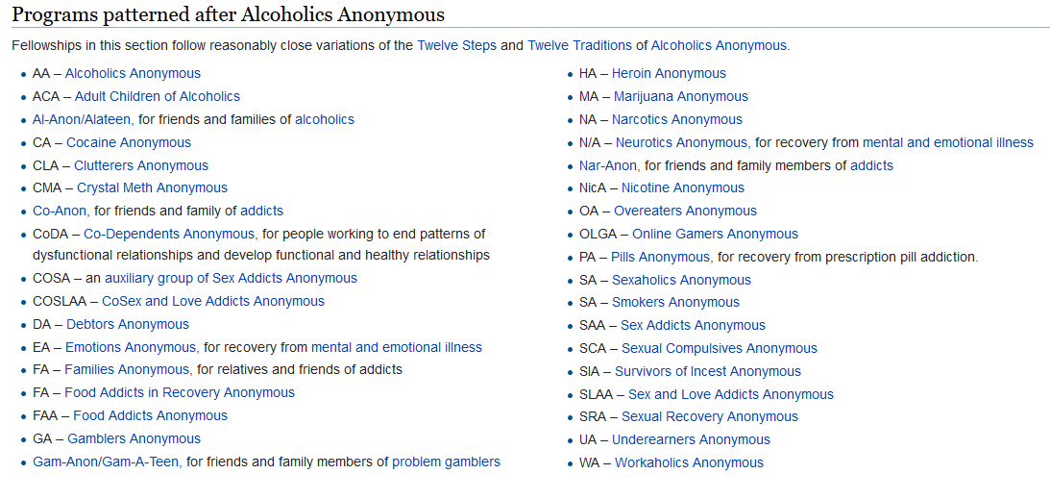

Slide 20
Disease model of addiction
At first, these processes were not understood. But it was assumed it is 1) brain disease and with 2) genetic susceptibility
Addicted person is a victim of this disease - it is not chosen and it is not an act of free will
Loss of control & craving as the common processes in addictions
Consumption of the substance causes craving for further dozes (through at first unknown psychological and neurological mechanism)

Slide 21
Disease model of addiction
Since the person is ill and suffering, he/she should be subject of medical treatment
Treatment was based on management of medical complications (stomach ulcer, liver disease,…) and raising patient health education – supervision of a physician
Therapy-like approach heavily influenced by 12 step program and 12-step programs take ideological support from scientific approach of disease model

Slide 22
Disease model of addiction
Addiction as a primary disease – addiction is not understood a result of another condition (other psychiatric condition, stress,…) but rather their cause
Addiction as a progressive disease - addiction is understood as a disease that has its course: 1) adaptive stage - increasing tolerance 2) dependent stage - withdrawal and maintenance usage 3) deterioration stage - resulting into major health and social problems
Addiction as a chronic disease – addiction is understood as a disease that will never disappear and the person will never be fully cured. Thus complete sobriety is the only way

Slide 23
Disease model of addiction - pros
Big leap in knowledge, new research
Removes stigma from suffering people
The classic disease model is still very simple to be understood by general public
When addiction became a disease (alcoholism as disease was acknowledged by American Medical Association in 1954) the help became more accessible

Slide 24
Disease model of addiction - cons
Despite huge advancement in knowledge, it was only poorly incorporated into this model. E.g. proofed usefulness of light substance taking contradicts chronic disease; natural remission and maturing out contradicts progressive disease; much stronger environmental factors contradict primary disease
Ignoring context - too little emphasis on psychological and social factors
The treatment method, although advancement at the beginning, is way behind treatments based on psychological and social models

Slide 25
Physical dependency theory
By suing the substance, the person can gradually develop a physical dependence
Physical dependence is a condition in which the person needs the substance otherwise suffers from various withdrawal symptoms
This theory assumes that addiction = physical dependence
NOT proved – many substances do not create physical dependence nor physical withdrawal symptoms. Many addicts return to addiction after period of treatment in which they were detoxified
Avoiding negative effects plays a role, however, more crucial proofed to be the pleasure-seeking

Slide 26
It is about (anticipated) pleasure
Positive-incentive theory - all drugs have pleasurable effects. Drug taking is more about getting the positive effects rather than about removing the negative effect
Positive-incentive value is usually much higher than hedonic value = anticipated pleasure is much higher than actual pleasure
Incentive-sensitization theory – repeated exposure to potentially addictive drugs leads to various changes in brain. The most important is sensitization = hypersensitivity to the incentive motivational effects of drugs and drug-associated stimuli that creates pathological wanting.
Addiction is not about the drug effect, it is about the anticipation of the effect. Addiction is motivation disorder

Slide 27
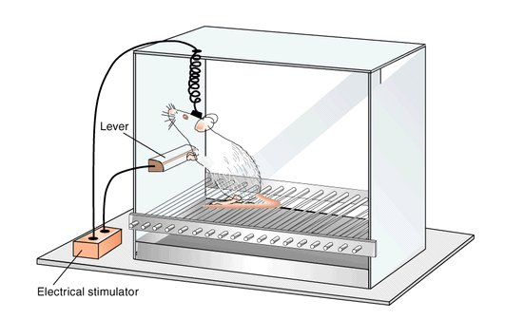
Intracranial self-stimulation

Slide 30
Mesolimbic dopamine pathway
Regulates motivation cognition and behavior and reinforcement learning – e.g. regulates behaviours related to food, drinks, safety, sex
Primary neurotransmitter – dopamine
The mesolimbic pathway connects the Ventral Tagmental Area near brainstem to the Nucleus Accumbens and to the Prefrontal Cortex. Important role plays amygdala and hippocampus

Slide 31
Mesolimbic pathway and addiction
In animals, drugs self-administered to nucleus accumbens had stronger effect and were preferred. It correlated with increase on dopamine release
All drugs affect dopamine functions. Many drugs work as direct dopamine agonists while the rest of drugs have indirect effect
Brain imaging technics showed massive dopamine involvement in nucleus accumbens. They also showed decrease of dopamine D2 receptors availability in addicts leading to increasing tolerance
Mesolimbic pathway gradually sticks to the addiction object to which it is hypersensitive while under sensitive to other stimuli – highjacked brain
https://www.youtube.com/watch?v=NxHNxmJv2bQ

Slide 33
Genetics and addiction
Susceptibility model – tries to explain why some substance users develop addiction while others do not
General heritability about 25% in mild drinking and 35% in heavy drinking (heritability estimates degree of variation of phenotypic trait in population)
Twin studies – strong genetic factor especially in males (almost no effect in females) and especially if alcoholism started before age 20 (little effect for later life)
In other drugs – the strongest influence of genetic factor in heroin (more than 50%), in other drugs similar to alcoholism (between 25-33%).
Huge discrepancy in studies, e.g. women are massively under-researched

Slide 34
Genetics and addiction
Genes and environment determine addiction together
Inherited characteristic is a predisposition/risk factor, not a disease itself – addiction is a complex phenomenon with no single one determining factor
Research on genetics of addiction is not to push people back and feel miserable of unchangeable. It is for better treatment and prevention

Slide 35
Genetics and addiction
Candidate gene studies – they try to find the concrete gene that is associated with the disease
Difficult to find such gene – many possible candidates and often contradicting results
Uncertainty about how much unique impact these genes have

Slide 36
Reward-deficiency syndrome
Kenneth Blum
People with DRD2-A1 allele gene form (older variant) of D2 dopamine receptors are at higher risk of addictions.
30% of white population – they have up to 40% less dopamine D2 receptors
Feel less reward from normal activities – need stronger impulse
Feel more negative emotions and anxiety – take drugs to relief from negative states of mind

Slide 37
Reward-deficiency syndrome

Slide 38
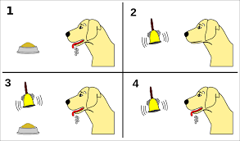
ADDICTION AS LEARNED BEHAVIOUR Classical conditioning
I. Pavlov & J.B. Watson
Learning is a result of pairing of a unconditioned stimulus with a neutral stimulus. After repetition of such paring, original reaction to unconditioned stimulus becomes conditioned to the originally neutral stimulus.

Slide 39
Addiction and classical conditioning
Drug effects are strongly influenced by the context in which the drug is administered. The context usually refers to the physical environment in which the drug is given.
Drug effect is paired with environmental stimuli – cues and they may trigger craving – overwhelming desire for the substance/behaviour
Classical conditioning is behind key factors of addiction – craving, withdrawal symptoms, relapse
Conditioned drug tolerance: tolerance and sensitization to the behavioural effects of drugs are expressed in the environment in which the drug is chronically administered but not in an environment not previously associated with the drug.

Slide 40
Cue reactivity – learned response that involves psychological and physiological reactions to drug related cues
Cues are the most important factors of relapse
Withdrawal model – cue reactivity should resemble withdrawal-like states (i.e. should produce opposite to the drug effect)
Incentive model – cue reactivity should be similar to positive motivational state (i.e. should produce somewhat similar to the drug effect)
We usually see mix of these two reactions, however, in alcohol/cocaine/tobacco/behavioral addictions incentive reaction is stronger while in heroin withdrawal reaction is stronger

Slide 41
ADDICTION AS LEARNED BEHAVIOUR Classical conditioning
B.F. Skinner
Experience of reinforce or punishment increases or decreases likelihood of certain behaviour

Slide 43
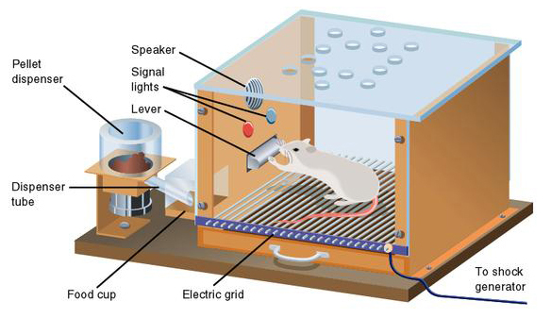
https://www.youtube.com/watch?v=I_ctJqjlrHA

Slide 44
Positive reinforcement: drugs and certain behaviours (sex, gambling) are strongly pleasurable and serve as positive reinforcer
Negative reinforcement: decreased level of drug in body unbalances physiological system - withdrawal symptoms
Occasional reinforcement – somewhat randomized reward produces much stronger reinforcement - activity to get the reward increases and is more resilient to change. Secondary reinforcement – cues learned via classical conditioning may be experienced as reinforcers themselves

Slide 45
Drugs and certain behaviours are powerfully rewarding themselves, but addiction arises through experience and repetition
Involved processes are automated and are not reflective
Pre-conscious cue processing - addiction related cues are mentally prioritized without knowing
Frequently conflict between not conscious/learned motivation and conscious attitude
Various people vary in their proneness to reward and punishment (e.g. Cloninger‘s typology of alcoholism)

Slide 46
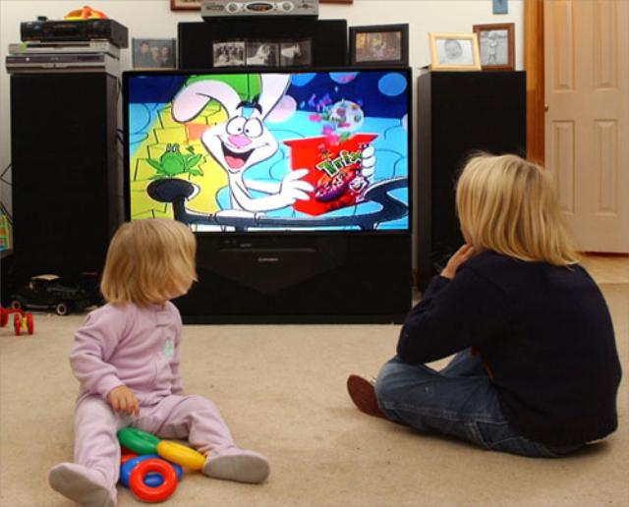
ADDICTION AS LEARNED BEHAVIOUR Social learning theory
Albert Bandura
Learning in social environment through observing and listening to others
Addiction is learned through imitation of and identification with role-models
Social identity – whom I follow, what is the group I belong to, what is the group I would like to be part of

Slide 47
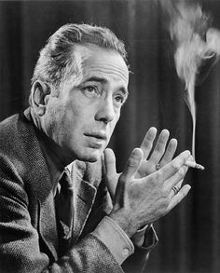
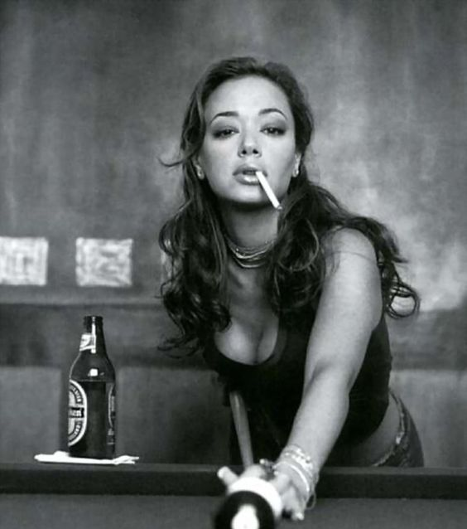

Slide 48
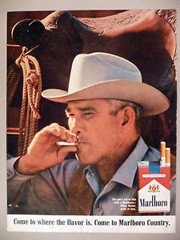
https://www.youtube.com/watch?v=EJT0NMYHeGw

Slide 49
SELF-EFFICACY
Albert Bandura
Individual believe in own ability to perform certain behaviour
High self-efficacy – set higher goals, invest more effort and energy. More resistant to stress and negative experience and able to try various coping strategies.
Low-self efficacy – lower effort, cease treatment more quickly. Lower stress resistance, often use substances as the first coping strategy
Learned hopelessness – opposite to self-efficacy. When the person repeatedly experience aversive stimuli. Sometimes a product of repeated abuse, trauma. Can lead to enduring negative mood states, addictive behaviours, cycles of poverty

Slide 50
SELF-MEDIACATION MODEL OF ADDICTION
Taking drugs or involvement in problematic behaviour is a coping strategy with negative and unpleasant mood states and/or negative life experiences
People with some mood disorder or problematic affect regulation are more prone to develop addiction - e.g. higher depressiveness, higher anxiety, personality disorders like antisocial or borderline
People with experience of child abuse, trauma or childhood neglect are much more prone to develop addiction

Slide 51
Psychodynamic psychology – emphasizes feelings and emotions as forces that shape our behaviour, focus on early child experience
S. Freud – psychoanalysis - use of drugs with oral administration (alcohol, tobacco,…) are a form of regression to the first year of life (oral stage – when pleasure is experienced through mouth). Oral stage is about gaining trust in others – addicts usually have underdeveloped trust and show unhealthy relationship profiles: avoidance and/or overdependency.

Slide 52
M. Klein – object relation theory
Birth and first months are extremely stressful for the child. Chaos, anger, fear are the dominant emotions – they must be cultivated in contact with parenting figure. Parenting figure is internalised as a mental object – parent (mother) within
Relationship with this internalized object affects social relationships throughout our lives - what develops in early childhood stays for lifetime
Good object relation = good affect regulation (positive mood, ability to cope with unpleasant, more resilient), poor object relation = poor affect regulation.

Slide 53
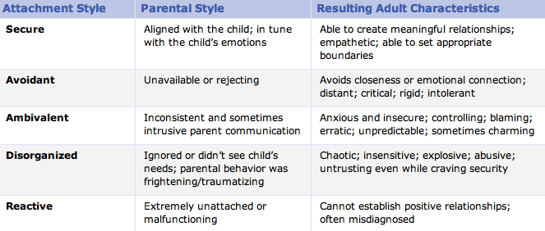
H. Harlow, J. Bowlby, M. Ainsworth – attachment theory
https://www.youtube.com/watch?v=OrNBEhzjg8I
Children internalize cognitive and affective representation of self and others based on their early attachment experiences.
Attachment to the parenting figure (significant other) is created especially in the first 6 months.
Attachment attitudes are persistent and lead our relationship to others and our affective regulation during our lives

Slide 54
Insecure attachment is strongly related to lifetime depressiveness and affective disorders, low self-esteem, lower social support. It creates fertile ground for substance use and other behavioural addictions
Self-medication model does not explain all cases of addiction – many addicts do not have affective difficulties, insecure attachment, child trauma or neglect.

Slide 55
DEVELOPMENTAL MODEL OF ADDICTION
Two main risk periods – early childhood (attachment) and adolescence
E. Erikson – psychosocial stages of development – adolescence is about identity crisis, time of storm and stress, and increasing power of peer groups. Substance use may develop as a mean to gain status in peer groups, it may become part of personal and social identity
Addiction may be understood as an externalized pathological behaviour. Externalized behaviour includes conduct problems (verbal and physical aggression, lying, risk taking, vandalism), ADHD, various addictions
Any externalized behaviour may be replaced by another externalized behaviour
Externalized behaviour may occur in childhood as a reflection of internalized disorders (anxiety, trauma, neglecting parental approach)

Slide 56
Addiction as rational choice
Taken from economic theory – addictive behaviours are consumer behaviour
We do things because they bring some benefits. We know about the negatives, but benefits out-weight them
Cost-benefit analysis
Weighting benefits (pleasure) and costs (e.g. money, legal consequences, health consequences). In stressful times, benefits of drugs are getting higher. Why are some substances much more often used? – their costs are not that high (it is legal, health effects only slowly accumulates over time,…).
Assumptions are rather vague. Detailed analysis (e.g. using mathematic formulas) usually wrong. E.g. theory predicts older people to be more involved in addictions, but it is the opposite

Slide 57
Why do we engage in addictive behaviours?
Improve social interaction
Improved physical & sexual appearance
Improved cognitive performance
Improved sexual performance
Improved self-esteem and feelings of self-worth
Coping with stress
Pleasure-seeking
Sensation & novelty seeking
Overcoming boredom
Reduce psychiatric symptoms
And others…

Slide 58
Societal risk factors
Families – genetics, parental neglect & abuse, impaired attachment styles, modelling behaviors, parental approval
Intimate relationships paradox - addictive behaviors often appear in both but being in a relationship is one of the main protective factors
Gender – addiction associated with a traditional gender role in men but also with non-traditional gender roles in women.
Environmental factors stronger in women while genetic factor stronger in men. Women have much lower chance of becoming addicted, their addiction tends to develop later but has faster progression and is more frequently associated with affective dysregulation
Being a parent is a protective factor in women but not in men

Slide 59
Societal risk factors
Peer influence is very powerful, especially in adolescence but also later in life
In adolescent the reason is to gain better position within group hierarchy, to socialize, to be more confident in establishing romantic relationships, to decrease anxiety in general
In later life stages the peer influence is more associated with mere availability of the substance and attitudes (norms)
Normative substance use – each group has some unwritten rules what is considered as normal. Addicted people often think that the norm is higher that it actually is - e.g. that others drink as much as themselves
Normative feedback (peer disapproaval) can be used for prevention and interventions

Slide 60
Societal risk factors
Ethnicity – addictions and addictive behaviours are much more common in ethic minorities
Reasons: cultural background, genetic susceptibility, more frequent poverty, discrimination and stress
Critical sociology – addictive behaviours are more frequently and more severely sanctioned when it is in minorities, youngsters, poor, lower socio-economical status – those that have less power within the society
The major society (that in charge) has power to label what is legal and what is illicit, what should be punished, what should be treated and even what research to support
Availability of the drug is necessary condition for addiction however many negative effects come only because the drug is not available. Difficult question – should be substances that are now considered as illicit available (under certain conditions)?

Slide 61
Social developmental model
Originated in criminology
Explains the origins and development of delinquent behavior during childhood and adolescence
children adopt the beliefs and behavioral patterns within 4 social units - family, community (neighborhood), school, peer groups. If the social unit has prosocial attitudes, then the child adopts a prosocial orientation; if the social unit is antisocial, then the child often manifests problem behavior
Positive socialization is achieved when youths have the opportunity within each unit to be involved in conforming activities, when they develop skills necessary to be successfully involved, and when those with whom they interact consistently reward desired behaviors.
These conditions should increase attachment to others, commitment to conforming behavior, and belief in the conventional order. These social bonds to conventional society prevent delinquent behavior.

Slide 62
Social developmental model
Individual risk and protective factors (e.g. cognitive and emotional regulatory abilities) out-weights the social factors
Risk factors out-weights the protective factors
From social factors, peer influence brings the biggest risks, especially in early initiation. The biggest protective factor comes from combination of well/functioning family and good individual predisposition
Family and community are relatively more important in childhood and early adolescence; school and peers are relatively more important in mid- and late adolescence

Slide 63
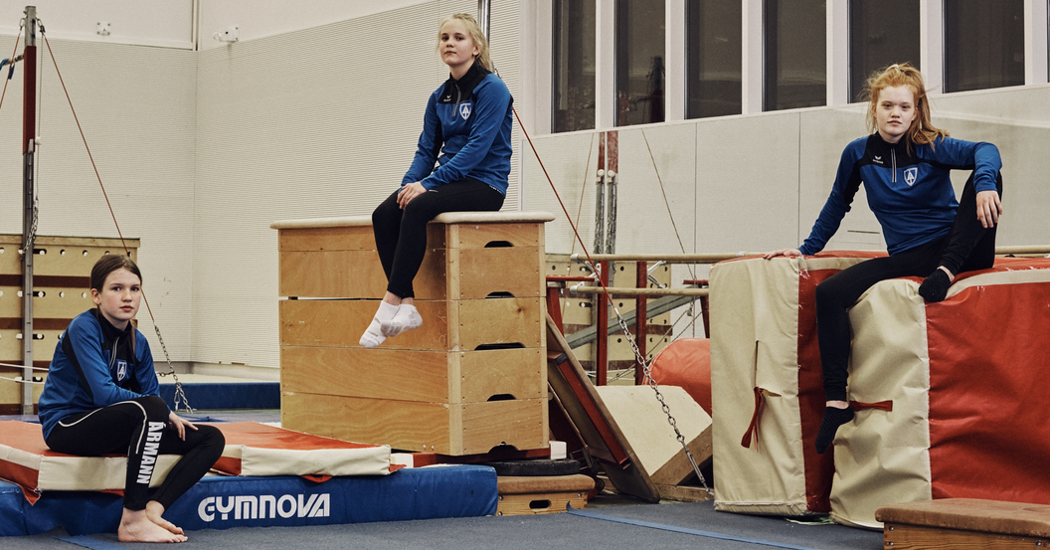
https://mosaicscience.com/story/iceland-prevent-teen-substance-abuse

Slide 64
