Slide 1
Civic and political socialization
Jan Šerek
Youth Development
17. 4. 2019

Slide 2
Why this issue and adolescence?

Slide 3
Why this issue and adolescence?
development of a social aspect of person‘s identity (Erikson, 1968)
social and institutional incentives
  educational system (Niemi & Hepburn, 1995)
  political rights

Slide 4
Why this issue and adolescence?
Impressionable years hypothesis
Life-long openness
adolescence
adulthood
adolescence
adulthood

Slide 5
Why this issue and adolescence?
Impressionable years hypothesis
Life-long openness

Slide 6
Why this issue and adolescence?
Three sources of support for impressionable years hypothesis:
longitudinal research has found that political orientations have the lowest stability in adolescence and young adulthood, while remaining relatively stable later in the life (Krosnick & Alwin, 1989; Prior, 2010; Sears & Levy, 2003)
Eckstein, Noack, & Gniewosz (2012) have found that political orientations become increasingly stable during adolescence

Slide 7
Why this issue and adolescence?
Three sources of support for impressionable years hypothesis:
the same pattern was revealed for other sociopolitical attitudes related to civic/political behavior, such as authoritarianism, dogmatism, tolerance, ethnocentrism, adherence to social equality etc. (Duckitt, 2009; Vollebergh, Iedema & Raaijmakers, 2001)

Slide 8
Why this issue and adolescence?
Three sources of support for impressionable years hypothesis:
studies on the collective memory show that people tend to recall from their memory those political events (e.g., democratic transition) that happened in their adolescence or young adulthood rather than the events that happened earlier or later in their lives (Valencia & Páez, 1999)
historical events have the largest impact on political development of the person if these events occur between adolescence and adulthood (Sears, 2002; Sears & Levy, 2003)

Slide 9
And what about children?

Slide 10
And what about children?
“by the time the child enters high school at the age of 14, his basic political orientations to regime and community have become quite firmly entrenched so that at least during the four years of high school little substantive change is visible”
(Easton & Hess, 1962, 236)

Slide 11
And what about children?
Criticism: Cook, 1985; Merelman, 1972;
Niemi, & Hepburn, 1995; Renshon, 1992

Slide 12
And what about children?
Criticism: Cook, 1985; Merelman, 1972;
Niemi, & Hepburn, 1995; Renshon, 1992
Children have different cognitive functioning compared to adults

Slide 13
And what about children?
Joseph Adelson and his colleagues:
Children
may differentiate between local and national government and know something about political parties but they do not understand why political parties compete with each other and what is the difference between democracy and dictatorship
Adolescents
differentiate between abstract public offices (e.g., president) and concrete persons holding these offices
consider long-term consequences of law and other social norms, their consistency with general moral principles, and their consequeces for various social groups
understand that political parties represent interests of different social groups

Slide 14
And what about children?
More general theories of cognitive development:
Jean Piaget
we become able to use abstract reasoning from age 11-12
Robert Selman
from age 12-14 we become able to take a perspective of a „third“ person
from age 15 we become able to take perspectives of „third“ non-aligned persons who come from different sociocultural backgrounds

Slide 15
How do they participate?

Slide 16
How do they participate?
political participation
civic participation

Slide 17
How do they participate?
political participation
civic participation

Slide 18
How do they participate?
political participation

Slide 19
How do they participate?
different definition → different picture of current youth

Slide 20
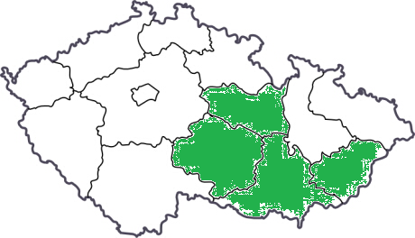
Our data
June 2014
about 2,000 9th and 10th graders (M_{age}= 15.7)
survey research
in schools

Slide 23
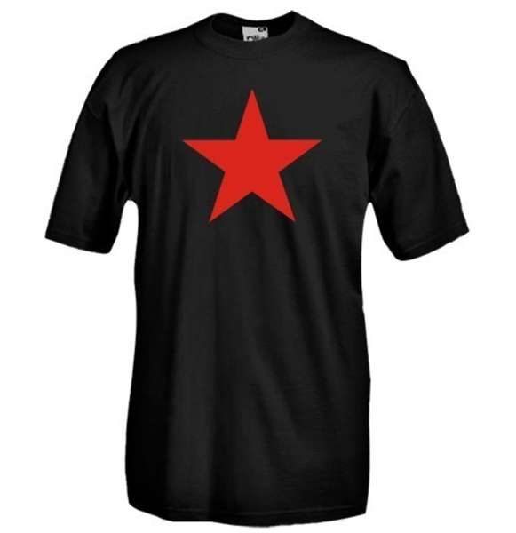


How do they participate?
civic engagement is issue-oriented and associated with one‘s lifestyle

Slide 25

How do they participate?
most young people are upset with everything related to „politics“

Slide 27
How do they participate?
it‘s not about online vs offline,
it‘s about „easy“ vs „difficult“

Slide 28
Please think about your adulthood now. If I thought that there was something wrong in the society, I would …

Slide 29
The CATCH-EyoU study (2017)

Slide 30
How do they participate?
they are far from favoring non-normative activities over normative activities

Slide 31
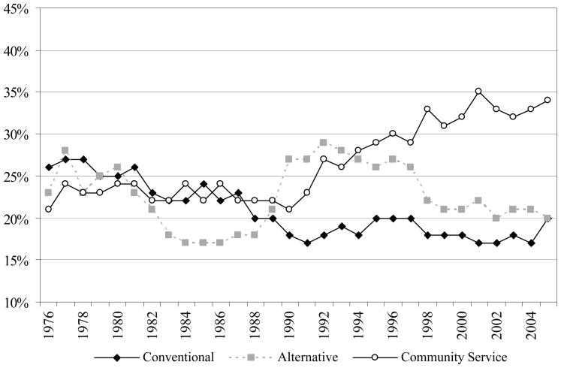
How do they participate?
Syvertsen, Wray-Lake, Flanagan, Osgood, & Briddell, 2011

Slide 32
How do they participate?
writing to public officials, giving money to a candidate, and working in a political campaign
Syvertsen, Wray-Lake, Flanagan, Osgood, & Briddell, 2011

Slide 33
How do they participate?
participating in lawful demonstrations and boycotting certain products or stores
Syvertsen, Wray-Lake, Flanagan, Osgood, & Briddell, 2011

Slide 34
How do they participate?
participation in community affairs or voluntary work
Syvertsen, Wray-Lake, Flanagan, Osgood, & Briddell, 2011

Slide 35
How do they participate?
they tend to focus on local and community issues

Slide 36
How do they participate?
they tend to focus on local and community issues
37% environment and animal rights
28% local issue
20% human rights in the Czech Republic
17% human rights abroad
11% politics

Slide 37
What is political/civic socialization?

Slide 38
What is political/civic socialization?
Macro-level perspective
how societies and political systems maintain their stability by instilling certain values, beliefs, and behavioral norms in their citizens?
Micro-level perspective
by which patterns and processes individuals engage in political/civic development , learning and constructing their particular relationships to the political/civic contexts in which they live?
(Sapiro, 2004)

Slide 39
What is political/civic socialization?
Macro-level perspective
how societies and political systems maintain their stability by instilling certain values, beliefs, and behavioral norms in their citizens?
Micro-level perspective
by which patterns and processes individuals engage in political/civic development , learning and constructing their particular relationships to the political/civic contexts in which they live?
(Sapiro, 2004)

Slide 40
What is political/civic socialization?
Ecological approach
“[…] development takes place through processes of progressively more complex reciprocal interaction between an active […] organism and the persons, objects, and symbol in its immediate external environment. To be effective, the interaction must occur on a fairy regular basis over extended periods of time” (Bronfenbrenner & Morris, 2006, p. 797).
“the form, power, content, and direction of the proximal processes effecting development vary systematically as a joint function of [1] the characteristics of the developing person, [2] the environment […], [3] the nature of the developmental outcomes under consideration, and [4] the social continuities and changes occurring over time through the life course and the historical period” (Bronfenbrenner & Morris, 2006, p. 798).

Slide 41

What is political/civic socialization?
Family
Class-room
microsystem
Bronfenbrenner, 1979
Wilkenfeld et al., 2010

Slide 42
What is political/civic socialization?
Family
Class-room
mesosystem
microsystem
Bronfenbrenner, 1979
Wilkenfeld et al., 2010

Slide 43
What is political/civic socialization?
Workplace
Boards,
directorate
exosystem
Family
Class-room
mesosystem
microsystem
Bronfenbrenner, 1979
Wilkenfeld et al., 2010

Slide 44
What is political/civic socialization?
Cultural values, political culture, ideology underlying economic or governmental system …
Workplace
Boards,
directorate
macrosystem
exosystem
Family
Class-room
mesosystem
microsystem
Bronfenbrenner, 1979
Wilkenfeld et al., 2010

Slide 45
What is political/civic socialization?
Implications of the ecological approach:
development can occur only if the person engages in an activity that takes place on a regular basis and becomes increasingly complex

Slide 46
What is political/civic socialization?
Implications of the ecological approach:
development can occur only if the person engages in an activity that takes place on a regular basis and becomes increasingly complex
development consists in person’s reciprocal interactions with a growing array of microsystems, starting with families and extending to peer groups, schools, mentors or associations

Slide 47
What is political/civic socialization?
Implications of the ecological approach:
development can occur only if the person engages in an activity that takes place on a regular basis and becomes increasingly complex
development consists in person’s reciprocal interactions with a growing array of microsystems, starting with families and extending to peer groups, schools, mentors or associations
adolescents’ individual characteristics (dispositions and abilities) influence how much and how they are civically engaged

Slide 48
What is political/civic socialization?
Implications of the ecological approach:
development can occur only if the person engages in an activity that takes place on a regular basis and becomes increasingly complex
development consists in person’s reciprocal interactions with a growing array of microsystems, starting with families and extending to peer groups, schools, mentors or associations
adolescents’ individual characteristics (dispositions and abilities) influence how much and how they are civically engaged
specific interactions between microsystems and adolescents might considerably differ across different regions, countries, social classes or generations

Slide 49
Socialization agents

Slide 50
Socialization agents
parents are role models

Slide 51
Socialization agents
parents are role models
parents can persuade the child

Slide 52
Socialization agents
parents control where the child spends her or his time
parents are role models
parents can persuade the child

Slide 53
Socialization agents
parents control where the child spends her or his time
parents are role models
parents can persuade the child
parents use democratic, authoriarian etc. practices towards the child

Slide 54

Socialization agents

Slide 55
Socialization agents
teachers and classmates are role models and produce social influences

Slide 56
Socialization agents
teachers and classmates are role models and produce social influences
civic/political knowledge and skills can be learned

Slide 57
Socialization agents
teachers and classmates are role models and produce social influences
civic/political knowledge and skills can be learned
democratic, authoritarian etc. practices
are used in the classrooms

Slide 58
Socialization agents
media
clubs, groups, organizations
friends
neighborhoods

Slide 59
Main issues & controversies
Agency
Directions of influence
Interventions
Multiple contexts and dispositions-environment interactions

Slide 60
Main issues & controversies
Agency
child/adolescent as passive recipient vs. active agent
current theories in developmental psychology stress that the process of socialization cannot be understood as a mere transmission of the environmental influences on a child (Maccoby, 2007; Nurmi, 2004)
political beliefs held by adolescents reflect rather adolescents’ hypotheses about parental beliefs than parental beliefs as such (Westholm, 1999)
civic/political socialization is a process by which young people actively ascribe meanings to the world of politics, based on the information and experiences provided by socialization agents (Metzger & Smetana, 2010)

Slide 61
Main issues & controversies
Agency
child/adolescent as passive recipient vs. active agent
current developmental theories stress that the process of socialization cannot be understood as a mere transmission of the environmental influences on a child (Maccoby, 2007; Nurmi, 2004; Bronfenbrenner & Morris, 2006)
political beliefs held by adolescents reflect rather adolescents’ hypotheses about parental beliefs than parental beliefs as such (Westholm, 1999)
civic/political socialization is a process by which young people actively ascribe meanings to the world of politics, based on the information and experiences provided by socialization agents (Metzger & Smetana, 2010)

Slide 62
Main issues & controversies
Agency
child/adolescent as passive recipient vs. active agent
current developmental theories stress that the process of socialization cannot be understood as a mere transmission of the environmental influences on a child (Maccoby, 2007; Nurmi, 2004; Bronfenbrenner & Morris, 2006)
political beliefs held by adolescents reflect rather adolescents’ hypotheses about parental beliefs than parental beliefs as such (Westholm, 1999)
civic/political socialization is a process by which young people actively ascribe meanings to the world of politics, based on the information and experiences provided by socialization agents (Metzger & Smetana, 2010)

Slide 63
Main issues & controversies
Agency
child/adolescent as passive recipient vs. active agent
current developmental theories stress that the process of socialization cannot be understood as a mere transmission of the environmental influences on a child (Maccoby, 2007; Nurmi, 2004; Bronfenbrenner & Morris, 2006)
political beliefs held by adolescents reflect rather adolescents’ hypotheses about parental beliefs than parental beliefs as such (Westholm, 1999)
civic/political socialization is a process by which young people actively ascribe meanings to the world of politics, based on the information and experiences provided by socialization agents (Metzger & Smetana, 2010)

Slide 64
Main issues & controversies
Directions of influence
Socialization agents
Young person

Slide 65
Main issues & controversies
Directions of influence
Socialization agents
Young person

Slide 66
Main issues & controversies
Directions of influence
Socialization agents
Young person
Main concerns:
new research (McDevitt, 2005)
internet (Dahlgren, 2009)
immigrant families (Wong & Tseng, 2008)

Slide 67
Main issues & controversies
Interventions
school-based programs
teaching
practicing skills
organization-based programs
mandatory community service

Slide 68
Main issues & controversies
Multiple contexts and disposition-environment interactions
cummulative effects of multiple contexts
it‘s not only about environment but also about one‘s own preferences, beliefs, values, personality traits, cognitive dispositions etc.
young people with different dispositions react differently on the same environment

Slide 69
Our research
what is the directionality between political attitudes and participation?
Šerek, Macháčková & Macek (2017)

Slide 70
Our research
what is the directionality between political attitudes and participation?
data from 768 high school students (aged 14 to 17)
Šerek, Macháčková & Macek (2017)

Slide 71
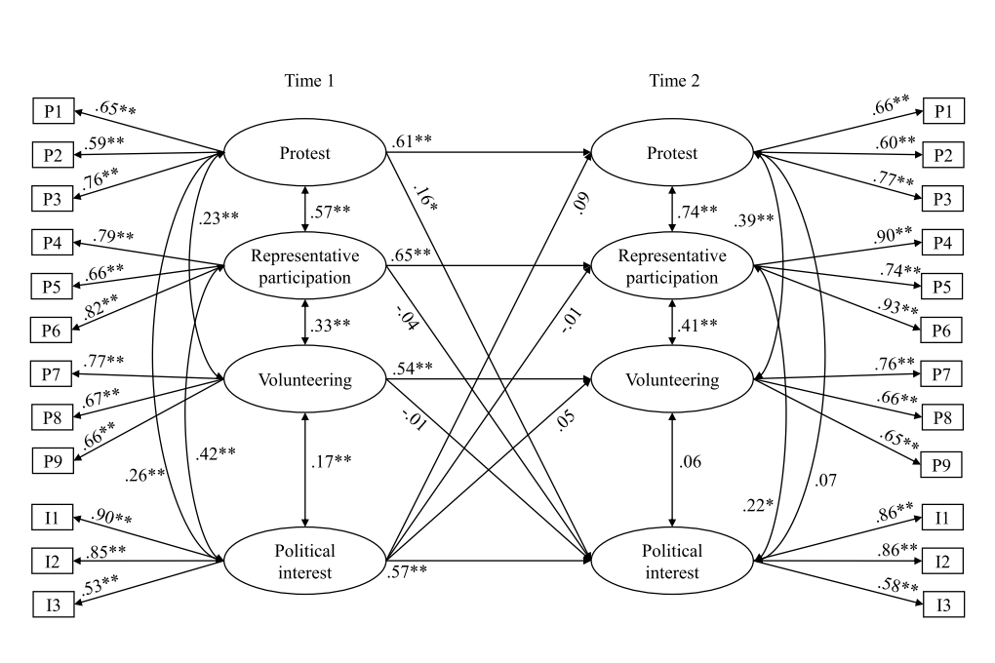
Our research
Šerek, Macháčková & Macek (2017)

Slide 72
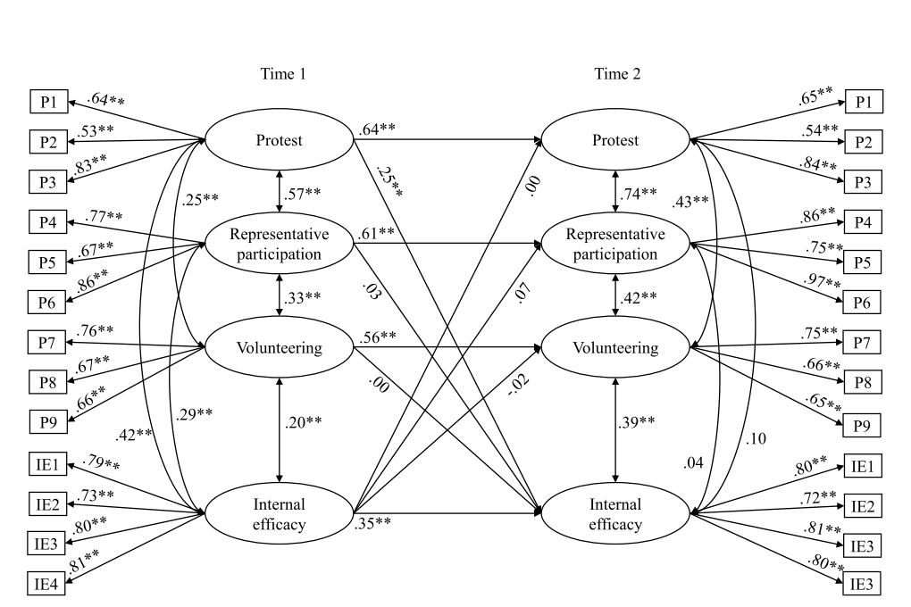
Our research
Šerek, Macháčková & Macek (2017)

Slide 73
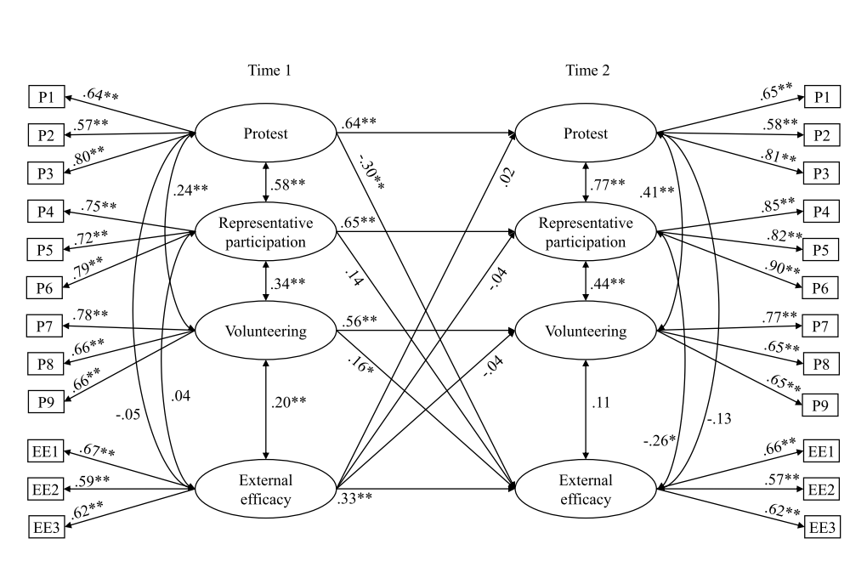
Our research
Šerek, Macháčková & Macek (2017)

Slide 74
Our research
active participation has the effects on political attitudes but the opposite effects are less pronounced
through their own political participation, young people form and clarify their political attitudes
Šerek, Macháčková & Macek (2017)

Slide 75
Our research
what short-term factors contribute to voting turnout of first-time voters?

Slide 76
Our research
what short-term factors contribute to voting turnout of first-time voters?
longitudinal data from cca 200 adolescents aged 18-19

Slide 77
Our research
February
Voting intention
Following news
Discussions Parents
Discussions Peers
Šerek & Umemura (2015)

Slide 78
Our research
February
May
Voting intention
Voting intention
Following news
Following news
Discussions Parents
Discussions Parents
Discussions Peers
Discussions Peers
Šerek & Umemura (2015)

Slide 79
Our research
February
May
June
Voting intention
Voting intention
Voting
Following news
Following news
Discussions Parents
Discussions Parents
Discussions Peers
Discussions Peers
Šerek & Umemura (2015)

Slide 80
Our research
February
May
June
Voting intention
Voting intention
Voting
Following news
Following news
Discussions Parents
Discussions Parents
Discussions Peers
Discussions Peers
Šerek & Umemura (2015)

Slide 81
Our research
February
May
June
Voting intention
Voting intention
Voting
Following news
Following news
Discussions Parents
Discussions Parents
Discussions Peers
Discussions Peers
Šerek & Umemura (2015)

Slide 82
Our research
February
May
June
Voting intention
Voting intention
Voting
Following news
Following news
Discussions Parents
Discussions Parents
Discussions Peers
Discussions Peers
Šerek & Umemura (2015)

Slide 83
Our research
February
May
June
Voting intention
Voting intention
Voting
?
Following news
?
Following news
?
Discussions Parents
Discussions Parents
Discussions Peers
Discussions Peers
Šerek & Umemura (2015)

Slide 84
Our research
February
May
June
Voting intention
Voting intention
Voting
Following news
Following news
Discussions Parents
Discussions Parents
Discussions Peers
Discussions Peers
Šerek & Umemura (2015)

Slide 85
Our research
February
May
June
Voting intention
Voting intention
Voting
Following news
Following news
Discussions Parents
Discussions Parents
Discussions Peers
Discussions Peers
Šerek & Umemura (2015)

Slide 86
Our research
February
May
June
Voting intention
Voting intention
Voting
Following news
Following news
Discussions Parents
Discussions Parents
Discussions Peers
Discussions Peers
Šerek & Umemura (2015)

Slide 87
Our research
February
May
June
Voting intention
Voting intention
Voting
Following news
Following news
Discussions Parents
Discussions Parents
Discussions Peers
Discussions Peers
Šerek & Umemura (2015)

Slide 88
Our research
adolescents who discussed politics with their peers before the election became more willing to vote
no such effect was found regarding discussions with parents
however, discussions with parents can stimulate more discussions with peers

Slide 89
Our research
both parents and peers are important but in different ways

Slide 90
Our research
both parents and peers are important but in different ways
why peers?

Slide 91
Our research
both parents and peers are important but in different ways
why peers?
stronger social influence

Slide 92
Our research
both parents and peers are important but in different ways
why peers?
stronger social influence
peers can be selected by a person

Slide 93
Our research
both parents and peers are important but in different ways
why peers?
stronger social influence
peers can be selected by a person
more concept-oriented than socio-oriented communication

Slide 94
Questions? serek@fss.muni.cz

