Slide 1
Selected topics in general psychology II.
Lubomír Kostron 2019

Slide 2
The course structure, 2nd part.
Introduction
Perception, judgment (and behavioral activities)
social judgment theory and the nature of information
A model of personality – what is missing?
The theory o tasks, situations and the environment/ecology
The role of emotions and group support in the solution of ill defined problems

Slide 3
7. System dynamics - learning to „see“ processes
8. The decision-making under uncertainity
9. Interpersonal cognitive conflict solution
(workshop with POLICY)
10. The puzzle of Consciousness
11. The aultimate knowledge – the art of asking the smart questions (workshop with „unknown objects“)
Students are expected to turn in a paper on one of the issues, listed above. For more detailes see the sylabus.

Slide 4
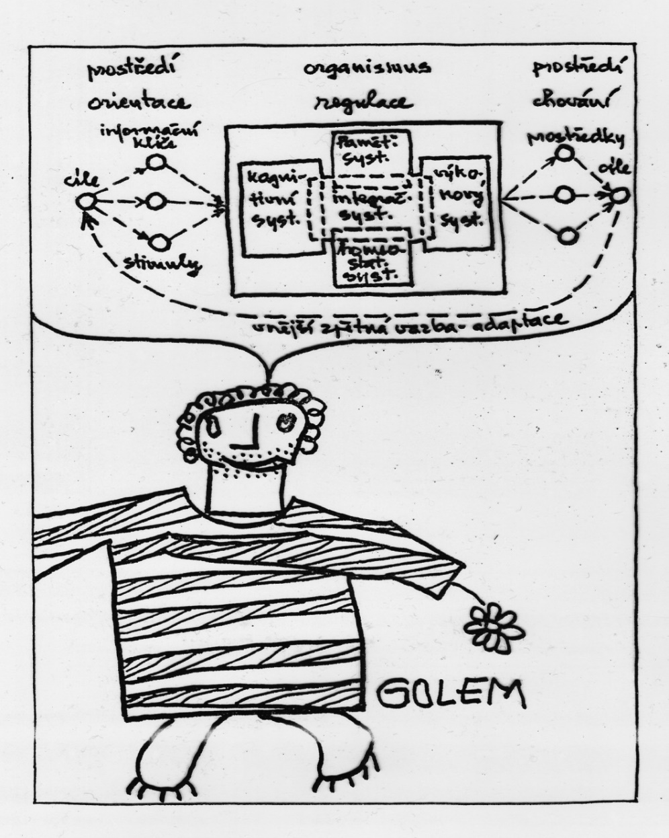
4. What do we miss so far?
Toward a personality model: the „central region“ of mind.

Slide 5
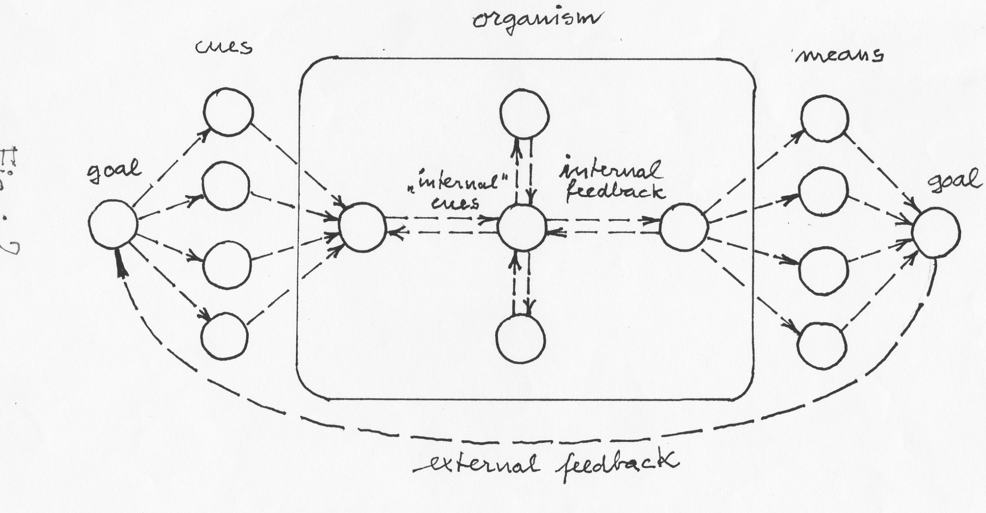

Slide 6
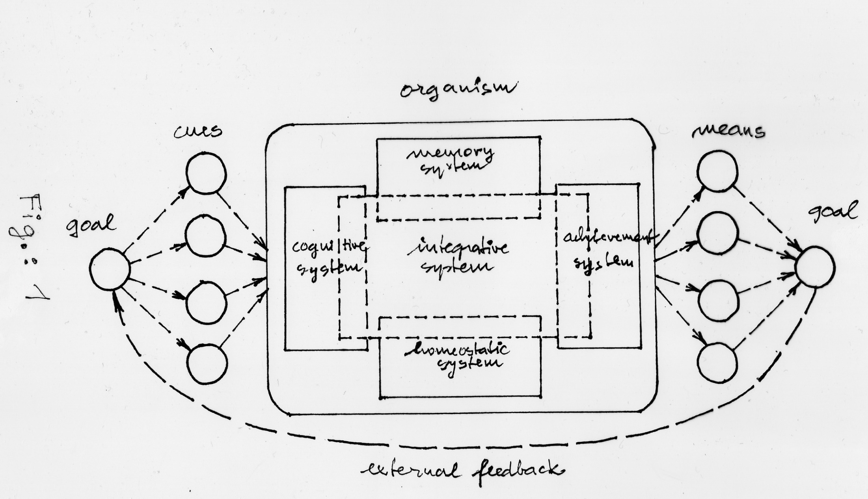
The central region structure
regulation
stimulation
activity

Slide 7
Where are the feedback loops?
environment
organism
environment
State of the body
Motives, needs
Situations, contexts
temperament
Information – novelty,
truthfulness
emotions
Situationscontexts
Subconscious judments and decisions
feelings
creativity
sensors
Action, Behavior
thinking
goals
stimulae
learning
Self-assessment
Conscious judgments and decisions
Behavioral patterns
objects
Images, patterns, function relations, values
Means, connotations
memory

Slide 8
Experiencing, emotions, motivation
„…It is only with the heart that one can see rightly;
what is essential is invisible to the eye“.
Antoine de Saint-Exupery
„The heart has its reasons of which reason
knows nothing“.
Blaise Pascal.

Slide 9
Albert Einstein´s letter to his doughter Liserl:
„…there is an extremely powerfull force, for which there is no formal scientific explanation yet. This force includes and rules all the other forces and it is even contained in all the phenomenae operating in the universe, but we did not identify it yet. This universal force is love. When the scientists seeked for an universal unifying theory of the universe, they omited the most powerfull, invisible force. Love is the light which lits those, who give it and those who obtain it. Love is the gravitation, since it causes that some people are being attracted to the other ones ….“
„… this force explains all and gives a meaning to the life. It is a variable, which we ignored too long time maybe becouse we are scared of it, for love is the only energy in the universe, which we did not learn how to subdue it to our will…“
„… To make love visible, I simply replaced one value in my most famous equation. If we would instead E= mc2 accept, that the energy to cure the world may be obtained through the love times the square of light speed, we would conclude, that love is the strongest force in existence, since it has no limits….“
https://wearelightbeings.wordpress.com/2015/04/15/a-letter-from-albert-einstein-to-his-daughter-about-the-universal-force-which-is-love/

Slide 10
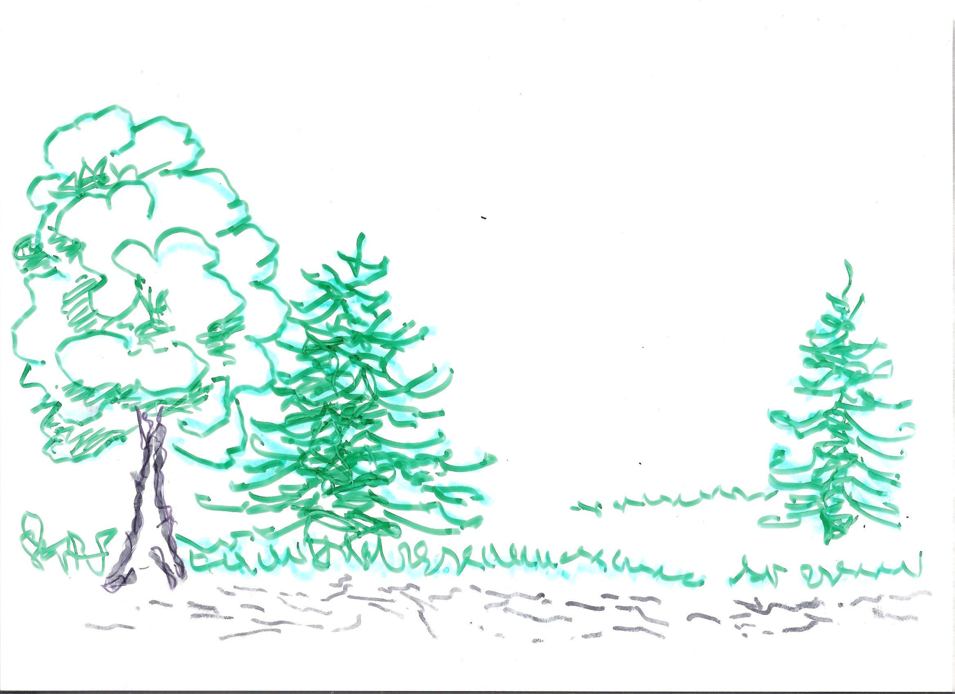
The thinking and feeling; the meaning of experiencing
and emotions
(an example the organizational structure and culture)

Slide 11
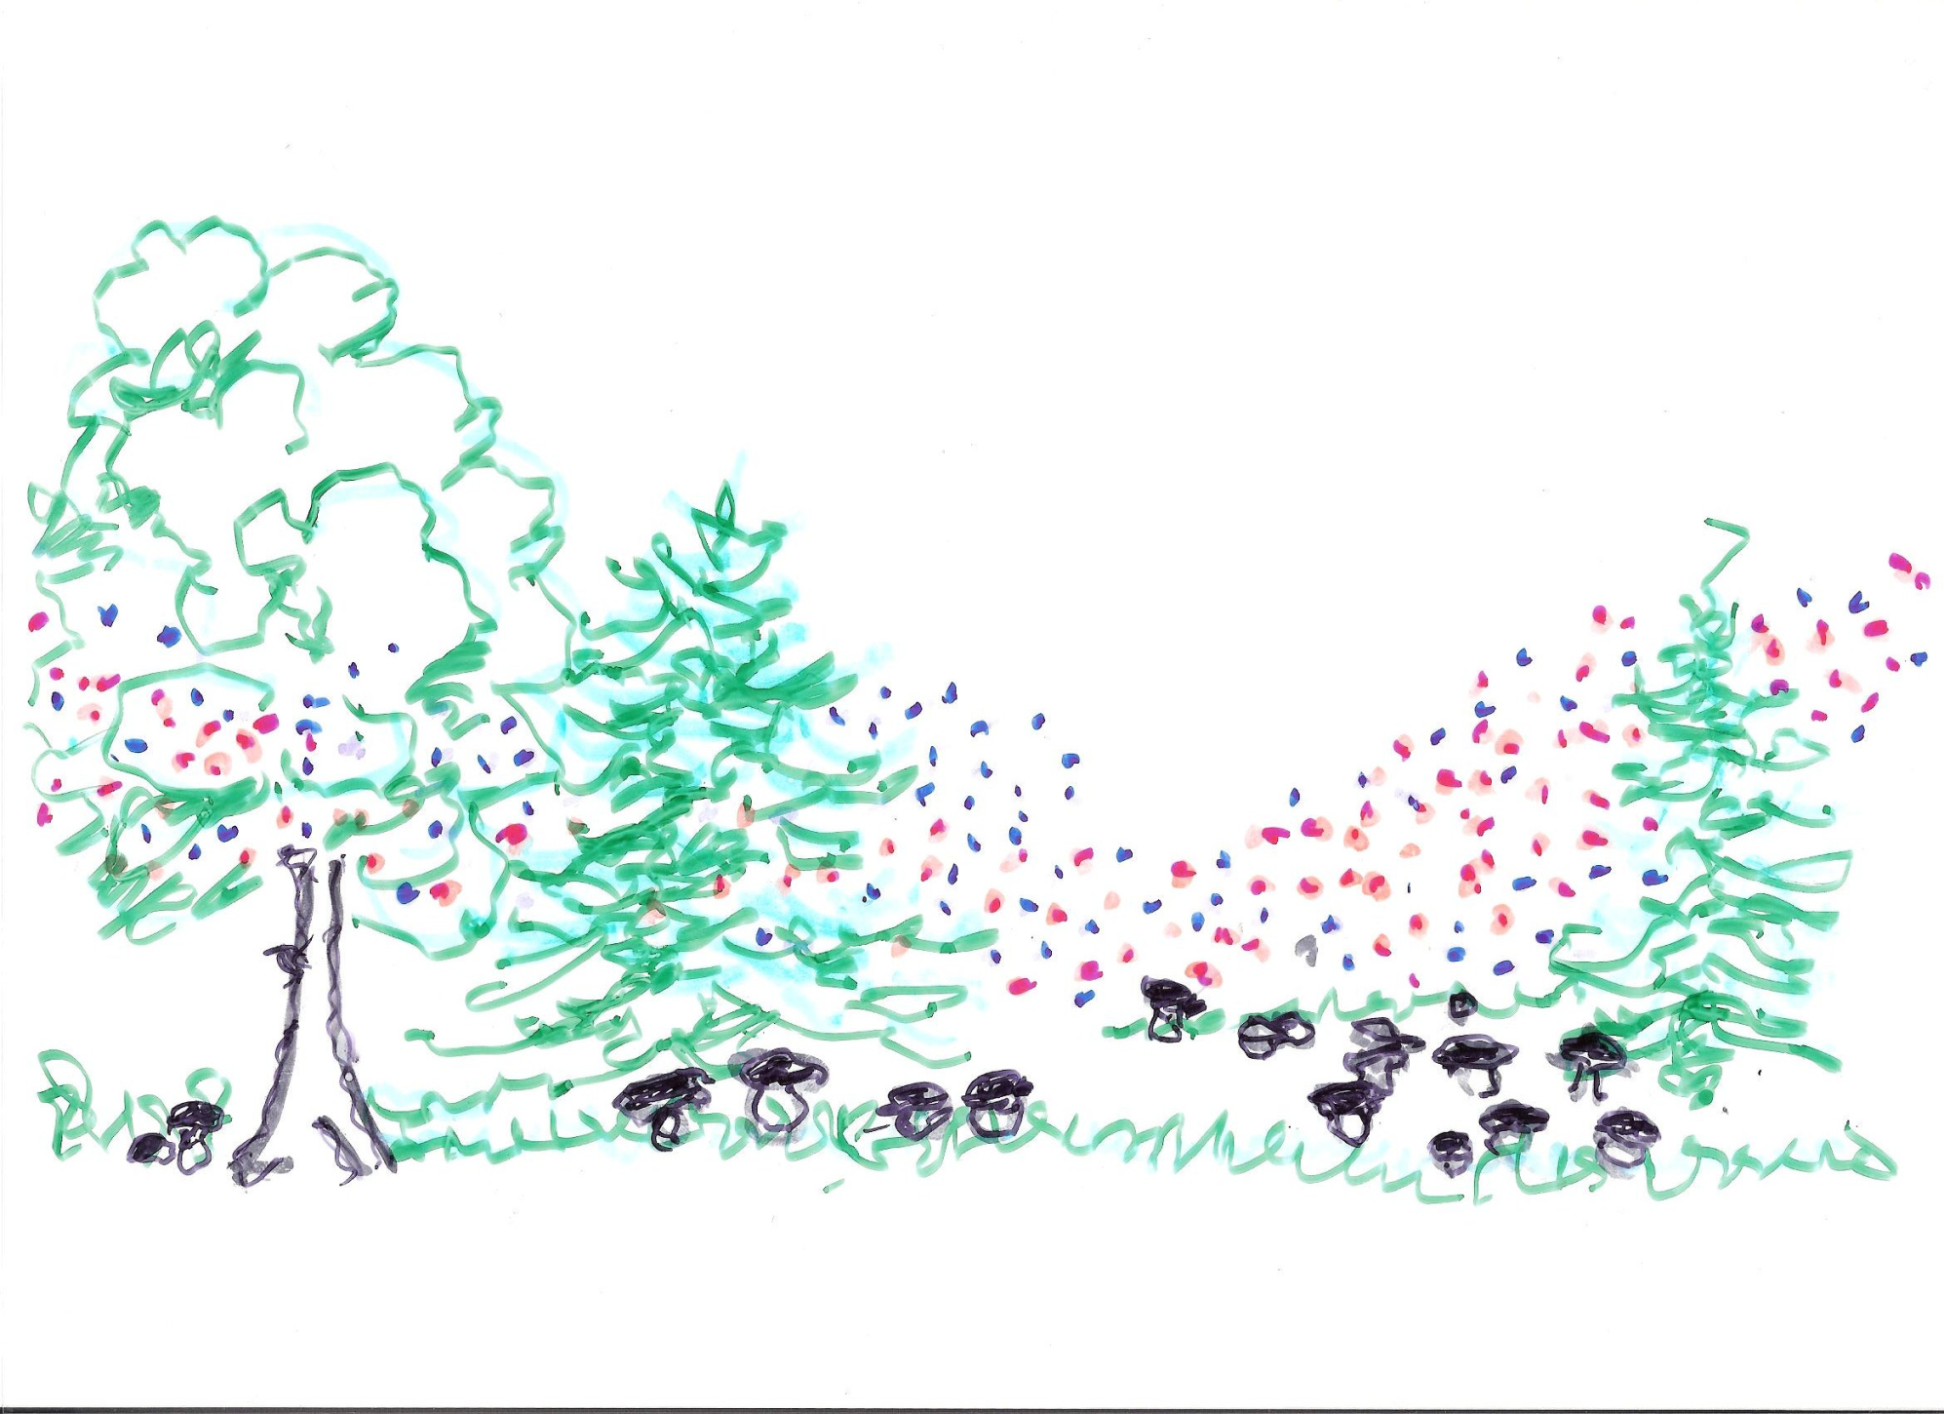
The thinking and feeling; the meaning of experiencing
and emotions
(an example of the organizational structure and culture)

Slide 12
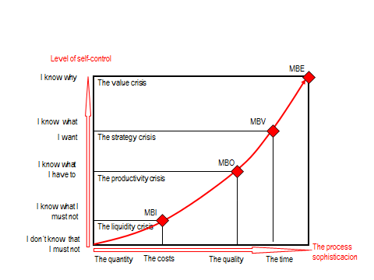
The transformation of motivation: external x internal motivation
The sophistications of organization´s processes and the level of self-control
(adapted from Hroník, Galuška, Kopčaj)

Slide 13
How does it all fit together?
Consider the case of
- an individual,
- social setting,
- a civilization

Slide 14
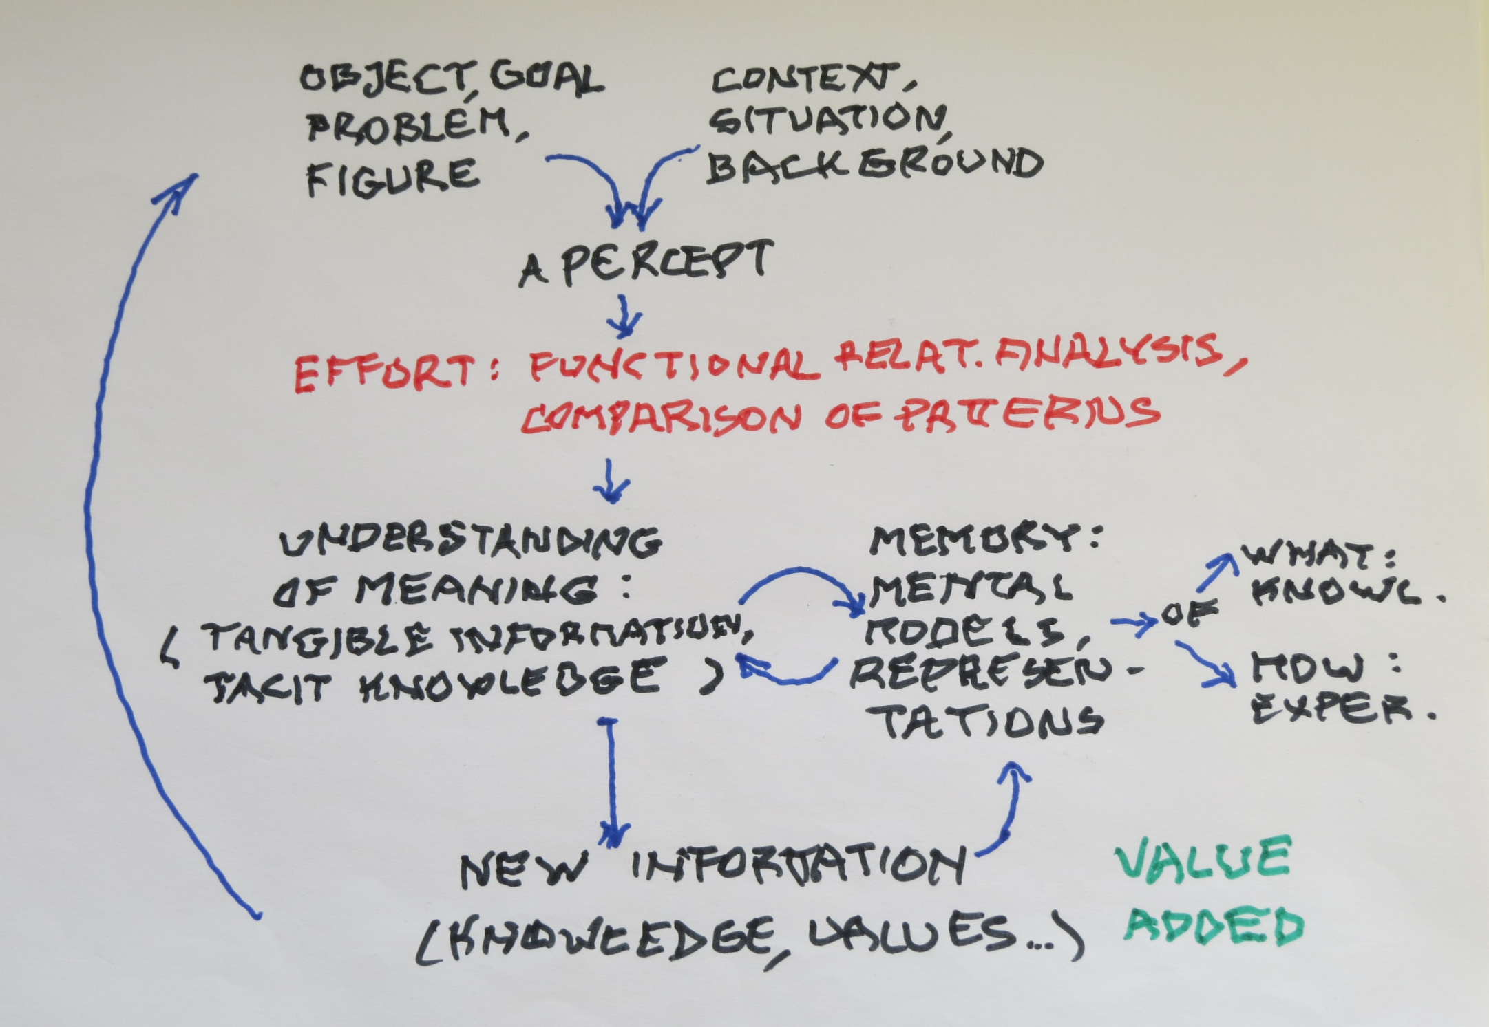

Slide 15
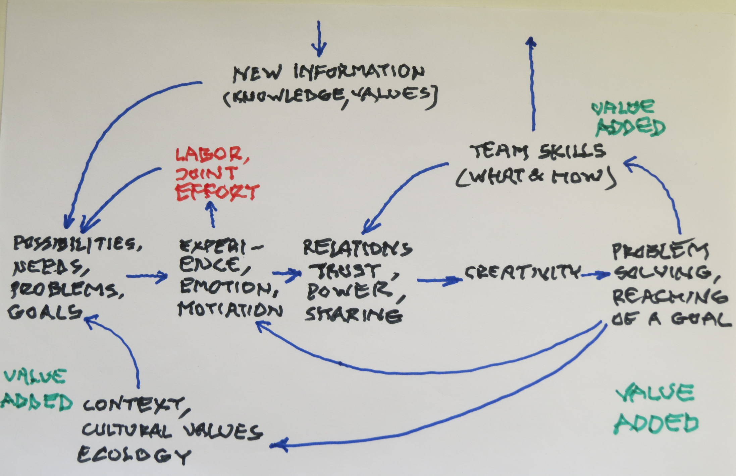

Slide 16
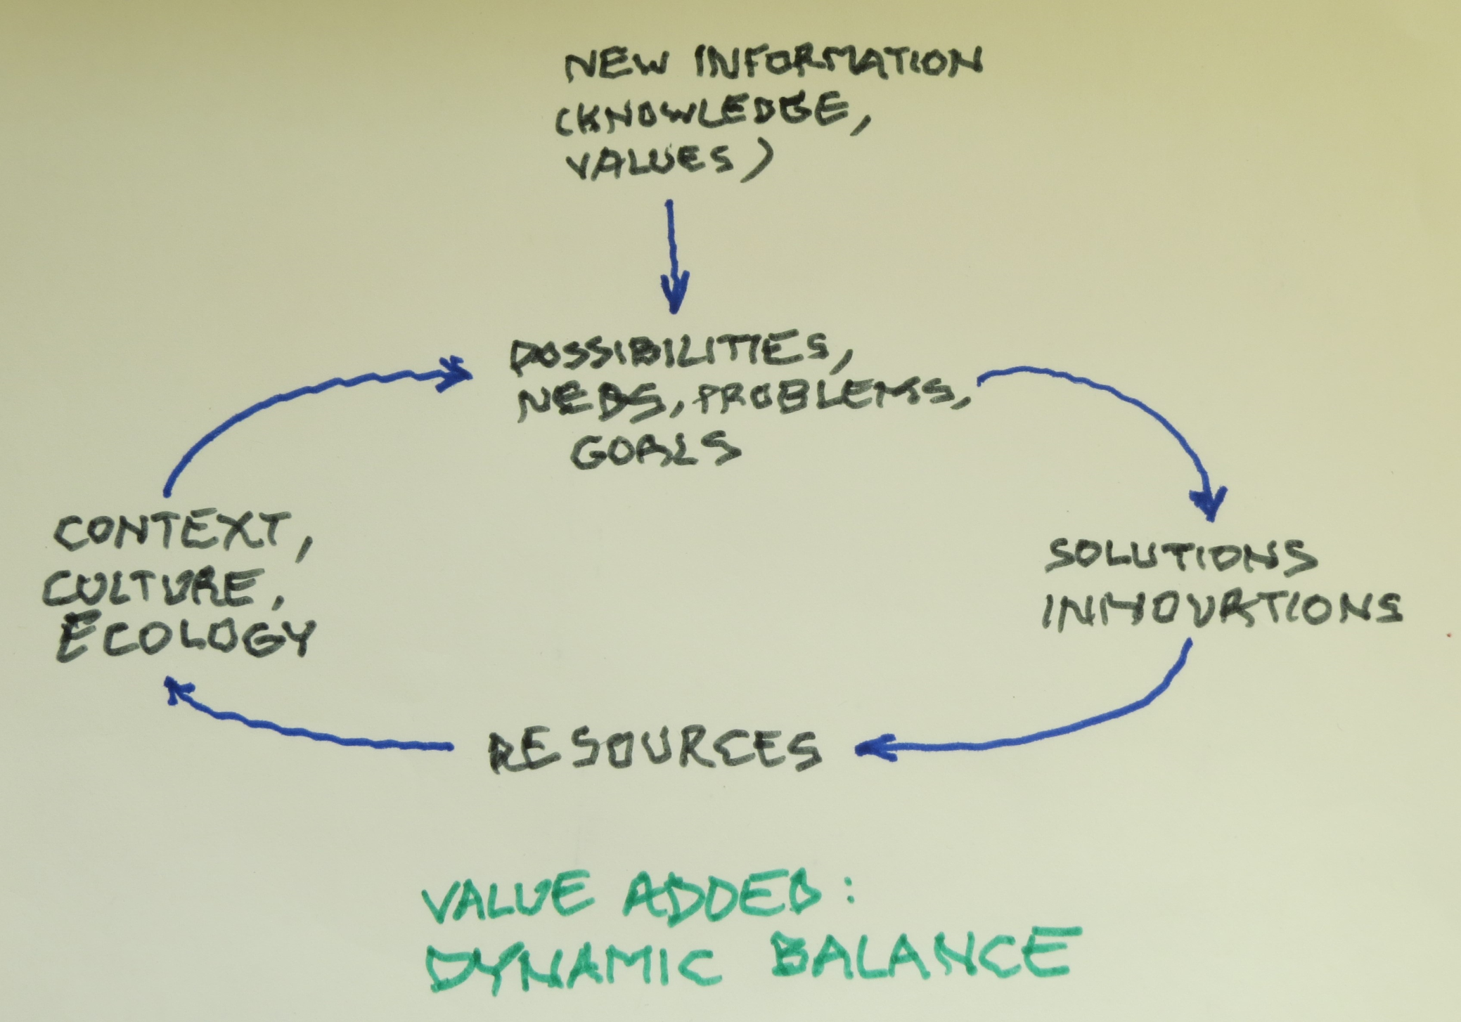

Slide 17
There is a catch, a witchious circle:
in order to determine a tool, which would serve us to understand a person´s behavior, we need to understand that person first!

Slide 18
5. The tasks, situations, environments -
the psychological theory of ecology
The Brunswik ´s requirement of representative experimental design (representative samaples of subjects as well as their ecology)
The Hammond´s theory of ecology is based on formal characterists of stimulae/cues/information, which the ecology presents
(any classification based upon the „content“ is not realistic).
The cues/incoming information induces either more analytical processes, or intuition: the „quasirational thinking“ consists of a mixture of both (see picture 16).
Which exceptional situations/tasks induce usualy rational thinking or intuition?

Slide 19
The personality and the environment problem
There are many psychological theories of personality;
Psychological theories of the environments/situations are rare;
The perception of a situation is influenced by its meaning for a given person. However, the understanding of the meaning may be influenced by an understanding of a much wider framework/context ( for instance - history).

Slide 20
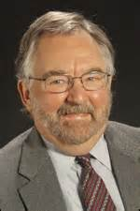
The typology of intelectual tasks by John Rohrbaugh, S.U.N.Y. at Albany, Rockefeller College of Public Affairs and Policy
http://grantome.com/grant/NSF/IIA-9014357
differentiation
Negotiation, common goals
New information seeking
More parties, many criteria, different interests. Agreement negotiations. The conflict of interests.
More solutions possible with outcomes, which may be divided; a co-operation is not necessary; creative generation of ideas.
analysis (criteria previously agreed upon)
intuition (usual solution possibilities)
Few possibilities of a solution; total co-operation is important; the cognitive conflict.
The making of strategies and planing.
Exploration, problem solving
integration
Assessment, decision - making

Slide 21
The situational - experiencing space
(a metaphore: the linear and curvilinear spacetime)
Exceptional, significant, symbolic and threatening situations (emotions at play, the subjective time experiencing changed).
individual
group, crowd
usual, common situation.
Related concept - genius loci

Slide 22
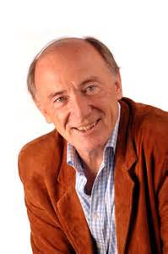
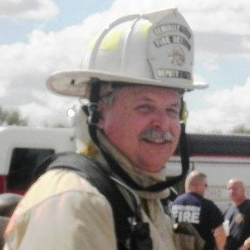
6. The role of emotions (and group support) in solving ill defined problems solution.
Bill Critchley, organizational consultant
Dave Casey - Director at Fire and Emergency Training Institute/ Louisiana State University
(perhaps not a picture of the right person…? But he look good.)

Slide 23
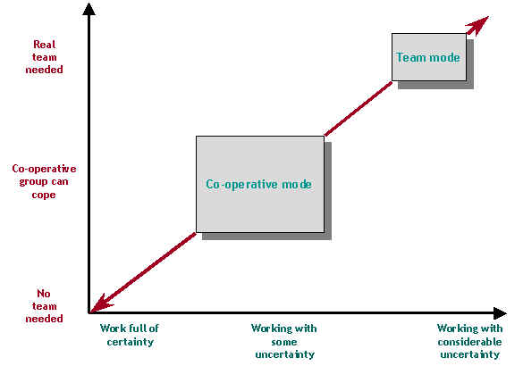
Bill Critchley, David Casey : tasks, emotions, work - building of a team

Slide 24
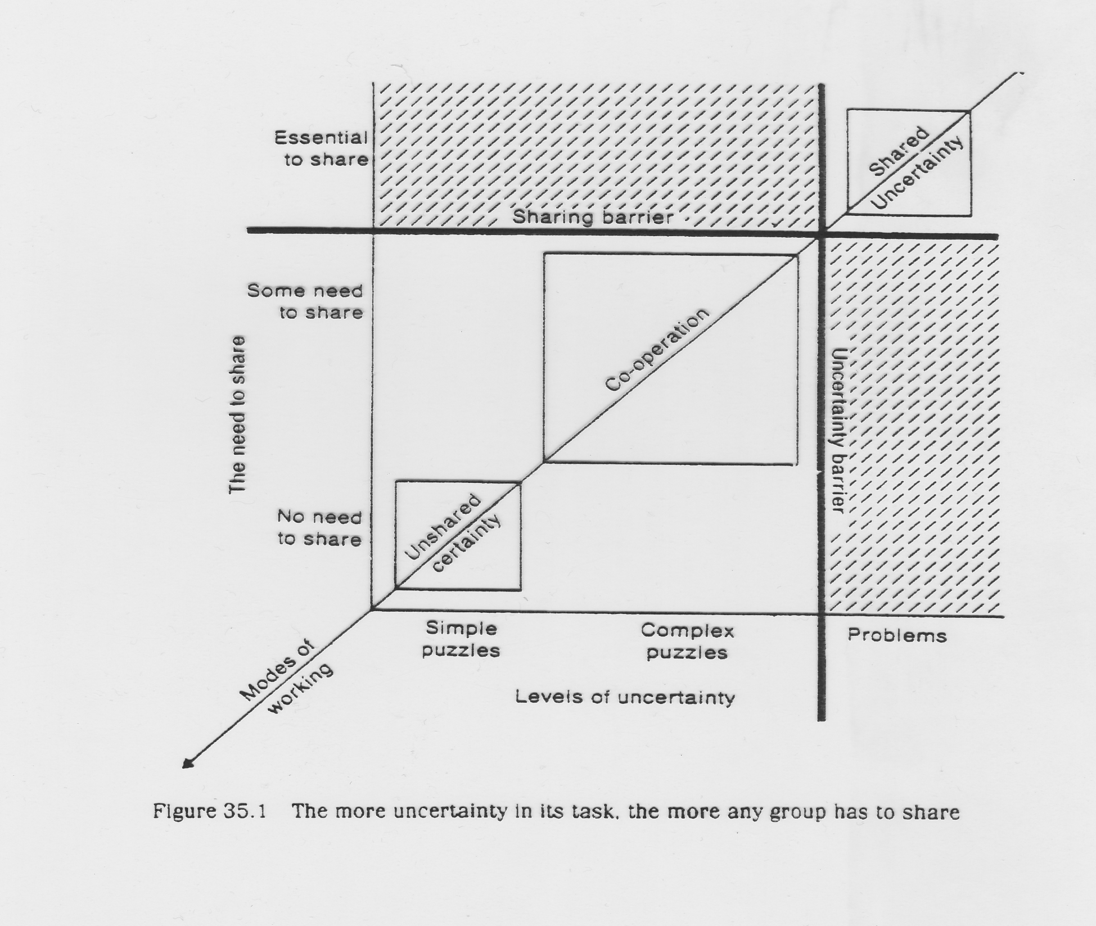

Slide 25
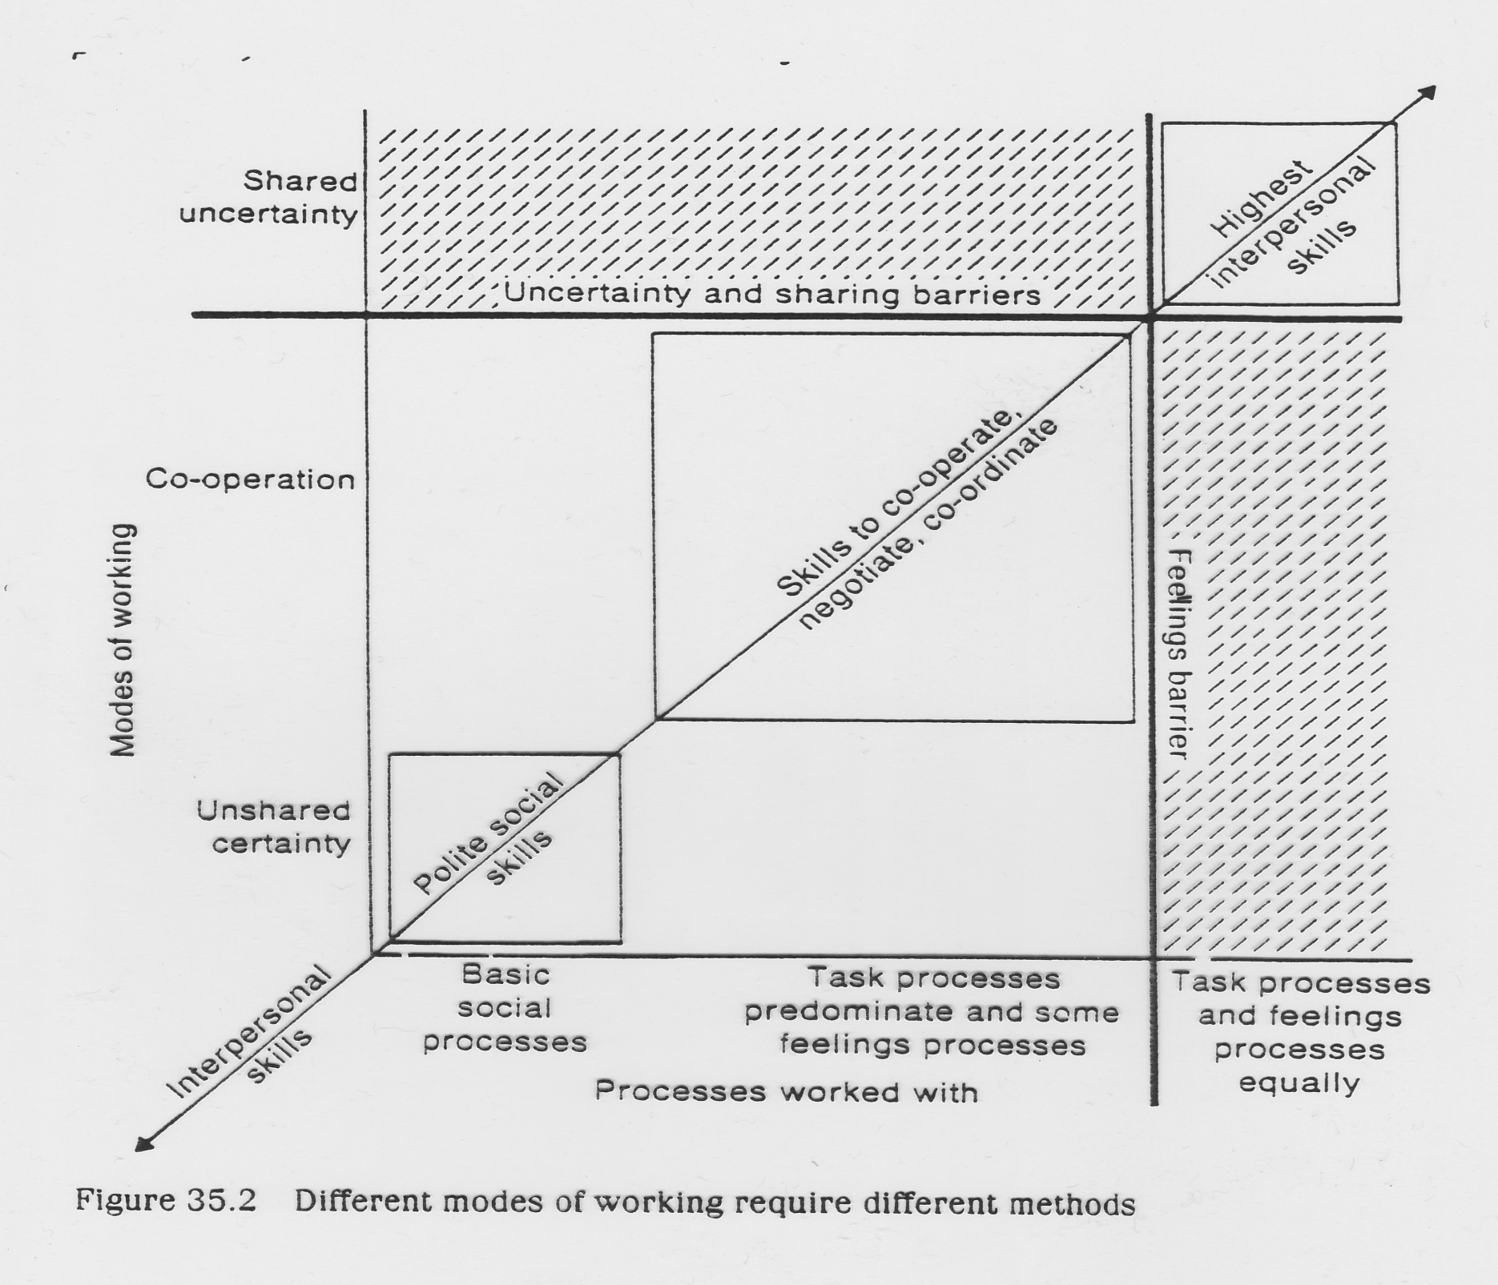

Slide 26
7. System dynamics - learning to see…
What connects perception, thinking memory and learning? The beginning of knowledge is:
bringing „static order“ into chaos,
recognizing change, processes, systems
- a single loop learning – adaptation
- a double loop generative learning

Slide 27
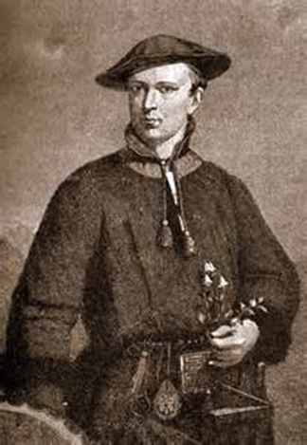
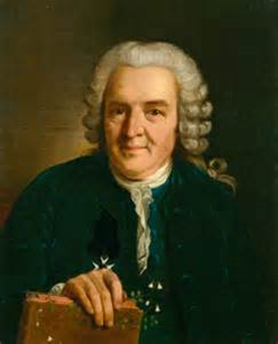
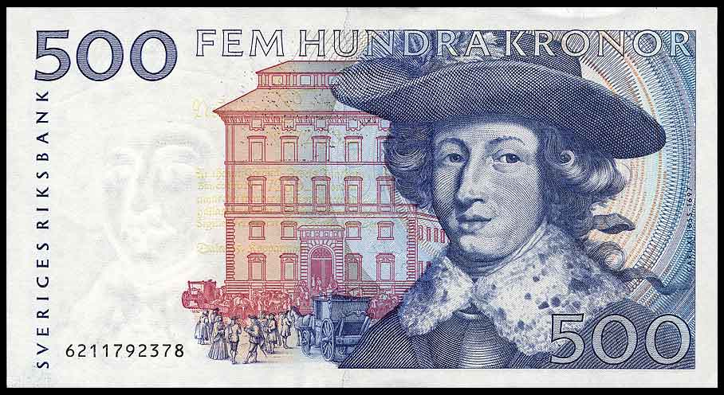
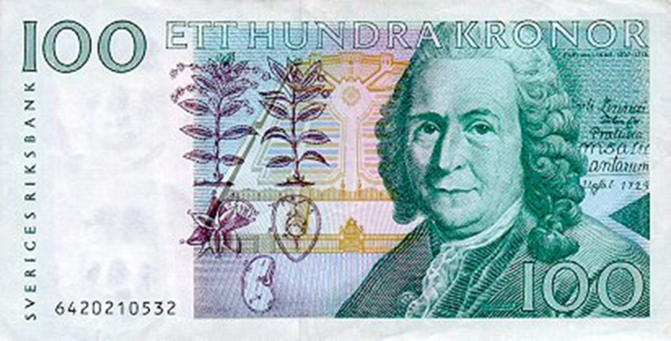
a) The static view of the world:
Classification, bringing order/system
into chaos.
Some notable examples:
Carl von Linné or Carolus Linnaeus, 1707 – 1778
is often called the Father of Taxonomy. Classification of plant and animals.
What are the classification kriteria?

Slide 28
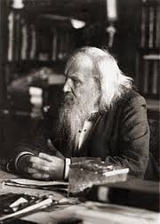
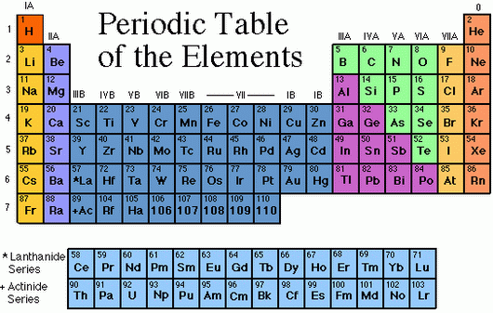
Dimitirij Ivanovič Mendelejev 8.2.1834 – 2.2.1907
What is the organizing principle?

Slide 29
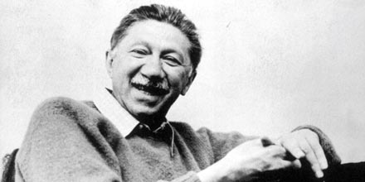
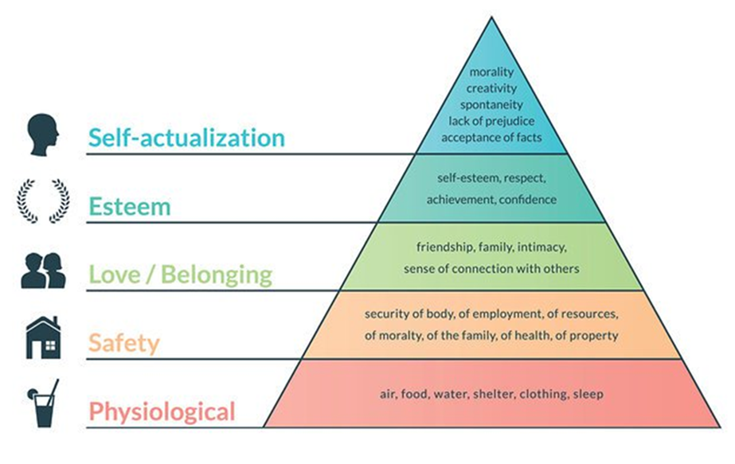
Abraham Harold Maslow´s hierarchy of needs
1.4.1908 Brooklyn –
8.6.1970 Menlo Park

Slide 30
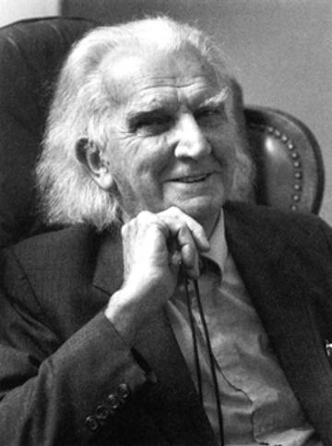
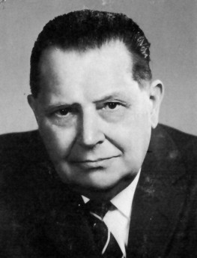
Co-founders of the general systems theory :
Living systems are open systems, characterized by:
complexity,
seeking of a dynamic equilibrium,
use feedback – loops and,
temporarily defy entropy by self- organization.
Kenneth Ewart Boulding
18.1.1910 – 18.3.2000
Ludwig von Bertalanffy 19.9.1901 Vienna – 12.6.1972 Buffalo, N.Y.

Slide 31
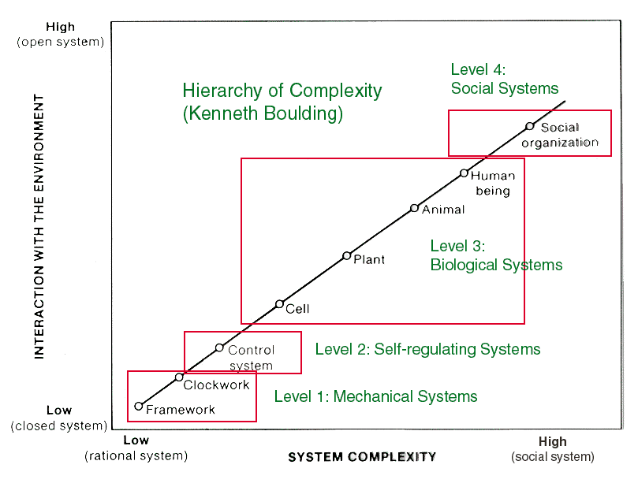

Slide 32
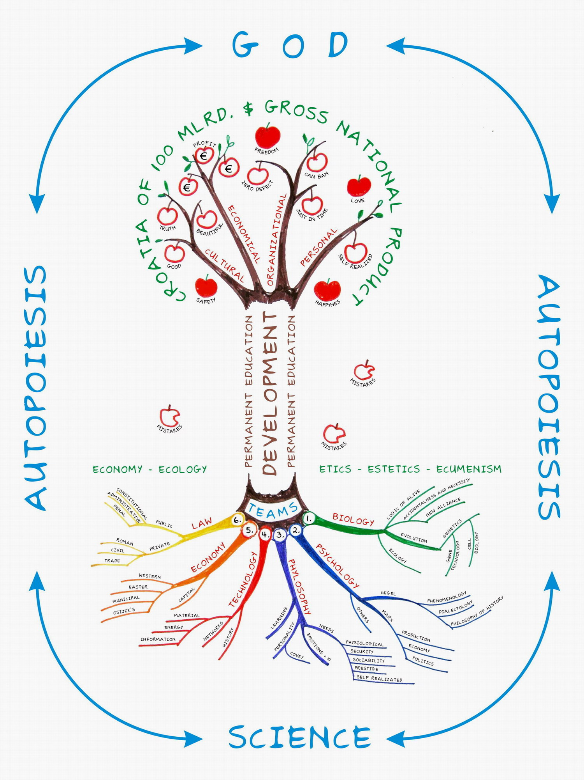
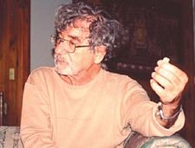
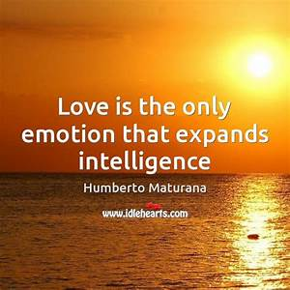
Humberto R. Maturana 14.9.1928
A concept of an„autopoietic (self-developing) system“, a separeate system, staying as a structure, which behavior is governed by it. Used alo in socials ciences.

Slide 33

The nervous system is coupled to the organism that it integrates in a manner that its plastic connectivity is being continuously determined though its participation in the autopoiesis of the oprganism.
Therefore, the connectivity of the nervous system is coupled to the history of interactions od the organism to which it is coupled.
Humberto Maturana, Cognitive strategies
Science is not a domain of objective knowledge, but a domain of subject dependent knowledge defined by a methodology that specifies the properties of the knower.

Slide 34
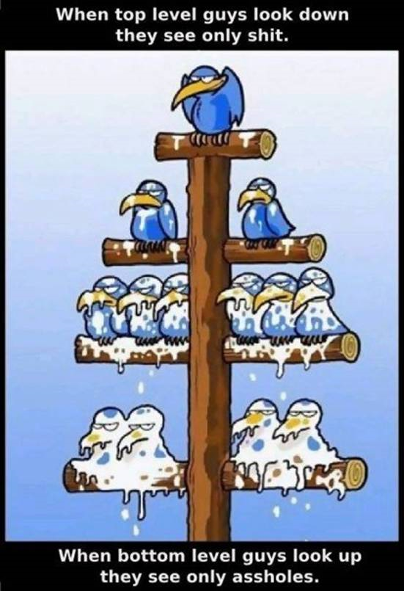
Two examples
of a static systems view
in the theory of organization

Slide 35
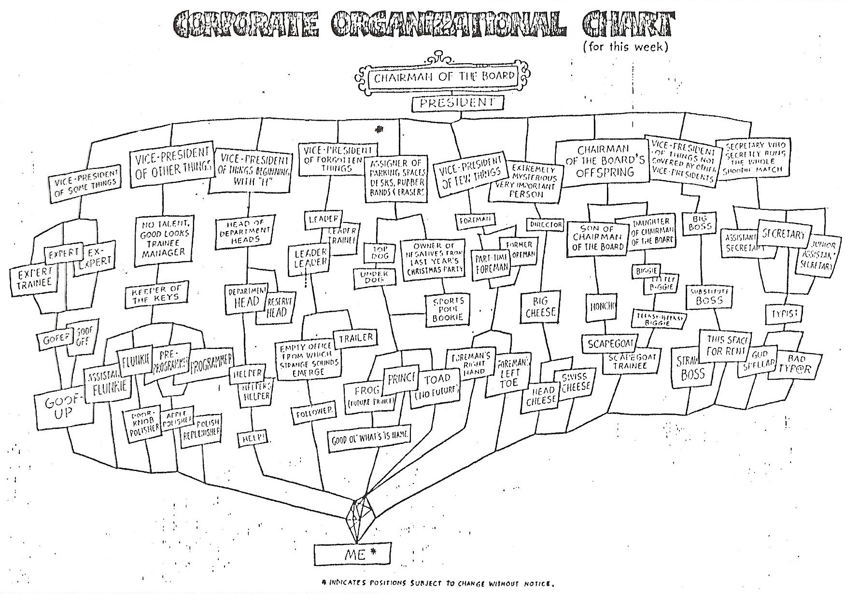

Slide 36
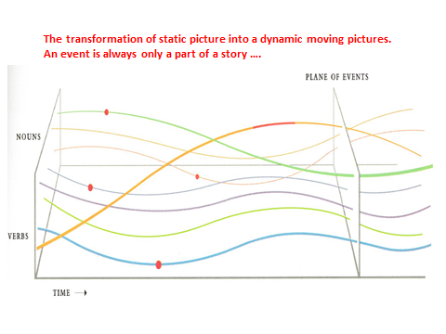

Slide 37
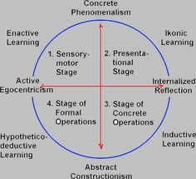
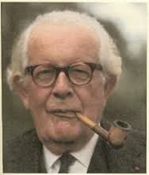
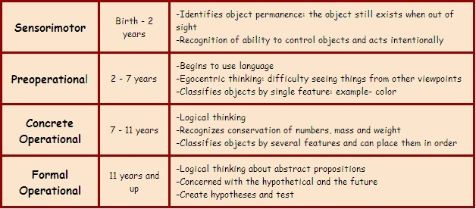
The cognitive development view
When you teach a child
something, you take away
forever his chance of
discovering it for himself.
J.P.
Jean Piaget 1896 Neuchatel - 1980 Geneva

Slide 38
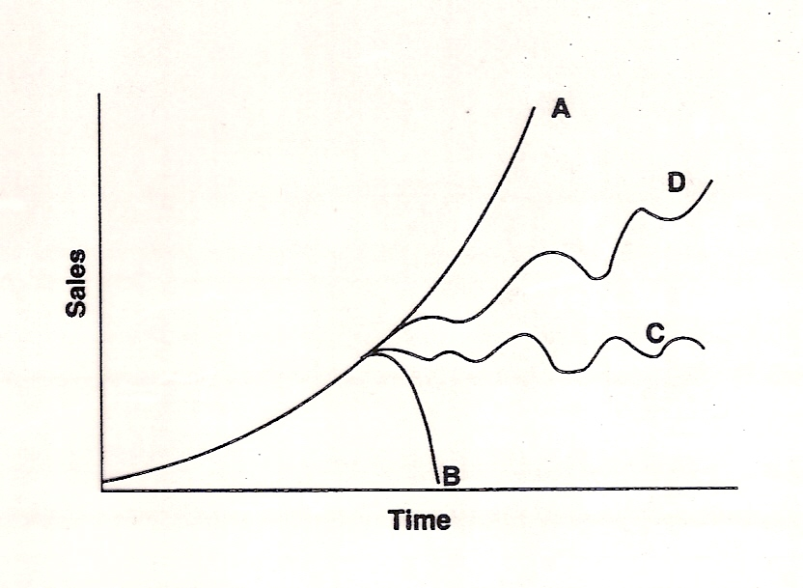
Picturing change over time – evolution, development.
Linear and non-linear view (see also slides 49 – 54)

Slide 39
The Technology of
problem solving
Is that stuff
working?
no
yes
Did you poke
into it?
no
Don´t you
poke into it !
yes
no
Did anyone
see you?
You clumsy!
Burke it!
yes
no
yes
Will you get
caught?
Did it work?
You
dumb head!
yes
no
no
Any scapegoat?
Forget it
yes
Nothing to worry about!

Slide 40
Decision - making and its consequences
The continuity
of past processes
rule.
I can foresee,
but not influence
Future
uncertainity
space
The past
evolution
The processes,I can influence
By decisions and actions
Predictions
time
horizon
present decision
time
By Jay W.Forrester

Slide 41
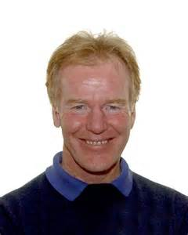
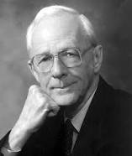
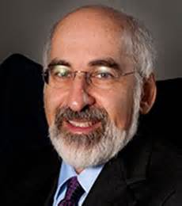
b) A way to a more advanced thinking:
the system dynamics
Peter M.Senge
1947 Stanford:
System dynamics thinking – „The learning organization“
Jay Wright Forrester
14.7.1918 – 16.11.2016
founder of S.D.,
„The world dynamics“
John Sterman : system dynamics modelling – „The Business Dynamics“
All at the Sloan School of management, M.I.T., Boston

Slide 42
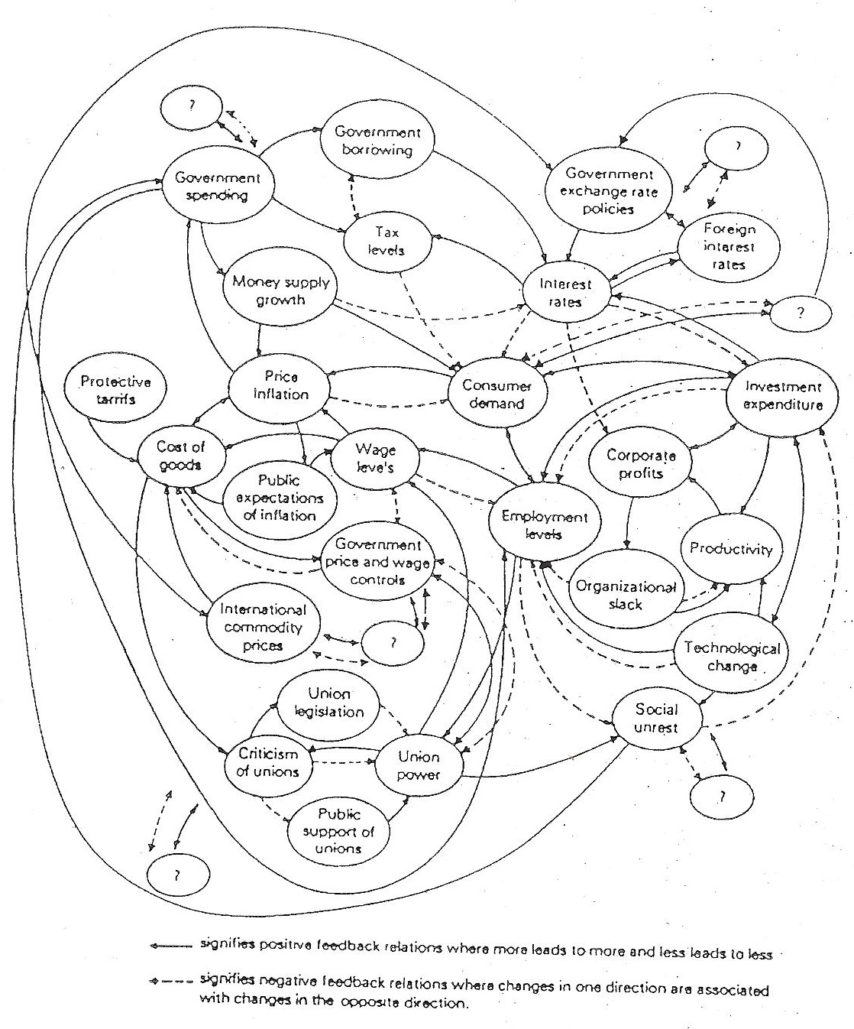
An example of
a dynamic structure, consisting of feedback
loop processes:
a price inflation model

Slide 43
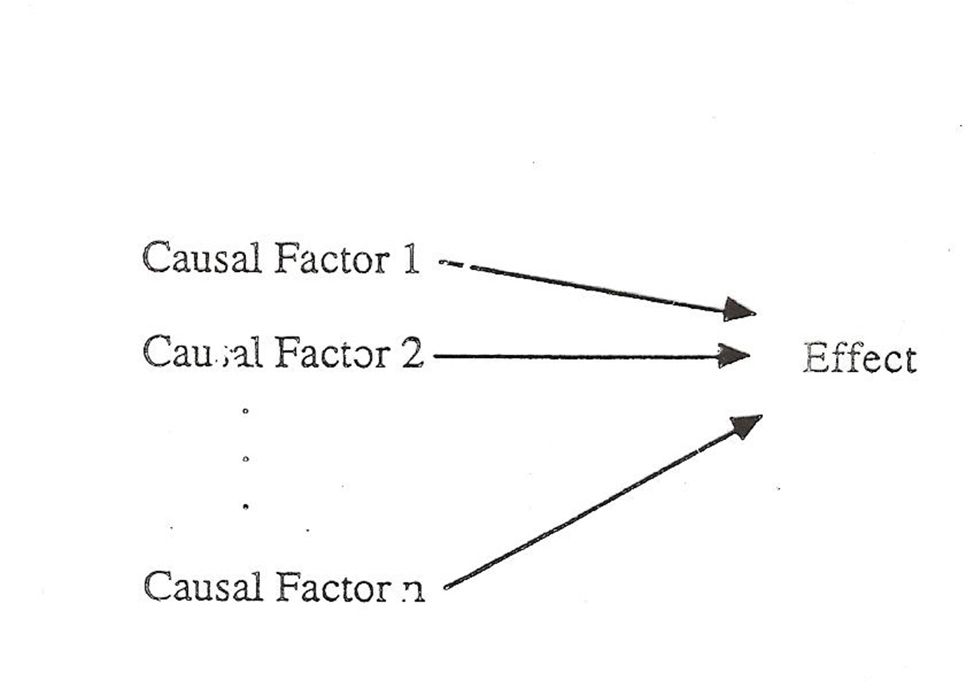
An example: how to turn the SWOT table into a set of processes, which hide the root cause of a problem

Slide 44
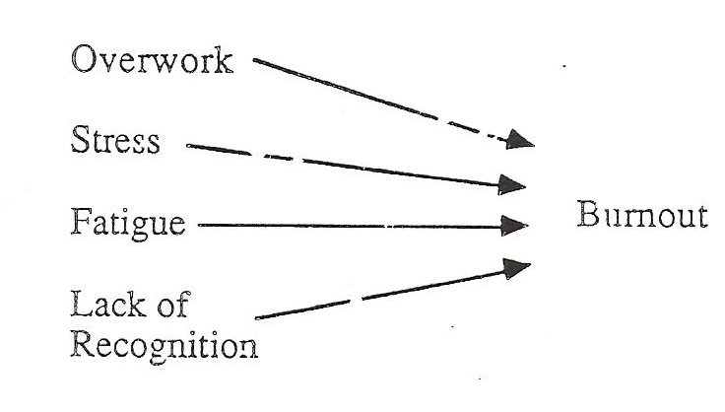

Slide 45
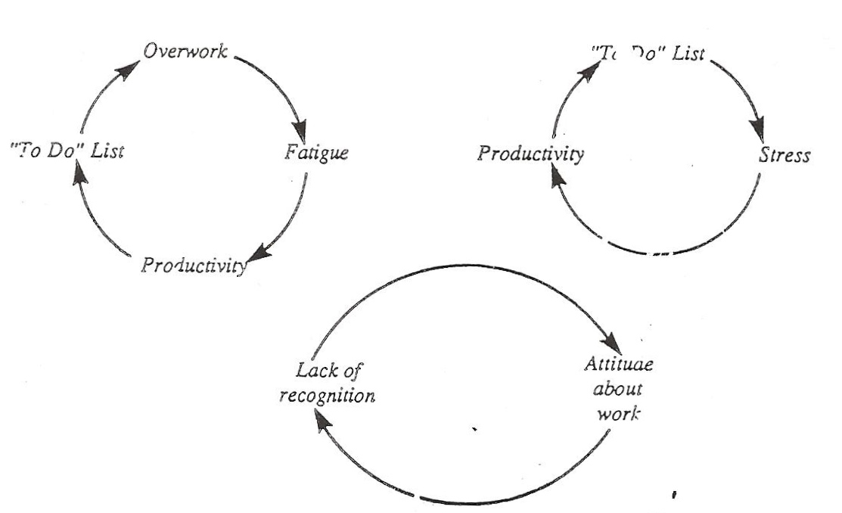

Slide 46
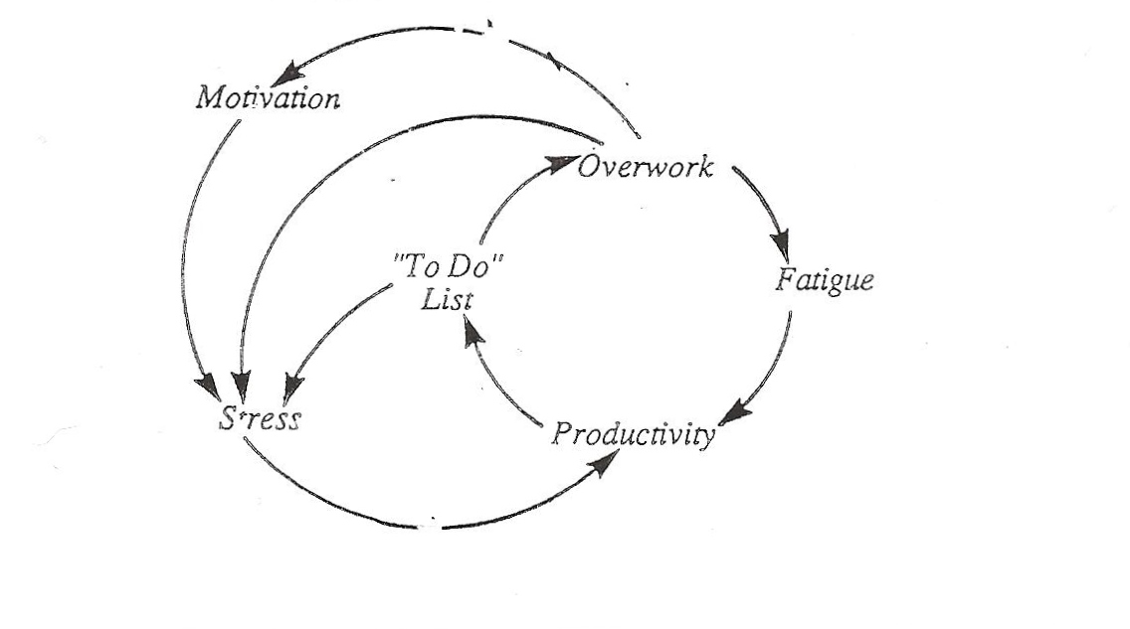

Slide 47
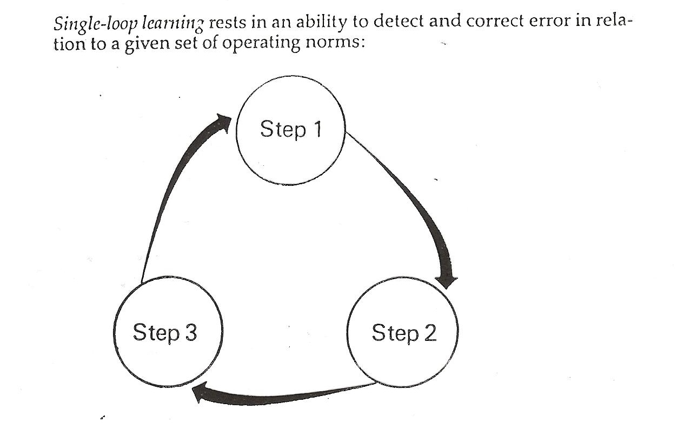

Slide 48
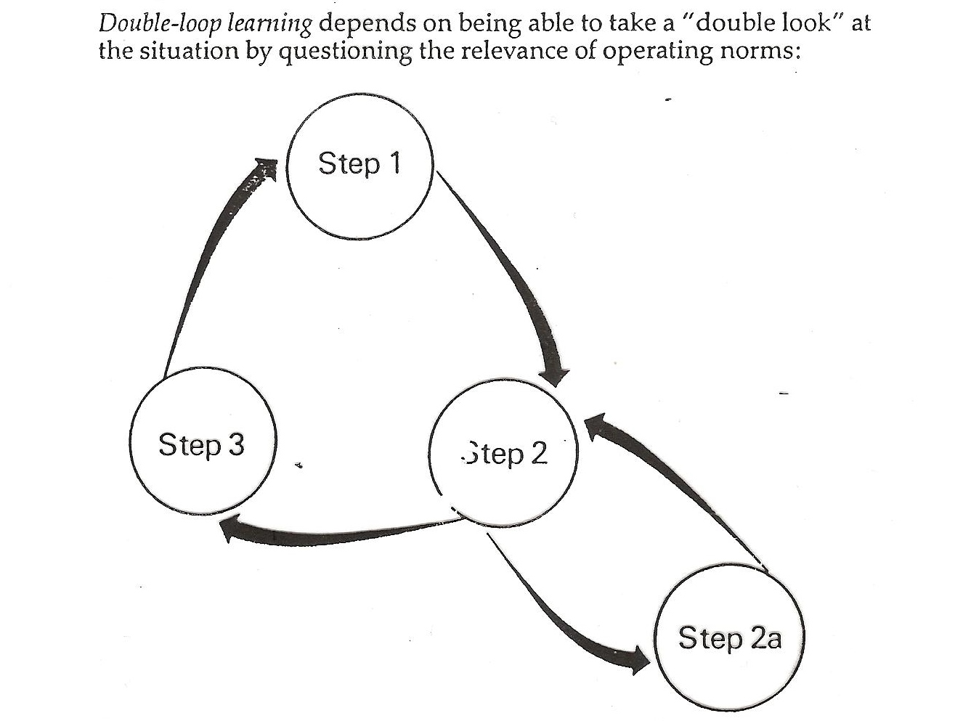

Slide 49
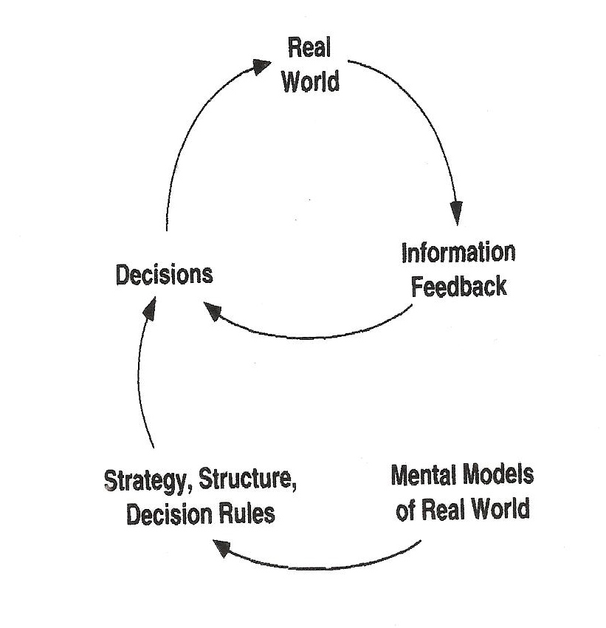

Slide 50
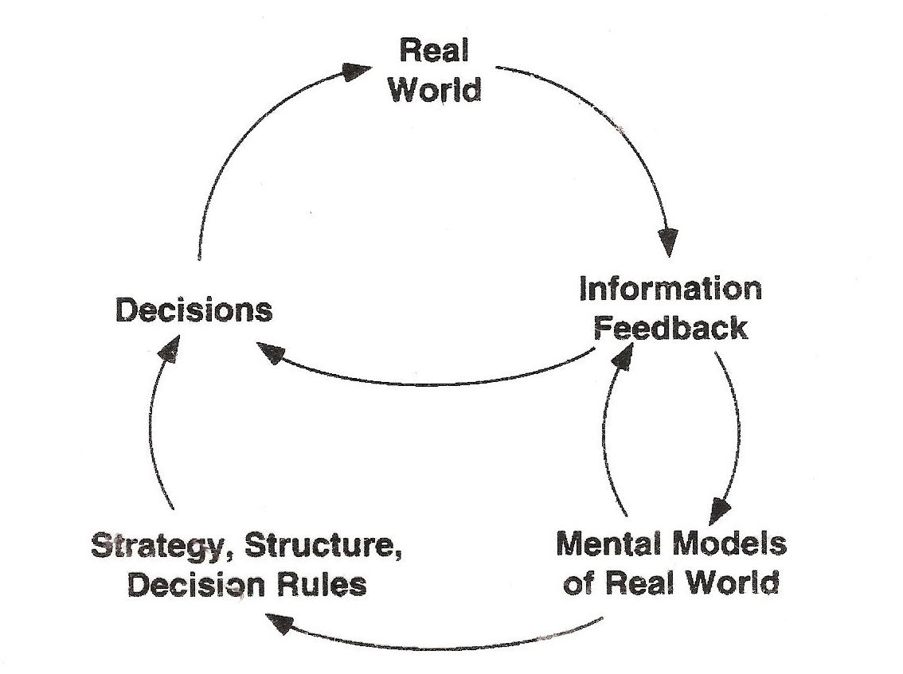

Slide 51
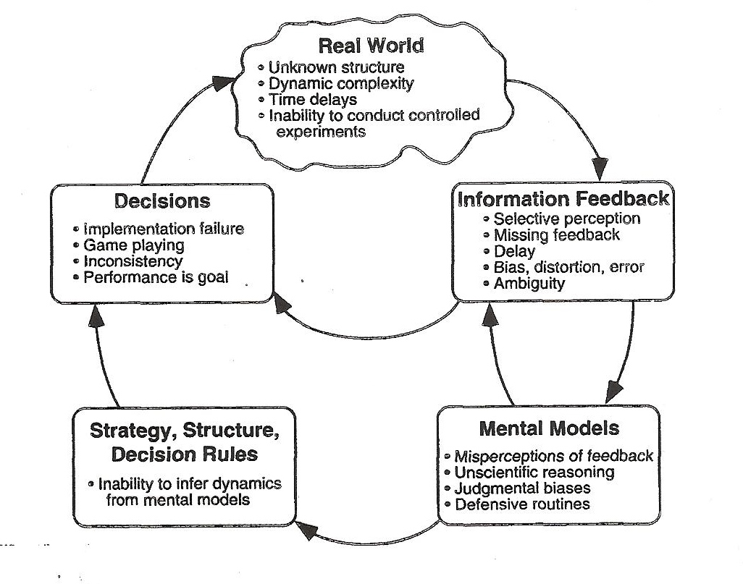

Slide 52
The feedback loop example:
The real determinants of the British Navy size
Cats dig out
bumblebees
Widows
keep cats
Bumblebees
pollinate shamrocks
Large supplies of cans
Increases number
of fighting sailors
Cattle graze off
shamrocks
Cattle turns into
a canned meat
for sailors

Slide 53
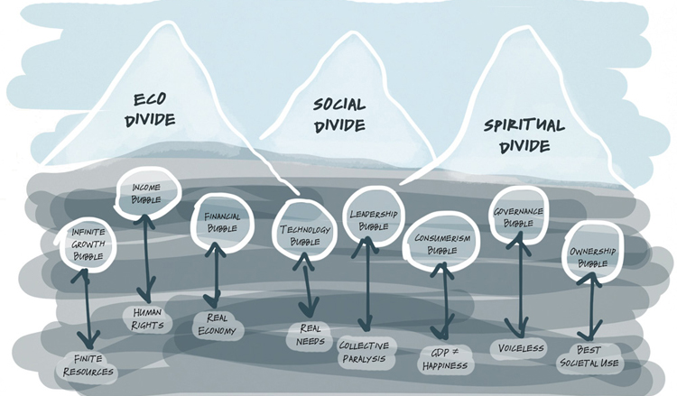



Otto F. Scharmer,
M.I.T.

Slide 54


Slide 55


8. Decision-making under uncertainty:
Dimensions of uncertainity – the object, the ecology/situation and the decision-maker
Uncertainty occurs when, given current knowledge, there are multiple possible states of nature.
S.U.N.Y. at Albany
Rockefeller College of Public Affairs and Policy
Thomas Stewart

Slide 56




Berndt Brehmer (1940 - 2014)
Swedish National Defense College

Slide 57





Ray W.Cooksey
University of Western Australia, University
of New England, Business School
https://www.youtube.com/watch?v=g2or-MWzwWQ
https://www.youtube.com/watch?v=PJ1uYgRyssI
https://www.une.edu.au/staff-profiles/business/rcooksey

Slide 58






Daniel Kahneman, psychologist, 2002 Nobel Price in Economics

Slide 59
Tom Steward´s slides: Probability is the most widely used measure of uncertainty
Relative frequency
  The probability of an event is the frequency of it’s occurrence divided by the number of experiments, or trials (for a very large number of trials).
Subjective probability (Bayesian)
  The probability of an event is the degree of belief that a person has that it will occur.
Morgan, M. G., & Henrion, M. (1990). Uncertainty: A Guide to Dealing with Uncertainty in Quantitative Risk and Policy Analysis. New York: Cambridge University Press.

Slide 60
Types of Uncertainty
Uncertainty 1 - States (events) and probabilities of those events are known
  Coin toss
  Die toss
  Precipitation forecasting (approximately)
Note: This is sometimes called aleatory uncertainty. It reflects the nature of random processes. For example, even though you know a fair die has six sides, you cannot reduce the uncertainty about what the next roll will show. But you can quantify the uncertainty. For the simple case of the die, the odds are 1 in 6 of any particular face turning up.

Slide 61
Types of Uncertainty
Uncertainty 2 - States (events) are known, probabilities are unknown
  Elections
  Stock market
  Forecasting severe weather

Slide 62
Types of Uncertainty
Uncertainty 3 - States (events) and probabilities are unknown
  Y2K
  Global climate change
The differences among the types of uncertainty are a matter of degree.

Slide 63
Epistemic Uncertainty
Uncertainty 2 and 3 include epistemic uncertainty. This is uncertainty due to incomplete knowledge of processes that influence events. Incomplete knowledge results from the sheer complexity of the world, particularly with respect to issues at the interface of science and society. As a result, models (computer or mental) necessarily omit factors that may prove to be important. It is possible to judge the relative level of epistemic uncertainty, i.e., because of the time frames and number of potentially confounding factors, it is higher in nuclear waste disposal and climate prediction than in the prediction of weather and asteroid impacts. Total uncertainty is the sum of epistemic and aleatory uncertainty.
(see Brunswik)

Slide 64
Picturing uncertainty
Picturing uncertainty
There are many ways to depict uncertainty. For example,
There are many ways to depict uncertainty. For example,
Continuous events:
scatterplot
Continuous events:
scatterplot
Discrete events:
decision table
Discrete events:
decision table
Any taxonomy –
For instance see slide 28

Slide 65
Continuous Judgments and Events
Consider the case of a continuous judgment about a continuous event. Examples:
  Weather forecasts of windspeed, temperature
  Economic forecasts of unemployment, inflation
  Medical diagnosis of severity of disease
  Judgment of suitability of a job applicant
  Judgment of quality of college applicant
  Judgment of need for admission to hospital

Slide 66

Scatterplot: Correlation = .50
66

Slide 67

Scatterplot: Correlation = .20
67

Slide 68

Scatterplot: Correlation = .80
68

Slide 69

Scatterplot: Correlation = 1.00
The perfect judgment
69

Slide 70
Uncertainty, Judgment, Decision, Error
Taylor-Russell diagram
  Decision cutoff
  Criterion cutoff (linked to base rate)
  Correlation (uncertainty)
  Errors
    False positives (false alarms)
    False negatives (misses)

Slide 71

Taylor-Russell diagram
71

Slide 72

Tradeoff between false positives and false negatives

Slide 73
Problem: Optimal decision cutoff
Given that it is not possible to eliminate both false positives and false negatives, what decision cutoff gives the best compromise?
  Depends on values
  Depends on uncertainty
  Depends on base rate
Decision analysis is one optimization method.

Slide 74

Example: Weather forecaster’s decision to warn the public about an approaching storm

Slide 75

Decision tree
Danger
No danger
Danger
No danger

Slide 76
The trouble is to create the hierarchies of problems to be solved according to their urgency in a constant flow of situations, presenting us with new tasks.
What to deal with and what to forget.
What are the desired consequences of decisions (goals) and what is the possible array unexpected consequences?
Problem solving of well or poor structured tasks returns us back to the cognitive continuum theory.

Slide 77
10. The most difficult and ages old puzzles of self-awareness and consciousness:
- exactly, what are they?
- Where do they come from?
- How did they evolve?
- too difficult just for psychologists:
Philosophers, shamans, clergyman, physicians, intellectuals,
esotheric seers, psychologists, physicists, neurologists
neuronal nets folks, artificial intelligence, artificial life folks ….

Slide 78
Simple Definition of consciousness
* the condition of being conscious : the normal state of being awake and able to understand what is happening around you
* a person's mind and thoughts
* knowledge that is shared by a group of people
Source: Merriam-Webster's Learner's Dictionary

Slide 79
Full Definition of consciousness
a : the quality or state of being aware especially of something within oneself
b : the state or fact of being conscious of an external object, state, or fact
c : awareness; especially : concern for some social or political cause
: the state of being characterized by sensation, emotion, volition, and thought : mind
: the totality of conscious states of an individual
: the normal state of conscious life <regained consciousness>
5 : the upper level of mental life of which the person is aware as contrasted with unconscious processes

Slide 80


Some examples:
Daniel C.Dennet,
multidisciplinary approach

Slide 81



„ Grof tries to disproof materialistic world view. He claims, that the interpersonal reality is equally real, as our usual reality, if not even more so. The criticism of his scientific and artistic legacy (see The Sisyfos Club – Grof „breaks the bonds of spacetime and thus he can get into anyhing at any time“) is right in a sense, that the proof of consciouness primacy over matter is hard to defend – it assumes the a priory „absolute consciousness“, or „the pregnant void“. I guess that this issue is primarily a matter of belief. The western science was never able to clarify the mind – matter relation“.
Pablo Kral
Psychiatrits Stanislav Grof (1931), transpersonal psychology

Slide 82



David Chalmers
philosopher

Slide 83



Antonio Damasio
neurologist

Slide 84




Quantum physics theory of consicousness mind.
Microtubules and quantum consciousness.
Sir Roger Penrose
Mathematics, physicist
Stuart Hameroff
anesthesiologist

Slide 85
The soul does not die , but returns to the universe
Stuart Hameroff and sir Roger Penrose claim, that human brain is a biological computer and our consciousness is a software, which runs there. This program does not cease to exist even after our death. The soul exists in the structures of filamentous brain cells called microtubules. When people enter the stage of clinical death, their microtubulae loose their quantum state, but the information contained there changes into a wave state and stays preserved. Quantum information can not be destroyed, it can only disseminate into a larger space.
Thus our soul is rather as program and our consciousness is a result of “quantum gravitation” processes within the microtubular structures (“orchestrated objective reductions” – Orch-OR).
http://www.quantumconsciousness.org/

Slide 86



Marvin Minsky
M.I.T.
cybernetics; A.I., A.L. groups

Slide 87
11. The ultimate knowledge – the art of asking the smart questions see III. the Art of Asking Smart Questions series.

Slide 89
Will you contribute to these explorations in any way?
Original views are of those, who know less!
Now read some more, think, submerge into your own imagination, make a choice and write!
Look forward to see what you come up with…

Slide 90
Literature:
Bill Critchley, David Casey building of a team http://www.new-paradigm.co.uk/Team Dev.htm
Hammond, K. R. (1996). Human Judgment and Social Policy: Irreducible Uncertainty, Inevitable Error, Unavoidable Injustice. New York: Oxford University Press.
Hammond K.R., Judgment under stress, Oxford University press,
Senge Peter, Sterman John, system dynamics (systems thinking and modelling), both at the M.I.T. Sloan School of management
Thomas R. Stewart, Ph.D., Center for Policy Research, Rockefeller College of Public Affairs and Policy, University at Albany, State University of New York
T.STEWART@ALBANY.EDU
www.brunswik.org.
See all authors on their web pages, www.TED.com, youtoobe….

