Slide 1
GAMING DISORDER INTERNET BASED ADDICTIONS HYPERSEXUALITY EATING DISORDERS EXCESSIVE EXCERCISING
ADDICTION

Slide 2
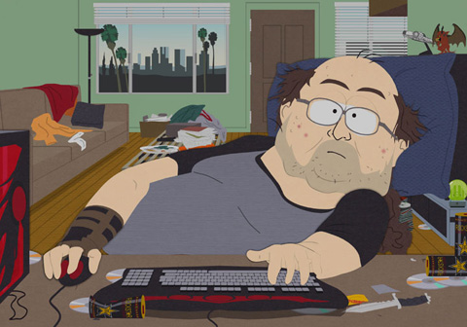
GAMING ADDICTION
https://www.youtube.com/watch?v=R83287N6kFg

Slide 3
GAMING DISORDER – does it really exist?
Computer games is one of the fastest growing entertainment industry (nowadays earning more than all world film industry)
From “nerd-only” genre it evolved to attract more diverse social groups
For the vast majority of gamers it is just a free-time activity without any harm – even phenomenon like induced aggressiveness was not proofed
Computer games suffer from moral panic - similar to situation in film cinemas in 30s, comic books in 50s, TV in 60s – situation is judged by people who grew up without computer games and thus they tend to misinterpret it

Slide 4
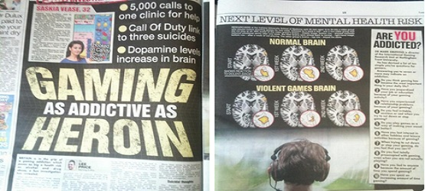
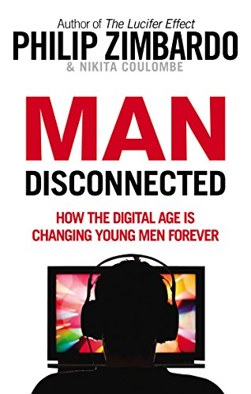
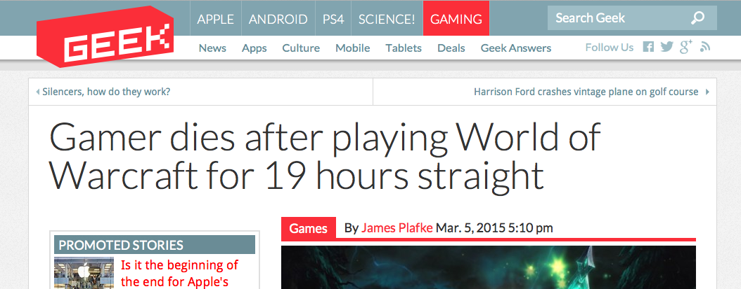

Slide 5
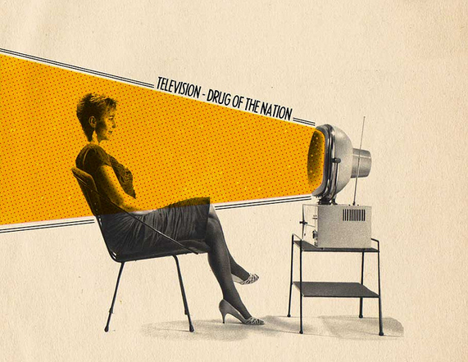
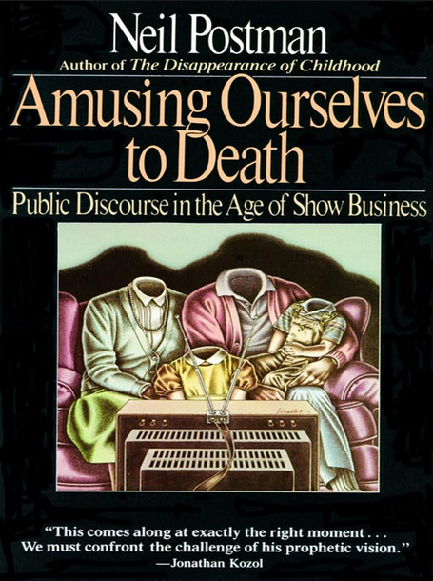
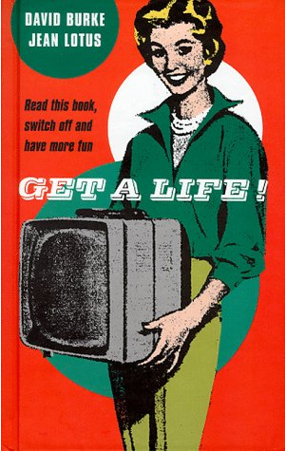
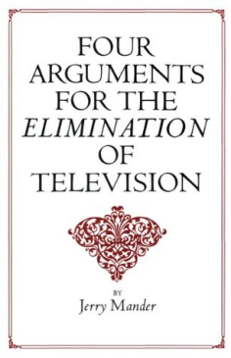
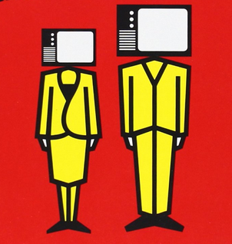
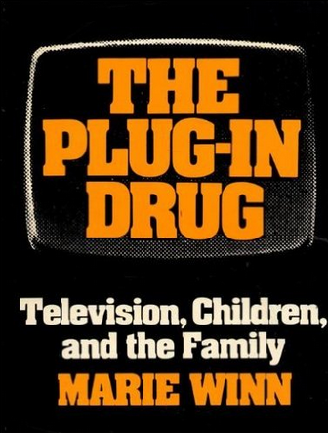
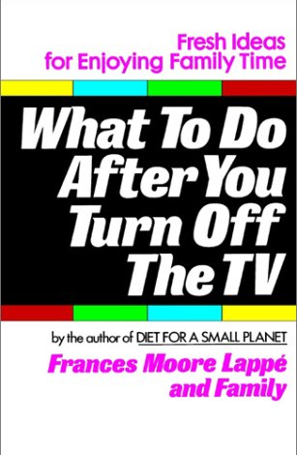
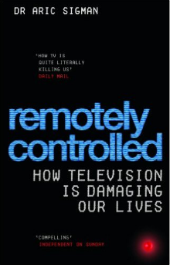
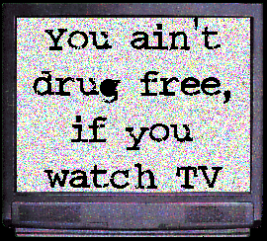
Notes:
Nadměrná konzumace televize
- hloupnutí, pasivita, lenost, obezita, vyšší kriminalita a ochota k násilí, těhotenství nezletilých...
Frankfurtská škola – televize odvádí pozornost od podstatných věcí
Boom kritiky televize v USA 70-90. léta, v ČR 90. léta a později
Williams (1975): flow jako sekvence nebo sada sekvencí obsahů

Slide 6
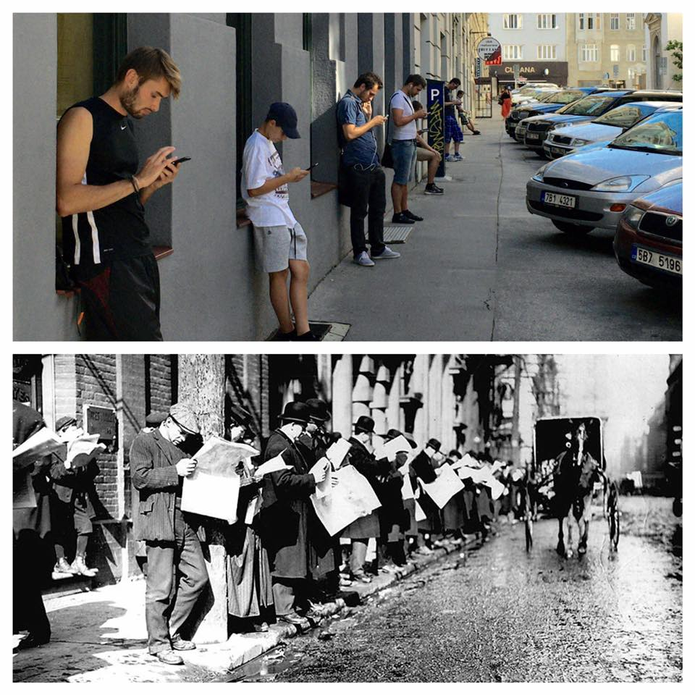
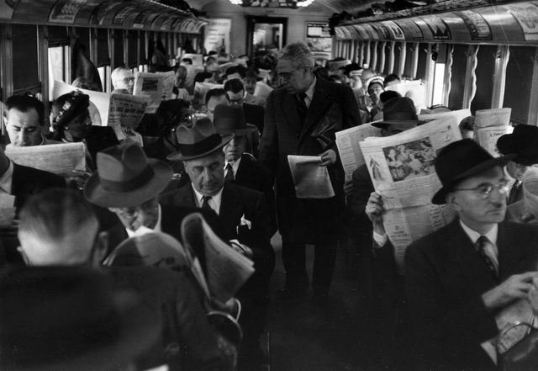

Slide 7
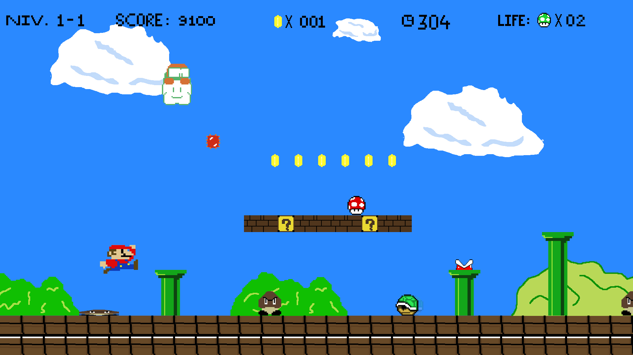

Slide 8
GAMING DISORDER
Intensity of gaming is much higher than any media usage before – online games are played about 20 hours per week, those with higher addictive potential about 35 hours per week on average
The most successful games are still those targeting “standard nerds” –90% of gamers are younger men (teenagers and young adults)
But we still know too little – only few neurological studies (however they support addiction model – intensive gamers have changes in reward pathway and prefrontal cortex similar to cocaine users) and too short longitudinal studies (we have no idea whether gaming disorder persists longer than 2 years)
Even if the addiction model will not proof, intensive gaming is not healthy due to time devotion, unhealthy physical and social lifestyle: problems in school/work, lack of sleep, problems in social interactions, health problems (repetitive strain injuries,…)

Slide 9
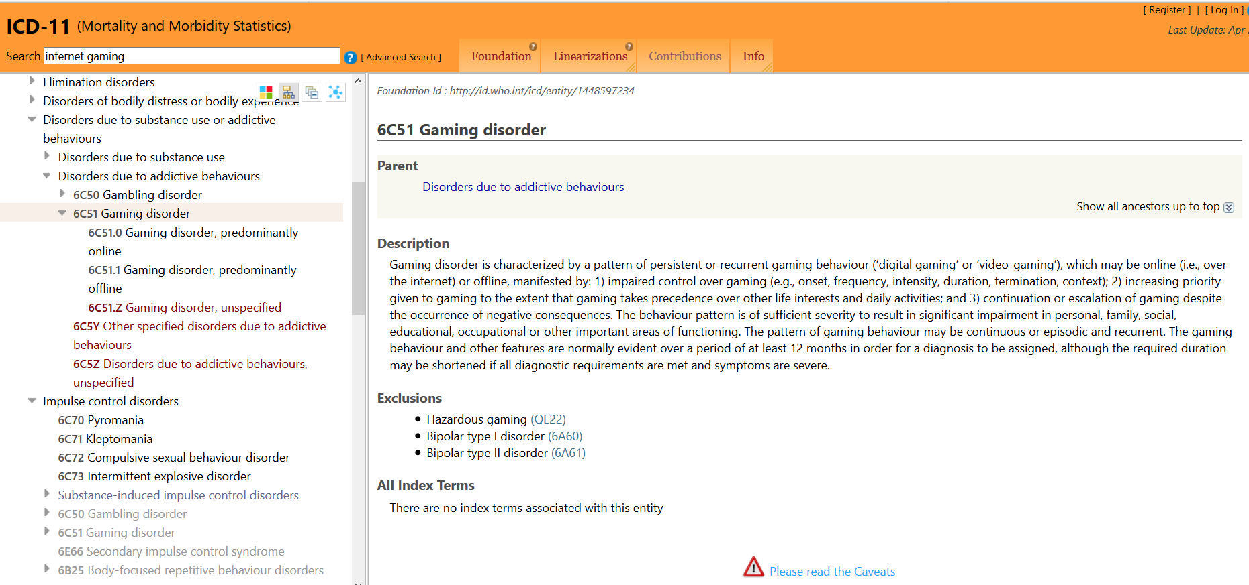

Slide 10
GAMING DISORDER
Included in DSM-5 in appendix (exists as experimental diagnosis for scientific community to accumulate more data) as Internet Gaming Disorder
Included in ICD 11 as Gaming Disorder (with variants “predominantly online” & “predominantly offline”). Gaming disorder, predominantly online is characterized by a pattern of persistent or recurrent gaming behaviour (‘digital gaming’ or ‘video-gaming’) that is primarily conducted over the internet and is manifested by:
impaired control over gaming (e.g., onset, frequency, intensity, duration, termination, context)
increasing priority given to gaming to the extent that gaming takes precedence over other life interests and daily activities
continuation or escalation of gaming despite the occurrence of negative consequences.
The behaviour pattern is of sufficient severity to result in significant impairment in personal, family, social, educational, occupational or other important areas of functioning.
The pattern of gaming behaviour may be continuous or episodic and recurrent. The gaming behaviour and other features are normally evident over a period of at least 12 months in order for a diagnosis to be assigned, although the required duration may be shortened if all diagnostic requirements are met and symptoms are severe.

Slide 11
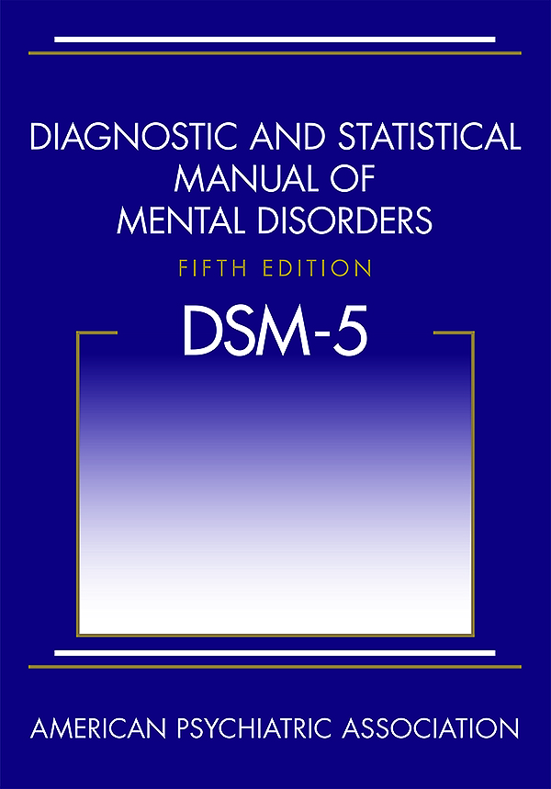
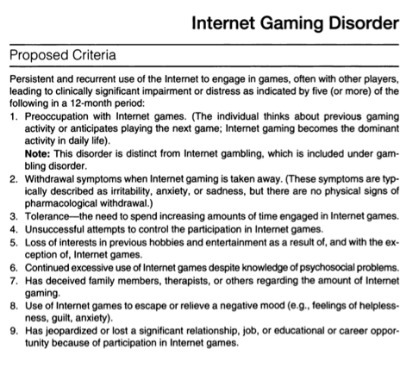

Slide 12
What games are suspects and why?
MMO – Massively Multiplayer Online (e.g. World of Warcraft, Even Online) & MOBA – Multiplayer Online Battle Arena (e.g. League of Legends, World of Tanks)
Other game genres like Simulation games or First-Person Shooter games do not seem to be the problem. Offline games (traditional computer and video games) are not problem at all
Important features (structural characteristics increasing addictive potential):
Social dimension – recognition, easy communication
Advancement & permanent rewarding
Permanent feedback – feelings of control
Persistent world – exist even when the person is offline, no-end and blurred time structure
Inclusion of reward mechanisms known from gambling (e.g. near miss, random reward boxes)

Slide 13
Risk factors of addiction
Males of younger age
Feelings of loneliness
Low self-esteem and low self-efficacy
Social anxiety and generally lower social competence
Need for control, low flexibility
Self-control difficulties and hyperactivity (e.g. ADHD) in younger age
Higher alexithymia (decreased ability to reflect emotions) and mild autism-like personality
Depressiveness

Slide 14
ADDICTION VS ENGAGEMENT
Engagement – intensive game play that is not pathological
I feel happy at the thought of playing
I often experience a buzz of excitement while playing
Addiction – intensive game play that could be labelled as pathological. General addiction criteria used in most addiction-like behaviours - conflicts, relapse, loss of control, escapism
I sometimes neglect important things because of an interest in…
I have made unsuccessful attempts to reduce the time I spend playing
I have used game play as a mean to escape from…

Slide 15
Are personality traits related to social functioning associated with gaming addiction and engagement?

Slide 16
Interpersonal dependency and online gaming addiction
Interpersonal dependency (Bornstein, 2003) - how cognition, motivation, affective responses, and actual behavioural patterns are affected by relationships to others
Healthy dependency (autonomy but situation appropriate help-seeking)
Destructive overdependence (fear of negative evaluation and reassurance seeking)
Dysfunctional detachment (fear of being overwhelmed, need for control)

Slide 18
Is dysfunctional impulsivity associated with online gaming addiction and engagement?

Slide 20
Do people play under influence of substances and is that associated with addiction and engagement?

Slide 21
Those under influence play more intensively: stimulant-type pharmaceuticals (+9.8 hr/week), Ecstasy/MDMA (+9.6), sedatives (+6.9), amphetamines (+6.2), caffeine (+3.8) Game-related motives were mentioned by 1/3 of respondents: avoiding sleep (25.8%), increased concentration (15.6%), enhanced enjoyment (13.8%), tension management (7.3%), increased courage (4.1%), avoiding hunger, (2.7%), and insomnia management (2.0%). Higher scores in addiction: sedatives (including alcohol), tobacco, tranquilizers (eliminating anxiety and fear) Higher scores in engagement: stimulants, caffeine, ecstasy

Slide 22
OTHER INTERNET BASED ADDICTIONS
General internet addiction (excessive internet use). Because the internet offers many platforms for entertainment, it is hard to track exactly what application is the most intensive. About 1% of teenagers show symptoms, about 4% at risk. Questionable whether it is really addiction (most likely not), plus high risk of false identification of addiction

Slide 23
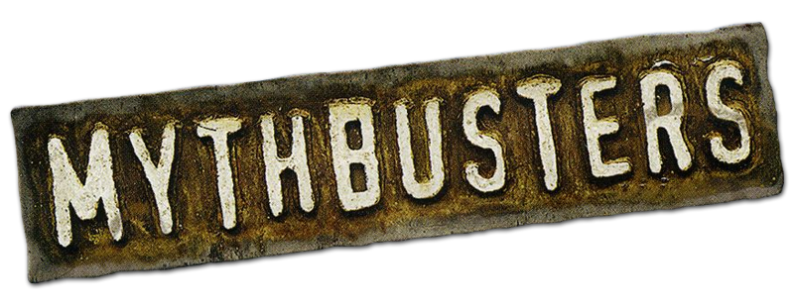
Is there anything like social networking site addiction or smart phone addiction?
Girls rather than boys
Extroverted personality traits rather than introverted
Poor self-control
Narcissistic personality traits, procrastination
If it is not addiction:
Need to belong & need to be in touch
Fear Of Missing Out
Procrastination - mood & anxiety management

Slide 24
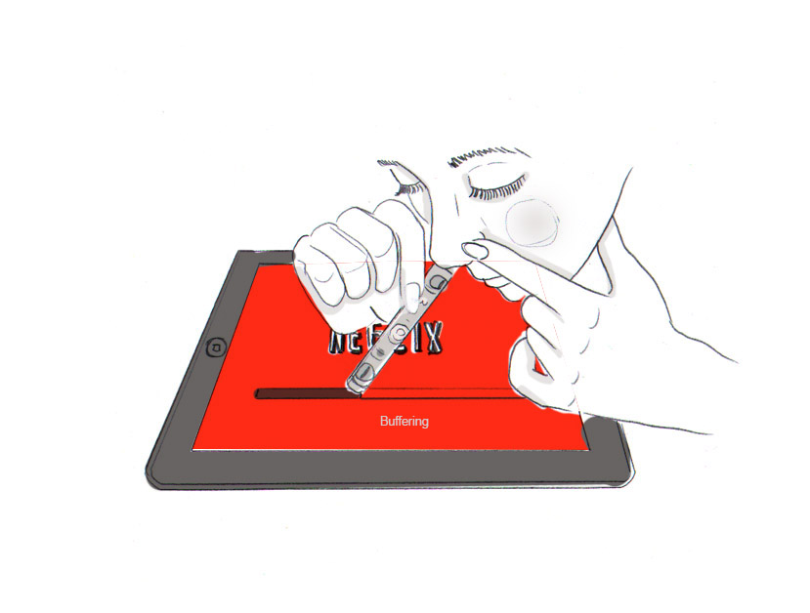
New addictions on the horizon?! Not really…

Slide 25
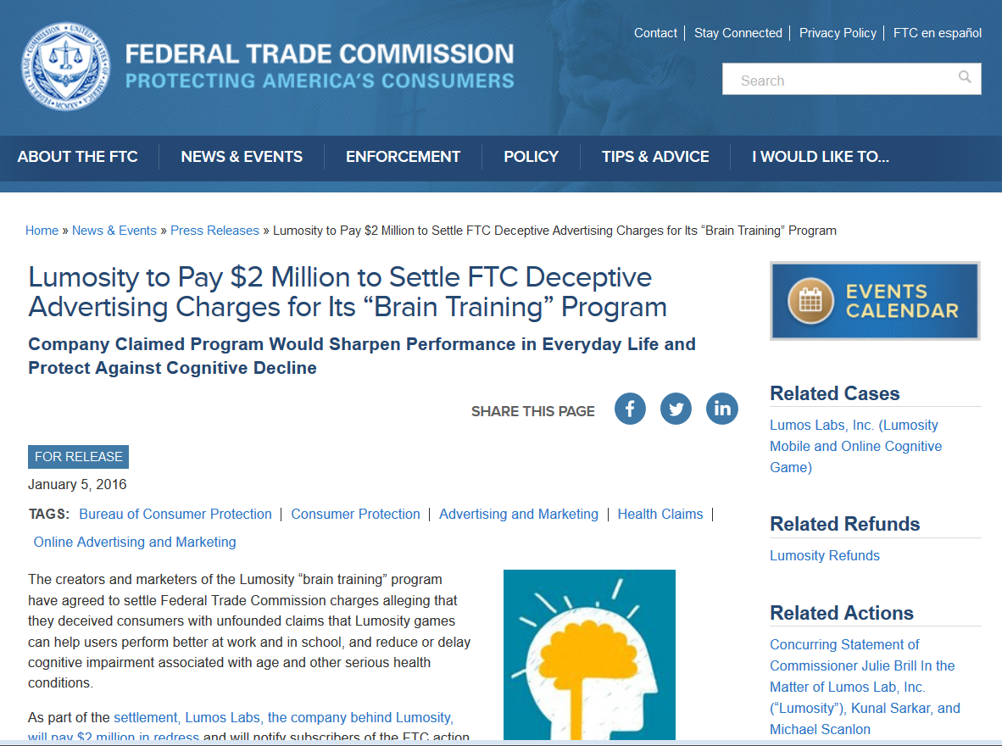
If it is not an addiction, is it OK?
Not really – quid pro quo: Time spend in digital media are often instead of time spend in healthier way
So if we remove access to digital media, it should be ok, right?
Not really – unstructured time activities tend to replace one another. Better lifestyle is not achieved by simply removing access to unhealthy activity.

Slide 26
SEX ADDCITION & HYPERSEXUALITY
First described by Benjamin Rush in 1812, then described by Krafft-Ebbing in Psychopathia Sexualis
Alfred Kinsey: 7 orgasm per day – 8% of population of males between teens-30.
But what is within the norm?
ICD 10 includes two potential diagnosis: “Excessive Sexual Drive” (F52.7, within block Behavioural syndromes associated with physiological disturbances and physical factors) but without formal diagnostic criteria (!) and with sub-labels satyriasis and nymphomania. “Excessive Masturbation”(F98.8, within block specified behavioural and emotional disorders with onset usually occurring in childhood and adolescence)
DSM-5 does not include hypersexuality
ICD 11 does include hypersexuality
Since there is no consensus yet, many terms and approaches exist: donjuanist; nymphomaniac; Messalina complex; sexaholic; onanist; erotomaniac,…

Slide 27
addiction vs hypersexuality
Both approaches agree that it must be 1) the most important activity (salience) 2) repetitive with unsuccessful attempts to stop or reduce (loss of control & relapse) 3) predominantly used in dysphoric mood states (mood management) 4) causing personal and interpersonal problems
Addiction model also includes 5) negative mood states when unable to perform sexual act (withdrawal) and 6) need to increase intensity (tolerance)
They may to some point differ in the treatment approaches (they also differently evaluate masturbation). Sexologists may be more focused on “ unsettled sexual identity” as the source of hypersexuality and using techniques like finding healthy sexuality (supporting playful and creative sexuality, building up intimacy,…)
In addiction model it is seen as learned behaviour that can be potentially unlearned through building up peer support system, relapse prevention, reducing shame, supporting healthy coping skills

Slide 28
ICD 11: Compulsive sexual behaviour disorder
Compulsive sexual behaviour disorder is characterized by a persistent pattern of failure to control intense, repetitive sexual impulses or urges resulting in repetitive sexual behaviour. Symptoms may include
1) repetitive sexual activities becoming a central focus of the person’s life to the point of neglecting health and personal care or other interests, activities and responsibilities
2) numerous unsuccessful efforts to significantly reduce repetitive sexual behaviour; and
3) continued repetitive sexual behaviour despite adverse consequences or deriving little or no satisfaction from it.
4) The pattern of failure to control intense, sexual impulses or urges and resulting repetitive sexual behaviour is manifested over an extended period of time (e.g., 6 months or more), and causes marked distress or significant impairment in personal, family, social, educational, occupational, or other important areas of functioning.
5) Distress that is entirely related to moral judgments and disapproval about sexual impulses, urges, or behaviours is not sufficient to meet this requirement.
Exclusions: Paraphilic disorders (atypical sexual arousal, manifested by sexual thoughts, fantasies, urges, or behaviours, the focus of which involves others whose age or status renders them unwilling or unable to consent)

Slide 29
Comorbidity and risk factors
Anxiety, depression, loneliness
Higher impulsivity
Low self-worth, high self-hatred, shame
Substance use – alcohol, amphetamine, cocaine and other behavioural addictions (gambling, eating disorders) = addiction interaction disorder – several addictive-like disorders coexist together and make the situation worse that each of the separately
History of sexual abuse
Insecure attachment style, avoidance in relationships

Slide 30
Preferred activities in sex-addicts
Only normophilic activities count
Masturbation
Porn and fantasy sex
Voyeurism
Anonymous sex
Paying for sex
Intrusive sex (boundary violation)
Exhibitionism
Sex addicts are generally bad in sex – high level of sexual dysfunctions and often periods of sobriety. They do not have interest in “normal” sex

Slide 31
Negative consequences
lower capacity to devote free time to their children, family, and partners. Gradually increasing risk of condemnation and following social problems
self-degradation and feelings of self-disgust and shame
self-destruction or stagnation in their personal lives or careers
Erectile problems, penis pain due to excessive masturbation
physical exhaustion, lack of sleep
Reducing women to sexual objects

Slide 32
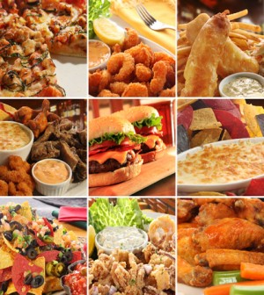
FOOD / EATING ADDICTION

Slide 33
Obesity epidemic
Prevalence – between 25-40% in developed societies – number tripled in last 20 years but currently is not that growing. The most significant growth in children (even under 5 years - where is about 6% obese).
Dramatic increase in developing societies (Asia)
Major cause of type 2 diabetes – and many other diseases (certain cancers, heart and veins diseases,…)
Treatment of obese people up to 30 times more expensive

Slide 34
Food addiction?
Unlike drugs, food consumption is normative
Eating disorders: obesity - binge eating – bulimia nervosa - anorexia nervosa - various dieting
Various patterns in various eating disorders. The most relevant – binge eating
Similar neurochemical effects as in other substance addictions
Especially in fat and double especially in sugar – sugar can start cycle of craving-binging- withdrawal-craving
Confirmed also from animal studies – sugar consumption initiated in very early age leads to craving/binging in adulthood
Anxiety, stress and depression starts craving for carbohydrates (but not e.g. for proteins) - carbohydrates and especially sugar can medicate dysphoric mood
Sugar is preferred by addicts in withdrawal states (e.g. in smokers)
Half of binge eaters (obese) meet criteria for addiction

Slide 35
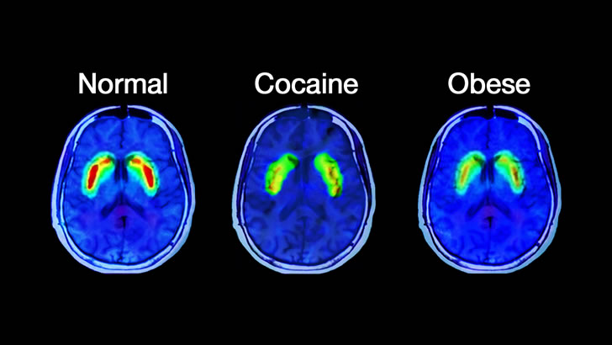

Slide 36
Are food restrictions addictive?
Example Anorexia nervosa (about 0.5-1% of western population, especially women. Over time, approximately 50%-60% recover, 20%-30% partially recover, and 10%-20% remain chronically ill – death rate 11% !) heritability similar to substance addictions. Typical comorbidity – perfectionism, anxiety
food restriction has been shown to increase the reinforcing effects of various drugs in humans and animals
Anorexia nervosa is similar to addiction:
begin during adolescence, and often begin as a
Both are conscious decision to engage in a behaviour (i.e., consume a drug or go on a diet)
Over time individuals report uncontrollable drive to pursue the maladaptive behaviour
They narrow their behavioural and cognitive repertoire so that weight loss and food restrictions become the most important in their life
They engage in dietary restriction as a mechanism for modulating anxiety and dysphoric mood (in much the same way individuals with substance abuse modulate mood with drug use).
When food occurs, anxiety increases in a similar manner to anxiety often reported during periods of drug abstinence, e.g. withdrawal.
Starvation and hunger increase level of endogenous opioids – however, it is probably not enough

Slide 37
Food addiction - definition
a pervasive and enduring pattern of both food perception and food-related behavior leading to either excessive food ingestion or aversion with food in harmful and unhealthy ways.
Such pattern continues, despite knowledge of its harmful consequences.
Food addicts usually present both a tolerance (i.e. a need to increase participation in their harmful relationships with food over space and time) as well as a form of withdrawal (i.e. an inability to escape their addiction with food without suffering undue anxiety, craving, or other adverse reactivity which may include depression or anger) when deprived of access to addictive foods.
This latter emotional and behavioral reactivity must reliably occur during efforts to either alter or disrupt the food addict’s harmful and maladaptive pattern of eating.

Slide 38
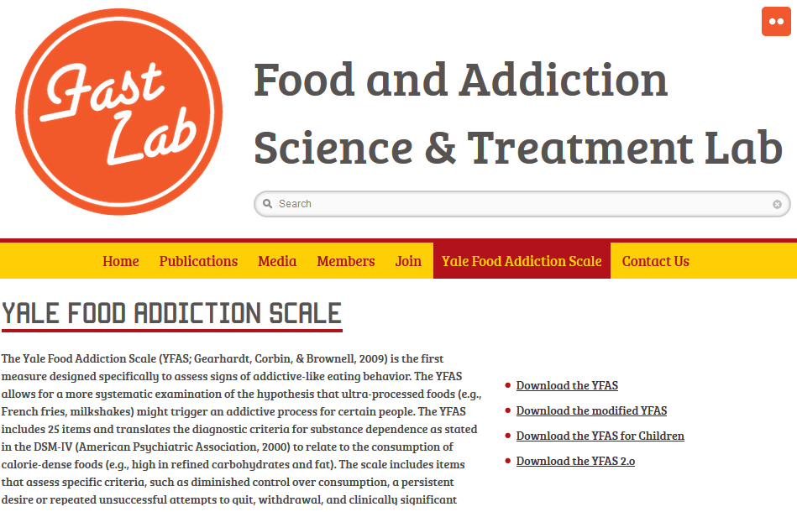
http://fastlab.psych.lsa.umich.edu/yale-food-addiction-scale/

Slide 39
EXCESSIVE EXERCISING
It is not an official diagnosis
Described in 70s
At first understood rather only as “activity based anorexia” - common co-occurrence with eating disorders
Primary vs secondary ex. ex. - Primary when there is ex.ex. without any further eating pathology (mainly bulimia or anorexia) – more common in men. Secondary ex.ex. when it is aspect/symptom of eating disorder – more common in women, more associated with mood disorders like depression, bipolar disorder
Exercising is in more days then not; it is of high intensity (typically 3 hours a day); does not have enough variation (it is stereotypical); the person reacts negatively to change of the routine; the person reacts negatively when unable to do the exercise; there are significant problems due to ex.ex. (personal problems, physical problems).

Slide 40
How is such addiction possible?
Early explanations - opioid endogenous system – but unlikely
More probable explanation: it affects dopaminergic reward pathways: 1) short term effect in humans - significant mood lift in/after intensive training 2) long term effect in animals – decreased availability of dopamine receptors after intensive physical activities over time
Activity based anorexia may have evolutionary basis – also animals tend to do high energy activities when they are starving
Social reinforcement – fitness is seen as highly desirable, attractive, prestigious
Negative reinforcement – negative mood swings, anxiety, flu-like sensations, irrational cognition (e.g. about one’s body) often follow when exercising is not possible. More intensity exercising is then sought which results into more muscle fatigue and injuries.

Slide 41
Negative effects
High intensity exercising over time often leads to lack of energy, physical and psychological exhaustion, lack of experiencing pleasure
Overtraining results into frequent injuries, deficit of immune system and illnesses, changes in endocrine system and inability to reproduce
Overtraining without resting phases leads to no more body benefits (e.g. no muscle growth)
Interpersonal problems

Slide 42
ANABOLIC ANDROGENIC STEROIDS

Slide 43
ANABOLIC-ANDROGENIC STEROIDS
Include testosterone and synthetic derivates of testosterone that have muscle building properties (anabolic) and masculinizing properties (androgenic) – these two main effects are always together (corticosteroids are chemically similar but have different biological effect and do not affect muscle gain)
Used in cycles – taken for some limited period of time only. A person usually has several such cycles in lifetime. Addicted people have shorter breaks between cycles or take AAC continuously.
Massive grow in general public during 80s (culture of action heroes)
After period of decrease, even greater increase currently – also in women
Popularity of sports like CrossFit & Strength athletics
Use in treatment of HIV and AIDS lead to increased availability on the market
AAS availability is other forms than injections (patches & gels)

Slide 44
addiction
Anabolic pathway – many users suffer from body dysmorphic disorder – they are massively concerned with their muscles and muscle gains (reverse anorexia nervosa), over time their concern even grows (as effect of AAS decreases with prolonged use)
Androgenic pathway – decreases natural production of testosterone, causes testicular atrophy – loss of reproductive capacity, loss of sex drive, loss of enthusiasm, increase in depressiveness and suicide tendencies. It takes months to reverse these effects after last dose of AAS. Taking AAS may weaken these natural effects – self-medication

Slide 45
addiction
Dopaminergic pathway – evidence from animals studies – conditioned place preference proofed to work in rats; self-administered AAS caused death by overdose in some hamsters; effects of AAS was stronger when administered into brain.
Neurological effect is not completely understood. It seems AAC binds to receptors in nucleus accumbens and are affecting opioid receptors
Opioid antagonist given to hamsters blocks the ACC self-administration in hamsters
Observation in humans – AAC users have much higher prevalence of opioids use than users of other drugs
Some early confirmation that treatment used in opioid addicts is helpful in AAC addicts

Slide 46
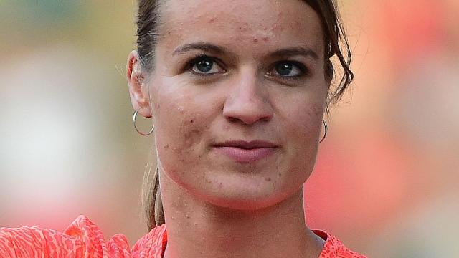
health effects
Strong cardiovascular effects – many cases of premature deaths – thrombotic effect, myocardial toxicity
Effect on reproduction system and inability to reproduce
In women significant voice change, significant body hair grow, clitoris grow, facial changes (more dominant chin, acne), a need for breast implants
https://www.youtube.com/watch?v=K2V7YQhsFo4

Slide 47
Psycho-social effects
Mania and hypomania – euphoria, hyperactivity, boosted self-confidence, hypersexuality, irritability, aggression, violence - including domestic violence, extreme aggression and even murders were reported under influence of AAS – but that is also influenced by personality (aggressive tendencies prior to AAS use) and hypermasculine culture
Major depression may develop as a withdrawal symptom
Problems associated with AAS will only grow as its polarity is steeply growing
But should it be banned?

