Slide 1
BIOLOGICAL BASIS OF ADDICTIONS
PSY292
ADDICTIONS

Slide 2
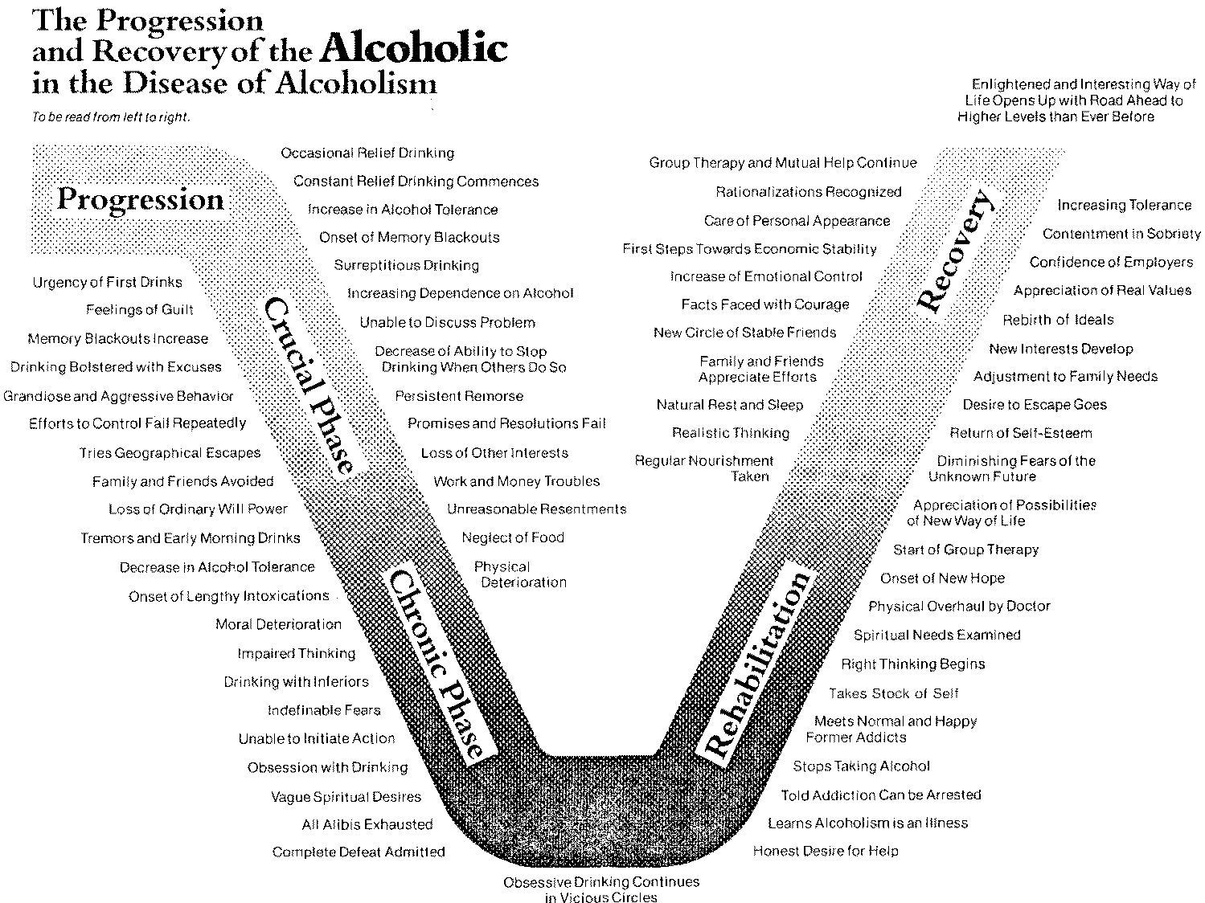
Disease model of addiction
Created in mid 20th century by Elvin Morton Jellinek
Addiction comes from underlying disease processes
The curve of progression and recovery

Slide 3
Disease model of addiction
At first, these processes were not understood. But it was assumed it is 1) brain disease and with 2) genetic susceptibility
Addicted person is a victim of this disease - it is not chosen and it is not an act of free will
Loss of control & craving as the common processes in addictions
Consumption of the substance causes craving for further dozes (through at first unknown psychological and neurological mechanism)

Slide 4
Disease model of addiction
Since the person is ill and suffering, he/she should be subject of medical treatment
Treatment was based on management of medical complications (stomach ulcer, liver disease,…) and raising patient health education – supervision of a physician
Therapy-like approach heavily influenced by 12 step program and 12-step programs take ideological support from scientific approach of disease model

Slide 5
Disease model of addiction
Addiction as a primary disease – addiction is not understood a result of another condition (other psychiatric condition, stress,…) but rather their cause
Addiction as a progressive disease - addiction is understood as a disease that has its course: 1) adaptive stage - increasing tolerance 2) dependent stage - withdrawal and maintenance usage 3) deterioration stage - resulting into major health and social problems
Addiction as a chronic disease – addiction is understood as a disease that will never disappear and the person will never be fully cured. Thus complete sobriety is the only way

Slide 6
Disease model of addiction - pros
Big leap in knowledge, new research
Removes stigma from suffering people
The classic disease model is still very simple to be understood by general public
When addiction became a disease (alcoholism as disease was acknowledged by American Medical Association in 1954) the help became more accessible

Slide 7
Disease model of addiction - cons
Despite huge advancement in knowledge, it was only poorly incorporated into this model. E.g. proofed usefulness of light substance taking contradicts chronic disease; natural remission and maturing out contradicts progressive disease; much stronger environmental factors contradict primary disease
Ignoring context - too little emphasis on psychological and social factors
The treatment method, although advancement at the beginning, is way behind treatments based on psychological and social models

Slide 8
Physical dependency theory
By suing the substance, the person can gradually develop a physical dependence
Physical dependence is a condition in which the person needs the substance otherwise suffers from various withdrawal symptoms
This theory assumes that addiction = physical dependence
NOT proved – many substances do not create physical dependence nor physical withdrawal symptoms. Many addicts return to addiction after period of treatment in which they were detoxified
Avoiding negative effects plays a role, however, more crucial proofed to be the pleasure-seeking

Slide 9
It is about (anticipated) pleasure
Positive-incentive theory - all drugs have pleasurable effects. Drug taking is more about getting the positive effects rather than about removing the negative effect
Positive-incentive value is usually much higher than hedonic value = anticipated pleasure is much higher than actual pleasure
Incentive-sensitization theory – repeated exposure to potentially addictive drugs leads to various changes in brain. The most important is sensitization = hypersensitivity to the incentive motivational effects of drugs and drug-associated stimuli that creates pathological wanting.
Addiction is not about the drug effect, it is about the anticipation of the effect. Addiction is motivation disorder

Slide 10
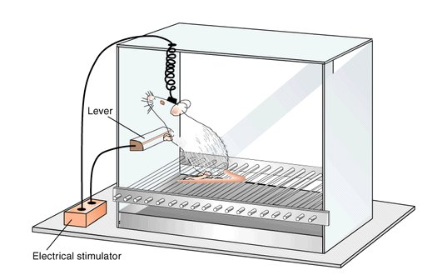
Intracranial self-stimulation

Slide 11
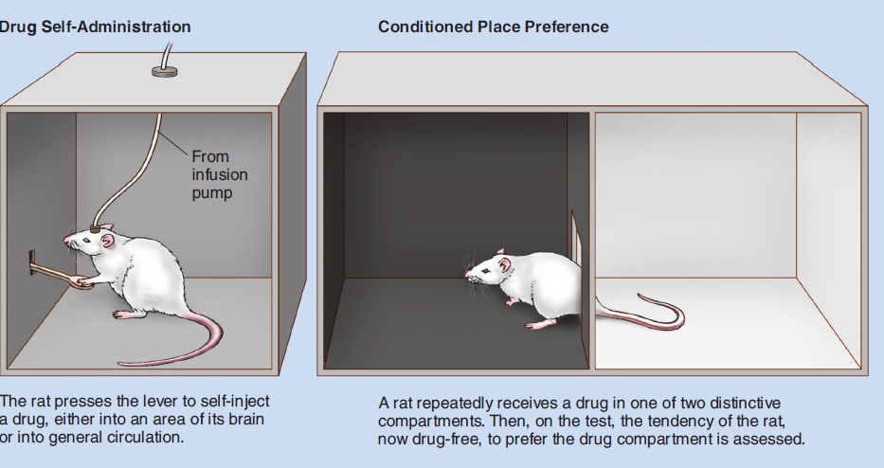

Slide 12
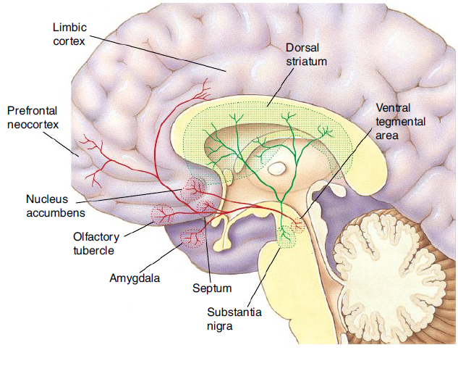

Slide 13
Mesolimbic dopamine pathway
Regulates motivation cognition and behavior and reinforcement learning – e.g. regulates behaviours related to food, drinks, safety, sex
Primary neurotransmitter – dopamine
The mesolimbic pathway connects the Ventral Tagmental Area near brainstem to the Nucleus Accumbens and to the Prefrontal Cortex. Important role plays amygdala and hippocampus

Slide 14
Mesolimbic pathway and addiction
In animals, drugs self-administered to nucleus accumbens had stronger effect and were preferred. It correlated with increase on dopamine release
All drugs affect dopamine functions. Many drugs work as direct dopamine agonists while the rest of drugs have indirect effect
Brain imaging technics showed massive dopamine involvement in nucleus accumbens. They also showed decrease of dopamine D2 receptors availability in addicts leading to increasing tolerance
Mesolimbic pathway gradually sticks to the addiction object to which it is hypersensitive while under sensitive to other stimuli – highjacked brain
https://www.youtube.com/watch?v=NxHNxmJv2bQ

Slide 15
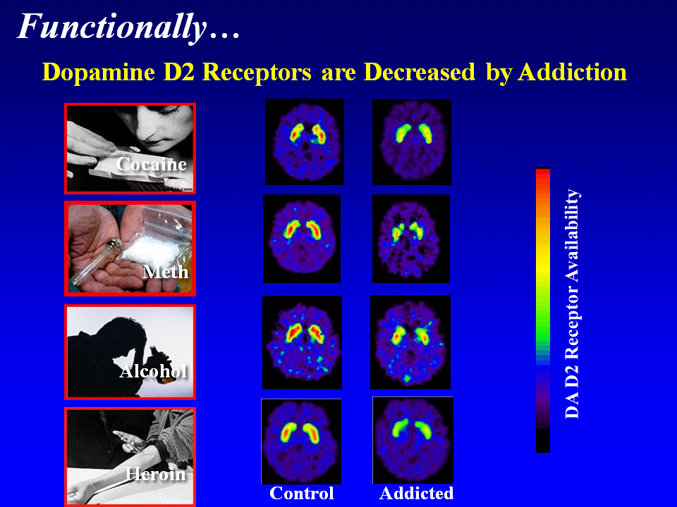

Slide 16
Genetics and addiction
Susceptibility model – tries to explain why some substance users develop addiction while others do not
General heritability about 25% in mild drinking and 35% in heavy drinking (heritability estimates degree of variation of phenotypic trait in population)
Twin studies – strong genetic factor especially in males (almost no effect in females) and especially if alcoholism started before age 20 (little effect for later life)
In other drugs – the strongest influence of genetic factor in heroin (more than 50%), in other drugs similar to alcoholism (between 25-33%).
Huge discrepancy in studies, e.g. women are massively under-researched

Slide 17
Genetics and addiction
Genes and environment determine addiction together
Inherited characteristic is a predisposition/risk factor, not a disease itself – addiction is a complex phenomenon with no single one determining factor
Research on genetics of addiction is not to push people back and feel miserable of unchangeable. It is for better treatment and prevention

Slide 18
Genetics and addiction
Candidate gene studies – they try to find the concrete gene that is associated with the disease
Difficult to find such gene – many possible candidates and often contradicting results
Uncertainty about how much unique impact these genes have

Slide 19
Reward-deficiency syndrome
Kenneth Blum
People with DRD2-A1 allele gene form (older variant) of D2 dopamine receptors are at higher risk of addictions.
30% of white population – they have up to 40% less dopamine D2 receptors
Feel less reward from normal activities – need stronger impulse
Feel more negative emotions and anxiety – take drugs to relief from negative states of mind

Slide 20
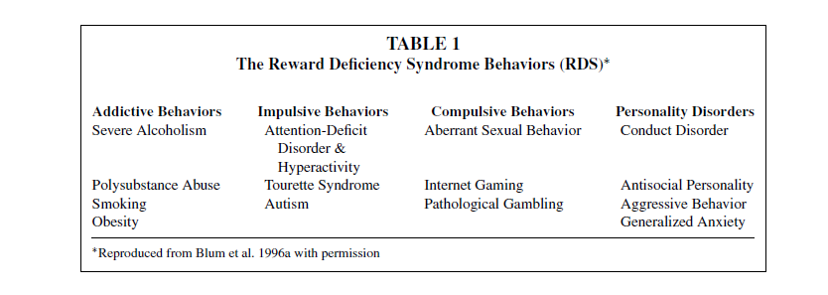
Reward-deficiency syndrome

Slide 21
Evolution and addiction
Mismatch hypothesis
Addiction is a by-product of our brain structure
Reward system has significant evolutionary advantage, however, it brings susceptibility when high-dopamine sources become vastly available
High-dopamine society – humans have much stronger dopamine system than other primates. That probably evolved with increased consumption of meat and fish oil. Higher levels of dopamine in reward system increased our activity, motivation, orientation to goals, intelligence. People with lower dopamine functions (reward deficiency syndrome) have higher chance to misuse high dopamine sources

Slide 22
Evolution and addiction
Mutualism hypothesis – plant-herbivore coevolution
Mammals have a long history of drugs-in-plants preference
Humans have preferences to ethanol (fermented in fallen fruits)
Humans have preferences to consume toxins in plants (e.g. nicotine, caffeine) as they were useful against parasites and bacteria

Slide 23
Evolution and addiction
Life-history theory
Clear demographic pattern – males in their teenage and twenties are by far the most susceptible group
The same group is also at risk of risk-taking, violence, sensation-seeking,… - product of sexual selection – young male syndrome
Substance use and abuse is part of general risk-taking behaviours
Both risk taking and addictive behaviours decrease after mid 30s and after the person settles down
Higher risk taking is evolutionary effective in certain scenarios (e.g. during migration). Quantity vs quality investment strategy

