Slide 1
ENVIRONMENTAL BASIS OF ADDICTION
PSY292
ADDICTION

Slide 2
Addiction as rational choice
Taken from economic theory – addictive behaviours are consumer behaviour
We do things because they bring some benefits. We know about the negatives, but benefits out-weight them
Cost-benefit analysis
Weighting benefits (pleasure) and costs (e.g. money, legal consequences, health consequences). In stressful times, benefits of drugs are getting higher. Why are some substances much more often used? – their costs are not that high (it is legal, health effects only slowly accumulates over time,…).
Assumptions are rather vague. Detailed analysis (e.g. using mathematic formulas) usually wrong. E.g. theory predicts older people to be more involved in addictions, but it is the opposite

Slide 3
Why do we engage in addictive behaviours?
Improve social interaction
Improved physical & sexual appearance
Improved cognitive performance
Improved sexual performance
Improved self-esteem and feelings of self-worth
Coping with stress
Pleasure-seeking
Sensation & novelty seeking
Overcoming boredom
Reduce psychiatric symptoms
And others…

Slide 4
I prefer my life of a drinker
To outsiders, it may seem out-of-control, but the person prefers the life that way. Person is happier with the drug than he/she would be without it.
We imagine alternative life for the addict but the addict imagines different alternative for him/herself
Language and discourse used by addicts serves some function (addiction vocabulary used for psychologist, family members, but totally different language among other addicts)

Slide 5
Diffusion and epidemic model of addiction
Diffusion follows rules of imitation – inferiors imitate the superiors (trickle-down effect). E.g. lower class adopts behaviour of higher class; role-models show trends
Epidemic follows rules of other (natural) epidemics. Spread of addiction through social proximity - via families, neighbourhoods, friendships, schools, workplaces, prisons
Urban hierarchy – usually goes from large cities to smaller towns and to countryside via the most frequent used means of transportation

Slide 6
Societal risk factors
Families – genetics, parental neglect & abuse, impaired attachment styles, modelling behaviors, parental approval
Intimate relationships paradox - addictive behaviors often appear in both but being in a relationship is one of the main protective factors
Gender – addiction associated with a traditional gender role in men but also with non-traditional gender roles in women.
Environmental factors stronger in women while genetic factor stronger in men. Women have much lower chance of becoming addicted, their addiction tends to develop later but has faster progression and is more frequently associated with affective dysregulation
Being a parent is a protective factor in women but not in men

Slide 7
Societal risk factors
Peer influence is very powerful, especially in adolescence but also later in life
In adolescent the reason is to gain better position within group hierarchy, to socialize, to be more confident in establishing romantic relationships, to decrease anxiety in general
In later life stages the peer influence is more associated with mere availability of the substance and attitudes (norms)
Normative substance use – each group has some unwritten rules what is considered as normal. Addicted people often think that the norm is higher that it actually is - e.g. that others drink as much as themselves
Normative feedback (peer disapproaval) can be used for prevention and interventions

Slide 8
Societal risk factors
Ethnicity – addictions and addictive behaviours are much more common in ethic minorities
Reasons: cultural background, genetic susceptibility, more frequent poverty, discrimination and stress
Critical sociology – addictive behaviours are more frequently and more severely sanctioned when it is in minorities, youngsters, poor, lower socio-economical status – those that have less power within the society
The major society (that in charge) has power to label what is legal and what is illicit, what should be punished, what should be treated and even what research to support
Availability of the drug is necessary condition for addiction however many negative effects come only because the drug is not available. Difficult question – should be substances that are now considered as illicit available (under certain conditions)?

Slide 9
Social developmental model
Originated in criminology
Explains the origins and development of delinquent behavior during childhood and adolescence
children adopt the beliefs and behavioral patterns within 4 social units - family, community (neighborhood), school, peer groups. If the social unit has prosocial attitudes, then the child adopts a prosocial orientation; if the social unit is antisocial, then the child often manifests problem behavior
Positive socialization is achieved when youths have the opportunity within each unit to be involved in conforming activities, when they develop skills necessary to be successfully involved, and when those with whom they interact consistently reward desired behaviors.
These conditions should increase attachment to others, commitment to conforming behavior, and belief in the conventional order. These social bonds to conventional society prevent delinquent behavior.

Slide 10
Social developmental model
Individual risk and protective factors (e.g. cognitive and emotional regulatory abilities) out-weights the social factors
Risk factors out-weights the protective factors
From social factors, peer influence brings the biggest risks, especially in early initiation. The biggest protective factor comes from combination of well/functioning family and good individual predisposition
Family and community are relatively more important in childhood and early adolescence; school and peers are relatively more important in mid- and late adolescence

Slide 11
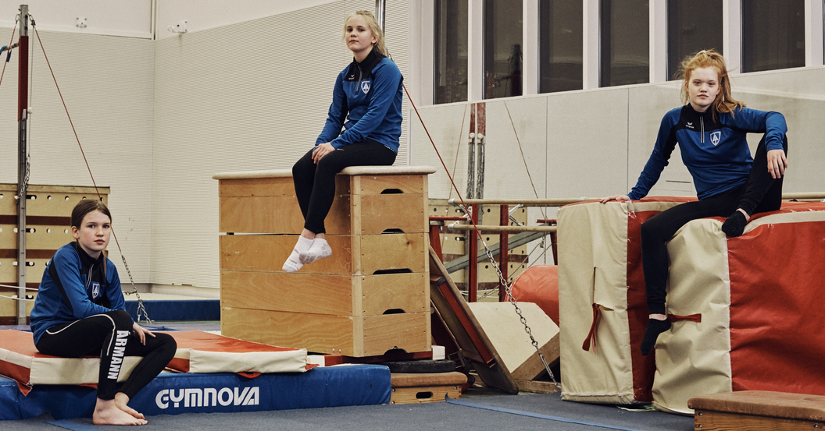
https://mosaicscience.com/story/iceland-prevent-teen-substance-abuse

Slide 12
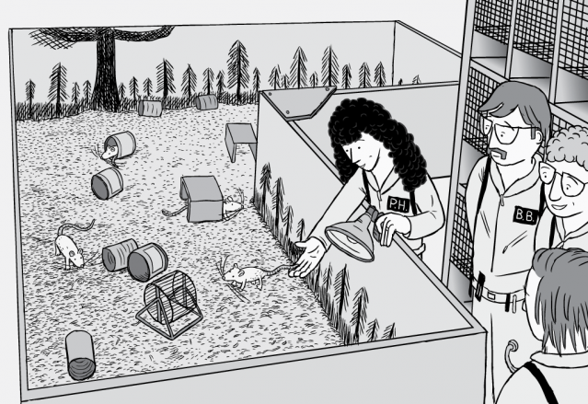
https://www.youtube.com/watch?v=ao8L-0nSYzg
https://www.psychologytoday.com/us/blog/all-about-addiction/201508/addiction-connection-and-the-rat-park-study

