Slide 1
HALLUCINOGENS
ADDICTION

Slide 2
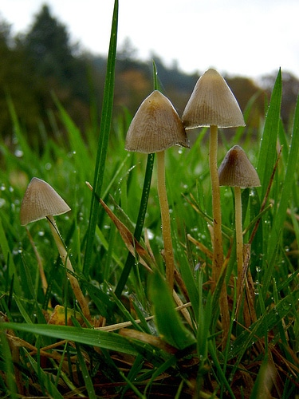
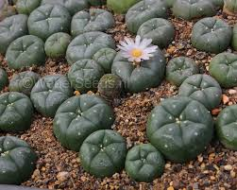
Tryptamines – Psilocin in psilocybe mushrooms; Ayahuasca
Lysergic acid – LSD – synthesized from alkaloids of ergot fungus (discovered in 1930s by Albert Hofmann, at first used as a freely accessible drug. Tested in 1950-60s for military potential military use and consequently made illicit in 70s)
Phenylalkylamines – Mescaline in Peyote
All these are alkaloids found naturally in some plants
All are serotonin agonists although precise way of function is not completely understood

Slide 3
effects
Physiological
they are safe as their effect is caused by very small doses that do not threaten physical health (e.g. orally administered LSD on blotters of paper that has 50-150 micrograms of the substance)
Short term effect include dizziness, weakness, tremors, nausea, blurred vision
LSD influences sympathetic system - increased hearth rate, slight fever
Psychological
All psychedelic drug changes perception and cognition
Massively context and expectancy dependent effects. Right mental set and environmental setting is absolutely crucial – have positive and supportive background (trip sitters) and have a positive mood
Merges consciousness and subconsciousness – hidden and suppressed hopes, fears, moods,… are magnified

Slide 4
effects
Positive effects
mental and physical stimulation, mood lift
sensory enhancement (taste, smell, visuals, etc), closed- and open-eye visuals, including trails, colour shifts, brightening, etc., feelings of flying
Profound life-changing spiritual experiences or personal revelations
therapeutic psychological reflection – can help even to treat addictions
feeling of oceanic connectedness to the universe; blurring of boundaries between self and other
Negative
anxiety, paranoia, fear, and panic – most hallucinogens can produce schizophrenia like states of mind
dissolved sense of self
delusions, delusional thinking, unwanted or unexpected life-changing spiritual experiences or personal revelations
insomnia
unwanted and overwhelming feelings
Flashbacks

Slide 5
addiction
No addiction as hallucinogens do not have any effect on dopamine levels in reward circuits (except for MDMA, cannabis, ketamine)
No physical dependency
No withdrawal symptoms
But hallucinogens users are often multi-drug users and thus are sometimes addicted to other drugs
No deaths report because of overdose
Overdose may happened and had destructive effect on psyche – hallucination flashbacks returning the whole life
No physiological or psychological addiction and dependency
Short-term tolerance – e.g. three LSD papers taken within a week have no effect

Slide 6
Risk factors
Hallucinogens are rarely drug of the first choice
Average age of the fist intake is higher (above 20) – except for MDMA that is about 16.
Data about problems associated with taking hallucinogens are often data on MDMA only - typically problems resulting from substance impurities, combination with other substances (alcohol), dehydration
High association with personality disorders – antisocial, paranoid, histrionic, schizoid (in this order) and potential link with psychosis
Link with suicidality, common accidents while on trip
Because of the polydrug use, it is hard to attribute the negative effect to specifically to hallucinogens
Since the prevalence of use is very low, hallucinogens are often listed together with „hard“ illicit drugs which spreads unnecessary bad reputation
Positive use of these substances are promising for use in therapy – PSD, depression, addictions

Slide 7
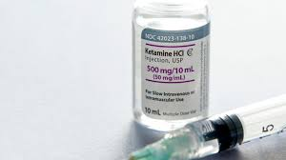
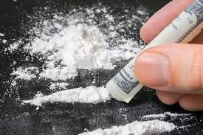
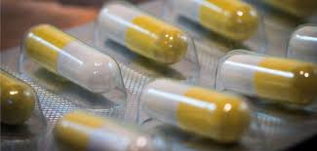
Illicit drugs with hallucination properties
Cannabis
MDMA
Dissociative anaesthetics - ketamine

Slide 8
KETAMINE
dissociative anaesthetic with analgesic and amnestic properties (dissociative = produce feelings of detachment from the self and the environment)
Used for medical (especially emergency, surgery, pain management) and veterinary purposes since 60s. Sometimes used as unofficial antidepressant and anti-asthma. As a drug used since 80s.
Used as a pill, liquid, powder, solution in injections
Effects are very similar to other hallucinogens
Extra psychological effect – tantra-like sexual feeling; passivity; lethargy
Extra physiological effect – relaxes muscles (especially of rectum)

Slide 9
Addiction and risks
Ketamine can be addictive – confirmed also from animal studies
Overdose has been reported (ketamine does not have know overdose reversal agent)
Withdrawal symptoms include anxiety attacks, palpitations, shaking
Most risk comes from the setting – danger of accidents, injuries
Spreading of transmitted diseases
Risk of rape and use in sexual slavery
Ketamine is usually found at the same places as MDMA

