Slide 1
Consumption as ethical/non-ethical activity; consumerism, moral discourses on consumption
SAN266, Week 12

Slide 2
question
How is consumption connected to values of Modernity?

Slide 3
Modernity
Consumption is related to values of modernity and democracy:
Is constructed as private and individual – personal choice; consumer is an individual doing rational decisions and fulfilling his/her needs
Consumer is citizen; consumption is an activity related to rights and responsibilities => this leads to specific ethics
Ulrich Beck (1997): „if modernity is a democracy oriented towards producers, late modernity is a democracy oriented towards consumers“

Slide 4
Consumer as a citizen with rights
Since the beginning of 20th cent. organisations fighting for the rights of consumers, increase from WWII
Sovereignity of consumer, aim of consumption is individual satisfaction
Rights of consumers
Right for safety
Right for information
Right to choose
Right to be heard

Slide 5
Consumer as citizen; Consumer as a political person
Right to intervene and have impact on capitalism
1. ½ 20th Cent.– USA – Main consumption narrative is related to citizenship– consumer is citizen (not client or costumer)
National Consumer Leagues, Progressive Movement, Ligue Sociale d’Acheteurs, consumer cooperatives
Endeavour to impact working conditions of worker. White lists. “Consumer has duty to act“
Connection of consumption and production; role of gender – female societies, housewives intervening in previously male spheres.

Slide 6
Work in couples
Describe macdonalisation

Slide 7
Context
Sassateli: globalised rationality + American cultural hegemony (McDonaldization) create space for various local resitences
Spread of inexpensive fast-food – reaction is support of local „traditional“, natural food; related to sustainable development; vegetarianism, slow-food, protests again McDon.
Harrison: 7 external factors increasing consumption of ethical goods – 1. globalization of markets and weakening of national states, 2. growing number of transnational companies, 3. growing number of groups creating competition, 4. consequences of technological inovations for society and environment, 5. stress on consumers on the market, 6. efficiency of market competition, 7. growing importance of movements stressing social responsibility (Harrison, Newholm, Shaw, 2005. The ethical consumer)

Slide 8
Ethical consumption
From consumer choice to consumer souverenity, from right to action; Consumer is active / consumption is activity with social consequences; choice is power
Ethical consumption: Can shopping change world or fight poverty/capitalism/materialism? – Questions of environment, redistribution and separation of production and consumption
Not abandoning consumerism, reevaluation how to consume: ‘make a difference with every cup’ of coffee.’ Fairtrade activist Laure Waridel in Coffee with Pleasure

Slide 9
Work in couples
1.
Can shopping change world or fight poverty/capitalism/materialism?
Discuss your opinion
2. Why do people engage in ethical consumption

Slide 10
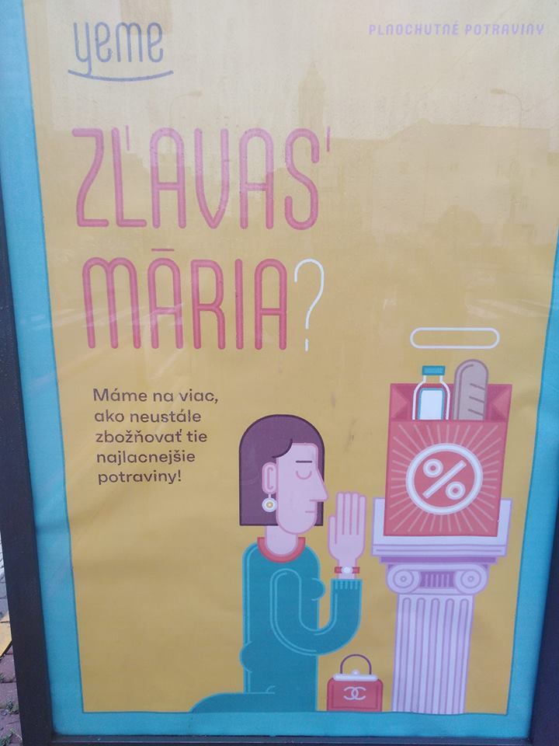
Motivation for ethical consumption
Question of motivation;
from private economic hedonist (Sassatelli) to alternative hedonist (Soper)
moral conspicuous consumption; Ethical consumption as a status signifier

Slide 11
Ethical consumption
Negative (I do not buy something from ethical reason), positive (I buy something from ethical reason). The starting point is that we have a choice
Boycott – Boycotting non-ethical goods
Buycott – positive ethical purchase behavior; buying goods with ethical characteristics (green and fair)
Activism – lobbying, protest events, happenings
Alternative acquisition of sources - „exit“ consumer society– shoplifting, dumpster diving, gardening, Neighbourhood barters of products

Slide 12
Group work
1. describe what is fair trade

