Slide 1
Commodification and its consequences: Consumption and authenticity
SAN266, week2, February 27, 2018

Slide 2
Group work
What is commodity?
What is commodification?
Do you know any authors/works focusing on commodification or exchange of commodities? How they conceptualised commodities and exchange of commodities?

Slide 3
Gregory. Gifts and Commodities. 1982
Gift exchange (gift societies/economies):
Transfer: obligatory, unlimited by time (relationships last in time)
Transactors – mutually obliged and related or transfer creates rekat
Objects – inalienable (taonga)
Commodity exchange (commodity societies/economies):
Transfer: voluntary, time is limited by transaction
Transactors – unrelated, relation is defined and motivated by transaction
Objects – alienable, value is commercial

Slide 4
Gregory. Gifts and Commodities. 1982
Ideal types of exchange and of societies -> Form of transaction is characteristic for a type of society and social relations
Gift societies – clan-based, qualitative social relations, reproduction of social beings
Commodity societies – class/based (production), quatitative social relations, social reproduction of things

Slide 5
Critiques/expansions
James Carrier. 1995. Gifts and Commodities: Exchange and Western Capitalism since 1700:
Commodities are gifts
Arjun Appadurai. 1986. Social Life of Things; Kopytoff.1986. Cultural biography of things
The status of things changes in tournaments of value or during their biographies – things become commodities in the process of commodification and can be decomoditified.
Nicolas Thomas. Entangled objects. 1991
Things are promiscuous: they change their meaning and status as they move from context to context

Slide 6
Group work two:
The movie Gods must be crazy shows usual European preconception about first contact of non-capitalist societies with consumer goods. Watch beginning of the movie and describe how it depicts effect of consumer goods on non-capitalist society.
https://www.youtube.com/watch?v=PdmpofujRmc&list=PLI8IGY1FbP5259LiXrPa38nPjxfBGBH_4&index=10

Slide 7
Consumer culture and modernity
Don Slater: Consumer culture as the culture of modern West – related to activities, institutions and values defining western Modernity: choice, individualism, market relations
Romantization of no-Europeans as authentic; romantization of Europeans as only real heirs of industrial revolutions
In SAN:
Otherness (as object of the study of SAN) is constituted as unfragmented culture opposed to modernity
Modernity and social changed interpreted as a loss of authentic culture

Slide 8
Western myths on consumption
Consumption means a loss of authenticity
Consumption is an act of free choice
People have different attitude to consumption than to production, attitude to production is more superficial
Mass consumption related to increase in irrational desires replaced more utilitarian and rational relation to material culture
consumption is in opposition to production

Slide 9
Consumer culture and modernity
In SAN:
Otherness (as object of the study of SAN) is constituted as unfragmented culture opposed to modernity
Modernity and social changed interpreted as a loss of authentic culture

Slide 10
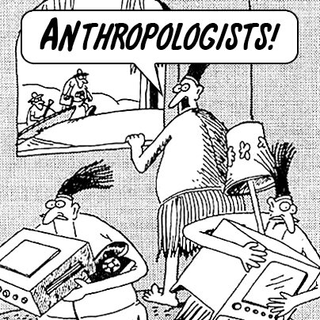
Antropologists are coming, hide TVs!

Slide 11
Consumption as a threat to authenticity
Anthropology until 1970’s ignoring consumption – chapters on social change
„social change“- consumption as a threat to the concept of culture
Interpretations of consumer goods:
Incorporation to cosmology, ideally through ritual (Carsten – money, Torren - Drinking cash, Miller – Christmas, Cargo cults)
Desctruction of cosmology – (Bohannan and Bohannan – spheres of echange at Tiv, Comaroff and Comaroff – Godly beasts, beastly goods)

Slide 12
Cargo
Cargo cults:
Millenarian movements first described in Melanesia, encompass a range of practices that will result in the appearance of material wealth, particularly highly desirable Western goods
https://www.youtube.com/watch?v=qmlYe2KS0-Y

Slide 13
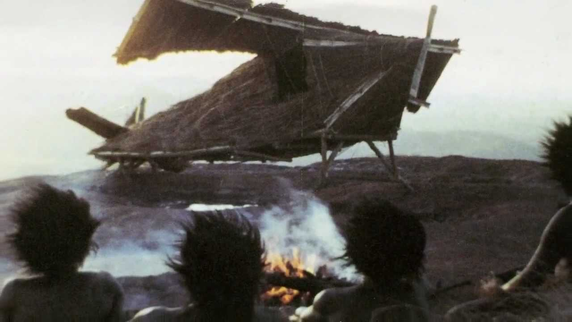
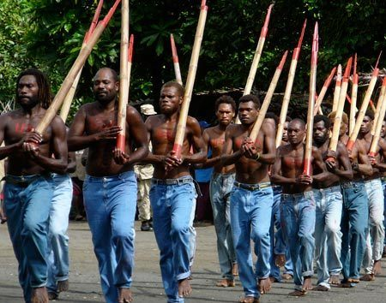
Cargo cults – Vanuatu, John Frum Army

Slide 14
Spheres of exchange
Bohannan and Bohannan. 1968. Tiv Economy.
Spheres of exchange: Goods and services belong to distinct value categories and can be exchanged only within the category (sphere of exchange) they belong to
Tiv: 3 spheres of exchange (subsistence goods, ritual and prestigious goods including slaves, people)

Slide 15
Important works
Marshall Sahlins. 1974. Original Affluent society
There is no natural desire to own goods or to own a lot. Against evolutionist hypothesis that free time evolves with affluence in late stages of social evolution
Nancy Munn. 1986. Fame of Gawa
Consumption is not utilitarian/functional
Marilyn Strathern. 1988. Gender of Gift.
Property and production are not neccesarily related

Slide 16
Daniel Miller
Daniel Miller. 1987. Material Culture and Mass Consumption
Focus on modern western society and consumption, consumption as creation of culture in capitalism
Daniel Miller (ed.). 1995. Acknowledging Consumption.
Research of consumption transforms anthropology as discipline
Global mass consumption means that people define themselves and their culture through commodities

Slide 17
Miller, Mintz, Tambiah etc.
Consumption is a means for creation of cultural forms. Creates modernity as heterogeneous praxis
Comaroff 1996:20 „culture is constructed through consumption“

