Slide 1
Acting things: agency
SOC 562, week 9, April 17th, 2019

Slide 2
Mauss – things and persons are culturally defined
MATERIAL TURN IN 1980’S
Appadurai (Social life of things, 1986): Objects are passive; they are recontextualised (commodified, decommodified); methodologically things in movement defined human and social world/context
Miller (Material Culture and Mass Consumption, 1987) things and subjects constitute each other in a dialectical process of objectification.

Slide 3
AGENCY
What things do rather than what they mean and how they are entangled with social relationships
Agency is „the socio-culturally mediated capacity to act.“ Laura Ahern (2001)
WORK IN GROUPS 1: Think of an example where agent/actor is not an individual human being.

Slide 4
Alfred Gell
Technology of Enchantment and the Enchantment of Technology. 1999. In Eric Hirsch (ed.) The Art of Anthropology. London: Atlone. 159-186.
WORK IN COUPLES
QUESTION 1: What is methodological philistinism? What is methodological philistinism? How does Gell use this concept?

Slide 5
Alfred Gell
Methodological philistinism
Art does not represent, art acts and do, has social effects
Gell x Bourdieu, Panofsky
WORK IN COUPLES
QUESTION 2: What is technology of enchantment?

Slide 6
Alfréd Gell, technology of enchantment
Art as technology of enchantment / canoe as a psychological weapon

Slide 7
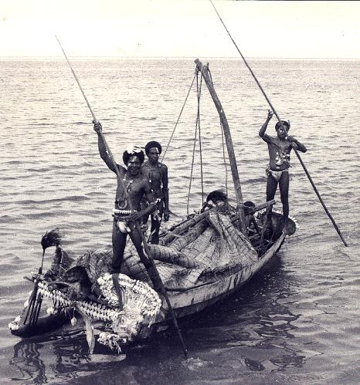
Trobriand canoe, kula
http://www.flickriver.com/photos/chaparralbrad/sets/72157621788001471/

Slide 8
Alfred Gell, enchantment of technology
Technology of enchantment depends on enchantment of technology
Enchanted technology, magic as a folk concept of agency
WORK IN COUPLES
QUESTION 3: What is enchantment of technology?

Slide 9
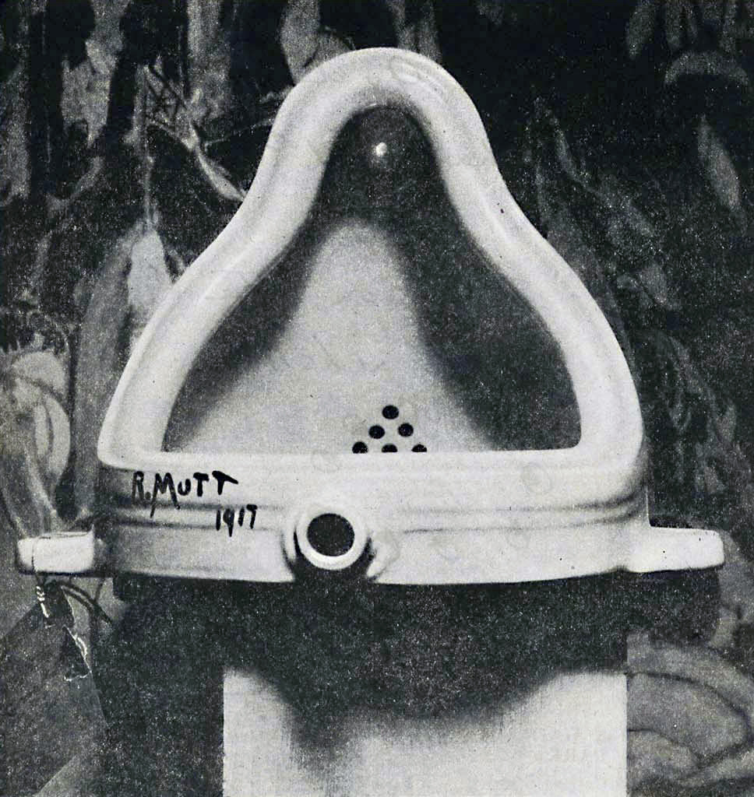
Picasso a Duchamp

Slide 10
Trobriand kanoe, Kula

Slide 11
Gell, Art and Agency: Anthropological Theory. 1998
Refusal of aesthetic theorz of art -> Art has practical meadiating role in social processes:
„the nature of art object is a function of social-relational matrix in which i tis embedded“ p.7.

Slide 12
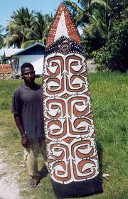
Asmat shields

Slide 13
Art and Agency
Patterns are interested for an art-historian. For a warrior the shield is weapon provoking fear
Shield is not effective because of its beauty, but because its effect - it is a social agent

Slide 14
Art and Agency
Social actor (a person, an object, collectivity) initiates causal sequences of certain type, events are caused by will, intention, they are not purely physical consequences
Things are created as a for of instrumental acting, they are supposed to influence thinking and acting of others.
Material objects embody complex intentions and mediate social agency

Slide 15
Art nexus
Artist is originator of index, primary social agent
Index - usually artefact, secondary social agent
Prototype - entity, represented by index (the king)
Index enables patient (recipient) to create causal inference related to abilities or intentions of artist
This operation is abduction of agency
Anthropology of art is anthropology dealing with situations containing indexes

Slide 16
Goya, Duke of Wellingtonu

Slide 17
Art and Agency
Theory of abduction – it is not causal inference, but inferred intentionality
Art achieves effects through distribution of agency of one subject to other subjects
Created product becomes distributed mind affected other minds
Objects have “secondary” agency: embodiment of human agency, we are inferring they contain it
Objects have effects AS objects / things with material qualities

Slide 18
Gell - Latour
Gell (1998:20-21) Latour (1999: 176-80) land mines:
Latour: hybrid agency, network
Gell: secondary agency.

Slide 19
Latour - ANT
Actor-network theory (ANT)
Extends the notion of agency beyond human actors – non-humans as well as humans can be actors.
Not bilateral relation between person and thing as in material culture studies, but networks of relations between various actors

Slide 20
Latour: US airforce acts, not B52, not a pilot, not a bomb

Slide 21
Latour - ANT
Laboratory Life: the Social Construction of Scientific Facts 1979
objects of scientific study are socially constructed within the laboratory
scientific activity as a system of beliefs and culturally specific practices—science is reconstructed not as a procedure or as a set of principles but as a culture

Slide 22
Latour - ANT
We Have Never Been Modern, 1991
Modernity makes a dualistic distinction between nature and society. Purification: an endeavor to keep nature and society; objects and subjects; politics, science and religion separated.
However, modernist distinction between nature and culture never really existed. Reality of the world consists of Hybridity: mixing of human and non-human agents, of politics, science and religion, we can not recognize separate elements

Slide 23
Latour - ANT
„The prime mover of an action becomes a new, distributed, and nested set of practices whose sum may be possible to add up but only if we respect the mediating role of all the actants mobilzed in the series.“ Latour 1999:181
“You discriminate between the human and the inhuman. I do not hold this bias but see only actors—some human, some nonhuman, some skilled, some unskilled - that exchange their properties”(Latour 1988: 303).

Slide 24
Latour - ANT
His concept of agency is a strategy against purification

