Slide 1
Biographies of things; things and human biographies: Social lives of things
SOC562, Week 2, 27. 2. 2019

Slide 2
Definitions of commodity:
Essentialist: defined as a type of object: a thing with use and exchange value; object produced for exchange (Marx)
Analytical: defined by form and function of exchange: An alienable object exchanged for its counter-value between otherwise unrelated people (Gregory, Carrier)
Kopytoff suggests processual definition. Summarize Kopytoff’s approach to commodity. What is the role of cultural biography of things in this approach?

Slide 3
Kopytoff – processual approach to commodification
if we want to understand whether when and how a thing becomes commodity, we have to look beyond individual transactions and beyond the Marxist thinking about use and exchange value.
Object are immersed in cognitive and cultural processes (moral economy defining their value and status) and their (non)commodity status is not stable
Methodological necessity to follow objects and their movement –things move in and out of various phases of being commodities and noncommodities in the process of commodification –decommodification - recomodiffication

Slide 4
Kopytoff – cultural biography of things
Methodological necessity to follow objects and their movement: As people, things have social lives and biographies
Sources and inspirations:
Inspired by biographical research in social sciences:
Based on a reasonable ammount of actual life-histories of people, it presents the range of biographical possibilities in the given society and examines how these possibilities are realised.
Mead: What is a successful social career of person? What is well-lived life? What departures of the ideal model are possible?
Genealogical models (e.g. Rivers) – kinship represented in ideal models of kinship diagrams. Rivers examines inheritance – rules and actual passing of objects

Slide 5

Kopytoff – cultural biography of things
Cultural biography of things as a method:
What are biographical possibilities inherent in the status of a thing in a particular period and culture? What does the thing come from? Who made it? What has been its career so far?
What is ideal career for such a thing? What are appropriate ages?
Paths and diversions
Cultural biography of a Zulu hats

Slide 6

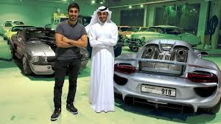
Biography of a car: a path

Slide 7

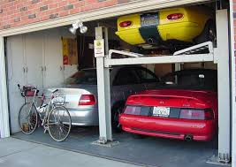



Biography of a car: a path

Slide 8
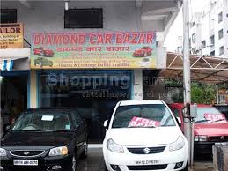
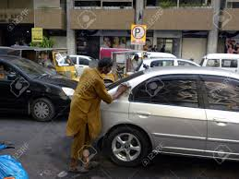

Biography of a car: a path

Slide 9


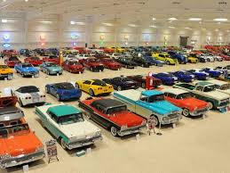
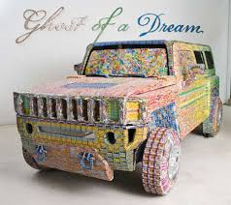
Biography of a car: diversions

Slide 10
Kopytoff – cultural biography of things
Enables us to understand commodification as a process (commodification – decommodification - recommodification)
Makes visible otherwise obscure meanings – redefinition of the meaning with the change of the context
Illuminating particular social context
Illuminating human biographies

Slide 11

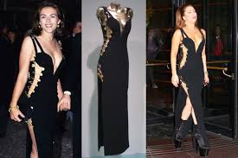
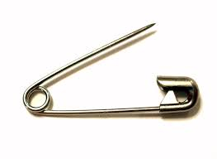
Cultural biography of thing
Hebdige, Dick (1979) Subculture: The Meaning of Style. London: Methuen & Co.
Hebdige, Dick (1988) Hiding in the Light: On Images and Things. New York: Routledge.

Slide 12
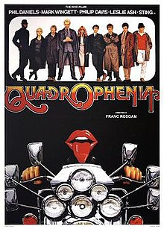
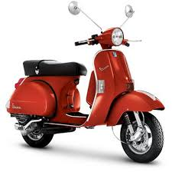
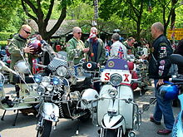
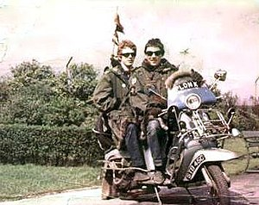
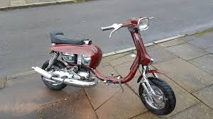
Cultural biography of thing

Slide 13
Biographies and things
Hoskins. J. 1998. Biographical objects.
Kodi, Western Sumba, Indonesia
It is not polite to ask about one’s life
Without the concept of telling the story of one’s life, but they do talk a lot about their material possessions
Biographical objects are personal possessions that serve as metaphors around which tellers organize their stories about the self.
Objects are biographical, she says, because they help
organize personal identity, giving it some of their unity and coherence.

Slide 14
Biographies and things
Jean Sébastien Marcoux. 2001. The Refurbishment of Memory. In Miller (ed.) Home Possessions.
what people bring with them when they move, what are the things that matter when the time to move comes, why they matter and how they come to matter
the things that people move with them are at the heart of the constitution of a memory which often resists displacements.
this memory is constituted throughout those displacements and how it is often transformed, altered and refurbished by the same token.

Slide 15
Biographies and things
Makovicky, Nicolette. 2007. Closet and Cabinet: Clutter as Cosmology. Home Cultures.
interiors as personal collections of objects and of memories, a space that was created by the members of the family
collection, ordering, display, and storage
The display speaks both of family propriety and domesticity, as well as the commemoration of past generations by mediating a generalized sense of past through the topological ordering of objects

