Slide 1
Things and cosmology: things as order
Week 6, 27th March 2019

Slide 2
Nancy Munn
Walbiri Iconography: Graphic Representation and Cultural Symbolism in a Central Australian Society. American Anthropologist 76(4): 914 - 915
Wallbiri - Australian aborigines, Central Australia, desert, small nomadic bands
Focus on iconography and symbolism
Forms of representation carried by men exclusively and women exclusively; Women: Sand stories; simple patterns (U-form, wave, line)
Men: initiation ritual Banba, appropriation of female reproductive power

Slide 3
Nancy Munn
the moral and the social order of the society are understood only as they are mapped out onto a cultural landscape which is naturalised by being mapped in turn onto the natural features of geographical landscape.
Importance of materiality in this process:
the properties of the landscape become of central importance; it provides the permanence, the authority, and the massivity which can legitimate the social world
Material forms provide a medium for present, transient and particular history to be subsumed under a large experience
past and present are absorbed into an infinite dreamtime

Slide 4
Nancy Munn
Focus on iconography and symbolism
Forms of representation carried by men exclusively and women exclusively

Slide 5
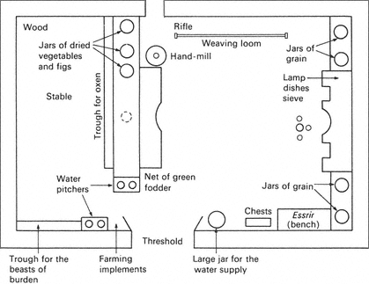
Pierre Bourdieu: Kabyl House
House as the space of objectification of generative schemes
Through habit and living every person builds a practical masterz of fundamental cultural schemes

Slide 6
Bourdieu, 1979 Distinction
Bourdieu, 1979 Distinction: A Social Critique of the Judgement of Taste
Kant, Critique of Judgement, 1790 – aesthetic (taste) judgements are individual and disinterested, based on formal qualities of object
Bourdieu: taste is not individual and is not disinterested

Slide 7
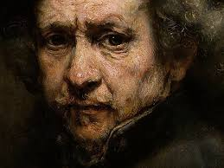
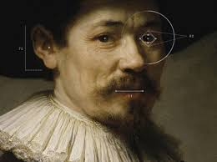
Bourdieu, 1979 Distinction

Slide 8
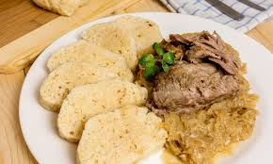
Bourdieu, 1979 Distinction
From art historian concept of culture (studying high arts) to anthropological concept of culture (studying way of life)
Social position defined by a combination of economic and cultural capital.

Slide 9
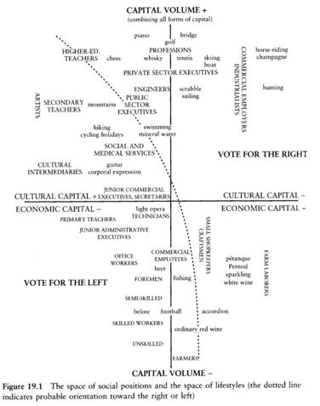
Bourdieu, 1979 Distinction

Slide 10
Bourdieu, Distinction- Habitus
„system of durable, transposable, dispositions, structured structures predisposed to function as structuring structures, that is, as principles which generated and organize practices and representations that can be objectively adapted to their goals without presupposing a conscious aiming at ends...“ Bourdieu, 1990, 53
Inscribed to bodies through previous experience (culture is not gloves, it is skin)
Unconscious
Individual habitus is in a homological relation to class habitus (defined by economic and cultural capital)
Individual habitus as creative tool of classification reproduces these forms of capital.

Slide 11
Bourdieu, Distinction- taste and symbolic power
Taste is subjective realization of habitus. Through taste habitus organizes consumption and lifestyle
Expressed in the language of individual preferences
„maries coulours and also people, who make „well-matched couples“, initially in regards to taste.“ Bourdieu, 1984, s. 243
Taste as symbolic power - Culture is a battlefield of class struggle:
Hierarchies of legitimity - Whose taste (in terms of class) will be considered legitimate
Hierarchies of hierarchies – whose test within dominant class will be legitimate (higher cultural or economic capital)

Slide 12
Bourdieu, 1979 Distinction
Distinction – key term
Meanings and usage of things is a tool for getting distinctions within the hierarchy of social relations.
Taste classifies classifier
Human experience and practice as mimesis and embodiment
Not a classification of objects, but classification of various structures of tastes and sets of expectations related to preferences of various groups of people
Differential distribution of social conditions

Slide 13
Critique
Too concentrated on cultural goods in terms of arts
Static, does not enable interpretation of change, economically reductionist
Romantisation of working class
Is not intersectionalist – does not think of gender, ethnicity, and age
Omnivores – higher classes consume goods of lower classes
Featherstone: Consumer Culture and Postmodernism
Habitus is static – is created during primary socialization
People have higher agency in consumption – they have to interpret and act their preferences in changing conditions. That changes their social positions, relations and lifestyles

Slide 14
Alison Clarke: Aesthetics of social aspiration (in Home Possessions, ed. by Miller)
Development of Bourdieu’s writing on both Distinction and Kabyl House
Taste preferences – related to social aspirations and imaginations of idealized future
Relationships and meanings change also in relation to aesthetic schemes.

