Slide 1
Consumption and identity, consumption and relations: How things make people
Week 8, 10th April 2019

Slide 2
Consumption and identity
Premise: Ability of objects to communicate social position
Not necessary through ownership – importance of distribution and circulation of goods for asserting status in some non-industrial societies (e.g. kula, potlach)
Consumption as an important status-signifier: concept of luxury goods in both non-industrial and industrial societies, taste as a class classifier in industrial societies (Veblen, Bourdieu).
Friedman, Jonathan (ed.). 2004. Consumption and Identity.
explicit connection between self-identification and consumption. The former may be a conscious act, a statement about the relation between self and world, or it may be a taken for granted aspect of everyday life, i.e. of a pre-defined and fully socialized identity.

Slide 3
Veblen. Theory of Leisure Class (1899)
Social status is measured by separation from everyday productive work.
Aim: visible distance from productive work
Conspicuous consumption and Leisure; Leisure does not mean passivity
Lifestyle is created in order to distinguish leisure class from productive classes (through consumption and leisure). In modern society it regulates relationships between classes
Objects are able to demonstrate status, because they are part of the lifestyle of groups with high status. Since goods can signify status, they can bee also the means of status competition.
Model of emulation– competitive mimicking of consumption patterns
Lower classes want to increase their status by mimicquing style of higher classes. Higher classes respond is a change of style
One of explanations of the dynamics of consumer culture

Slide 4
Veblen. Theory of Leisure Class
Critique of Veblen:
Reduces social motivation to envy and repetition – desire to be equal with these who have higher status.
Style is not only trickling down
Mechanistic view on hierarchies and their reproduction

Slide 5
Consumption and identity
Veblen: inspiration for:
Sociology of consumption, especially American
Consumers try to acquire things that can serve as positional goods – status symbols. Through acqusition and/or display of such goods they try to show or improve their position in social structure and confirm so social hierarchies and borders
This discourse changes with World of Goods and Distinction - > Objects as material means of social interaction and communication, as mechanism of social reproduction

Slide 6
Douglas, Isherwood 1979 World of goods
Inspired by Veblen
How objects define social position? Information approach to consumption
Social meaning is unstable. Consumption as a ritual activity creates visible public definitions of cultural categories and classifications
Consumption as a flow of information integrates people into meaningful world but creates also inequalities: poverty is not lack of possessions or wealth, but exclusion from the flow of informations
Meanings of things reflect pre-existing social reality. They are structured by society. This approach ignores the fact that social order is not only reflected but is also constituted, reproduced and changed through material praxis

Slide 7
Douglas, Isherwood 1979 World of goods
„ Rituals are conventions that set up visible public definitions.“
„consumption is a system of reciprocal rituals which entail expenditures for appropriate marking of the occasion, or of the guests and hosts, or the community at large.“
„Goods, in this perspective, are ritual adjuncts; consumption is a ritual process whose primary function is to make sense of the inchoate flux of events.“

Slide 8
Individual work
Summarise what you learned during the last lesson and answer:
How Bourdieu describes relation between consumption and social position?

Slide 9
Consumption and identity
Daniel Miller (ed.). 1995. Acknowledging Consumption.
The study of consumption transforms anthropology as a discipline
Global mass consumption leads to increase in definition of culture, ideas and selves through commodities
Gender, ethnicity, religion etc. expressed through commodities
Consumption as an important sphere for creating and expressing identities in postmodern societies.
Bauman (Liquid Modernity): Consumption as a means for creation of identity in postmodern society, identities are liquid – people can experiment with them, adopt and abandon them; consumption is an individualistic play with identities

Slide 10
Consumption and identity in postmodern society
Consumption and identity are related through lifestyle. Lifestyle is oriented around objects of consumption. Everyday routines of sociality:
Giddens: Consumption and identity are related through lifestyle; Everyday routines of sociality: „lifestyle is routine acting “; routines are embedded in everyday choices and practices of fashion, food, behaviour etc.; Routines (unlike Bourdieu’s habitus) can be changed
Slater: lifestyle does not correspond to traditional status differences and class differentiation, does not expect long socialization and learning. Is not stable, depends on consumer choices, cultural representations, signs and media. Voluntary – choice of identity; identity can be accepted and abandoned

Slide 11
Consumption and identity: example - gender
Jantzen, Ostergaard, Vieira: Becoming a woman to the backbone. Lingerie consumption and experience of feminine identity
Edndeavour to control the environment through the control over the body:
Foucault: technologies of subjectivation -> technologies for creation of self/person -> formalized sets of techniques leading individuals to correct management of their bodies
Right things for the right occassion on the right body; lingerie enables certain feeling, experience of the body

Slide 12
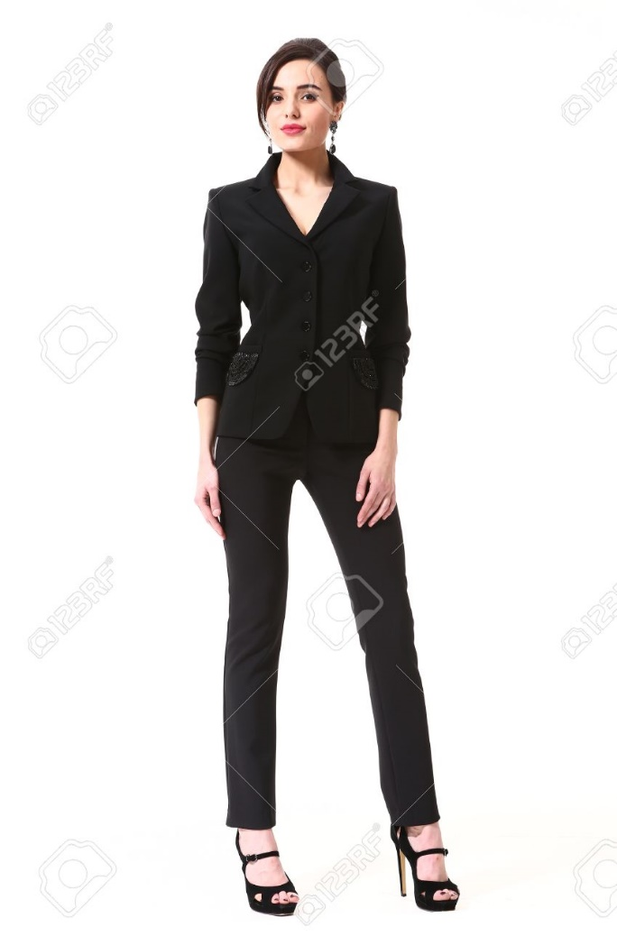
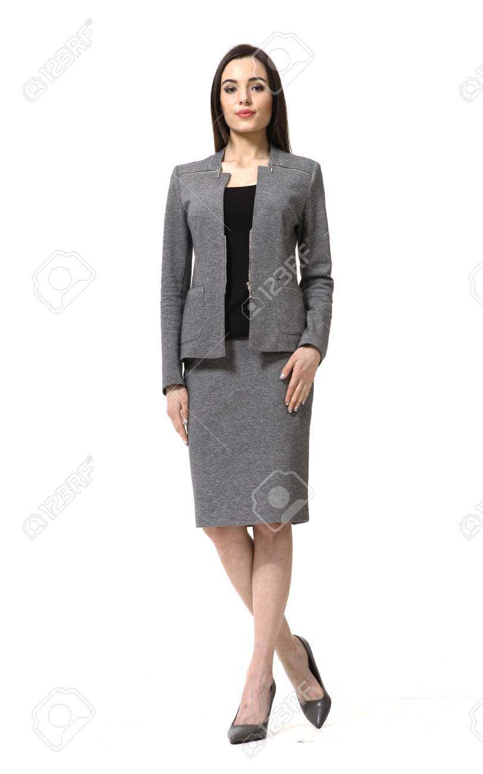
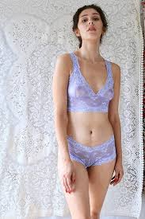
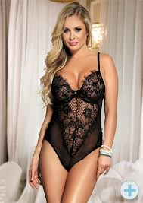
Power of invisible things

Slide 13
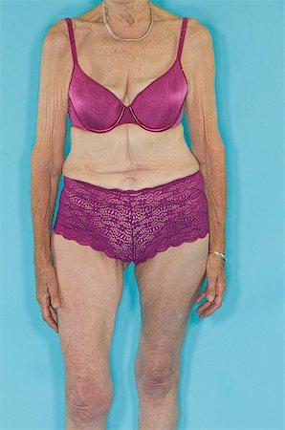
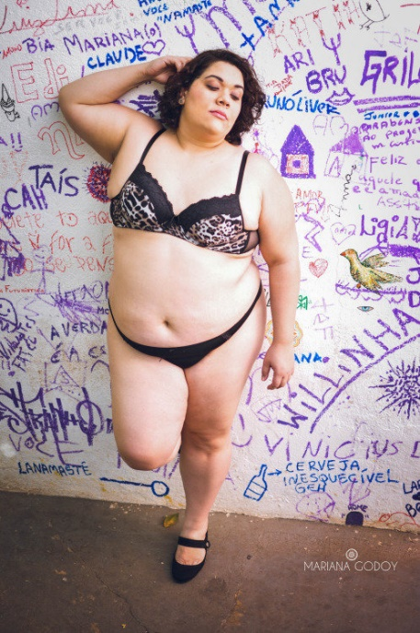
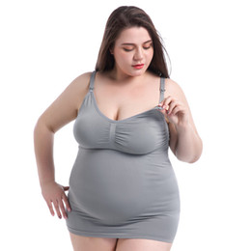
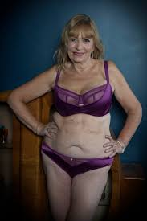
Importance of having right body

Slide 14
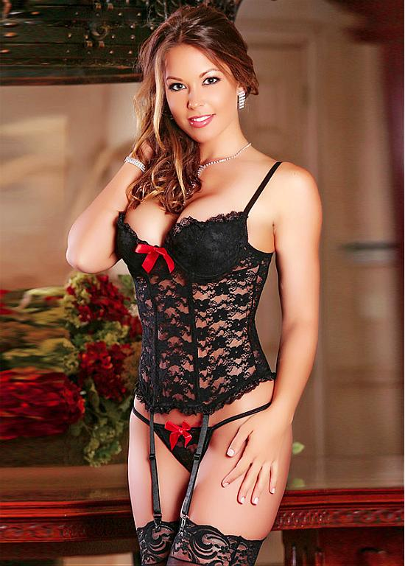
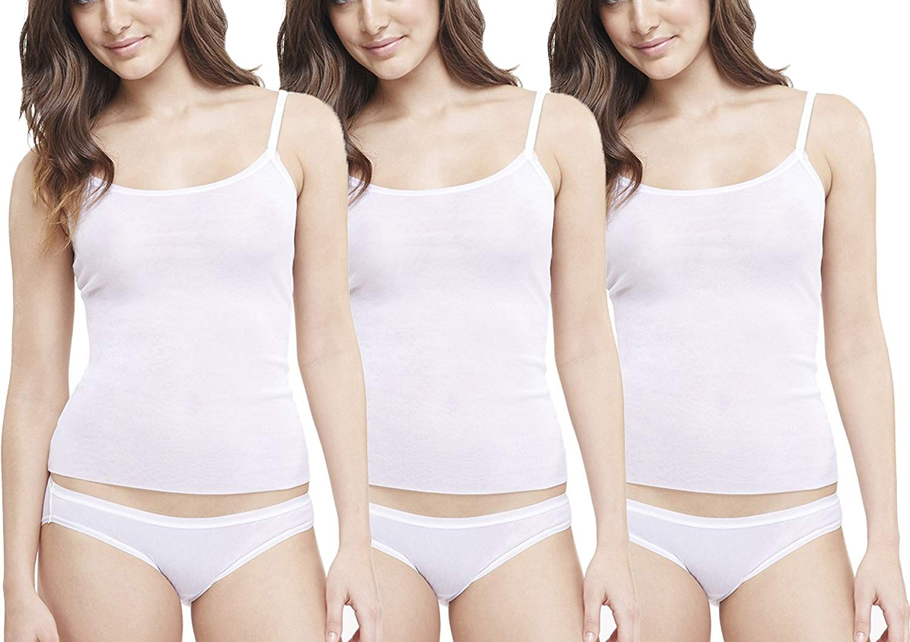
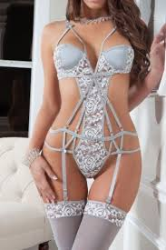
Harlot versus Madonna; courtesan versus housewife

Slide 15
Work in couples:
Describe (10 sentences) relation between consumption and identity in Layne’s work on pregnancy loss.

Slide 16
Consumption and relationships: objectification
Daniel Miller. 1987. Material Culture and Mass Consumption
Objects of consumption are key elements of culture – they are used in dialectic process of objectification and as such are means for creation of social meanings, identities and practices
The concept is inspired by Hegel, Marx, Simmel”, Bourdieu, and Munn
For Miller it does not make sense to analyse things on their own and social relations on their own: Culture „is always a process and is never reducible to either its object or its subject form“ p.11

Slide 17
Consumption and relationships: objectification
Mass culture as a dominant context for subject-object relation
„A theory of culture can have no independent subject, as neither individuals nor societies <subject> can be considered as its originators, since both are inseparable from culture itself <object>“
“Finally, the term objectification may be used to assert that the process of culture, which must always include self-alienation as a stage in its accomplishment, is thereby inherently contradictory.“ p. 33

Slide 18
Miller, Daniel. 1998. Theory of Shopping.
Consumption as a ritual practice
Consumption as destruction – opposite of production, TBC
Sacrifice – in archaic religions related to consumption. Idealised segment of production is given to Gods and cancels negative consequences;
Shopping and sacrifice – same structure

Slide 19
Shopping and sacrifice – same structure
Sacrifice
shopping
separates parts consumed by gods from parts consumed by people
Transcendental transformation leading to social order and relations. Sacrifice creates relationship to divine
spending changed to saving, thrift separated from treat
Transcendental transformation leading to social order and relations. shopping creates relationship to people -> making love in supermarket

Slide 20
Miller, Daniel. 1998. Theory of Shopping.
Shopping: Stages
1. Idea of excess connected with violent destruction – spending woman – discurse, not practice
2. Practice negating discourse – ritual of shopping – the aim is transcendence
3. Creation of relationhsip with other important subjects. Shopping as expression of love and other relationships

Slide 21
Work in groups
Prepare examples of:
Consumption expressing position in social hierarchy (e.g. class)
Consumption related to ethnic, gender or other group identity. You can think about social categories intersectionally
Consumption expressing self/relation: a Unique combination of personal characteristics and preferences
Consumption expressing/creating relation

