Slide 1
Culture Industry

Slide 2
Frankfurt School
The Institute for Social Research, part of the University of Frankfurt am Main, Germany
founded in 1924 and was devoted to the study of scientific Marxism
Theodor W. Adorno (philosopher, sociologist and musicologist)
Walter Benjamin (essayist and literary critic)
Herbert Marcuse (philosopher)
Max Horkheimer (philosopher, sociologist)
Erich Fromm (Freudian analyst )
Jürgen Habermas (philosopher and social theorist)

Slide 3
Frankfurt School
Main historical influences:
The failure of proletarian revolutions in Western Europe, and the successful 1917 revolution in Russia
The rise of European Fascism
Dominance of Monopoly Capitalism
“Critical theory” Critical of what?
Current social conditions to bring hidden structures to light
From political-economy determinism to mutual shaping among politics-economy-culture

Slide 4
Culture Industry
Adorno & Horkheimer
Movies and radio need no longer pretend to be art, The truth that they are just business is made into an ideology
Interested parties explain the culture industry in technological terms…No mention is made of the fact that the basis on which technology acquires power over society is greatest.
Use value -> Exchange Value
‘Genuine’ or ‘autonomous’ art VS the products of the culture industry (Standardization)

Slide 5
Adorno & Horkheimer
Culture Industry
Art can provide an alternate vision of reality
The radical character of autonomous art stems not from its content but from its form
Culture Industry - The triumph of instrumental reason over the role of culture
Standardized art does nothing to stimulate critical social reflection. Rather, it creates standardized responses.
Extinguishing the revolutionary potential of the masses, by providing relief from the stresses of life under capitalism through brief and surface level distractions
Culture Industry cements its audience to the status quo, and transforms culture itself into an ideological medium of domination

Slide 6
Walter Benjamin
“The Work of Art in the Age of Mechanical Reproduction” examined the connection between art and technology.
Aura is a “strange web of space and time” or “a distance as close as it can be.” Aura is associated with the traditional, nostalgic notions of artwork and is lost with the onset of photography.
Technical reproduction can put the copy of the original into situations which would be out of reach for the original itself.
The contemporary masses desire to bring things closer spatially and humanly, while uniqueness is rejected by accepting its reproduction.

Slide 7
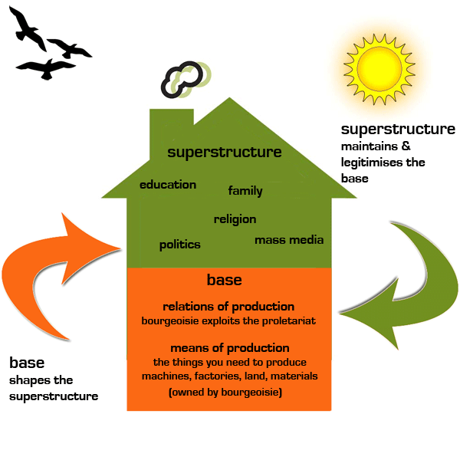
Antonio Gramsci
Bourgeoisie Civil Society
Hegemony and False Consciousness
The success of dominant classes in presenting their definition of reality, their view of the world, in such a way that it’s accepted by other classes as ‘common sense’.
The dominant ideology is designed to help those in power maintain their control over society
Coercive Control + Consensual Control
Hegemony is mobilised through civil society or cultural institutions such as: Education; church; family; and Media
COUNTER-Hegemony
Media as Tools for spreading and reinforcing the dominant hegemony => Sites of struggle, i.e., a place of competition between competing social forces.

Slide 8
http://www.pbs.org/wgbh/pages/frontline/shows/cool/view/

