Slide 1
Media Society and Culture

Slide 2
News media in a democratic society
Is supposed to
Report events objectively as they occur, to allow citizens to make informed political choices
Control governmental abuses of power, through investigative journalism
But, it is more like a Propaganda System
However, this control is remains invisible when the media are private and formal censorship is absent, portraying themselves as the voice of public

Slide 3
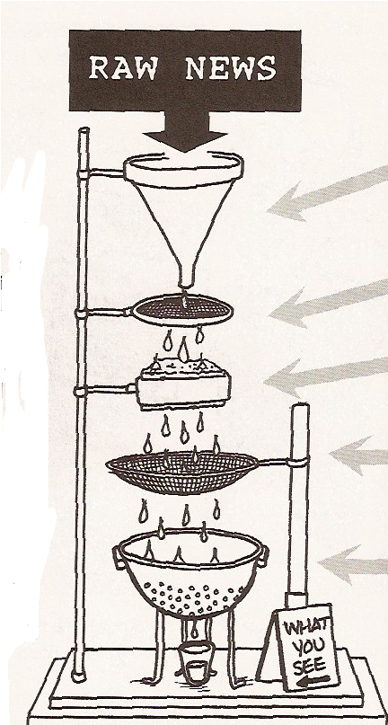
News Filters
Financial ownership
Funding through advertising
Reliance on PR
“Flak”
“Anti-communism”

Slide 4
News Filters
corporate ownership of the media (Own interests)
Financial reliance on advertising (Source of money, Business friendly)
Reliance on PR information provided by government and business (Limited source of news. Over-reliance on power eilites)
“Flak” as a means of disciplining the media (Law suits, petitions, complaints from interest groups/powers/businesses)
“anticommunism” (Anti-terrorism) as a control mechanism (Obedient audience. Controlled by fear)

Slide 5
Media on Politics
  Transmit political information from political actors to the public
  Gatekeeping
    Media makes decisions about what is news, and for how long
  Watchdog function
    Informal check in our political system
      Media allows the public to keep tabs on behavior of elected officials
  Expand scope of an issue
    More media attention leads to higher levels of public knowledge about issue
      This leads to more pressure on politicians

Slide 6
Rich Media Poor Democracy
Robert McChesney
Most of the news and entertainment available today comes from just a few massive entertainment corporations – function as virtual monopolies or oligopolies
A handful of media giants compete with one another for market share, but they all know their mutual survival is assured.

Slide 7
Media Industries
Main trends
  Corporate concentration
  Conglomeration
  Hypercommercialism
“…media system is an integral part of the capitalist political economy, and . . . this relationship has important and troubling implications for democracy.”
“The media system exists as it does because powerful interests have constructed it so that citizens will not be involved in the key policy decisions that have shaped it.”

Slide 8
Concentration
Conglomeration
“Concentrated media markets tend to be vastly less risky”
Horizontal integration has been common in media for a long time
  Low overhead
  Greater bargaining power
Vertical integration
  Synergy
  Deregulation
Cross-promotion and cross-selling
Merchandising
Branding

Slide 9
Hyper commercialism
spread of media conglomerates externally to new areas of social life
  Amusement parks
  Spectator sports
Commercialization of our childhood
  Commercialization of Life Experiences
Farewell to journalism
  Make journalism a profit center
  Breakdown of separation between advertising and editorial
  Lowering editorial standards
    Lifestyle, nightly horrors, fluff

Slide 10
Agenda setting
Experiment 1 – News stories about defense
  Group A: Stories about weakness in defense
  Group B: No stories about defense
  *** Group A participants much more likely to cite defense as a major problem facing nation
Experiment 2 – Various news stories
  Group A: Stories about defense
  Group B: Stories about pollution
  Group C: No added stories
  *** Participants cited defense, pollution, depending on what stories they were exposed to

Slide 11
Framing
The way that the media presents a story
Can affect who we blame for a particular problem, which affects how we think the government should respond
  Individual vs. societal frames
    Poverty experiment
    Those who were exposed to societal frames more likely to blame society for high poverty levels
      More likely to support welfare, food stamps, etc.
    Those who were exposed to individual frames more likely to blame individuals
      Oppose social welfare programs

Slide 12
Priming
Prominence of stories in the media can affect the standards by which we judge political leaders
  Bush overall approval rating – 71%
    Approval of handling of economy – 49%
    Approval of handling of taxes – 52%
    Approval of handling war in Iraq – 71%
  **Overwhelming coverage of the war is priming the public
    Evaluate Bush, they do so based on war, rather than economy or taxes

