Slide 1
MSC W 6 Re-presentation

Slide 2
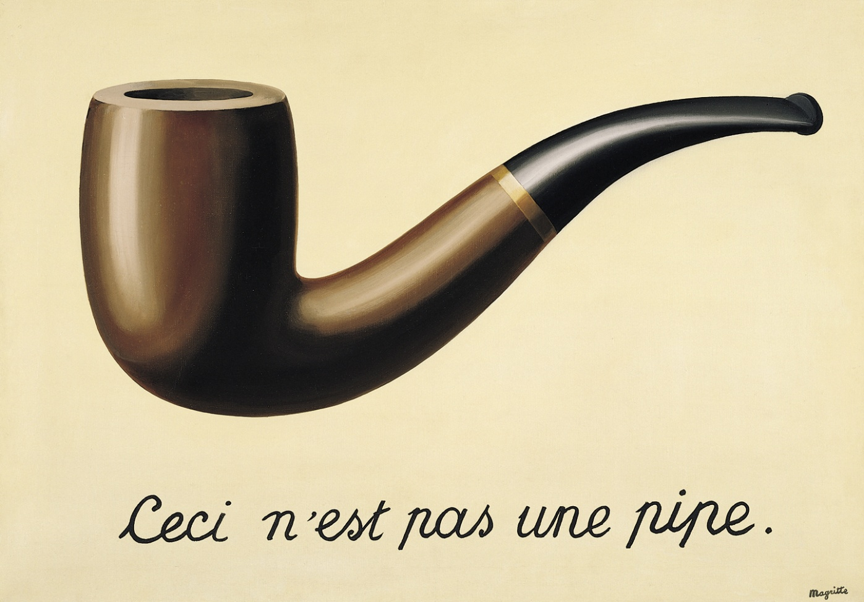
This is not a pipe

Slide 3
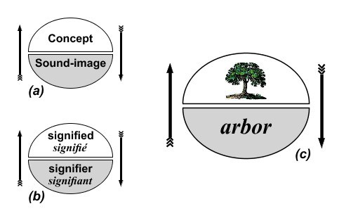
Semiotics
REpresentation
Saussurean Semiology

Slide 4
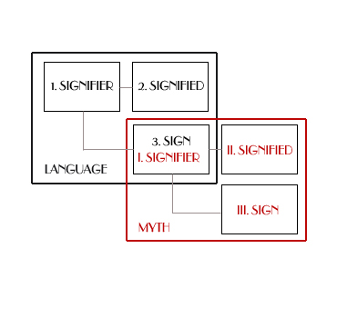
R. Barthes’s Myth
Repeating Representation
Myth Today
Myth - "mode of signification" -- myth.
Barthes argued that "since myth is a type of speech, everything can be a myth…. [And] it is conveyed by a discourse.” Myth is not defined by the object of its message, but by the way in which it utters this message
Second-order semiological system

Slide 5
Theory of Semiotics
a sign: anything which may be interpreted to ‘stand for’ (or substitute for) something.
a theory of sign-production: a theory of communication & a theory of ‘mentions’ & a theory of communicational acts.
A theory of communication: how information may be transmitted from a channel to a destination.
(Advertisement)
A theory of ‘mentions’: how signs may be used for naming things and for making statements about actual situations
(Housewife)
A theory of communicational acts: how a sender may transmit verbal or non-verbal messages to an addressee.
(Preparing Meals)
Semiotics: how codes may establish rules for systems of signification & how signs may be produced and interpreted
Emberto Eco

Slide 6
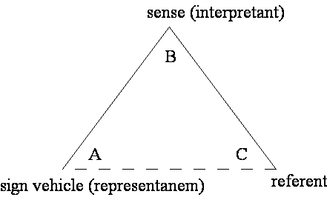
Pearcean Semiotics
We.
the Interpreter
The role of Interpretant
Interpretants: Immediate Interpretant
A general definitional understanding of the relationship between the sign and dynamic objects: Dynamic Interpretant
Effect actually produced on the mind: Final Interpretant

Slide 7
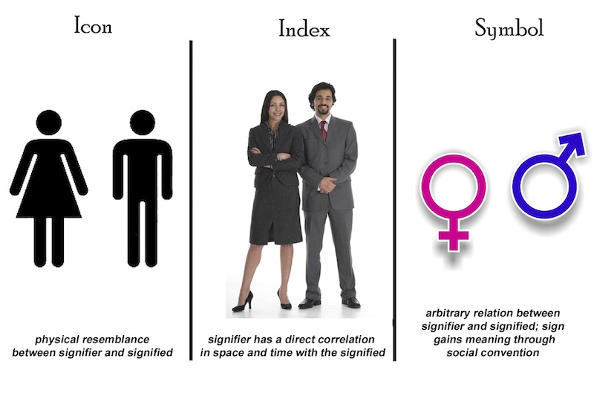
Peircean Semiotics

Slide 8
Stuart Hall
Representation
Based in neo Marxism, Hall is one of the founders of the British School of Cultural Studies.
Power consistently strives to fix meaning to support its agenda.
Individuals receive meaning, but remake it minute by minute.
Meaning is constantly changing.
Meaning cannot be fixed.
It is imperative to critically interrogate the meanings of media representations.

Slide 9
Stuart Hall‘s Cultural Studies
Stuart Hall doubts that social science can find useful answers to important questions about media influence;
For Hall the question is how does the media create support?
Cultural Studies is influenced by a Marxist interpretation of society, which is suspicious of any analysis that ignores power relationships
Cultural Studies wants to do more than interpret. It seeks to change things
It wants to empower people who are on the margins of society
the media maintain the dominance of those already in power--the media maintain the status quo;
That mainstream media research masks the struggle for power
Hall wishes to gain public place where the voices of the masses can be heard

Slide 10
Mediated Meanings
Words and other signs have no intrinsic meaning
Words don’t mean - people mean
Hall asks, “Where do people get their meanings?”
Hall’s answer: through communication and culture--through discourse;
Culture is concerned with the production and exchange of meanings

Slide 11
Representation “Skills”
Camera Work/Lighting: “Mass Media redesign information by replacing the vantage point of the viewer within the frame provided by a cameraperson/journalist photographer.”
Editing: Heroes are given more time and more shots.
Music: Heroes, Major key. Villians, Minor Key.
Casting: Actors cast to play heroes/villains are people whose appearance is encoded by our social codes.
Heroes are socially central types who embody the dominant ideology.
Urban Space
Repeating

Slide 12
Intertextuality & Performativity
Meaning of images/language in texts depends on knowledge of previous
texts
The meaning of intertextual links are constructed by viewers based on
their media knowledge
Gender is not something we are automatically born with, it is something we
continually “perform”
“Gender is the repeated stylization of the body, a set of repeated acts within
a highly rigid regulatory framework that congeal over time to produce the
appearance of substance, of a natural sort of being.” Judith Butler

Slide 13
