Slide 1
Introduction to Political Economy of Media
Media/Cultural Industries
Monika Metykova
Email: 32153@mail.muni.cz m.metykova@sussex.ac.uk
Notes:
*

Slide 2
Quiz
Which of these describes media as holding those in power to account?
1. bodyguards of democracy
2. watchdogs
True or false:
All EU member states have public service broadcasting fees that are paid directly to the public service broadcaster.
Notes:
*

Slide 3
Quiz continued
Can you think of three examples when journalists' independence is threatened? These can be from democratic or authoritarian countries.
True or false:
Political economists of the media focus on the current state of media systems, they do not think that their history is important.
Notes:
*

Slide 4
Media/Cultural Industries
Industrial production and circulation of texts (not restricted to written texts)
David Hesmondhalgh: The Cultural Industries:
Core cultural industries: broadcasting; film industries; content aspects of the Internet industry; music industries; print and electronic publishing; video and computer games; advertising and marketing
These interact/interconnect with each other in complex ways, mainly because they compete for the same resources: disposable consumer income; advertising revenue; consumption time; creative and technical labour
Notes:
*

Slide 5
Why study media/cultural industries?
Make and circulate texts that influence our understanding of the world (the effect is complex)
Manage and circulate creativity (are ‘symbol creators’ (Hesmondhalgh’s term) different? Geniuses? Responding to a higher calling? Or is it similar to other kinds of labour?)
Agents of economic, social and cultural change (and the contents/texts are a good indicator of this) etc.
Examples: 1950s US sitcom I Love Lucy and 1990s Friends
https://www.youtube.com/watch?v=doUYH3Uria4 https://www.youtube.com/watch?v=DqwzvtjeYBQ BBC Mr Tumbler
https://www.youtube.com/watch?v=Rpv_GpSUgz8
Notes:
*

Slide 6
Other reasons?
McQuail:
Activities of media are economic and political (political function of media in a democracy + information and ideas cannot acceptably be monopolized by private individuals – a public good)
As well as dependent on changing technologies of distribution
Alternatively: internal – media professional – point of view
Notes:
*

Slide 7
Public good vs. commercial enterprise
Emergence of radio
1922 British Broadcasting Corporation Ltd. founded
5 March 1926: Parliamentary Crawford Committee published its broadcasting report; termination of the British Broadcasting Company, Ltd. and creation of a Crown chartered, non-commercial British Broadcasting Corporation from 1927
Funded by a licence fee (compulsory radio licence until 1971), public good
public service broadcasting;1st general manager John Reith: educate, inform and entertain
vs. the United States – funding from advertising (soap opera – dramatic serials on radio sponsored by soap manufacturers: Procter&Gamble, Colgate-Palmolive, Lever Brothers)
Notes:
*

Slide 8
Task in small groups
In European countries public service media were present from the beginning. Do you have any ideas about what may happen to them in the future? (Especially considering technical developments such as on-demand video, free contents, competitors like Netflix etc.)
Notes:
*

Slide 9
Media economics
Media/cultural products have special characteristics:
Hybrid/mixed in terms of markets, product and technology (operate in a dual market, selling a product to consumers and a service/audience to advertisers; diversified products and technologies and organizational means for distribution)
High labour intensiveness and high fixed costs (although changing with new technologies and media expansion)
High degree of uncertainty (in terms of consumer evaluation – still difficult to predict audience tastes) and uniqueness of the product
Despite standardization media products can rarely be repeatedly sold in the same form
Media especially prone to concentration
Many media businesses are hard to enter without large capital resources
Media are affected by the public interest
Notes:
*

Slide 10
Task in small groups
Can you think about examples of television programmes that are expensive to produce and those that are cheap?
Notes:
*

Slide 11
News - a special kind of commodity
News – a double commodity
Advertisers and consumers are the news organization’s customers
Advertisers compete for public attention
McManus: What Kind of Commodity Is News? Communication Research 19(6), 1992.
Notes:
*

Slide 12
Notes:
*

Slide 13
Foreign news – expensive to produce
steady decrease in foreign news coverage
the decline of the foreign correspondent
http://www.ted.com/talks/alisa_miller_shares_the_news_about_the_news?language=en
Notes:
*

Slide 14
Media Standards Trust study 2010 Shrinking World
Coverage of foreign news in UK print
4 daily newspapers:
Daily Mirror
Daily Mail
Guardian
Telegraph
Notes:
*
Available at: http://mediastandardstrust.org/wp-content/uploads/downloads/2010/11/Shrinking-World-FINAL-VERSION.pdf
*

Slide 15
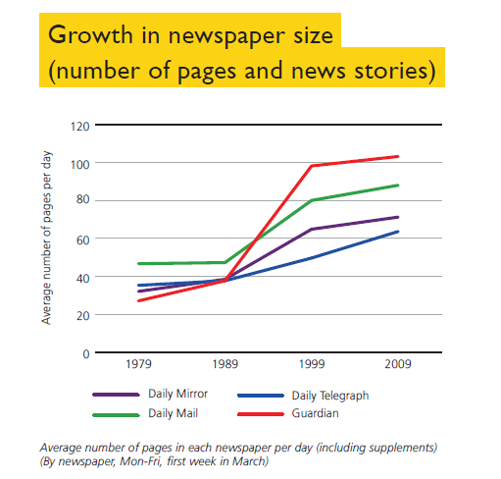
Notes:
*

Slide 16
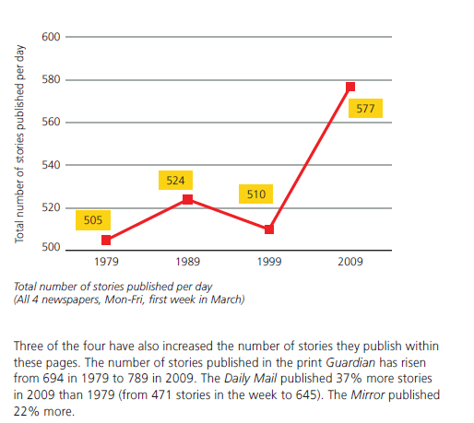
Notes:
*

Slide 17
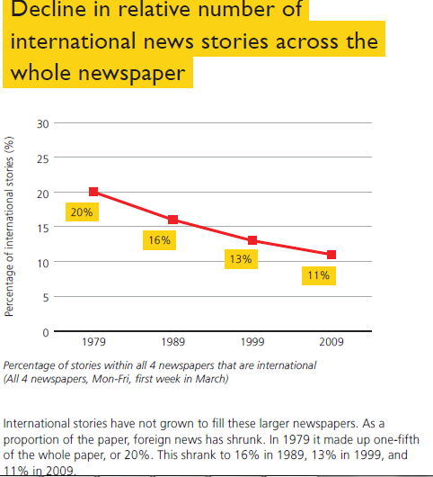
Notes:
*

Slide 18
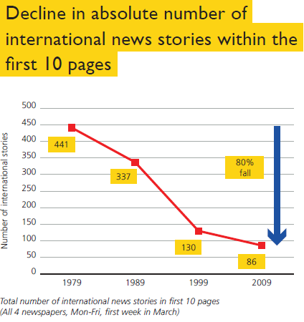
Notes:
*

Slide 19
Production, distribution and consumption of news is material
A 2015 New York Times article opened with:
Russian Ships Near Data Cables Are Too Close for U.S. Comfort
WASHINGTON — Russian submarines and spy ships are aggressively operating near the vital undersea cables that carry almost all global Internet communications, raising concerns among some American military and intelligence officials that the Russians might be planning to attack those lines in times of tension or conflict.
The issue goes beyond old worries during the Cold War that the Russians would tap into the cables — a task American intelligence agencies also mastered decades ago. The alarm today is deeper: The ultimate Russian hack on the United States could involve severing the fiber-optic cables at some of their hardest-to-access locations to halt the instant communications on which the West’s governments, economies and citizens have grown dependent.
(25 October 2015)
Notes:
*
*

