Slide 1
Globalization of News Industries: From the Telegraph to Al Jazeera
Monika Metykova
Email: m.metykova@sussex.ac.uk
32153@mail.muni.cz
Notes:
‹#›

Slide 2
What we've learnt so far
Political economy of media approach
Vincent Mosco: “political economy is the study of social relations, particularly the power relations, that mutually constitute the production, distribution, and consumption of resources, including communication resources”
Some representatives of this approach: Noam Chomsky, Edward Herman, Herbert Schiller, Vincent Mosco, Peter Golding, Graham Murdock, Ben Bagdikian, Robert McChesney, Janet Wasko
Notes:
‹#›

Slide 3
What we've learnt so far
Theories of the press
Models of journalism/media systems
Characteristics of media/cultural industries
Economic characteristics of media commodities:
Operate on a dual market; are affected by public interest; prone to market failure (e.g. concentration)
Mark Fowler, head of The Federal Communications Commission (US regulator)
“television is a toaster with pictures”
His program of deregulation has brought radical change to the industry, ranging from network takeovers to the rise of home shopping networks.
“In the Fowler era, broadcasting licenses, once rigorously monitored by the F.C.C.,
became commodities traded on the open market. Stations changed hands overnight
and then changed hands again in a flurry of speculation, profit-taking and -inevitably
- miscalculation and bankruptcy. The public interest, Mr. Fowler said, would be
determined by the ''public's interest.'' That is, if the public didn't like the way a
broadcaster was running a station, the enterprise would fail; the public didn't need
the Government's help. “
http://www.nytimes.com/1987/01/19/arts/under-fowler-fcc-treated-tv-as-commerce.html
Notes:
‹#›

Slide 4
What we've learnt so far
Advertising as a funding mechanism:
- ignores minority audiences, low-income groups and possibly results in low quality journalism
PSB vs. commercial broadcasters
- PSB – special roles in society and its independence from the market as well as the government is crucial
Notes:
‹#›

Slide 5
What we've learnt so far
Spatialization – time-space distanciation
Globalization – of media products, producers, audiences and also regulation – our focus today
Global village
https://www.youtube.com/watch?v=HeDnPP6ntic
Notes:
‹#›

Slide 6
Task in small groups
So what is globalization? And why has it become so “politicized” recently?

Slide 7
“A globalizing society?” By Allan Cochrane and Kathy Pain In David Held's A Globalizing World? Culture, Economic, Politics
Notes:
‹#›

Slide 8
What is Globalization?
Increasing changes and uncertainty in the world
Politics, cultures and economics are merging across boundaries
Notes:
‹#›

Slide 9
Example of the global software market
The nature of global change
-The centralization of power in the hands of just a few major organizations🡪 the notion of power as domination
-Advanced communication technologies have changed the spatial frames
-Big Corporations VS smaller companies
Notes:
‹#›

Slide 10
Homogenization of economy and culture
Significance of increased connectedness
Endless expansion of unregulated capitalist relations
‘Runaway World’ (Giddens)
http://www.bbc.co.uk/radio4/reith1999/
-Americanization/ Westernization
-Destroying local cultures
-e.g. Coca Cola, McDonalds
-a world of “winners” and “losers”
Notes:
‹#›

Slide 11
Social relations, economies, cultures and politics merging across nation-state boundaries
Influencing each other
Climate change—unregulated capitalist relations Worldwide concerns🡪seeking for consensus
Notes:
‹#›

Slide 12
What is Global about Globalization?
Jan Scholte's Globalization: A Critical Introduction
Globalization as:
Internationalization
Liberalization
Universalization
Westernization
Deterritorialization
“Globality (as supraterritoriality) describes circumstances where territorial space is substantially transcended”
“Within the domain of our planet, location, distance and borders place no insurmountable constraints on supraterritorial relations. In this sense the yare suitably called ‘global’ phenomena”.
Notes:
‹#›

Slide 13
Current trends in politics?
https://www.youtube.com/watch?v=TKvAKROiwk4
https://www.youtube.com/watch?v=1fEpScnNLfs&spfreload=5

Slide 14
Global players on local markets
Box office hits
Advertising companies
Private broadcasters
Notes:
‹#›

Slide 15
A task in small groups
Which were the most successful films of 2018 and how much did they earn in the box office in the US and CR? How does this compare to the most successful locally made films?

Slide 16
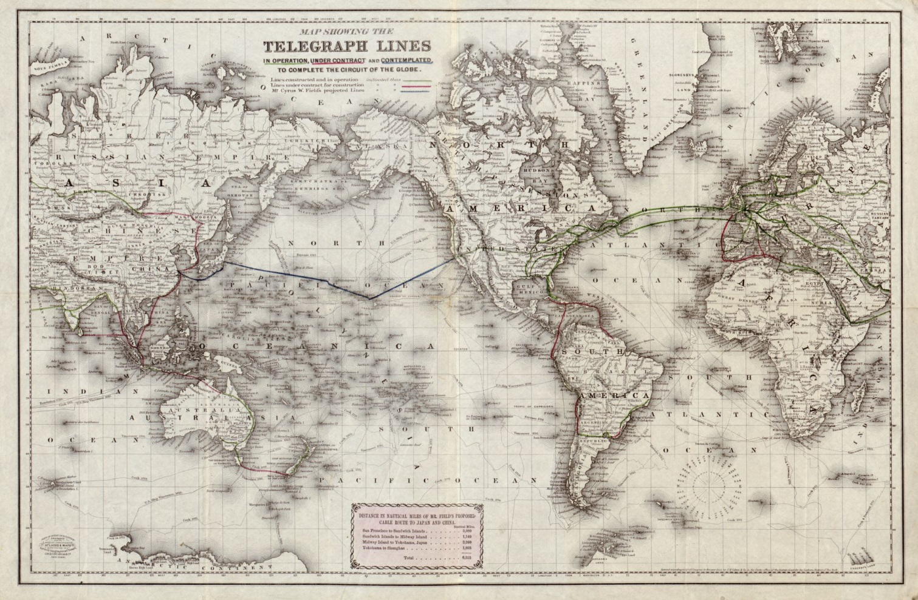
Inequalities in access to communication resources persist
Notes:
‹#›
http://knowmore.washingtonpost.com/2015/02/02/map-the-worlds-telegraph-lines-in-1871/
‹#›

Slide 17
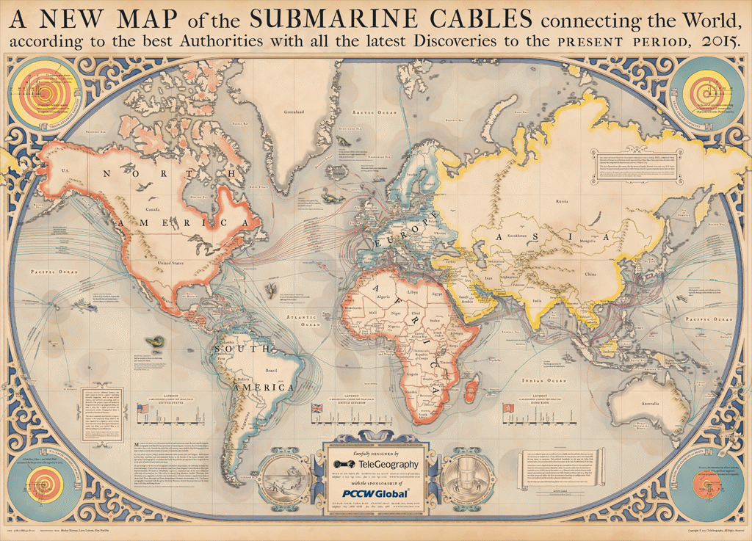
Notes:
‹#›
Source: https://www.telegeography.com/telecom-maps/submarine-cable-map/index.html
‹#›

Slide 18
Foreign news flows – a few bits from history
1953 UNESCO study:
Six telegraphic agencies can be classified as world agencies (came into being between 1835 and 1918): AFP (France; 1835), AP (USA; 1848), INS (International News Service, USA; 1909), Reuters (UK; 1851), TASS (USSR; 1918), UP (USA; 1907)
Notes:
‹#›
Source: News Agencies: Their Structure and Operation, UNESCO 1953 http://unesdoc.unesco.org/images/0007/000734/073446eo.pdf
‹#›

Slide 19
1970s – key in addressing imbalances in news
Five news agencies dominate globally:
AFP (France); AP (USA); Reuters (UK); TASS (Soviet Union); UPI (USA)
Notes:
‹#›
Source: The World of News Agencies; UNESCO working paper (undated)
‹#›

Slide 20
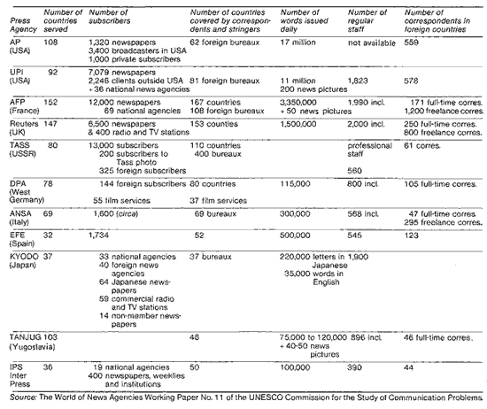
Notes:
‹#›

Slide 21
Others?
Non-aligned news pool (1970s – Yugoslav and other news agencies)
Inter Press Service (1960s Latin America)
Part of something much bigger – the NWICO (New World Information and Communication Order) discussions at UNECSO – mid-1970s and mid-1980s with the particular aim of addressing imbalances in media coverage; media influence but also issues related to technologies, protection of journalists etc.
MacBride Report:
http://unesdoc.unesco.org/images/0004/000400/040066eb.pdf
US withdrew its membership of UNESCO in 1984; with UK and Singapore following in 1985
Notes:
‹#›

Slide 22
The major players remain the same
1980s: the big four continue to dominate Reuters; UPI; AP and AFP
Not only scholarly interest (work of Oliver Boyd-Barrett) but also reported in general media:
A 1981 article in the New Internationalist:
Between them, the big four (Reuters, UPI, AP and AFP) send out 34 million words a day and provide 90 per cent of the entire foreign news output of the world's newspapers. The Third World, which represents over two-thirds of the world's population and area, accounts for only 25 per cent of reports from the four agencies. Since these agencies are based in the West, the major part of their news package is about events in the industrialised countries. Publisher of the Fiji Sun, Philip Harkness, complains about his editors being snowed under with British football results and other unusable material originating from the Western agencies. Running against the fast current of this broad river of news from the West is a trickle of information from the Third World which barely manages to reach the doors of the readers in New York, London or Paris. This counterflow from the developing countries is also controlled by the 'big four'. The exchange of news between the West and Asia is typical of the imbalance. AP sends out from New York to Asia an average of 90,000 words daily. In return AP takes in 19,000 words either from its correspondents or from the national news agencies of Asia. Reuters and UPI also send out four or five times more than they take from that continent. The news-gathering priorities of the news agencies are reflected in the postings of their own correspondents. Some 34 per cent are confined to the US while a further 28 per cent are based in European capitals. Only 17 per cent are in Asia and Australia, 11 per cent in Latin America, 6 per cent in the Middle East and 4 per cent in Africa. A reporter posted to Delhi is expected to cover events from Kabul in the west to Rangoon in the east - a land mass sprawling over five and a half million square kilometres.
http://newint.org/features/1981/06/01/four/
Notes:
‹#›

Slide 23
Which news are in the news flow?
Check two websites in your country – what countries are the news from on the home page?
Is there a world news section? What countries appear there?
Notes:
‹#›

Slide 24
The West still rules on the news market in the 1990s?
1990s – e.g. Kim and Barnett’s study The Determinants of International News Flow: A Network Analysis. Communication Research 23(3), 1996
Notes:
‹#›

Slide 25
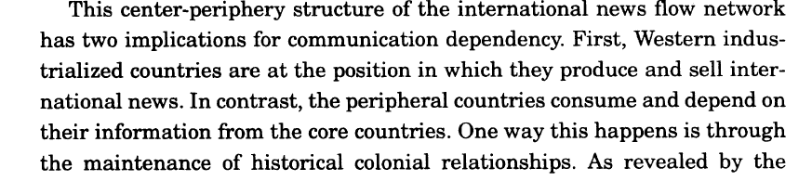
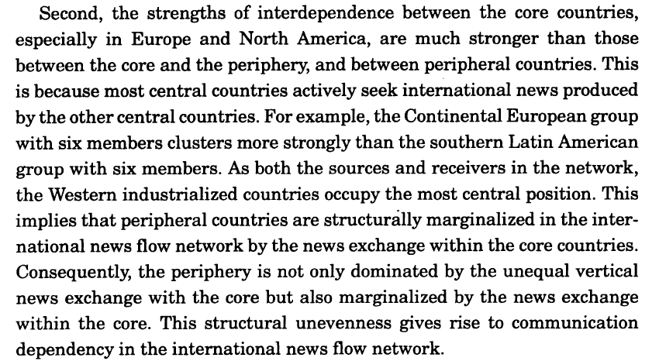
Notes:
‹#›

Slide 26
Anything new?
Al Jazeera; CCTV; RT – a bit of research on these
Counter-flow or public diplomacy tool?
Naomi Sakr (2009, p. 115) :
Well before it launched into broadcasting in English, the station was routinely credited by Western observers with having “taken on the West”, even though broadcasters in languages other than Arabic could never have competed for the same Arabic-speaking audience. The station’s supposed challenge to Western media was magnified in these reports at the very time when its staff were being harassed, imprisoned and even killed and its access to sources and audiences was being blocked. In the Arab world, meanwhile, smear campaigns portrayed the station as a lackey of US neo-imperialism or a plaything of Qatar’s ruler, whereas its actual achievement was to create an unprecedented space for pan-Arab public discussion. To the extent that these depictions misrepresented reality, they suggest that Al-Jazeera’s original Arabic-language operation did pose a threat to hegemonic interests and was predictably subject to processes of neutralisation and exclusion.
Hillary Clinton on Al Jazeera in 2011
https://www.youtube.com/watch?v=L6sYB5d1Bu4
Notes:
‹#›

Slide 27
In her analysis of the coverage of the global financial crisis of 2008 by Al Jazeera, CNN, RT and BBC World, Robertson argues for a more nuanced understanding of the ways in which global news media cover global crises (and events in more general).
It can be argued that some channels (AJE, for example) are ‘more global’ than others when their framing strategies are considered. Nor should all global channels be relegated to the same corner of the newsroom – especially not the ‘counter-hegemonics’. Where RT reports differently from BBC World and CNN in an ‘old-fashioned’ way (i.e. a way familiar from news reporting in the cold-war decades of the 1970s and 1980s, its world marked by great power rivalry), AJE reports differently, in a ‘new-world-order’ sort of way. Its world is also bigger and its component parts more interconnected. Whether or not it is a brave new world is a question that requires more empirical analysis (Robertson 2014, p. 623–4).

Slide 28
Are news flows still relevant?
Segev: Visible and invisible countries: News flow theory revised. Journalism 16(3), 2015.
Online news flows tested
Notes:
‹#›

Slide 29
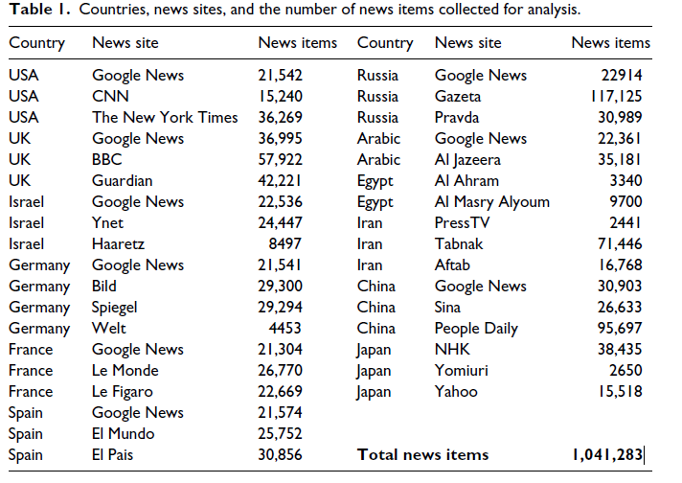
Notes:
‹#›

Slide 30
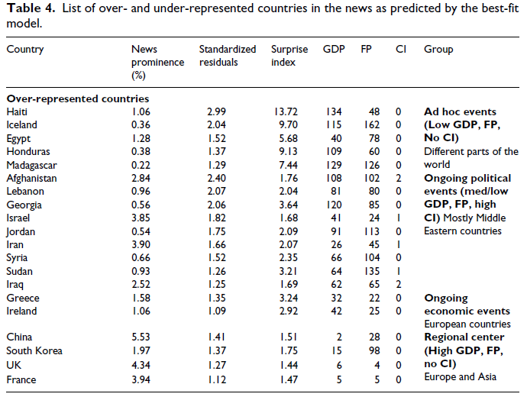
Notes:
‹#›

Slide 31
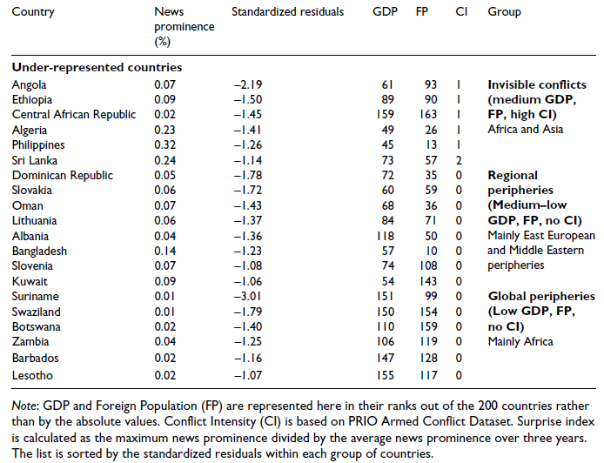
Notes:
‹#›

Slide 32
And what about new technologies?
In terms of mainstream news contents online – no greater diversity found
Commercial alternatives to established news agencies can also be found:
http://www.demotix.com/
Importantly, the work of journalists is also changing, e.g. crowdsourcing:
Ian Tomlinson case:
http://www.ted.com/talks/paul_lewis_crowdsourcing_the_news
Help me investigate:
http://helpmeinvestigate.com/
Ushahidi
http://www.ushahidi.com/
http://www.ted.com/talks/erik_hersman_on_reporting_crisis_via_texting?language=en
Notes:
‹#›

Slide 33
Online-only US media move into global news
Thirty of the largest digital-only news organizations account for about 3,000 jobs and one area of investment is global coverage. Vice Media has 35 overseas bureaus; The Huffington Post hopes to grow to 15 countries from 11 this year; BuzzFeed hired a foreign editor to oversee its expansion into places like Mumbai, Mexico City, Berlin and Tokyo. The two-year-old business-oriented Quartz has reporters in London, Bangkok and Hong Kong, and its editorial staff speaks 19 languages. This comes amid pullbacks in global coverage form mainstream media. The amount of airtime network evening newscasts devoted to overseas reporting in 2013 was less than half of what it was in the late 1980s. International reporters working for U.S. newspaper have declined 24% from 2003 to 2010. As the new digital native outlets continue to add staff, the country may be seeing the first real build-up of international reporting in decades – save for a few start- ups like Global Post. It could even perhaps be the start—at least in approach—of U.S.-based news outlets that are truly international, both in their audience in the focus of their content.
Notes:
‹#›
Pew Research Center, March, 2014, “State of the News Media 2014: Overview”
‹#›

Slide 34
Transnational/Global Audiences
- societies becoming increasingly multicultural – even if politicians shy away from the concept
- implications for journalists/content makers/policy makers
- how do media hold societies together if the audiences are fragmented?
Notes:
‹#›

