Slide 1
DEFENCE INDUSTRY AND INTERNATIONAL COOPERATION
MINISTRY OF DEFENCE
OF THE
CZECH REPUBLIC
Mgr. Matěj Novák
International Defence-Industrial Cooperation Unit
Industrial Cooperation Department
INDUSTRIAL COOPERATION DIVISION

Slide 2
STRUCTURE
Industrial Cooperation Division
Restored since 1/1/2020, It forms a dedicated part of the Czech MoD focused on defence industry development support, internal defence-industrial relations, international industrial cooperation and R&D area.
INDUSTRIAL COOPERATION DIVISION
Industrial Cooperation Department
Research & Development Unit
Market Research Unit
International Defence-industrial Cooperation Unit
Project Bureau Unit

Slide 3
FROM 2014 UP TO NOW
Historical development
Before 2014: basically no strategic approach towards defence industry development support
2014: Division of Industrial Cooperation and Organizations Management established.
2014 – 2015: first baby steps, charting the course to create comprehensive defence industry support system.
2016 – 2017: Strategy preparation and publishing ; large number of events and projects
Very successful in these two years – the volume of our exports has almost doubled!
Role and influence of our Division has been praised by industry and both domestic & foreign partners
End of 2017: Independent division dissolved
1/1/2018: Industrial Cooperation Department became part of the Acquisition and Armaments Division
1/1/2019: Department have been reorganized under the Defence Policy and Strategy Division
1/1/2020: Industrial Cooperation Division restored
Notes:
During the years, we managed to build a unique partnership with Czech defence industry based on trust
Very successful in the past two years – the volume of our exports has almost doubled!
Role and influence of our Division has been praised by industry and both domestic & foreign partners

Slide 4
INTERNATIONAL DEFENCE-INDUSTRIAL COOPERATION
Identification of opportunities for the Czech Defence Industry.
Bringing Czech Defence Industry with political delegations abroad.
Organization of visits of partner MoD‘s to the Czech Republic.
Official endorsement on political level.
Preparation of the genuine Czech G2G Defence Export System
Organization of Czech Defence Industry days, Industrial fora etc.
Anchoring industrial cooperation through memoranda of understanding.

Slide 5
Challenges for 2020 and beyond
Maximization of domestic Def-Ind participation on the planned major acquisition projects (IFV, helicopters, MADR radar system, SPH)
Participation of Czech companies in the European Defence Fund (EDF) consortia
The PROPED framework
Improving competitiveness, R&D, ensuring security of supplies for the Army of the Czech Republic
Participation in setting the functioning system of internal Defence-Industrial relations during the State of Emergency

Slide 6
CZECH DEFENCE INDUSTRY
Mainly comprised of private SME‘s
95 % of defence industry production → export
Long tradition (100+ years)
Combat proven products
Focus on new technologies and areas (UAVs, UGVs, C4)
Uniqueness in certain fields (PSS, trucks, small arms)
Defence and Security Industry Association (www.aobp.cz)

Slide 7
Structure of Czech Defence industry

Slide 8
Defence industry: Export structure

Slide 9
Military Equipment Exports 2014-2018
Territory | 2014 | 2015 | 2016 | 2017 | 2018
EU | 128 802 | 156 021 | 181 988 | 169 232 | 191 295
Non-EU Europe | 22 690 | 24 766 | 24 048 | 21 248 | 37 024
Sub-Saharan Africa | 5 452 | 20 682 | 46 383 | 32 086 | 19 348
North Africa | 37 304 | 41 603 | 30 408 | 20 066 | 12 334
Asia | 57 329 | 99 101 | 114 877 | 114 129 | 119 427
Middle East | 113 586 | 133 781 | 204 904 | 122 586 | 69 860
Latin America | 23 262 | 29 938 | 28 984 | 13 080 | 21139
North America | 33 449 | 42 587 | 42 950 | 64 811 | 65 568
*Values listed in thousands of EUR.

Slide 10
CZECH STATE DEFENCE EnterpriseS
LOM Praha – Aircraft Repair Plant
VOP CZ – Military Repair Enterprise
VTÚ – Military Technical Institute
VVÚ – Military Research Institute

Slide 11
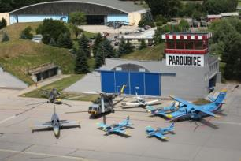
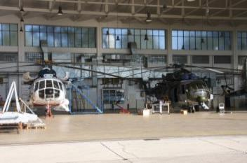
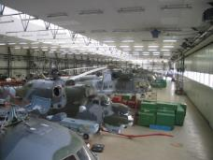
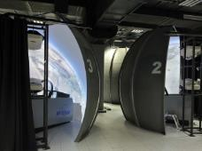
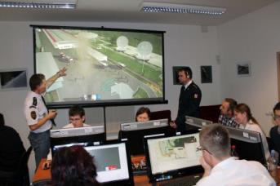
Lom praha, s. p. tiskařská 270/8, 108 00 praha 10
LOM PRAHA s.p. is the leading company specializing on the Mi helicopters lifecycle support in the NATO and EU countries.
Product portfolio:
overhauls, upgrades and modernizations of Mi-2, Mi-8/17, Mi-24/35 helicopters and their dynamic components
training for pilots
comprehensive services regarding tactical simulation for aircraft, helicopters and ground forces training
Notes:
LOM PRAHA s.p. is the leading company specializing on the Mi helicopters lifecycle support in the NATO and EU countries certified by the Russian MVZ Mil and OAO Klimov companies, the Interstate Aviation Committee MAK and domestic aviation authorities. Unlike many competitors, it can offer comprehensive services associated with overhauls, i.e. a complex support of the aviation technology lifecycle.
The company focuses, in particular, on overhauls, upgrades and modernizations of Mi-2, Mi-8/17, Mi-24/35 helicopters and their dynamic components (turboshaft engines, gearboxes and auxiliary power units) lifecycle support. Furthermore, LOM also manufactures and repairs piston engines. Company also provides training for pilots in our Flight Training Center in Pardubice. VR Group, a.s., the company’s subsidiary, is providing comprehensive services regarding tactical simulation for aircraft, helicopters and ground forces training.

Slide 12
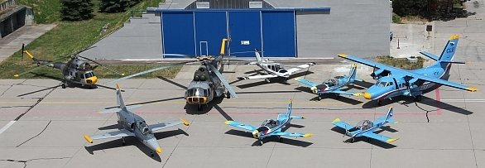
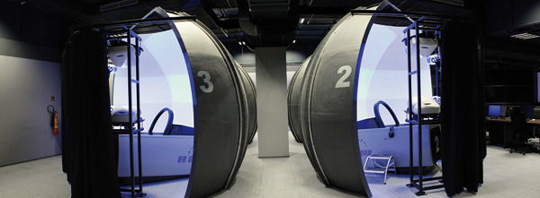
CLV & tsc pARDUBICE*
Notes:
Centrum leteckého výcviku Pardubice

Slide 13
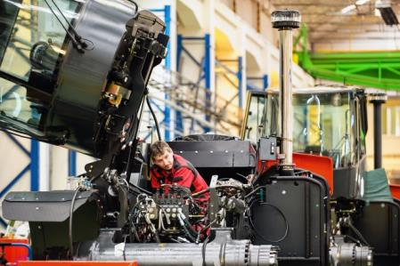
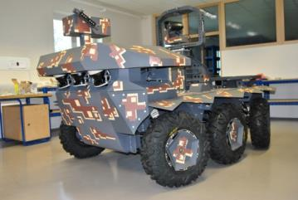
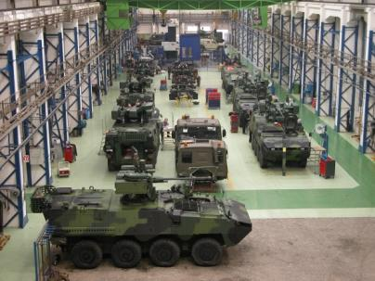
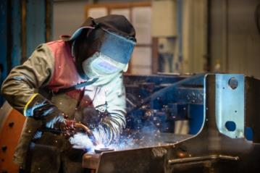
VOP cz, s. p. dukelská 102, 742 42 šenov u nového jičína
VOP CZ, s.p. is a state enterprise working as an integrator and supplier of modern defence equipment and systems mainly to the requirements of Army of the Czech Republic and subsequently to foreign customers too.
Notes:
Tho company core responsibilities are perceived in:
providing continuous and effective security support national defense and security of the population through comprehensive services and products in the field of military technology and partnerships within the framework of international organizations.
reliable, flexible and innovative collaboration with all partners and effective use of technological equipment for military and civilian production.
participation in the development of science, research and development at Czech and international level and putting the acquired knowledge into practice.

Slide 14
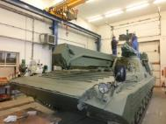
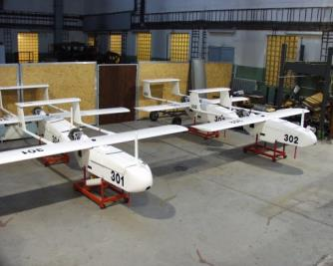
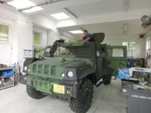
Vojenský technický ústav, s. p. mladoboleslavská 944, 197 06 praha 9 -kbely
The Military Technical Institute is a state enterprise - provides strategic deliveries and services needed to guarantee Czech Republic's defence and security, as well as to fulfil its obligations associated with Czech Republic's NATO and EU memberships.
Consists of three branches focused on research, development and testing in their respective fields of work:
Air Force and Air Defence Military Technical Institute (AFADMTI) – Air Force and GBAD
Military Technical Institute of Ground Forces (MTIGF) – Ground Engeneering
Military Technical Institute of Armament and Ammunition (MTIAA)
Notes:
The Military Technical Institute is a state enterprise established by the Ministry of Defence of the Czech Republic in order to provide strategic deliveries and services needed to guarantee Czech Republic's defence and security, as well as to fulfil its obligations associated with Czech Republic's NATO and EU memberships.
The Military Technical Institute consists of three branches focused on research, development and testing in their respective fields of work:
Air Force and Air Defence Military Technical Institute (AFADMTI) stationed in Prague, provides services associated with defence science, research, development and testint in the field of Air Force and Groun Based Air Defence.
Military Technical Institute of Ground Forces (MTIGF) stationed in Vyškov - in the field of ground engeneering.
Military Technical Institute of Armament and Ammunition (MTIAA) stationed in Slavičín - in the field of armament and ammunition.

Slide 15
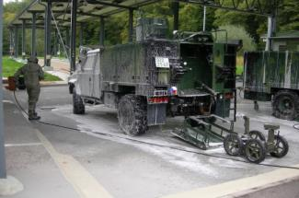
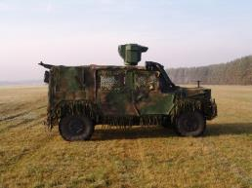
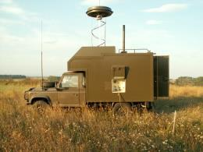
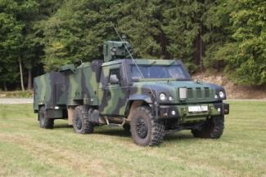
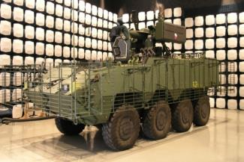
Vojenský výzkumný ústav, s. p. Veslařská 230, 637 00 Brno
Military Research Institute, state enterprise, is the only state-owned company issued by Ministry of Defence that holds the character of a research institute.
Specializations:
CBRN Protection.
Special electronics, camouflage and deception – sensors, electronics and cybernetic warfare.
Materials Engeneering – special metal and non-metal materials, technology of surface protection, the system of quality and the technology of logistics.
Notes:
Military Research Institute, state enterprise, is the only state-owned company issued by Ministry of Defence that holds the character of a research institute.
It ensures meeting strategic and other significant interests of the state in the field of defence and security, the development of capacities of the Army of the Czech Republic, armed forces and the Emergency System of the Czech Republic as well as it performs the activities of industrial and business nature to ensure supplies and services needed to guarantee the defence and safety of the Czech Republic and discharges liabilities based on the membership in NATO and the EU.
VVÚ performs research and experimental development assignments connected to higher innovations, mainly the technology of ground forces, materiel in the core fields of specialisation that are chemical, biological, radiological and nuclear protection and connected fields, such as chemical protection of the army, sensors, electronic and cybernetic warfare, camouflage and deception, special metal and non-metal materials, technology of surface protection, the system of quality and the technology of logistics.

Slide 16
SELECTED PRIVATE COMPANIES
AERO VODOCHODY
Jet Trainer L-39
New version L-39NG (Williams engine, new avionics, new airframe)
Broad international cooperation (Embraer KC-390)
ERA PARDUBICE, RAMET, Retia, T-CZ
Passive surveillance systems
TATRA TRUCKS, TATRA DEFENCE VEHICLE
Unique, unbeatable chassis for demanding use
World-wide use for various weapons platforms
Production of wheeled AFV‘s PANDUR II and chassis for TITUS
ČESKÁ ZBROJOVKA
Complete line of small weapons and tactical eqiupment for armed forces
URC Systems, MESIT Defence
Radio-electronic warfare systems

Slide 17
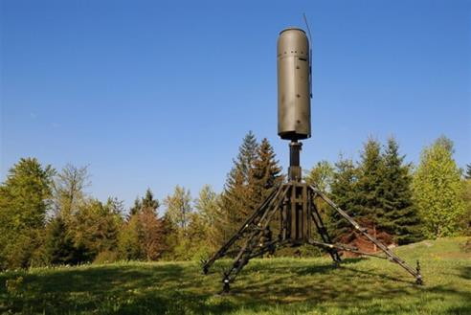
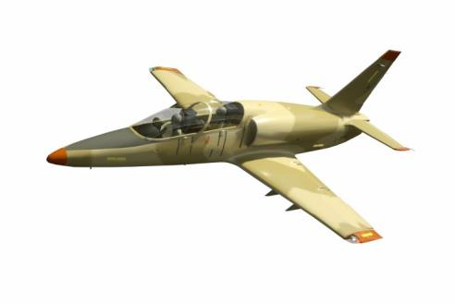
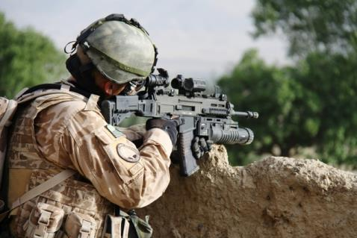
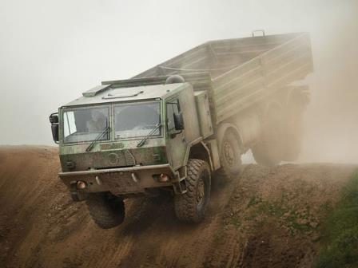
SELECTED PRIVATE COMPANIES II.

Slide 18
Q&As
email.:
Novakm7@army.cz
THANK YOU VERY MUCH FOR YOUR ATTENTION

