Slide 1
schedule + geography
week 2 - 26th February

Slide 2
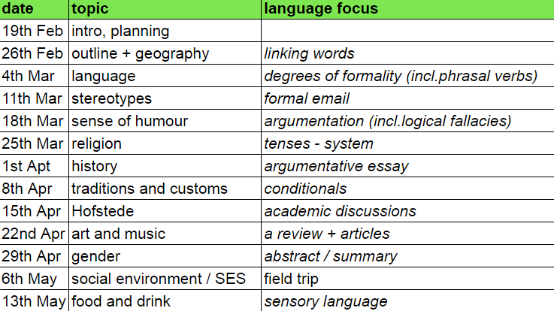
course outline

Slide 3
requirements
formal email
informal email
argumentative essay 1st draft
argumentative essay 2nd draft
abstract
summary
reflection on your presentation
review
wordlist
surprise me:)
attendance + active participation | 10
in-class minipresentation | 10
portfolio | 30
final essay | 25
poster presentation | 10
final interview | 15
TOTAL | 100

Slide 4
geography class :)
Draw a map of the world...

Slide 5
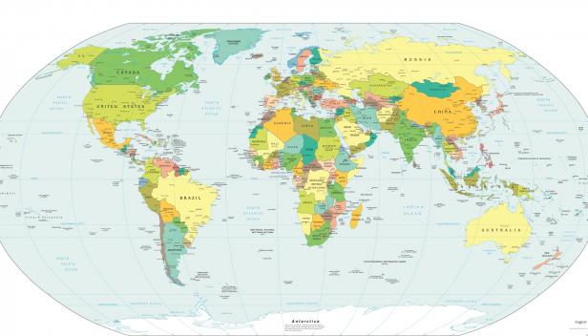

Slide 6
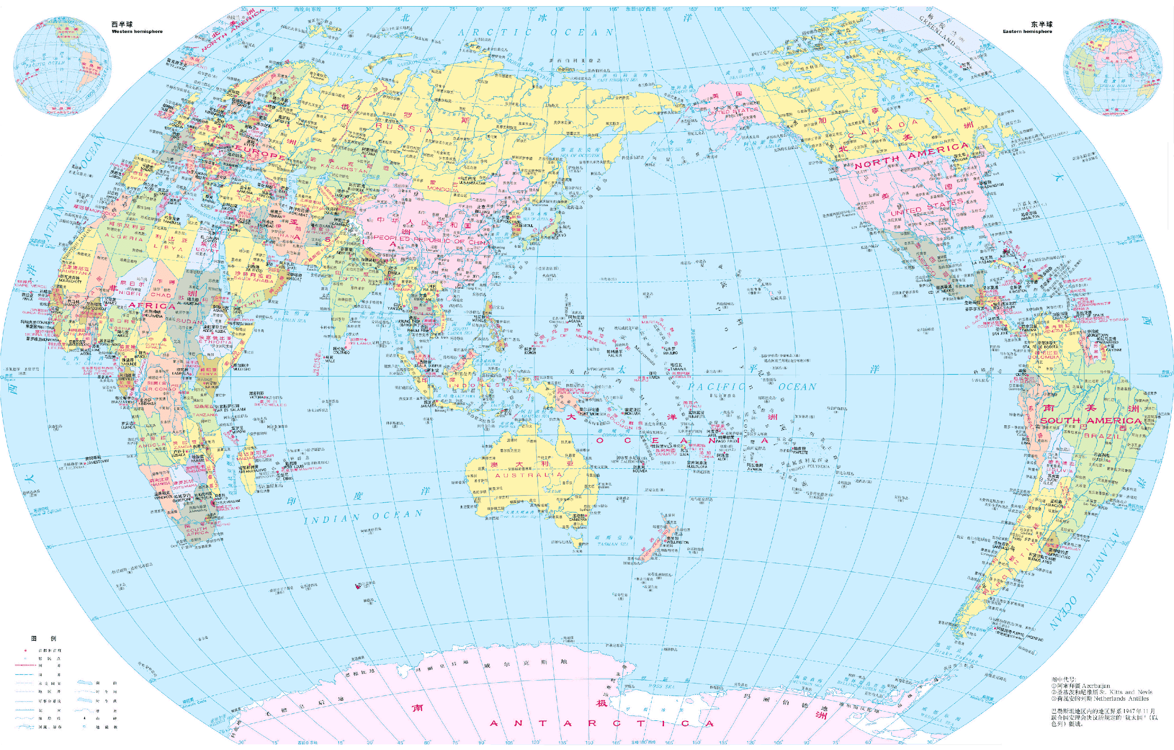

Slide 7
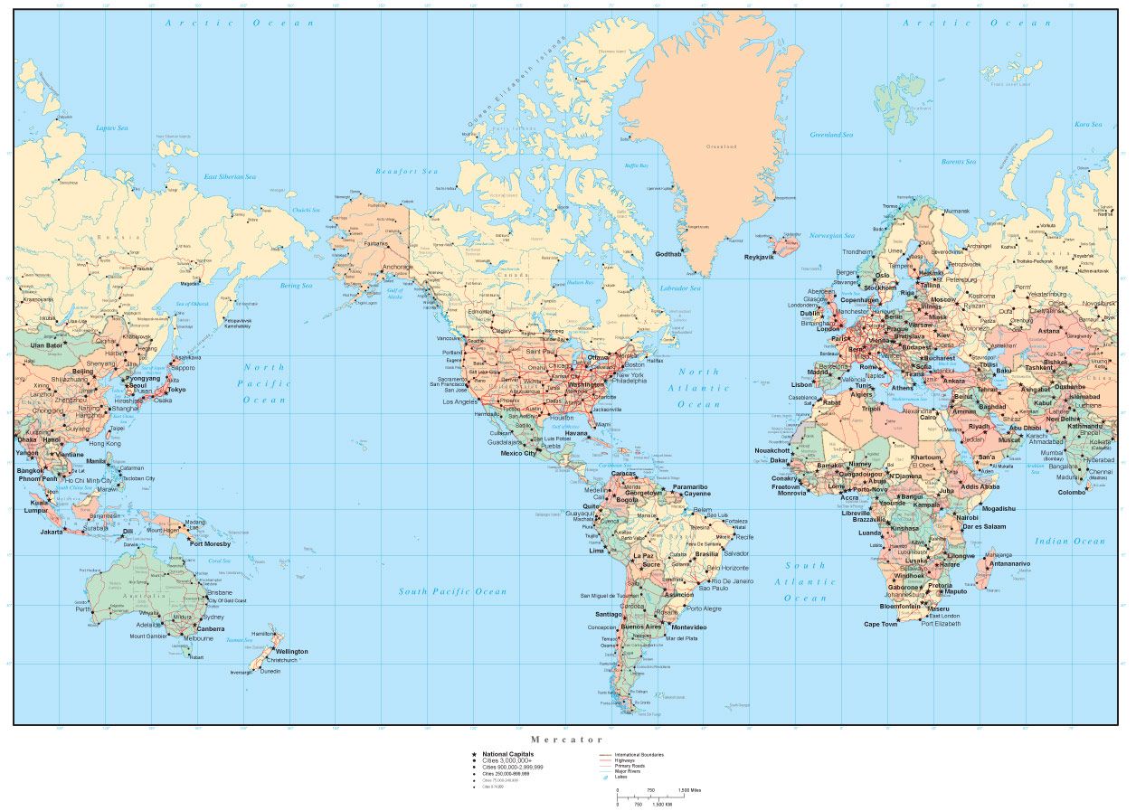

Slide 8
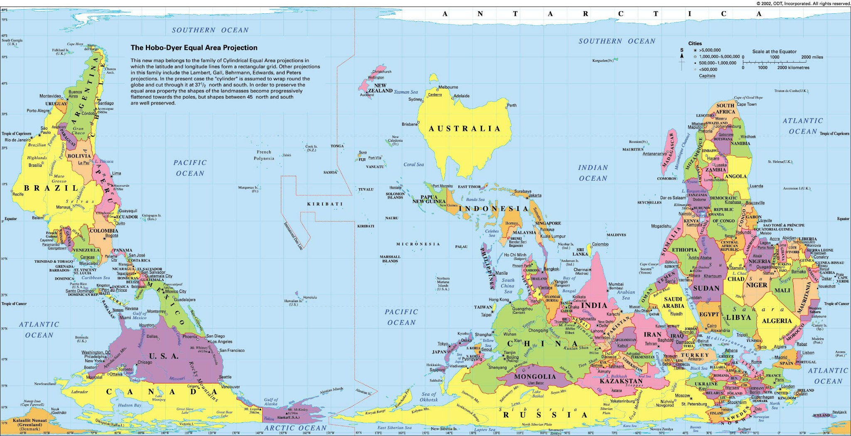

Slide 9
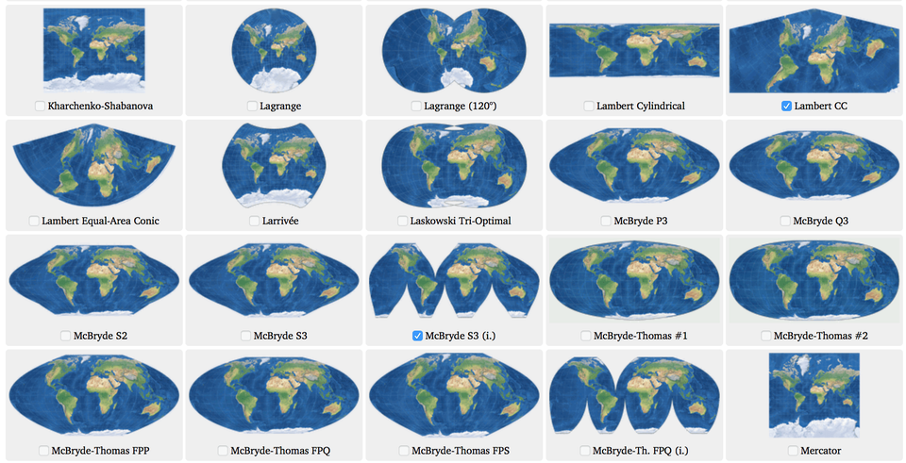

Slide 10

https://www.youtube.com/watch?v=lPNrtjboISg
https://www.youtube.com/watch?v=kIID5FDi2JQ

Slide 11
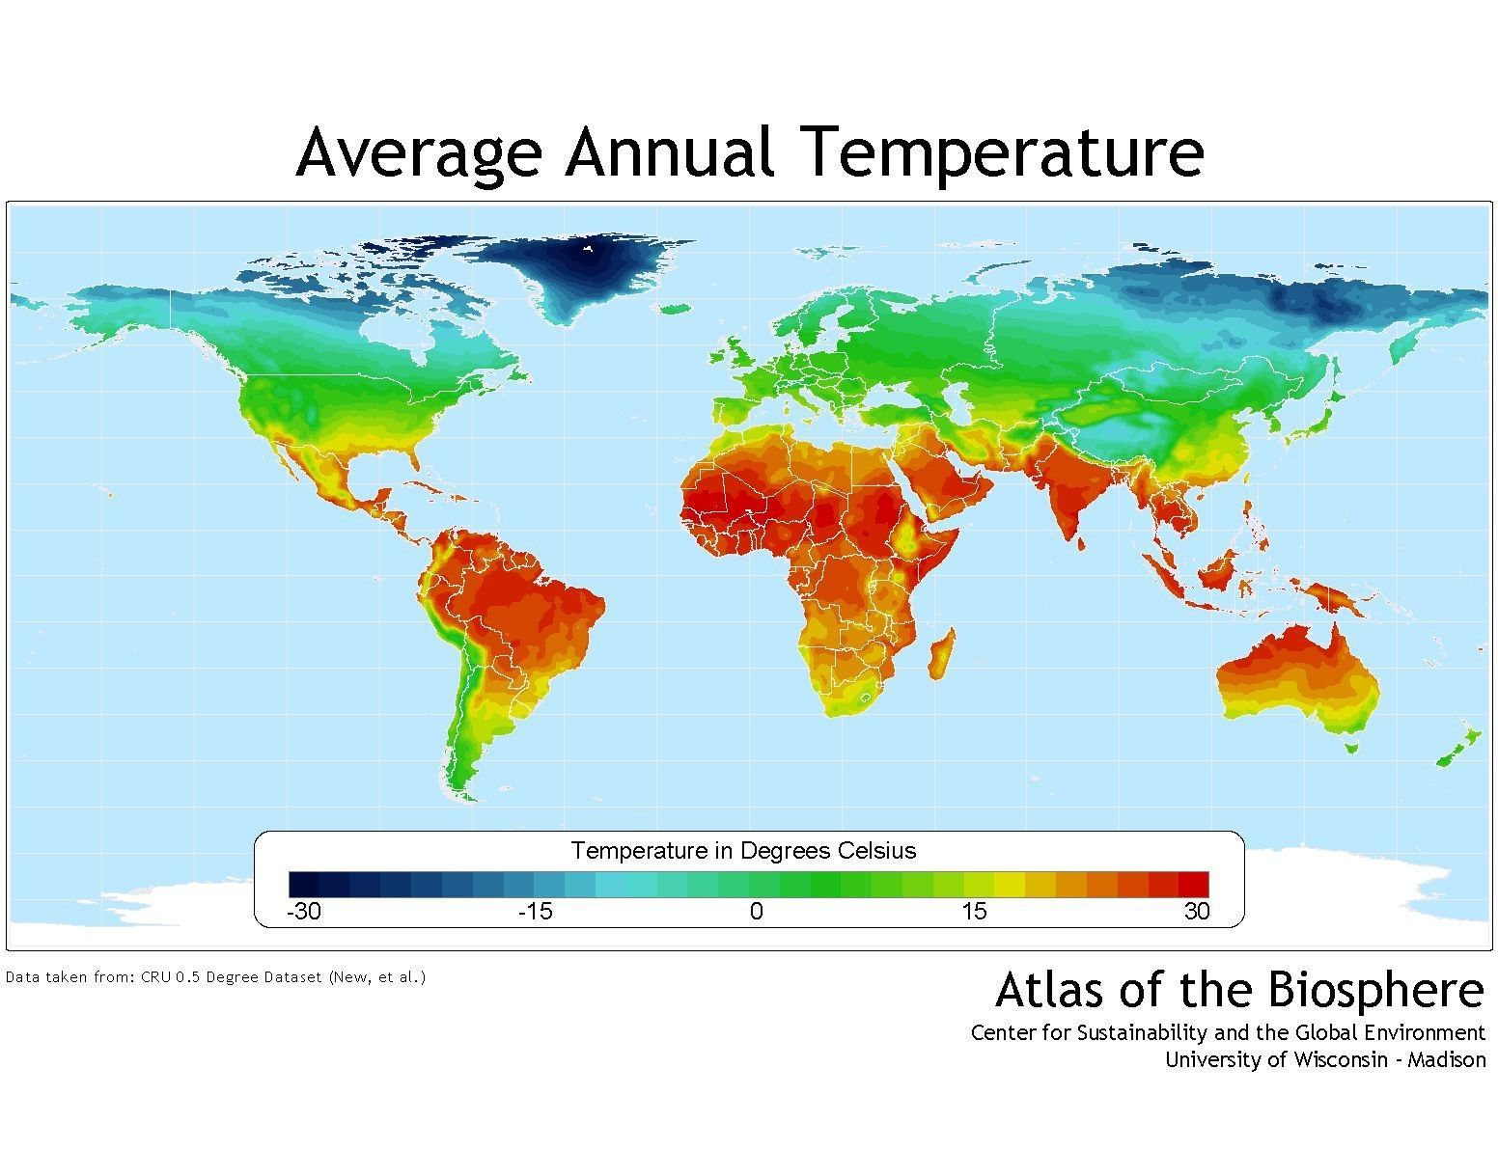

Slide 13
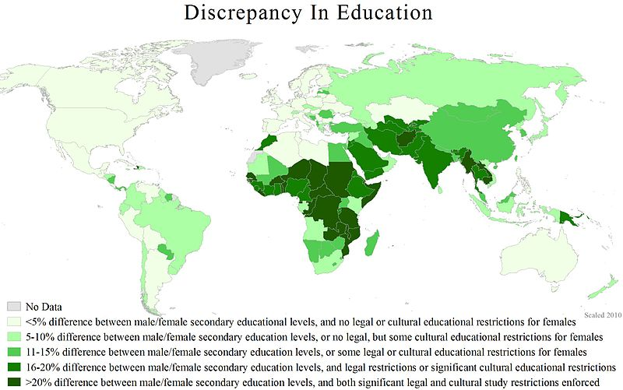

Slide 15
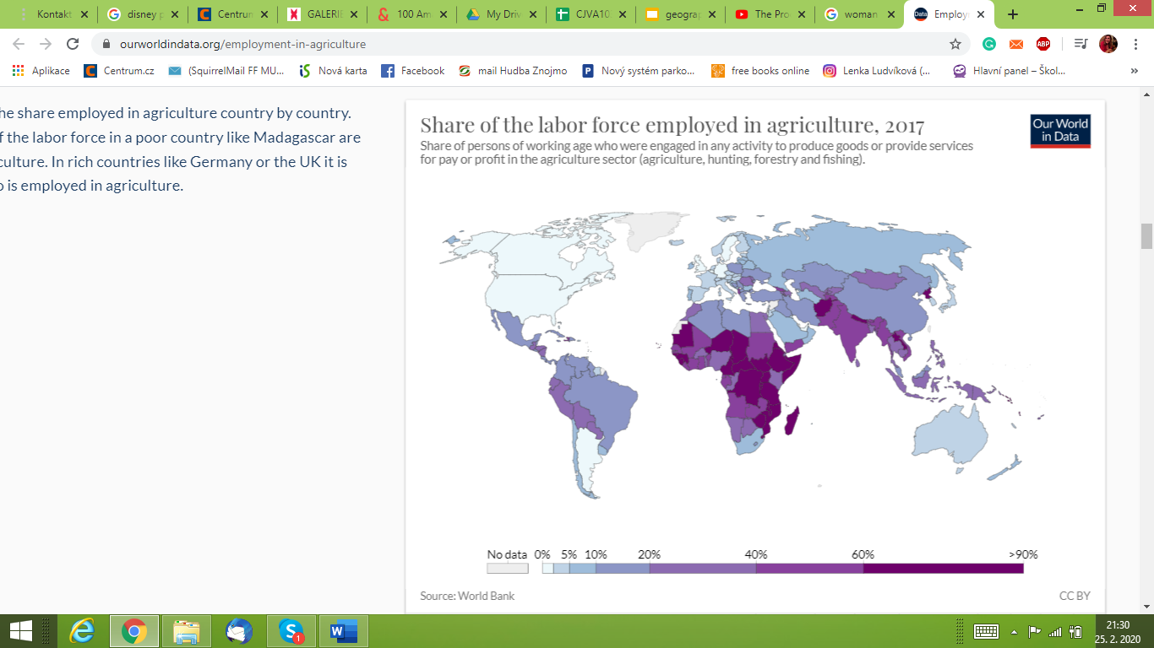

Slide 17
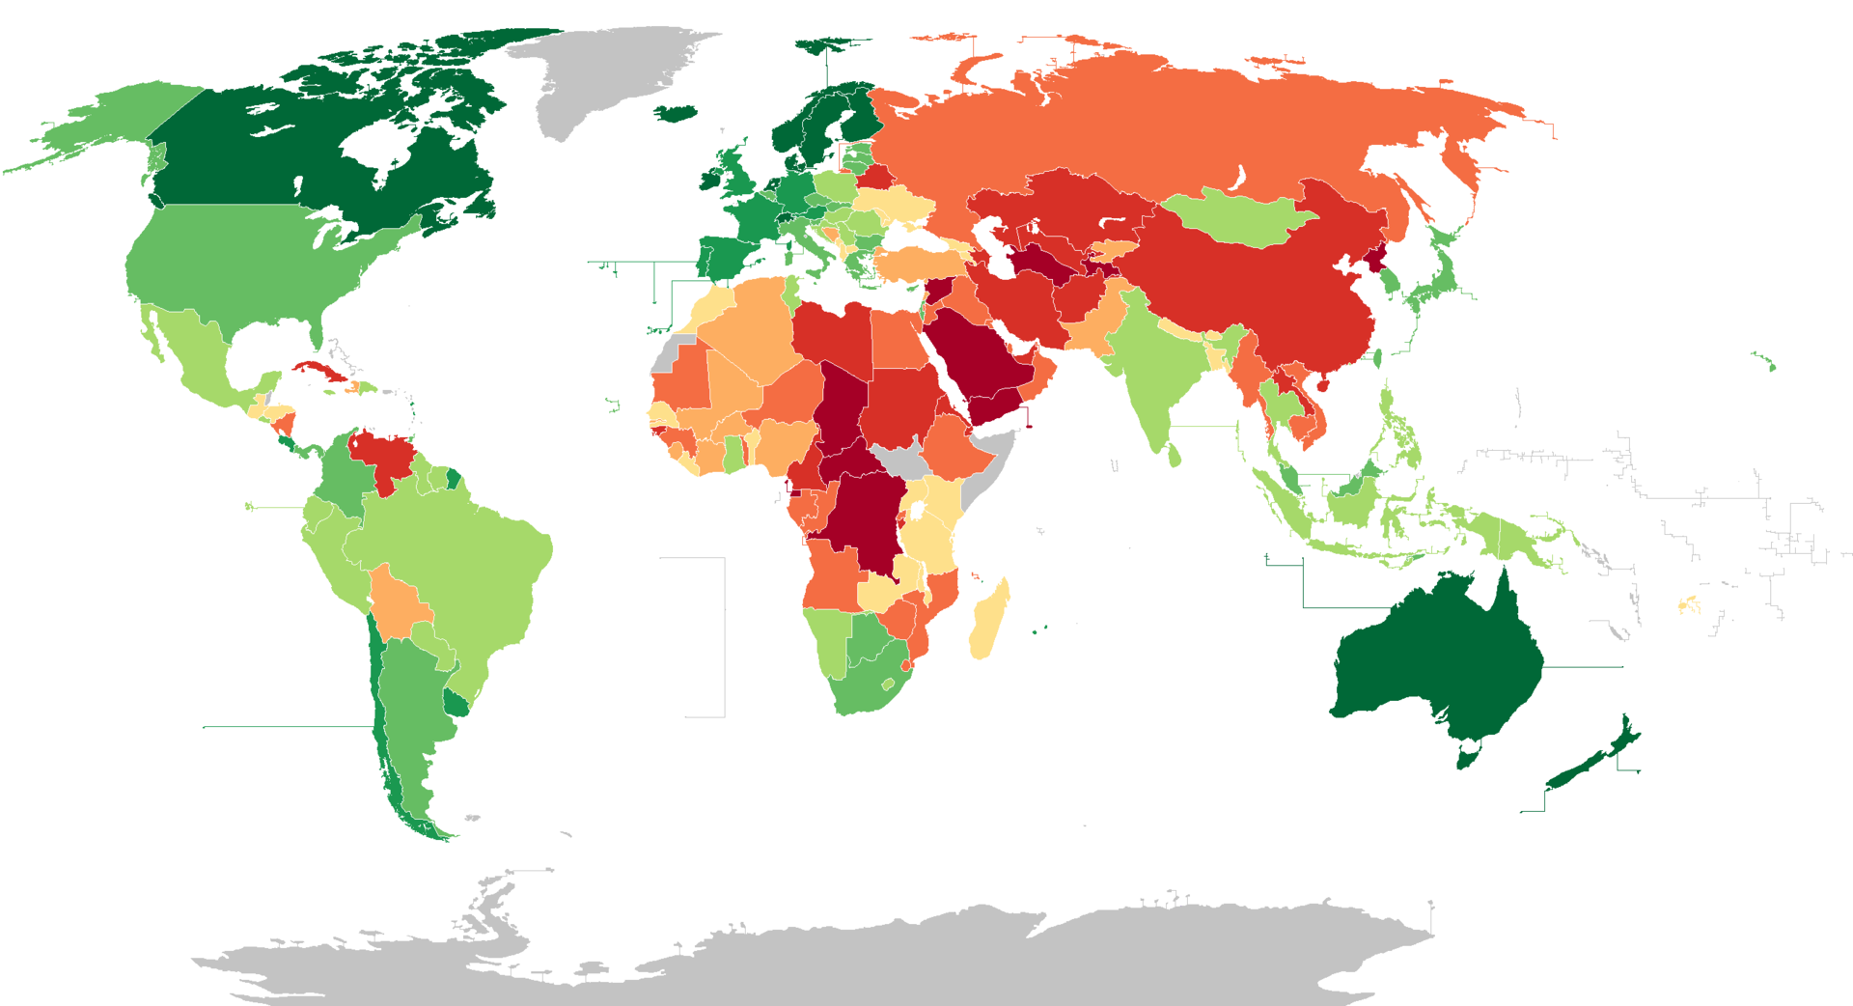

Slide 18
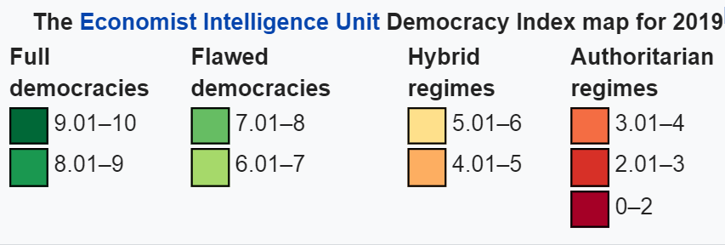

Slide 19
Your map? Find an interesting map that shows a division related to culture…

Slide 20
linking words
nevertheless
however
meanwhile
because
since
whereas
furthermore
moreover
thus
in spite of
despite
therefore
consequently
similarly
as opposed to
in my opinion
although
nonetheless
on the contrary
on the other hand
in other words
though
equally
additionally
clearly
as
in addition
particularly
besides
above all
mainly
as a result
even though
not only… but also
naturally
in most cases
for example
in general
to begin
to conclude
still
yet
in other words
for this/that reason
namely
also
in contrast to
briefly
this implies that
in detail
so that
under these circumstances

