Slide 1
argumentation

Slide 2
argument X argumentation
quarrel
everyday life
no clear structure
X
critical thinking process that defines / clarifies / advocates in order to persuade sb to make a certain decision
a CLAIM supported by reasoning / evidence
a few subclaims make a claim, a few claims make a case
legal and academic sphere
language of appropriate register

Slide 3
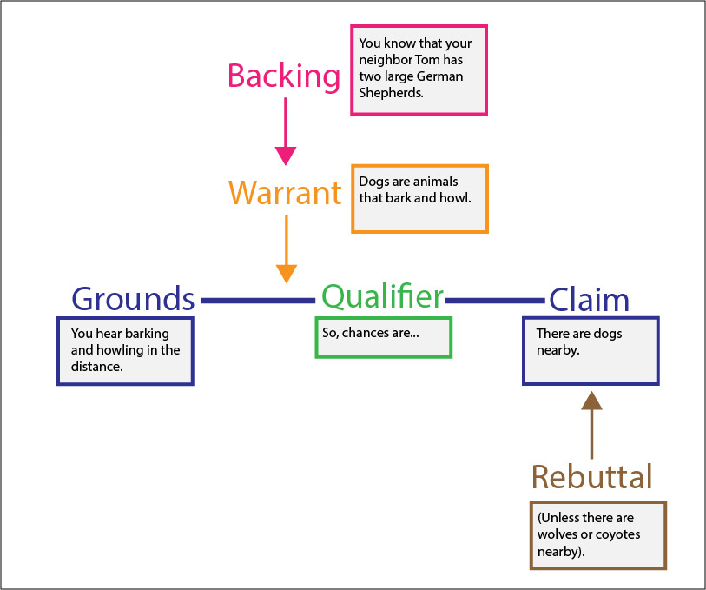
Toulmin model
https://owl.purdue.edu/owl/general_writing/academic_writing/historical_perspectives_on_argumentation/toulmin_argument.html

Slide 4
Toulmin model
CLAIM - the argument being made (conclusion of the reasoning)
GROUNDS - the data and facts offered to support the claim
WARRANT - logically connecting the grounds to the claim
BACKING - supporting the warrant
QUALIFIER - stating the strength of the claim
REBUTTAL - exception to the claim

Slide 5
Toulmin model - task
In the discussion forum: Write a sentence / short paragraph according to Toulmin model related to the COVID-19 situation…

Slide 6
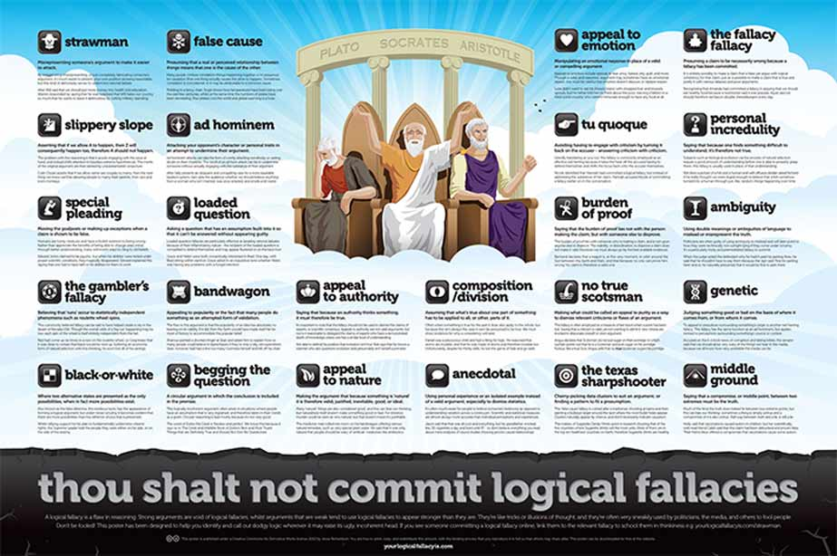
logical fallacies in argumentation

Slide 8
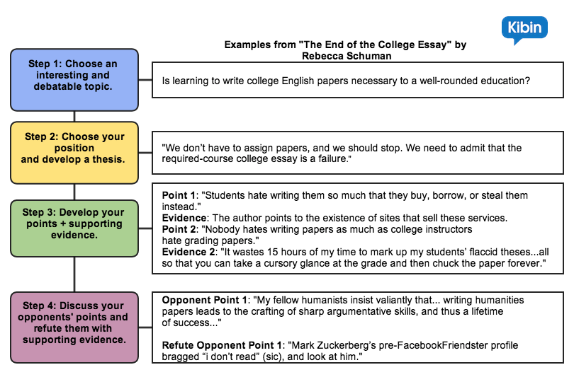

Slide 9
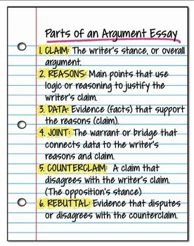

Slide 10
