Slide 1
art and music

Slide 2
What is art?
What is music?

Slide 3
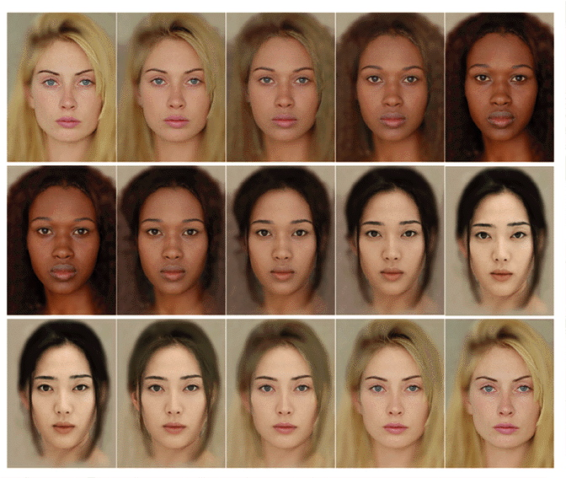
the concept of beauty

Slide 4
beautiful in different cultures…?
Think about different eras, different countries, different subcultures...

Slide 5
and music?
https://www.youtube.com/watch?v=FKEkr0KXiC8
https://www.youtube.com/watch?v=RY66q43G63Y
https://www.youtube.com/watch?v=ckVYO9oI8vc
https://www.youtube.com/watch?v=QUbx-AcDgXo
https://www.youtube.com/watch?v=XCV7_LcEruw
https://www.youtube.com/watch?v=Ki6Mzh6aeGI
https://www.youtube.com/watch?v=oqt7TJTWL-M

Slide 6
review - how to...
Some good sources that will help you with writing a review are listed below:
ART
https://www.ocadu.ca/sites/default/files/legacy_assets/content/teaching-learning/WLC/Online+Resources/Writing%20Art%20Reviews.pdf
BOOK
https://writingcenter.unc.edu/tips-and-tools/book-reviews/
FILM
https://edusson.com/blog/how-to-write-movie-review

Slide 7
a review...
Please, write an art review and make it one of the items in the portfolio. You can choose a piece of art or an exhibition or an art gallery… Ideally, you should incorporate an analysis of a cultural aspect in your writing.

